Slide 1

Independent. Innovative. And always open source.
dotnetfoundation.org

Slide 2
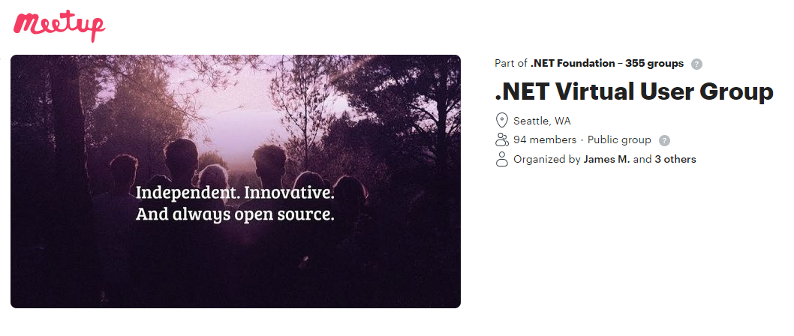
.NET Foundation Virtual User Group
Find virtual user groups happening around the globe!
meetup.com/dotnet-virtual-user-group

Slide 3
Process for Meetup with Stream support
User Group submits Form
Form create Planner task and e-mail notification
Admin team sets up Meetup, schedules Stream team
Stream team sets up event and hosts
Video is automatically added to YouTube
Event listing publicized by Marketing team

Slide 4
Process for Meetup w/o Stream support
User Group submits Form
Form create Planner task and e-mail notification
Admin team sets up Meetup, adds live stream link
Admin team adds video to YouTube playlist
Event listing publicized by Marketing team

Slide 5
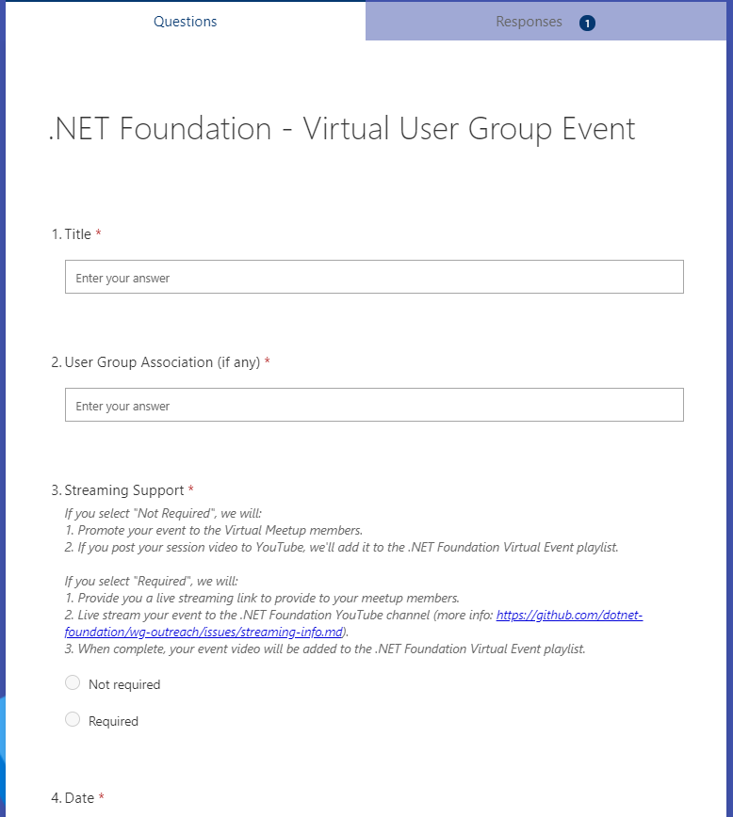
New Event Form

Slide 6
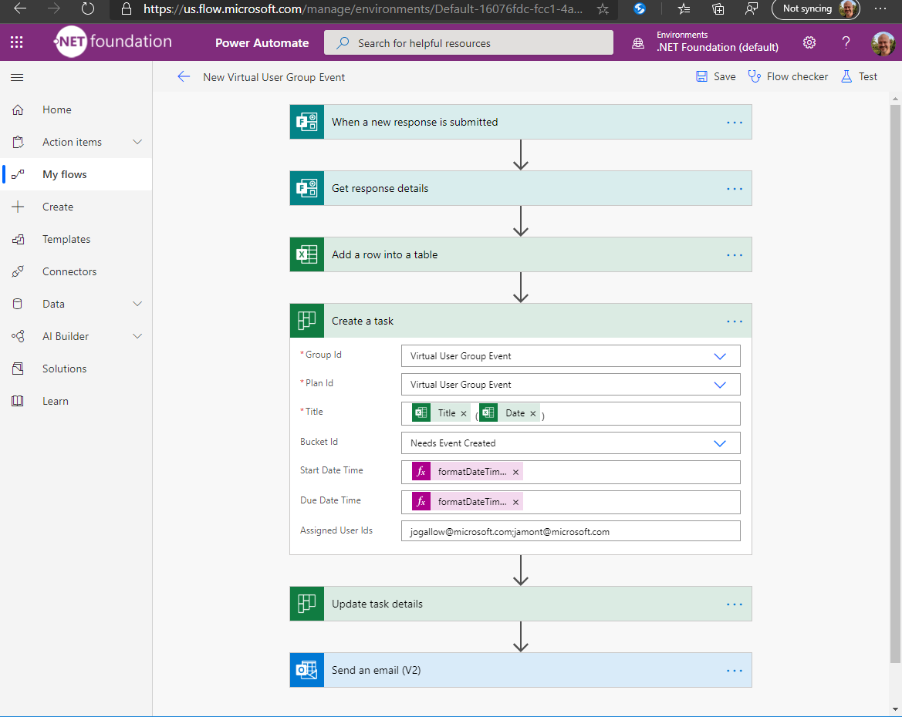
Backend Automation

Slide 7
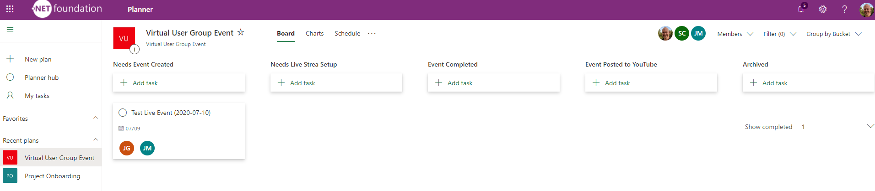
Meetup Planner

Slide 8
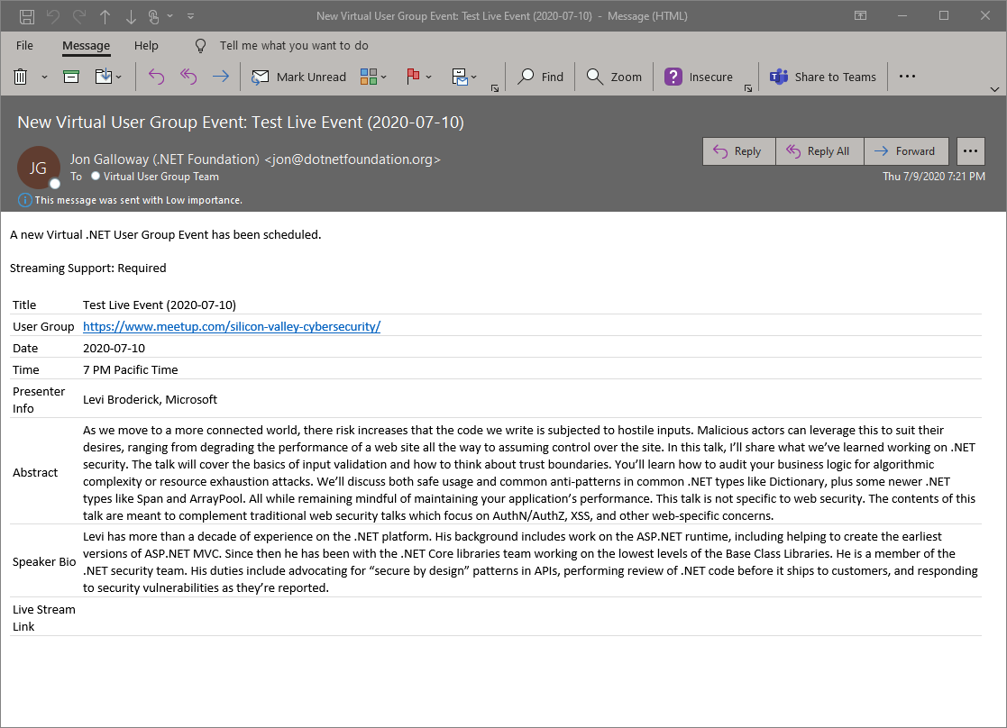
Meetup Planner

Slide 9
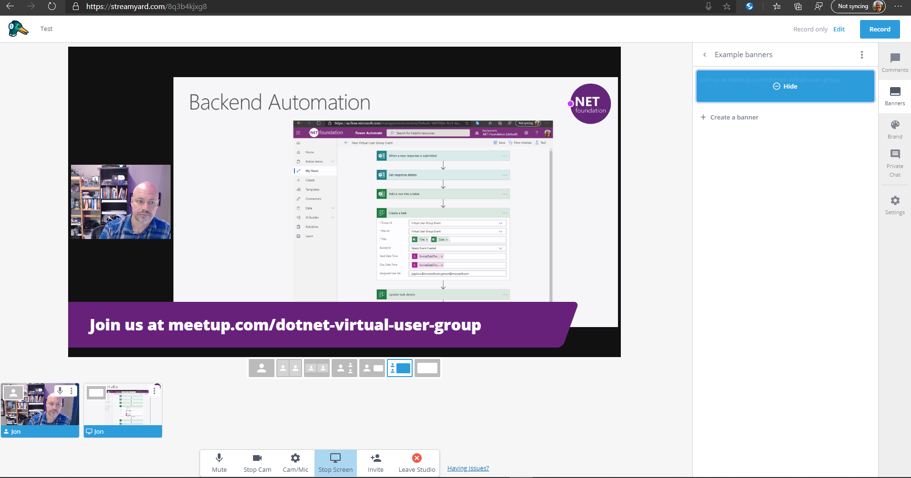
Streaming with StreamYard

Slide 10
StreamYard Tips
Password-less login
Login with VirtualUserGroupTeam@dotnetfoundation.org
One-time 6 digit code is e-mailed to that distribution list
Speakers are invited by e-mail, same login process
Lobby is shown below screen
You can practice using a “Record only” broadcast
Create your own free account to test
YouTube events are set up through Restream

Slide 11
Signups
Admin team to manage new events
Streaming team to host events

