Slide 1

Independent. Innovative. And always open source.
dotnetfoundation.org

Slide 2
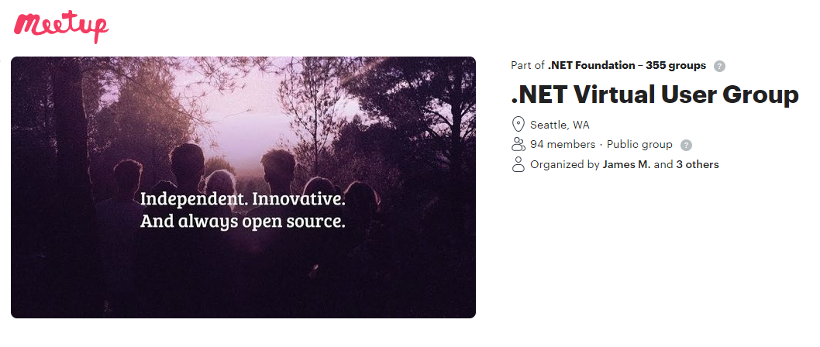
.NET Foundation Virtual User Group
Find virtual user groups happening around the globe!
meetup.com/dotnet-virtual-user-group

