Slide 1




Downstream results overview
Francisco Pascoal
Institutional organizers
Sponsors

Slide 2
Summary of results
Clean data, which can be readily used for or analyses;
Alpha diversity;
How diverse are our samples;
Taxonomy;
What is present in our samples;
Beta diversity;
What are the shifts in community composition across samples.

Slide 3
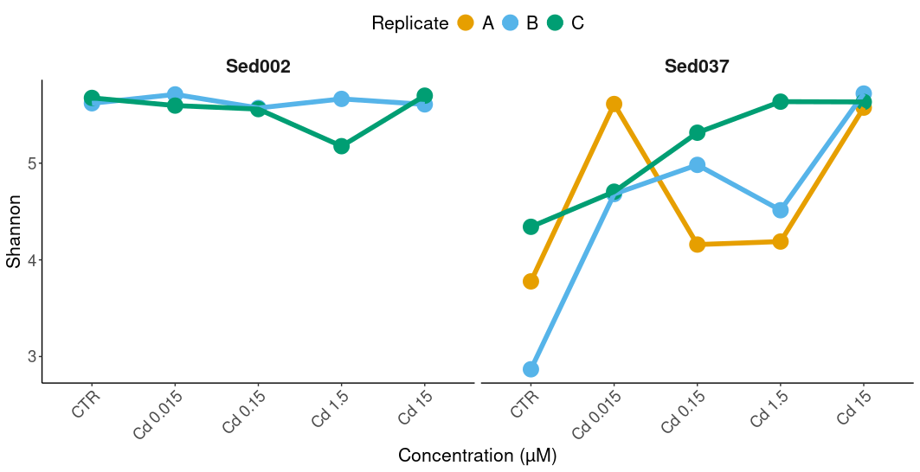
Recall alpha diversity (1)
Shannon index illustrated different diversity trends between Sediments 2 and 37;
Constant diversity in Sed002;
Increased diversity after treatment in Sed037.

Slide 4
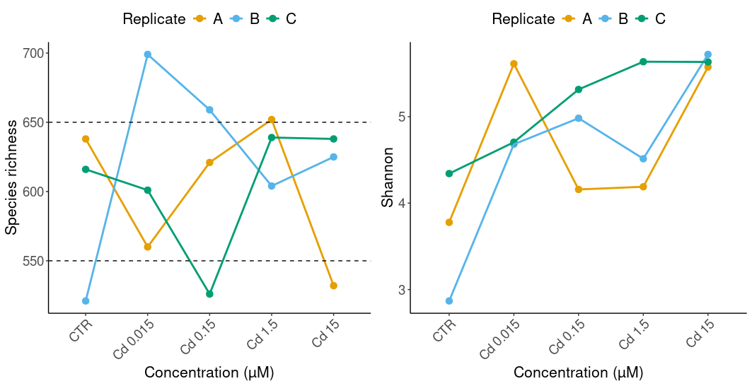
Recall alpha diversity (2)
Sed 37
There was no clear trend in Species richness;
Shannon index increased after Cd treatment;
This increase was overall significant (p<0.05, One-Way Repeated Measures ANOVA test); but we were not able to identify which groups were responsible (p>0.05, pairwise Student's t-test).

Slide 5
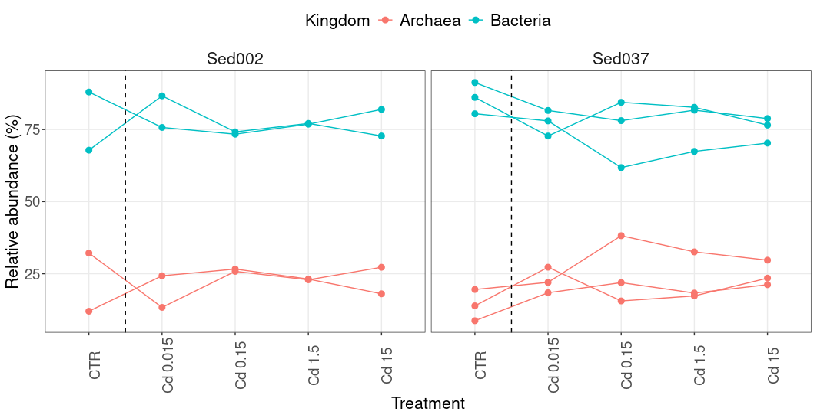
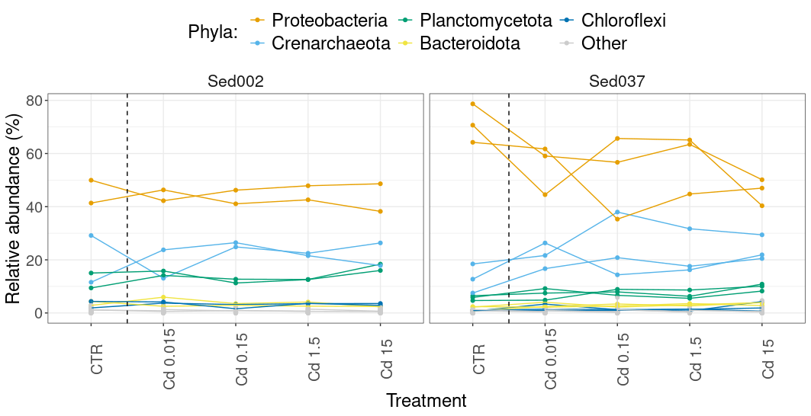
Recall taxonomy (1)
At Domain level, we can already see differences between Sediments 2 and 37:
Bacteria decrease;
Archaea increase.
At Phylum level, it becomes clear that some Proteobacteria group was responsible for the differences between Experiments 2 and 37.

Slide 6
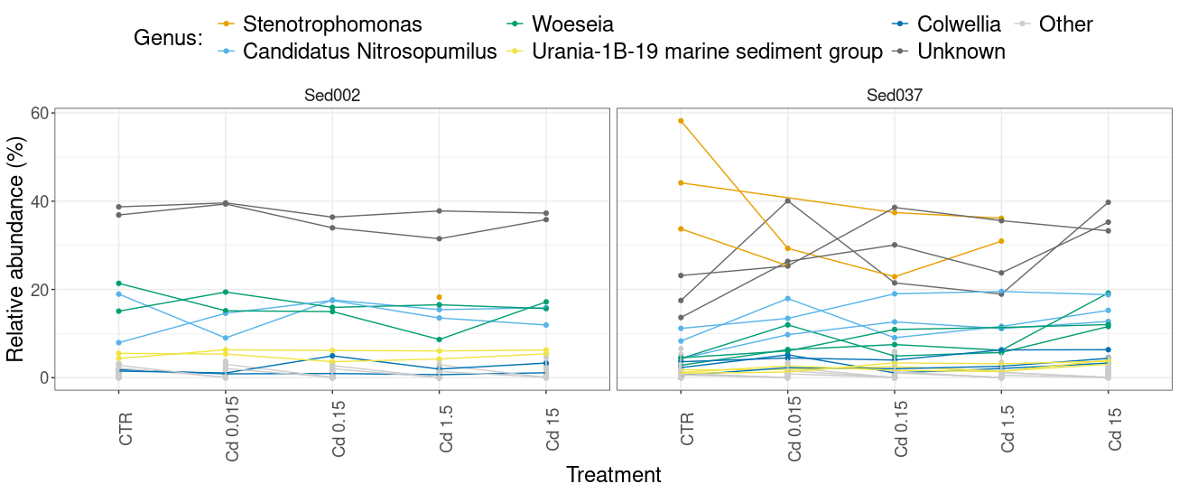
Recall taxonomy (2)
An overview of Genus level quickly highlighted Stenotrophomonas as the culprit of the major differences between Experiments 2 and 37;
There was an increase in relative abundance of unknown genera after Cd treatment in the sediment 37.

Slide 7
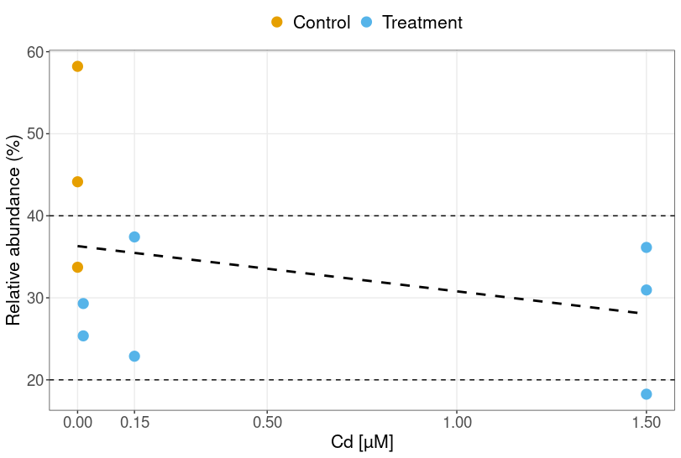
Recall taxonomy (3)
After closer inspection, we discovered that Stenotrophomonas was more abundant in the Control group, but decreased its relative abundance after Cd treatment;
However, there was no trend after increasing concentrations of Cd.

Slide 8
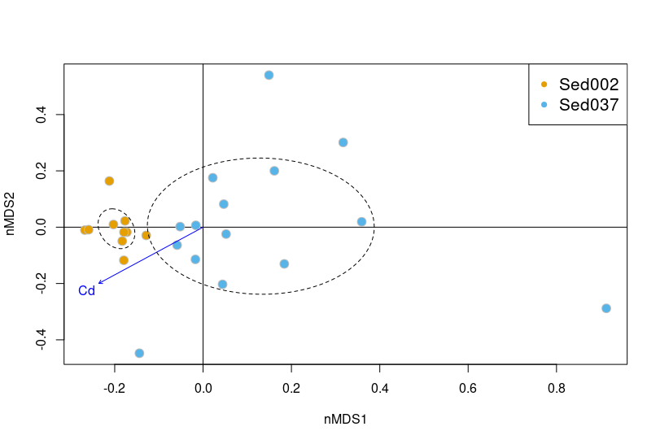
Recall beta diversity (1)
Both sediments presented distinct community compositions;
The sediment 37 presented most of the community composition variability.
PERMANOVA confirmed that any differences in community composition were mostly derived from the source sediment and not from Cd treatments.

Slide 9
Conclusions
The two sediments represented different microbial communities, with distinct responses to Cd treatment;
The sediments were collected at a very similar place, indicating high local heterogeneity;
The presence of Stenotrophomonas in the control group of sediment 37 seems to have been responsible for the major differences.
The sediment 37 also included more unknown genera, which grew upon Cd treatment.

