Slide 1




Microbial ecology
Francisco Pascoal
Institutional organizers
Sponsors

Slide 2
Objective
Ecology is the study of living organisms in their environment.
Basis for the description of microbial communities in their environment;
The specific aim of a given ecological analysis will vary according to the research question and experimental design.

Slide 3
Contents
Overview of common steps in microbial ecology;
Pre-processing and data cleaning;
Normalization;
Alpha diversity;
Beta diversity;
Taxonomic analysis;
Statistical tests.

Slide 4


Overview of common steps in microbial ecology
species abundance table;
taxa reference table;
metadata.
Ecological analyses
Alpha diversity;
Beta diversity;
Taxonomy;
Statistics.
upstream
data cleaning
(and verify if you see anything strange)
Normalization
(if necessary)

Slide 5



Pre-processing and data cleaning
Common steps
Verify the type of objects you have;
Merge tables, if necessary;
Match sample information in species abundance table with metadata;
Clean metadata information;
Clean taxonomy.
Remove NAs at domain/kingdom and phylum level;
Remove organelles;
Remove other unwanted groups.
Other (singletons, etc).
Suggestion for R
You should always dedicate some time to inspect your data.

Slide 6
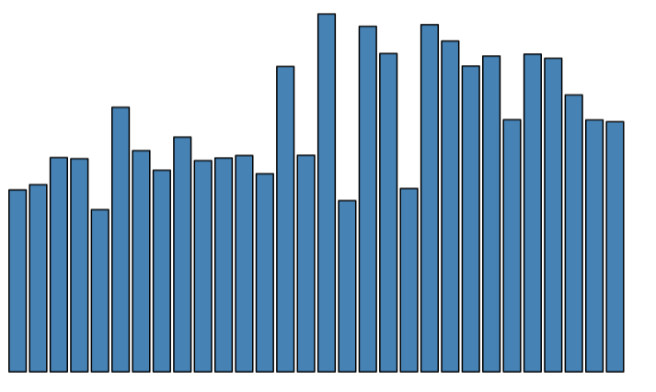
Normalization (1)
Normalization might be necessary for fair comparison of samples.
The diversity estimates might become biased, when we have samples with very different numbers of reads.
How do we know if one sample really has more species than another, if they have a total number of reads that is different?
Rarefaction is the most common solution.
Total reads
Sample

Slide 7

Normalization (2) – rarefaction
Suggestion for R
What is rarefaction?
Random sub-sampling of x reads;
All samples end up having the same total number of reads;
This method comes from general ecology;
It automatically deals with singletons.
Samples with less than x reads will be removed. So, you must balance having as much reads as possible versus losing as fewer samples as possible.

Slide 8
Normalization (3) – pros and cons of rarefaction
Pros:
All samples get the same number of total reads;
Reads are selected randomly;
Popular and easy to understand.
Cons:
Loss of valid information (species);
Unsuited for compositional data.

Slide 9
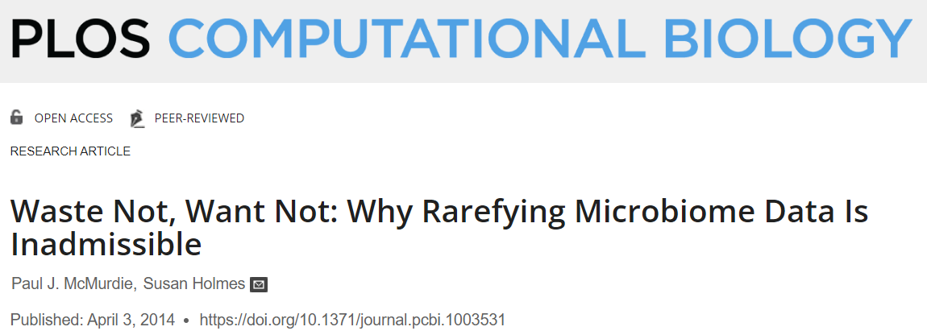

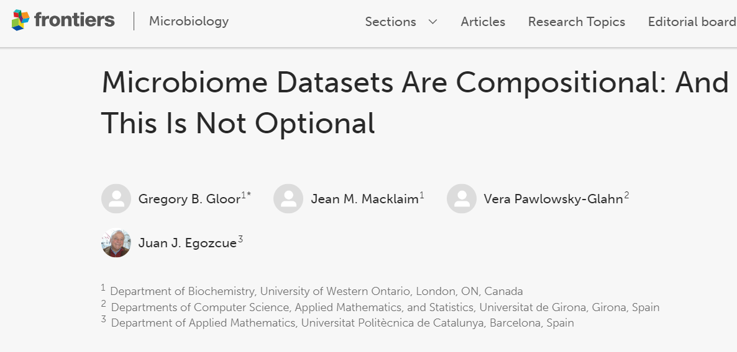
Normalization (4) – suggested reading

Slide 10
Normalization (5) – alternatives to rarefaction
Suggestion for R
Relative abundance;
note: you should replace absolute abundance with relative abundance independently of rarefying or not your data.
Hellinger transformation – square root standardized to unit total;
clr – central logo ratio.
will introduce negative abundance values.
None solve the problem of uneven sequencing power.
Some may be used together with rarefaction.

Slide 11
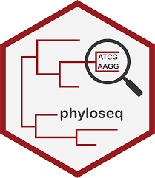
Alpha diversity (1)
Alpha diversity is the sample-level diversity
Suggestion for R
Common metrics:
Species richness: the number of different species (ASVs/OTUs/etc);
Shannon index: estimates entropy;
Simpson: considers the relative abundance of species (downweighs rare species).

Slide 12
Alpha diversity (2) – with phylogenetic tree
Suggestion for R
Common metrics:
Faith index: calculates the length of the tips of the phylogenetic tree;
Weighted Faith: weights the length of the tips by the relative abundance.
geiger R package

Slide 13
Alpha diversity (3) – how to chose an index?
Some considerations:
At least, calculate species richness;
Add additional metrics to account for the difference in relative abundance;
Avoid overwhelming your analysis with redundant metrics.
there are too many alpha diversity metrics, and they almost perfectly correlate with each other (see: Swenson, 2014).
If phylogenetic trees are available, add some metric that accounts for phylogenetic diversity.

Slide 14
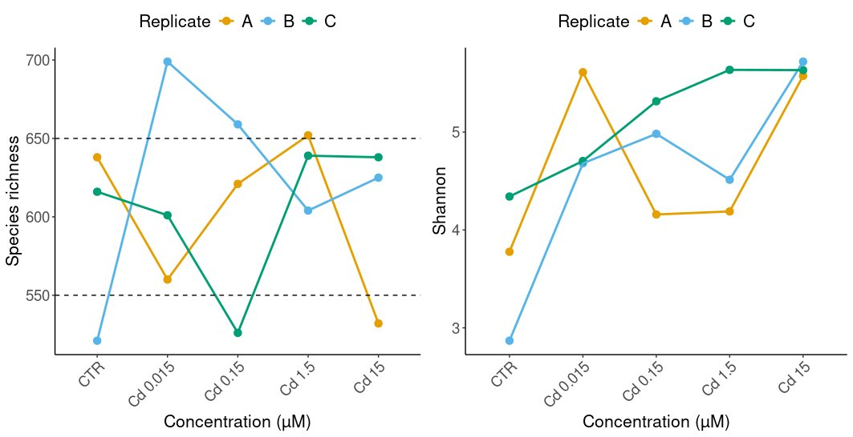
Alpha diversity (5) - examples
Alpha diversity as a function of Cadmium (Cd) concentration.
Species richness
Shannon
Sed037
What were the differences between species richness and Shannon?

Slide 15

Beta diversity (1)
Beta diversity is the between-samples diversity
Possible approaches:
Calculate some metric (example: Bray-Curtis/Sorenson index);
multivariate analysis and ordination methods – community structure analysis.
Suggestion for R
alpha
beta

Slide 16
Beta diversity (2) – multivariate analysis
What is multivariate analysis in beta diversity context?
It’s a group of statistical methods that we use to separate samples by community composition;
These methods reduce many dimensions into two dimensions, for example, principal component analysis (PCA).

Slide 17
Beta diversity (2) – calculate dissimilarity
2 dimensions
3 dimensions
Step 1 – calculate distance between samples:
Using species abundance as orthogonal axis;
Two and three dimensions are easy to understand visually, but we use hundreds or thousands of dimensions;
The process is repeated for all samples;
Together, the axes represent the community composition;
this step results in a dissimilarity matrix.
ASV2
ASV2
b
a
b
ASV1
ASV1
a
$$d\left(a,b\right)= \sqrt{{(a_{ASV1}−b_{ASV2})}^{2}+{(a_{ASV2}−b_{ASV2})}^{2}}$$
General formula (any number of dimensions)
ASV3
$$d\left(a,b\right)= \sqrt{{(a_{ASV1}−b_{ASV1})}^{2}+…+{(a_{ASVn}−b_{ASVn})}^{2}}$$
$$d\left(a,b\right)= \sqrt{{(a_{ASV1}−b_{ASV1})}^{2}+{(a_{ASV2}−b_{ASV2})}^{2}+{(a_{ASV3}−b_{ASV3})}^{2}}$$
Note: I’m using Euclidean distance as an example.

Slide 18
Beta diversity (3) – ordination plot
Principal component 2
Step 2 - reduce n dimensions to 2 dimensions;
the mathematical approach to reduce dimensionality is the multivariate analysis method;
The plot of the multivariate analysis is the ordination;
The two axis represent the community composition;
The closer two samples are, the more similar they are, and vice-versa.
c
b
Principal component 1
a

Slide 19
Beta diversity (4) – add environmental layers
Principal component 2
Step 3 - Add environmental information
we can add layers of environmental information on top of the ordination plot;
numerical and categorical environmental variables are added differently;
For numerical variables, we can use vectors or gradients;
For categorical variables, we can group them explicitly (centroids, hulls, etc).
water
c
Cd
b
Principal component 1
a
sediment

Slide 20
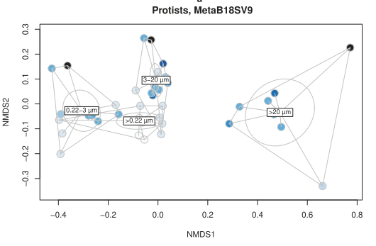
Beta diversity (5) – example
Method used:
Bray-Curtis distance (step 1);
nMDS ordination plot (step 2);
Centroids separate size fraction filtration (step 3 – categorical);
Blue colors are proportional to filtered volume (step 3 – numerical);
What we can see:
protist community composition was divided by size fractions;
the effect of volume was contained within each size fraction, i.e., filtration volume was less important than the size fraction.
Pascoal F. et al., (2023). Inter-comparison of marine microbiome sampling protocols. ISME Communications.

Slide 21
Beta diversity (6) – dissimilarity options
Step 1 - Community dissimilarities:
Euclidean distance (linear);
Manhattan methods (non-linear);
Bray-Curtis/Sorenson;
Jaccard.
Chi-squared;
UniFrac
incorporates the phylogenetic distance.
Can be weighted or unweighted
These examples are generally good.
Suggestion for R

Slide 22
Beta diversity (7) – dissimilarity options
Step 2 – Multivariate analysis:
Eigenvector methods
Ordination by rotation and projection
PCA – Principal Component Analysis (linear)
Euclidean distance
CA – Correspondence Analysis
Chi-squared distance (weighted linear)
Multidimensional Scaling (MDS)
takes any distance metric;
Principal Coordinates Analysis (PCoA) – classical MDS;
metric MDS – linear;
nMDS – non-linear.
Suggestion for R

Slide 23
Beta diversity (8) – constrained vs unconstrained
Unconstrained methods:
Calculate dissimilarities of community composition and make ordination plot;
Add layers with environmental information afterwards;
Constrained methods:
Incorporate the environmental information as constraints of the ordination.
To do so, we need to specify a model:
community composition ~ variables
Examples:
Redundancy Analysis (RDA) – constrained PCA;
Constrained Correspondence Analysis (CCA) – constrained CA.
Note: if a model is constrained by all environmental variables, it becomes equivalent to the unconstrained version.
Suggestion for R

Slide 24
Beta diversity (9) – how to choose?
Some tips:
Use the method that is a better description of your dataset;
Experiment different options;
some methods favor abundant species, etc.
also experiment with normalization methods.
There is no absolute best option;
If you have domain knowledge of the interaction between a variable and your community, that knowledge can help you decide.

Slide 25
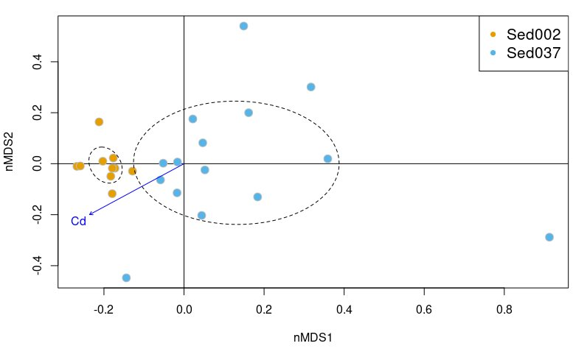
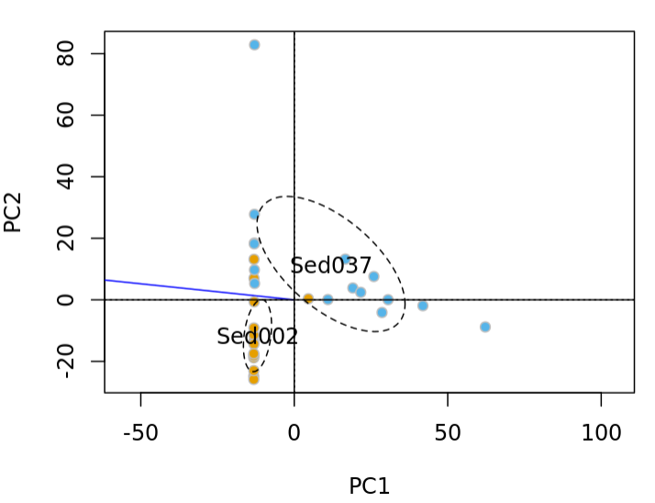
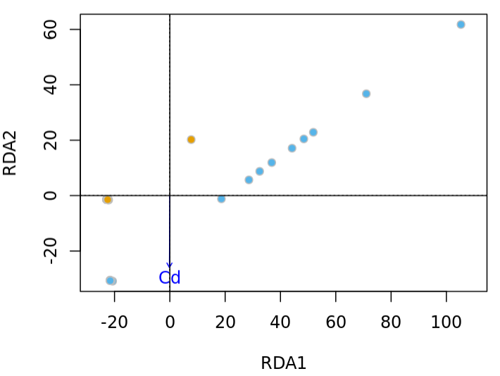
Beta diversity (9) – more examples
Bray-Curtis distance + nMDS
Euclidean distance + PCA (unconstrained)
Euclidean distance + RDA (constrained by Experiment)
Sed002
Sed037

Slide 26
Taxonomic analysis (1)
The taxonomy information will provide a more qualitative view of your microbial community.
Some general tips:
Identify the most abundant phyla;
Illustrate relative proportion of different groups within a taxonomic level;
this is tricky.
Balance the depth of the analysis with the amount of information;
Look at groups of interest for more detailed insights.

Slide 27
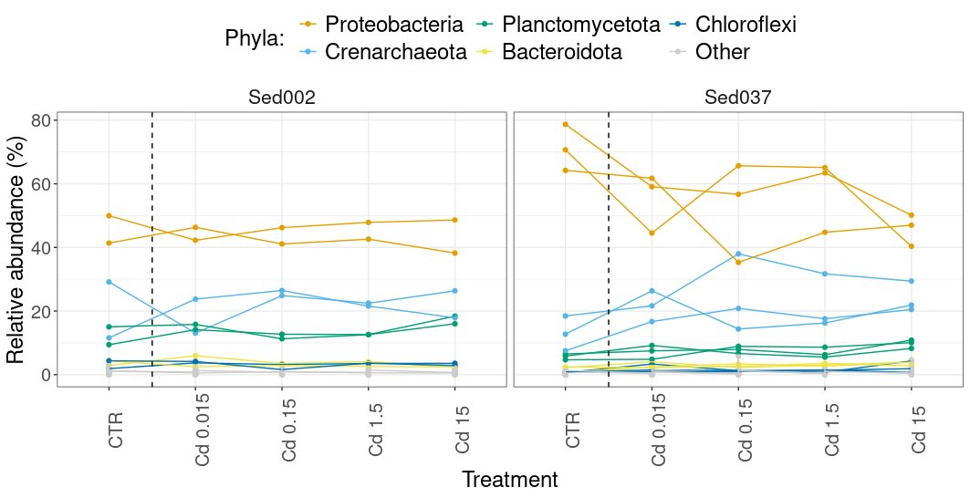
Taxonomic analysis (2) – examples
Balance:
Overview of major groups;
Detailed information.
For example:
Describe the most abundant phyla;
Not very useful, but good starting point.

Slide 28
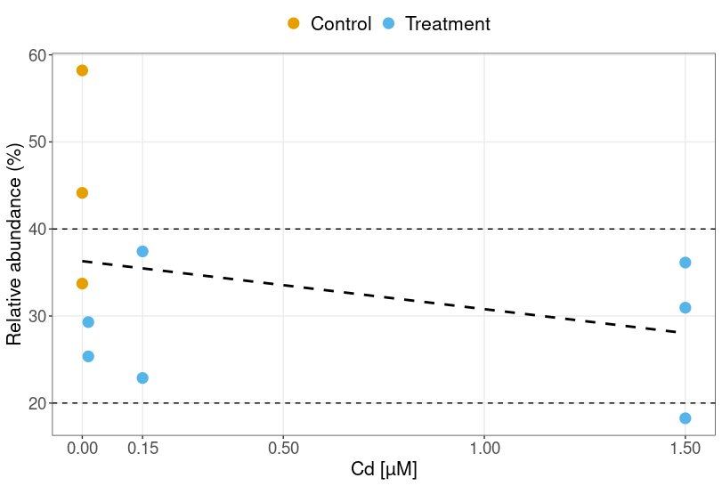
Taxonomic analysis (3) – examples
More specific analysis:
Stenotrophomonas genus relative abundance as a function of Cd concentration.
The abundance of Stenotrophomonas genus decreased after Cd treatment.
And was responsible for major differences between sediments.

Slide 29
Statistical tests (1)
Suggestion for R
Common tasks and tests in alpha diversity:
Correlation between two variables;
correlation analysis.
Correlation between more than two variables;
correlation matrix.
rstatix R package

Slide 30
Statistical tests (2)
Common tasks and tests in alpha diversity (cont.):
Comparing the means of two groups of samples;
Student’s t-test (parametric option);
Wilcoxon test (non-parametric option, has many other names).
Comparing the means of more than two groups of samples;
one-way/two-way ANOVA test (parametric option) + post-hoc;
Kruskall-Wallis test (non-parametric option) + post-hoc;

Slide 31
Statistical tests (3)
Notes on parametric tests:
Parametric tests are more powerful, so they should be preferred, when possible;
Parametric tests require:
normal distribution of data (use Shapiro-Wilk test);
homogeneity of variance (use Levene test).
The pre-requisites are more important if you have a small sample size (n < 30 samples).

Slide 32
Statistical tests (4)
Common tasks and tests in beta diversity:
Verify if community composition is different between groups of samples
PERMANOVA test – permutation of MANOVA.
Suggestion for R

Slide 33
Recommend reading
Swenson, N. G. Functional and Phylogenetic Ecology in R. Use R! (Springer New York, 2014). doi:10.1007/978-1-4614-9542-0.
Kassambara, A. Practical Statistics in R II - Comparing Groups: Numerical Variables. (Datanovia, 2019).
Oksanen, J. Multivariate analysis of ecological communities in R: vegan tutorial. Trends in Ecology & Evolution 3, 121 (2015)

Slide 34
Thank you

