Slide 1




Insights into data visualization
Francisco Pascoal
Institutional organizers
Sponsors

Slide 2
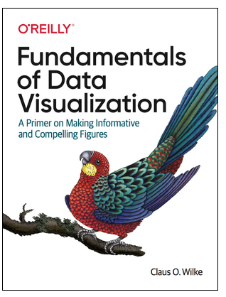
Based on
The book Fundamentals of Data Visualization, by Wilke;
Data science lectures at Dalhousie University;
Problem solving in microbial ecology.

Slide 3
Part 1 - Basic concepts
“ugly — A figure that has aesthetic problems but otherwise is clear and informative.
bad — A figure that has problems related to perception; it may be unclear, confusing, overly complicated, or deceiving.
wrong — A figure that has problems related to mathematics; it is objectively incorrect.”
From Wilke, Fundamentals of Data Visualization

Slide 4
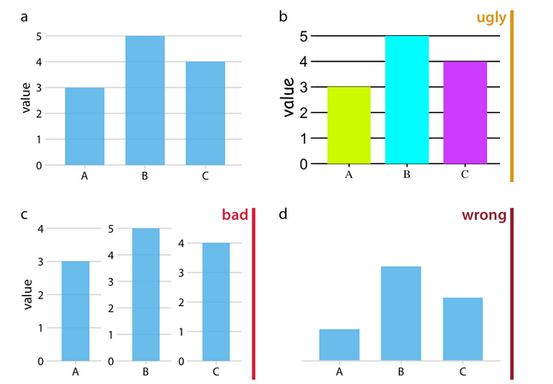
Example
From Wilke, Fundamentals of Data Visualization

Slide 5
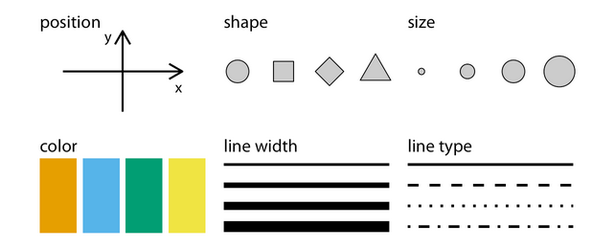
Some terminology (1)
Aesthetics – mapping of data into quantifiable features of an illustration.
From Wilke, Fundamentals of Data Visualization

Slide 6
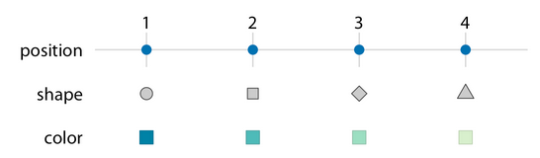
Some terminology (2)
A scale defines a unique mapping between data and aesthetics.
From Wilke, Fundamentals of Data Visualization

Slide 7
Types of data
Quantitative/numerical continuous;
Quantitative/numerical discrete;
Qualitative/categorical unordered;
Qualitative/categorical ordered;
Date or time;
Text.

Slide 8
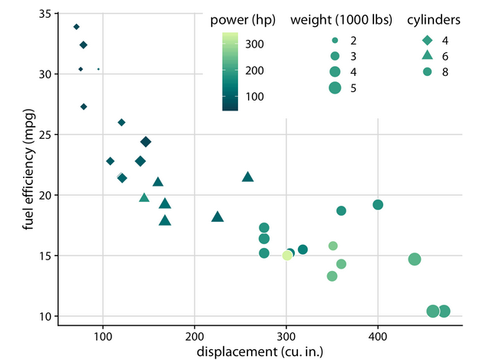
Example of a good plot
quantitative
continuous
quantitative discrete
From Wilke, Fundamentals of Data Visualization

Slide 9
Part 2 - Color scales
“(i) we can use color to distinguish groups of data from each other; (ii) we can use color to represent data values; and (iii) we can use color to highlight. ”
Wilke, Fundamentals of Data Visualization
If you are using color for something else, you are probably doing something wrong.

Slide 10

Qualitative color scales
Example of qualitative color scale:
To distinguish categories, we use qualitative color scales, with the following rules:
One specific color for each category, that is easily distinguishable from the other colors in that scale;
No single color is more highlighted/impressive/stronger/ etc than the others;
The colors are not ordered, nor give the impression of an order.

Slide 11
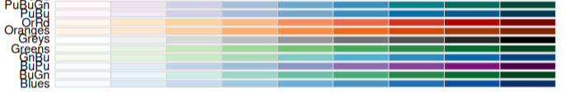
Quantitative color scale (1)
Sequential color scale, where:
There is an intuitive ordering of values, so that we can see which values are smaller or larger;
There is an intuition on the distance between data points;
The color varies uniformly in the color scale.
Single-hue palettes are more common (and safer), but multi hue color palettes can also be used. Examples:
From RColorBrewer package

Slide 12
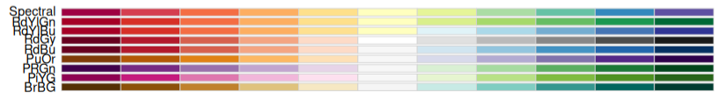
Quantitative color scale (2)
Examples of diverging scale
Additionally, if the sequential scale has two directions (not unidirectional), then two different scales can be combined.
Rules for diverging color scale:
2 color scales combined;
Middle point is a very light color (neutral);
Extremes are darker points of each scale;
Balanced (the scale should be the same for each side).
From RColorBrewer package

Slide 13
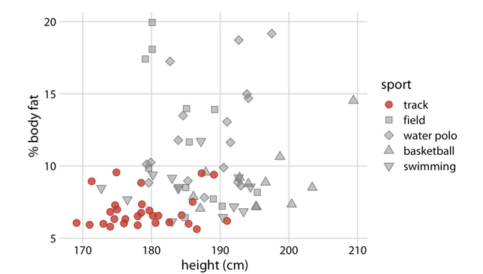
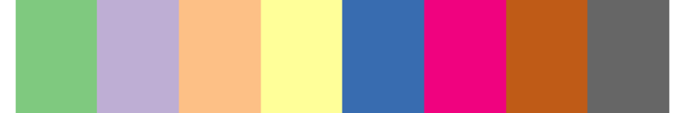
Highlight coloring
Colors can also be used to highlight some important detail in the data. For example, to standout one important category from other, less important categories.
Use a palette that combines uniform, light colors, with more intense and strong ones.
From Wilke, Fundamentals of Data Visualization
From RColorBrewer package
Be careful with colors competing for attention, it might be wiser, for example, to just use two colors, one grey and one strong (like red).

Slide 14
Visualizing proportions
Main options:
Pie chart;
Stacked bar plot;
Side by side bar plot.

Slide 15
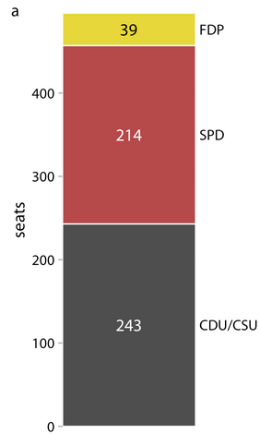
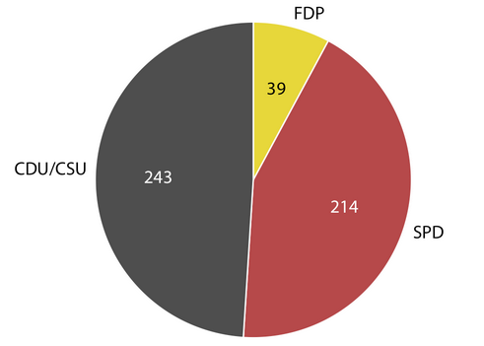
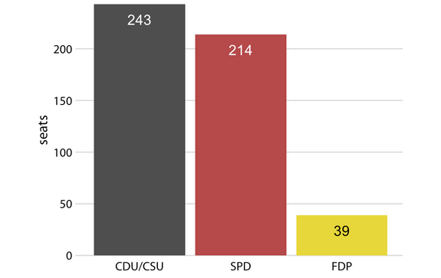
Examples for proportions (1)
Stacked bar chart
Side by side bar chart
Pie chart
All are good and correct (all could be used), but pie chart is the best option for this example. Why?
From Wilke, Fundamentals of Data Visualization

Slide 16
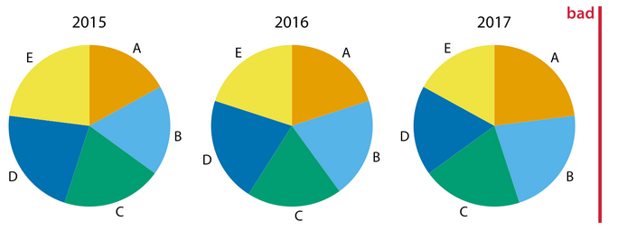
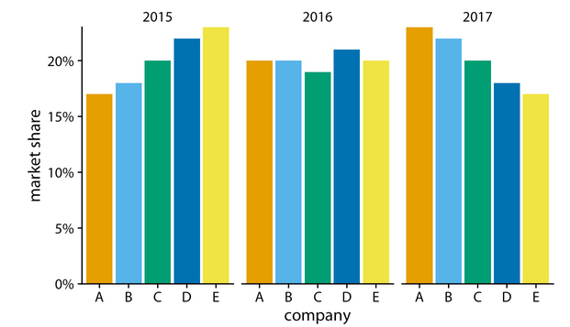
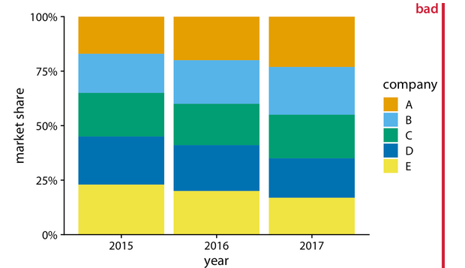
Example for proportions (2)
Don’t use multiple pie charts.
Side by side bar chart is the best option for this example.
Stacked bar chart.
Usual alternative for multiple pie charts, with clear information on A and E, but unclear for B, C and D
From Wilke, Fundamentals of Data Visualization

Slide 17
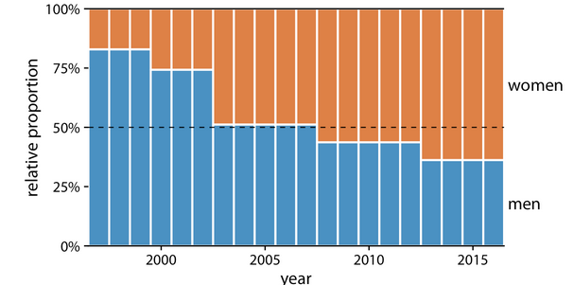
Example for proportions (3)
Stacked bar charts are the best when you have few variables.
Comparing by a discrete variable
From Wilke, Fundamentals of Data Visualization

Slide 18
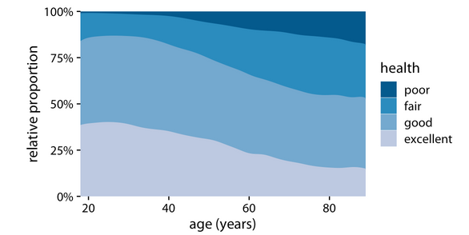
Example for proportions (4)
Discrete ordered variable
(sequential coloring)
An area plot is like a stacked bar chart with a continuous position x.
Comparing by a continuous variable
From Wilke, Fundamentals of Data Visualization
Note: this plot has some limitations

Slide 19
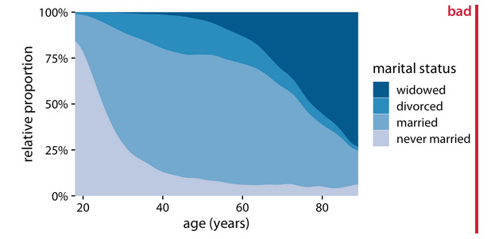
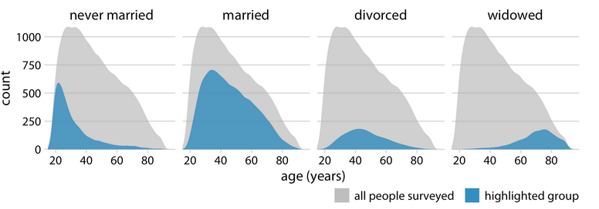
Example for proportions (5)
The distribution of marital status with age is very pronounced, making this plot misleading.
Better, because it provides information on the population distribution.
From Wilke, Fundamentals of Data Visualization

Slide 20
Visualizing nested proportions
Nested proportions have categories within categories.
Example of 2 nested categories, bridge construction:
modern;
steel;
wood;
iron.
craft;
steel;
wood;
iron.
Common issues:
Double counting (proportions above 100%);
Unclear hierarchy.

Slide 21
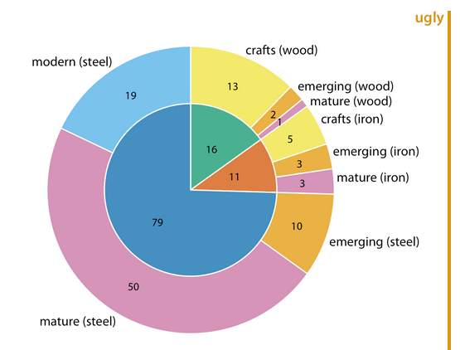
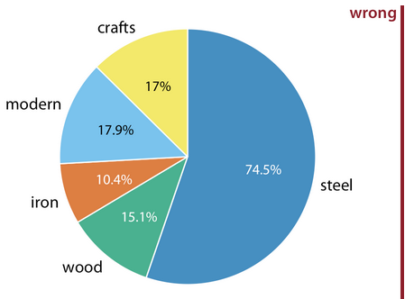
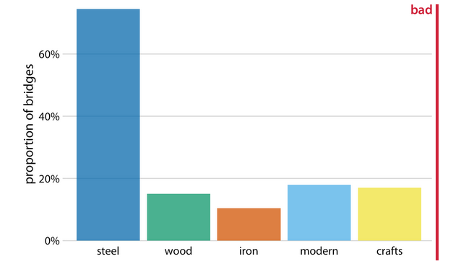
Example for nested proportions (1)
nested pie chart
Does not allow to know which material was used by modern or craft;
Adds up to 135% (wrong)
Solves the double count problem;
BUT it is unclear that steel, wood and iron are sub-divided into modern and crafts.
Looks like 5 categories, when we have 2 categories sub-divided into 3 categories
From Wilke, Fundamentals of Data Visualization

Slide 22
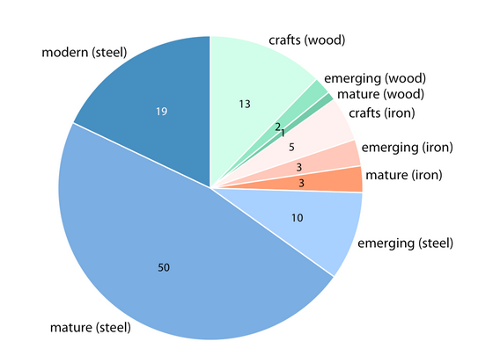
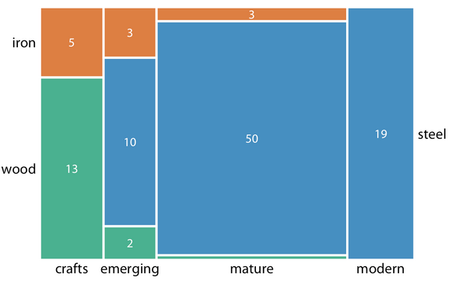
Example for nested proportions (2)
Mosaic plot
Pie chart
(with a coloring trick)
qualitative coloring (3 colors) for material
quantitative coloring (sequential, unidirectional) for time period
From Wilke, Fundamentals of Data Visualization

Slide 23
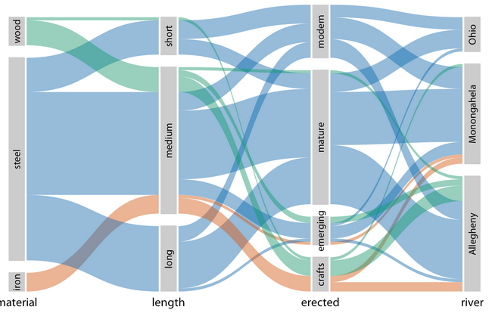
Examples for nested proportions (3)
Parallel plot with 4 nested categories
If we have many nested variables, then mosaic and nested pie charts can easily become ugly, overcrowded and difficult to interpret.
One alternative is parallel plots.
From Wilke, Fundamentals of Data Visualization

Slide 24
Part 3 - Common problems with color usage
“Color needs to be applied to serve a purpose, it must be clear, and it must not distract.”
Wilke, Fundamentals of Data Visualization
Common issues:
To much colors;
Coloring for the sake of coloring;
Non-monotonic color scales;
Non-friendly to color blind people.

Slide 25
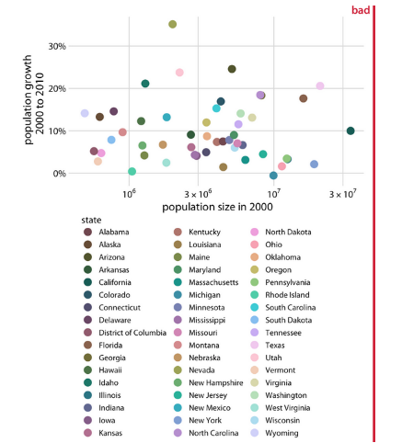
Too many colors (1)
Problems:
The coloring is not useful to distinguish categories;
It is possible to guess which colors is what category, but it requires a lot of work;
(Misleading )Some colors seem to be related, while they represent independent, distinct categories.
If you have too many colors, you probably need another visualization option, instead of changing the color pallet.
From Wilke, Fundamentals of Data Visualization

Slide 26
Too many colors (2)
“qualitative color scales work best when there are three to five different categories that need to be colored. Once we reach eight to ten different categories or more, the task of matching colors to categories becomes too burdensome to be useful, even if the colors remain sufficiently different to be distinguishable in principle.”
Wilke, Fundamentals of Data Visualization
From Wilke, Fundamentals of Data Visualization

Slide 27
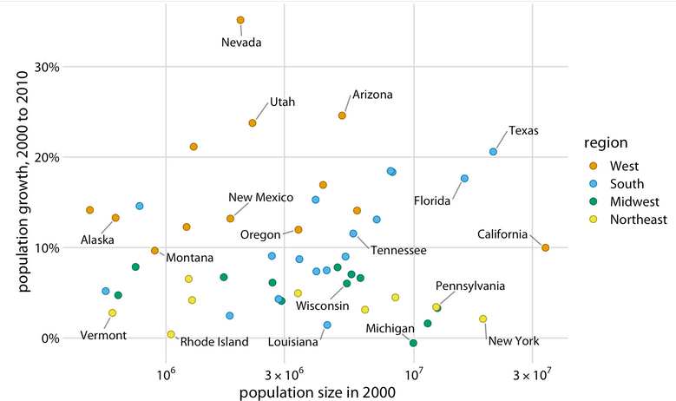
Too many colors (3)
solution
From Wilke, Fundamentals of Data Visualization

Slide 28
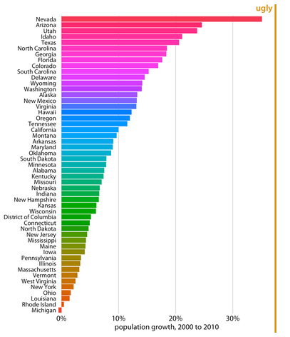
Coloring for the sake of coloring
If an aesthetic is unnecessary and/or redundant, it might do more harm than good.
Common issues:
The rainbow coloring is not mapped onto any variable;
The rainbow coloring makes a fake pattern.
rainbow palette is circular and non-monotonic scale
(next problem)
From Wilke, Fundamentals of Data Visualization

Slide 29
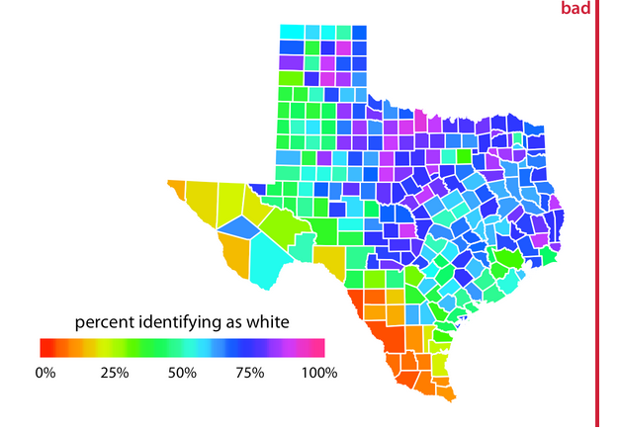
Lack of monotonicity in color scale and circular pallet
Lack of monotonicity in the color scale means that the intensity of the color does not change uniformly through the pallet.
Issues with non-monotonic color scale:
Unclear scale (low vs high values);
Tiring for the eyes;
Unclear ordering of values.
From Wilke, Fundamentals of Data Visualization

Slide 30
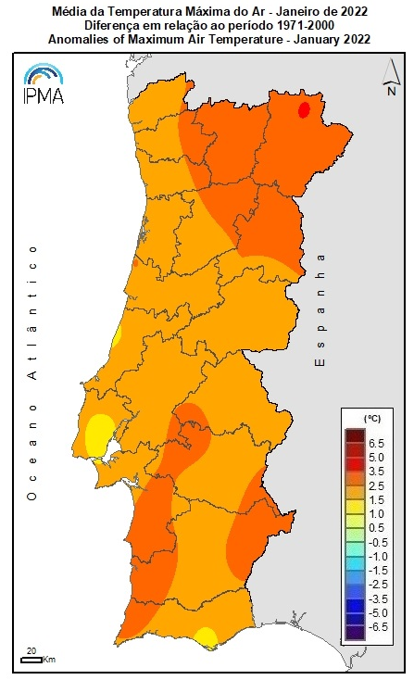
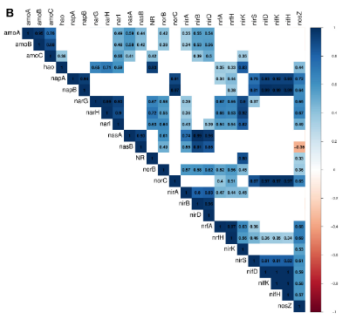
Monotonic colors
monotonic colors in a map
monotonic colors in a correlation
Don’t assume which direction a specific color represents
sequential diverging coloring for quantitative continuous variable
sequential diverging and multi-hue coloring for quantitative continuous variable
From Pascoal et al., 2022 (Frontiers in Microbiology)
From IPMA (https://www.ipma.pt/pt/oclima/monitorizacao/)

Slide 31
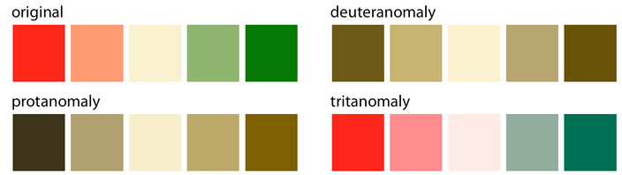
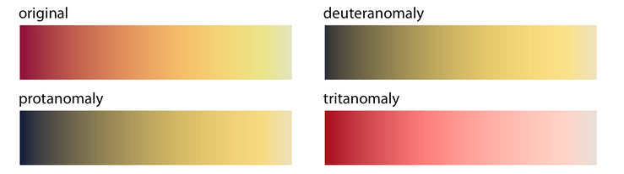
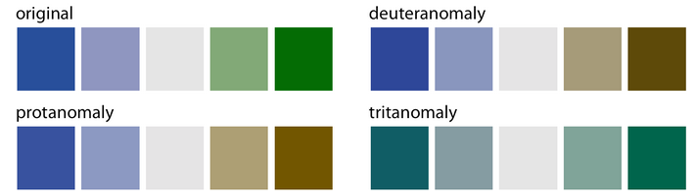
Color blind issues (1)
Color blind people typically do not distinguish:
red-green;
blue-yellow.
The problem is more serious for diverging scales
red-green
Sequential scales, usually, are ok, because they should represent a unidirectional gradient.
blue-green
the original colors are perceived differently, but the inherent meaning is similar enough.

Slide 32
Color blind issues (2)
The color-blind friendly palette is harder for qualitative coloring
(fewer coloring options)
Color blind friendly palette proposed by Wilke in Fundamentals of Data Visualization

