Slide 1
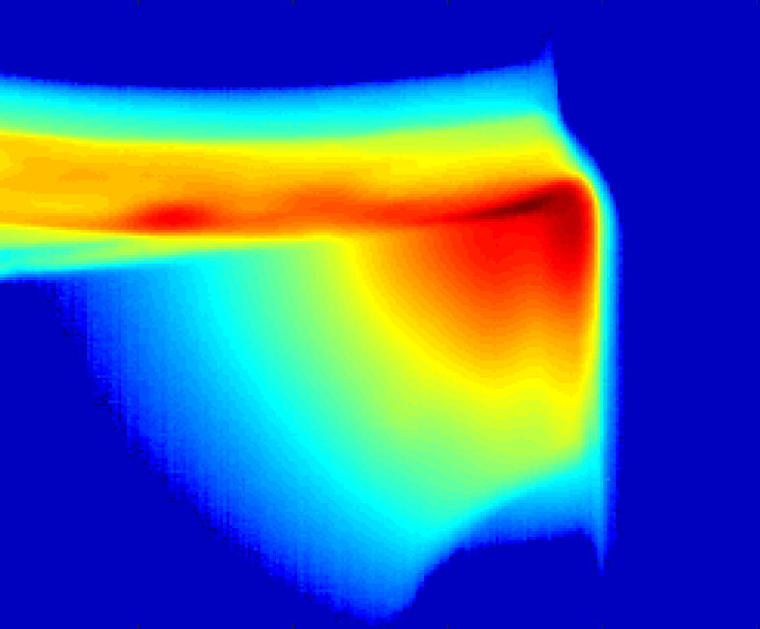
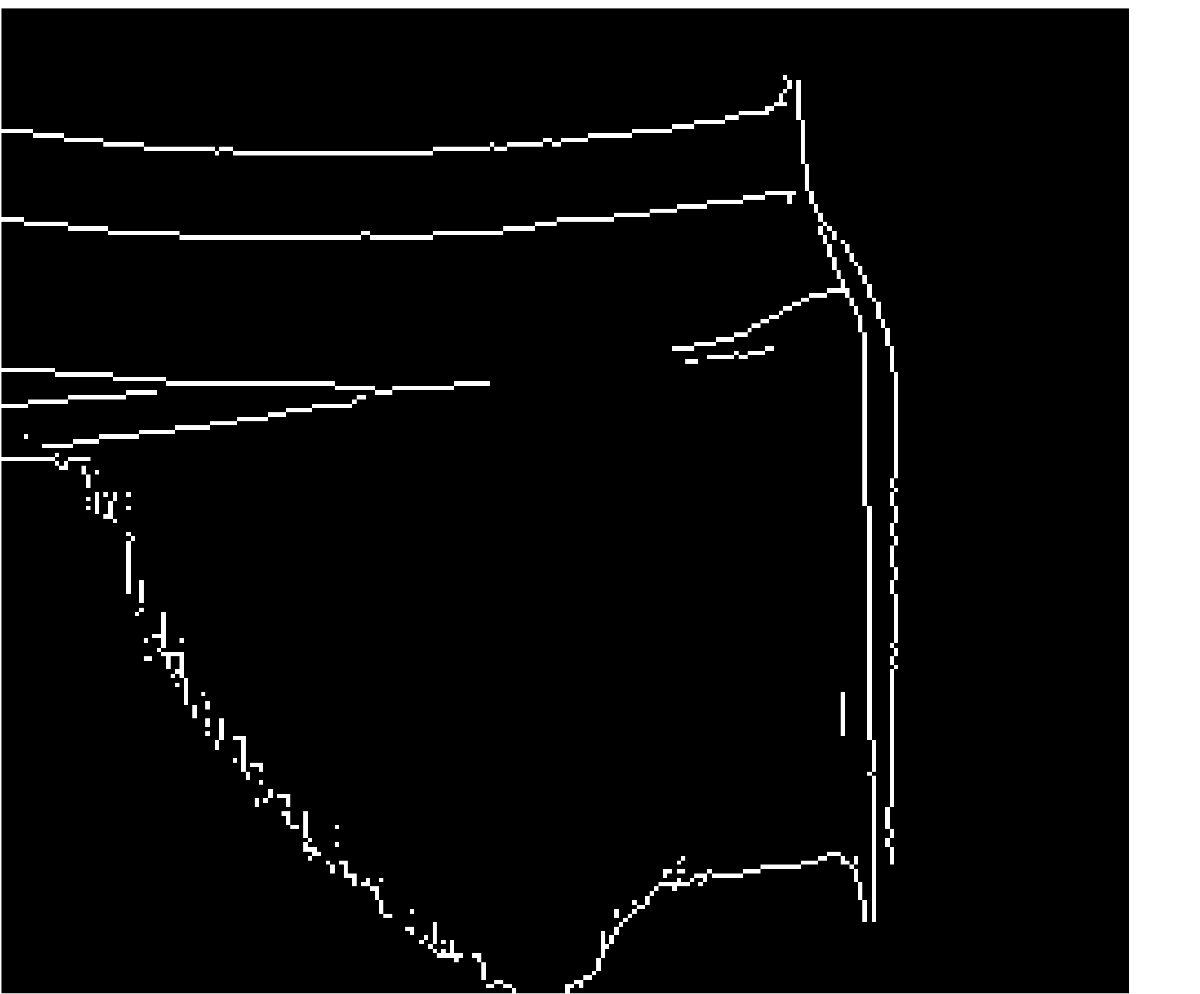
(a)
(b)

Slide 2

(a)
Tool shape
(b)

Slide 3
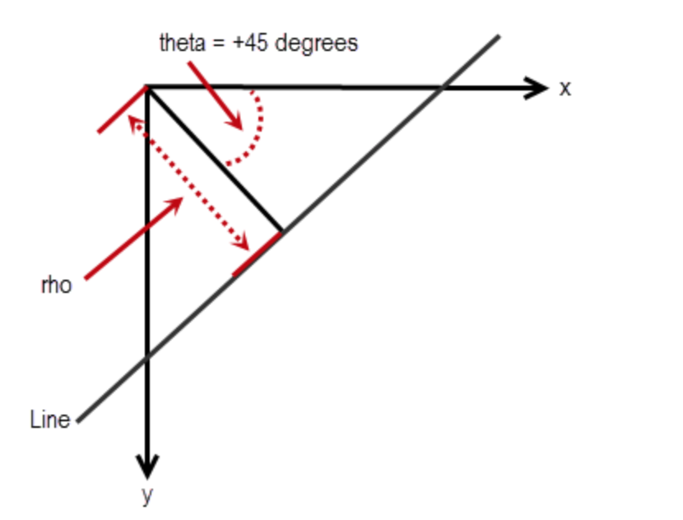

Slide 4


x
$$θ$$
$$ρ$$
Line
y

