Slide 1

ADA PROGRAMMING LANGUAJE
ADRIAN ROBERTO CARMONA RODRIGUEZ
DATA 3ª
ADRIAN ROBERTO CARMONA RODRIGUEZ.
DATA 3ª

Slide 2
What is Ada?
Ada is an object-oriented and strongly typed programming language that was designed by Jean Ichbiah of CII Honeywell Bull on behalf of the United States Department of Defense.
It was designed with safety in mind and with a philosophy aimed at reducing common errors and difficult to discover.

Slide 3
What was based Ada?
is based on very strong typing and run-time checks (disabled for performance benefit). The synchronization of tasks is done using the primitive rendezvous.
Ada is used mainly in environments where high safety and reliability are required such as defense, aeronautics , air traffic management and the aerospace industry, among others.

Slide 4
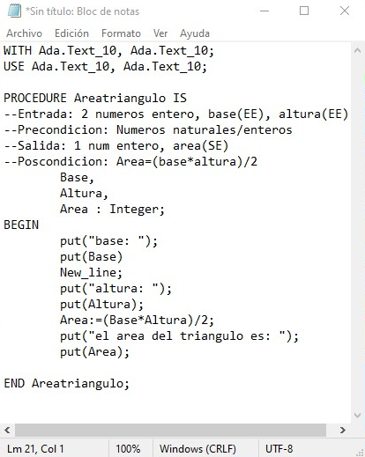
Example

Slide 5
REFERENCES
https://www.ecured.cu/Lenguaje_de_programaci%C3%B3n_Ada
https://tecnologia.fandom.com/wiki/Ada_(Lenguaje_de_programaci%C3%B3n)

