Slide 1


Name: Adrian Kok, Edward Tang, Henson Chen, Angus Lee
School: University of Toronto
Team: Team A

Slide 2
Executive Summary
In this presentation, we answer the main prompt: “Defenders often need to be physically strong in order to compete and progress in the world cup.”
Considerations
Analysis
Solution
Physically Strong: What is considered as physically strong?
Progression: What is considered as progression?
Link: What is the relationship between physicality and progression?
Fifa 22 Dataset: We use a Fifa 22 dataset which contains all the attributes of players during the 2018 world cup
Conclusion: An all-in-one app which shall encourage middle aged workers to return to the office.
Functionality
Booking tables and meeting rooms through the app
Perform the COVID screening through the app
Gain rewards by heading to the office through the app
Can replace their access card to get into office
Progression: We use the Point system used by Fifa to rank progression during the 2018 world cup
Regression: We use multiple linear regression too see if there is a relationship between the variables
Employee Gender Ratio
2018 World Cup Results

Slide 3
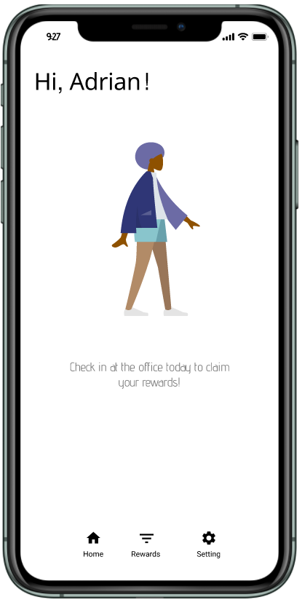


Physical Attributes
Overall, what is considered as physical attributes? In our case, we believe physical attributes is more than just a player’s height and weight, rather a demonstration of their physicality.
Agility
Jumping
EY already currently holds partnerships for coupons. EY can leverage this partnership to provide rewards within EYHome.
Such an APP(EYHome) with free rewards would only be feasible with scale. The idea is that leveraging the Hybrid model will increase productivity, netting out costs in the long run.
Power Strength
Power Stamina
EY already holds many strong connections with retail partners. EY can leverage these relationships to build the APP and provide its functions.
EY currently hosts booking/card access/ and certification on separate websites. EYHome would simply integrate the 3 systems together.
Balance
Sprint Speed
Because the APP is small and inhouse, the development for the EYHome would not be very costly.
EY in the past has created many in house apps such as EY Canvas. As a result, they are capable of developing EYHome.

Slide 4
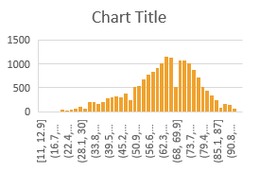
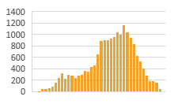
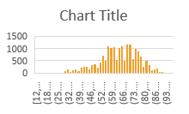
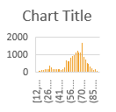
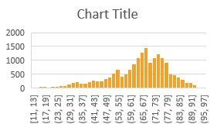
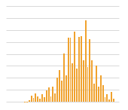
Physical Attributes
Overall, what is considered as physical attributes? In our case, we believe physical attributes is more than just a player’s height and weight, rather a demonstration of their physicality.
Agility
Jumping
Power Strength
Power Stamina
Balance
Sprint Speed

Slide 5
Progression
For our Analysis, we use the Point system made by Fifa to measure progression. While not a direct measure of progression, it gives us a good idea of which teams did better than others.
X Variables
Y Variable
movement_agility | power_jumping | power_stamina | movement_balance | movement_sprint_speed | power_strength
89 | 95 | 92 | 63 | 91 | 80
90 | 68 | 73 | 95 | 87 | 59
96 | 61 | 78 | 82 | 90 | 53
52 | 78 | 44 | 35 | 61 | 83
86 | 69 | 89 | 60 | 77 | 80
78 | 84 | 79 | 80 | 83 | 84
Team | Points
France | 19
Croatia | 14
Belgium | 18
England | 10
Uruguay | 12
Wins
Loss
# of Points | 3 Points for the Winning Team
# of Points | 1 Points for the Winning Team
Draw
Caution
Loss | 0 Points for the Winning Team
Note that the team that places third can receive higher points than second

Slide 6



Regression Results
For EY, the key questions to be answered are regarding their workers. Why are they not going back to office? What would motivate them to return to office? Do they enjoy going to the office?
Regression
Analysis
R Squared
As discovered in EY’s Q&A session, it was found that middle aged workers are the individuals who are not going back to the office.
Coefficient T Statistics
EY has held multiple in person office events, such as special days, treat carts, and more. Similarly, they have invited groups such as bands, to light up the EY office.
Intercept
Per research, EY employees expect technological support, work from home stipend, and provided equipment to work in the Hybrid work setting.
Jobs of EY employees (Value Proposition model)
Analysis
1.
Soccer is a heavy team reliant game
Considers going to the office
Examines added physical costs (money)
Examines added emotional costs (time)
Examines benefits (e.g positive social interactions)
Makes Decision
2.
Little Variation in Y variable
If workers are not going to the office, it means the physical and emotional costs outweigh the benefits one can get for an EY not going to the office.
Every player is more or less physical
3.

Slide 7



Implementation/Risks and Mitigations
What is the plan for deployment? What are some risks the project may encounter?
Overview
First
Second
Third
Fourth
Took Fifa 22 player Attributes
Merged with Fifa Points through mapping
Ran Multiple Linear Regression
Determined a Result
Risk
Mitigation
Fifa 22 variables may not measure physicality
Leave out Variables which don’t represent physicality, such as accuracy
Variables are different in scale
Standardize the Variables so that they are all on similar scale
Points may not be a true representation of progression
Make sure that teams that get higher points are generally the ones that progress further down the stages
Conclusion
EYHome is the ideal solution to attract workers to return to the office. It relieves all the pains workers have when returning to the office, such as added costs, time, and convenience. Deployment would make workers happier and more willing to operate in the Hybrid workforce model.

