Slide 1
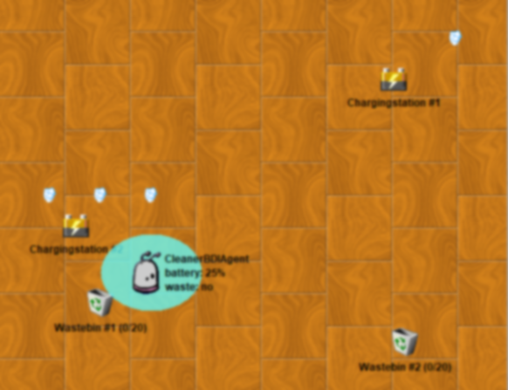
0
0.1
1
1
2
3
1
4
Patrol Plan 2
0.1
0

Slide 2
0
0.1
1
1
3
2
1
4
Patrol Plan 3
0.1
0

Slide 3
maintain condition becomes false
Maintain Battery Loaded
Perform Patrol
inhibits
Goal active
maintain condition becomes true
Goal idle
Patrol Plan 3
Load Battery
Patrol Plan 2
Patrol Plan 1
Maintain Battery Loaded
Perform Patrol
inhibits
Goal suspended
Goal active
Plan aborted
Patrol Plan 3
Load Battery
Patrol Plan 2
Patrol Plan 1

Slide 4
Goal Plan Tree Example
Eat pan-cakes
goal
Make pancake
plan
Pan- cake mix ready
Pan-cake flipped
…
sequential = AND
Get in- gredients from shelf
alternative = OR
Buy missing ingredi-ents
Throw pancake
alternative = OR
Flip with spatula

