Slide 1
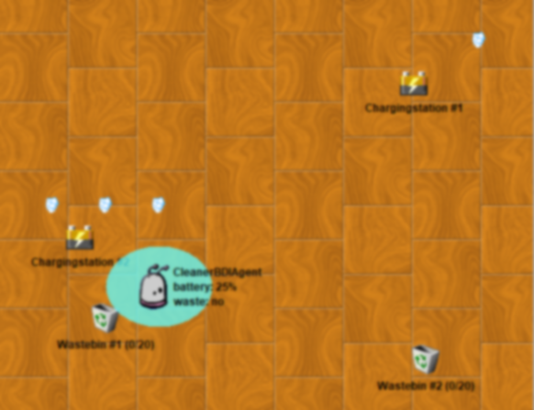
0
0.1
1
1
2
3
1
4
Patrol Plan 2
0.1
0

Slide 2
0
0.1
1
1
3
2
1
4
Patrol Plan 3
0.1
0

