Slide 1
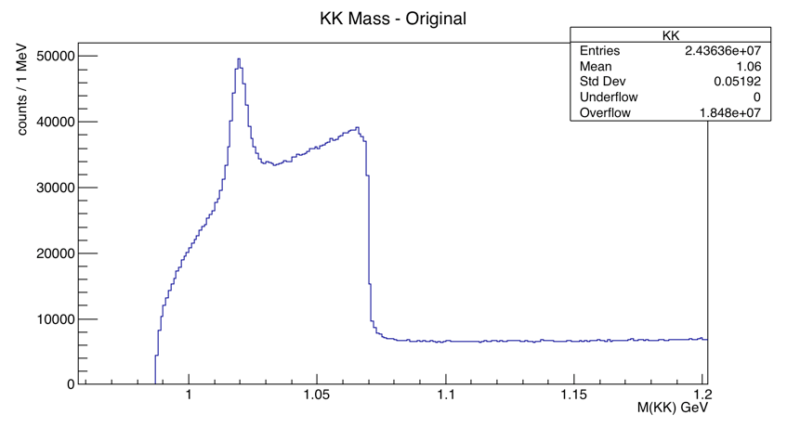
Original Kaons

Slide 2
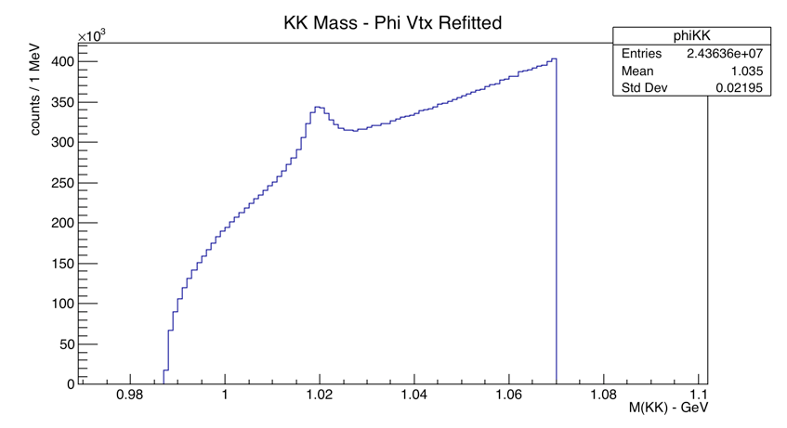
Original Kaons
2 Vtx Refitted Kaons
(on which we cut)

Slide 3
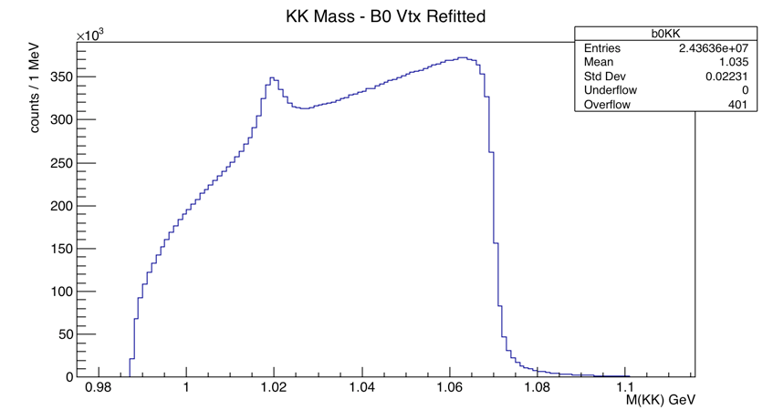
4 Vtx Refitted Kaons

Slide 4
M(KK) – Original [GeV]
M(KK) – B0 four tracks refit [GeV]

Slide 5
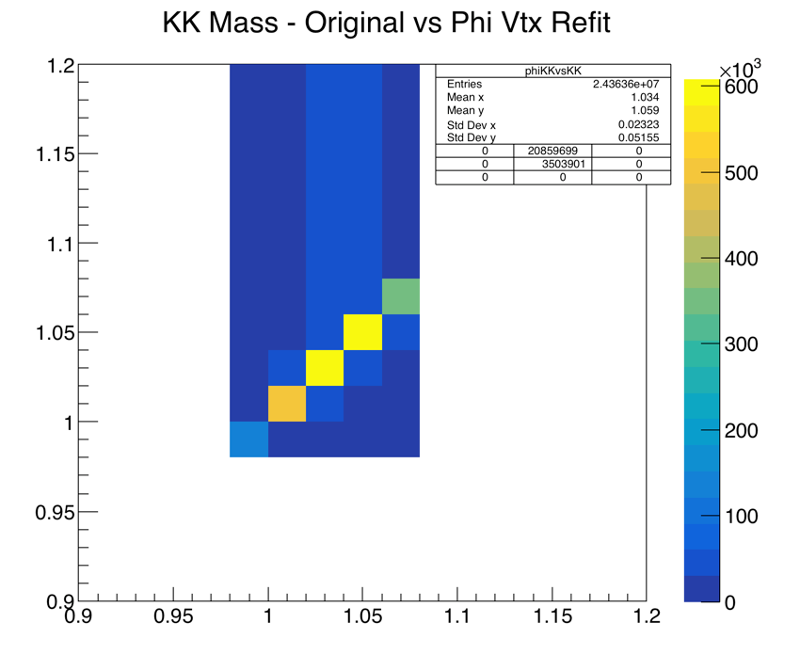
M(KK) – Original [GeV]
M(KK) – Phi Two tracks refit [GeV]

Slide 6
KK Mass – B0 Vtx Refti vs Phi Vtx Refit
M(KK) – B0 four tracks refit [GeV]
M(KK) – Phi Two tracks refit [GeV]

Slide 7
