Slide 1
UNet base (no super-resolution)
DEPRECATED

Slide 2


t
Pos Encoding
Time MLP
Relu
y
Label Embedding
Conv2D
Conv2D
Conv2D
Conv2D
Downsample
Batch Norm
Batch Norm
ATTENTION
DECODER
DECODER
Conv2D
Batch Norm
Upsample
Conv2D
ENCODER
CONCATENATE
Batch Norm
ENCODER
Relu
Relu
Relu
Relu
ENCODER
DECODER

Slide 3
UNet for super-resolution
DEPRECATED

Slide 4

t
Pos Encoding
Time MLP
Relu
LR
Encoding
Interpolation
Conv2D
Conv2D
Conv2D
Conv2D
Conv2D
Downsample
Batch Norm
Batch Norm
ATTENTION
DECODER
DECODER
Conv2D
Batch Norm
Upsample
Conv2D
ENCODER
CONCATENATE
Batch Norm
ENCODER
Relu
Relu
Relu
Relu
ENCODER
DECODER
Conv2D

Slide 5





ATTENTION
$$W_{}:1x1x1$$
Conv2D
=
Batch Norm
$$ψ:1x1x1$$
=
Conv2D
Where 1x1x1 is the
convolution with
kernel_size = 1x1
stride = 1
g
$$W_{g}:1x1x1$$
Relu
$$ψ:1x1x1$$
Sigmoid
Channel Repetition
Interpolation
x
$$W_{x}:1x1x1$$
x

Slide 6
UNet for super-resolution 2 (Attention Unet)
DEPRECATED

Slide 7
t
Pos Encoding
Time MLP
Relu
LR
Encoding
Interpolation
Conv2D
Conv2D
Conv2D
Upsample
Conv2D
Batch Norm
Batch Norm
Downsample
Downsample
Downsample
CONCATENATE
DECODER
Conv2D
Conv2D
ENCODER
BOTTLENECK
Conv2D
DECODER
ENCODER
Batch Norm
Relu
Relu
ATTENTION
Relu
ENCODER
DECODER
Conv2D
BOTTLENECK
=
ENCODER

Slide 8
UNet for super-resolution 3 (Residual Attention Unet)
BEST

Slide 9
t
Pos Encoding
Time MLP
Relu
LR
Encoding
Interpolation
Conv2D
Conv2D
Conv2D
Conv2D
Upsample
Batch Norm
Batch Norm
Downsample
Downsample
Downsample
Batch Norm
CONCATENATE
DECODER
Conv2D
Conv2D
ENCODER
BOTTLENECK
Conv2D
DECODER
ENCODER
Relu
Relu
ATTENTION
Relu
Conv2D
DECODER
Batch Norm
ENCODER
Conv2D
BOTTLENECK
=
ENCODER

Slide 10
UNet for super-resolution 3-bis (Residual Attention Unet)
DERPECATED

Slide 11
t
Pos Encoding
Time MLP
Relu
LR
Encoding
ENCODER
Interpolation
Conv2D
Conv2D
Conv2D
Conv2D
Downsample
Downsample
DECODER
Conv2D
Batch Norm
Batch Norm
Downsample
Normalization
Interpolation
Interpolation
Conv2D
Conv2D
ENCODER
BOTTLENECK
Batch Norm
DECODER
ENCODER
Interpolation
CONCATENATE
Relu
Relu
MultiHeadAtt
Relu
Conv2D
DECODER
Batch Norm
ENCODER
Conv2D
BOTTLENECK
=
ENCODER

Slide 12
UNet for super-resolution 4 (Residual Vision Multihead Attention Unet)
WORK IN PROGRESS

Slide 13
t
Pos Encoding
Time MLP
Relu
LR
Encoding
Interpolation
Conv2D
Conv2D
Conv2D
Conv2D
Upsample
Batch Norm
Batch Norm
Downsample
Downsample
Downsample
Batch Norm
CONCATENATE
DECODER
Conv2D
Conv2D
ENCODER
BOTTLENECK
Conv2D
DECODER
ENCODER
VISION MHA
Relu
Relu
Relu
Conv2D
DECODER
Batch Norm
ENCODER
Conv2D
BOTTLENECK
=
ENCODER

Slide 14
What’s ?
VISION MHA
Q
Image Encoding
Positional Encoding
Layer Norm
Dropout
Multi Head Attention
(Q,K,V)
Transposed Convolution
Transpose and reshape
Interpolation
K
Image Encoding
Positional Encoding
Layer Norm
Dropout
The real shapes
of K and Q are the
followings (i.e. K is twice
smaller than Q with
respect to the height and
width.
Q
K

Slide 15
UNet for new data generation (Residual-Attention Unet)
BEST

Slide 16
t
Pos Encoding
Time MLP
Relu
y
Label Embedding
Conv2D
Conv2D
Conv2D
Upsample
Batch Norm
Batch Norm
Downsample
Downsample
Downsample
Batch Norm
CONCATENATE
DECODER
Conv2D
Conv2D
ENCODER
BOTTLENECK
Conv2D
DECODER
ENCODER
Relu
Relu
ATTENTION
Relu
Conv2D
DECODER
Batch Norm
ENCODER
Conv2D
BOTTLENECK
=
ENCODER

Slide 17
UNet for new data generation (Residual-Attention Unet style DiffiT)
WORK IN PROGRESS

Slide 18
t
Pos Encoding
Time MLP
Swish
y
Label Embedding
UP
UP
UP
Conv2D
Downsample
Downsample
Downsample
Batch Norm
ENCODER
ENCODER
BOTTLENECK
Conv2D
ENCODER
DECODER
DECODER
DECODER
Upsample

Slide 19
DiffiT residual block
Time MLP
Swish
Group Norm
Conv2D
Swish
ATTENTION
BLOCK
ENCODER
BOTTLENECK
DECODER
Conv2D
If shape different

Slide 20
ATTENTION BLOCK
Self Attention
Time MLP
Swish
g
Conv2D
Self
Attention
Swish
Conv2D
Sigmoid
Channel Repetition
Batch Norm
Batch Norm
Conv2D
Swish
x
Batch Norm
Conv2D
Conv2D
x

Slide 21
UNet for SAR_TO_NDVI (Residual-Attention Unet)
BEST

Slide 22
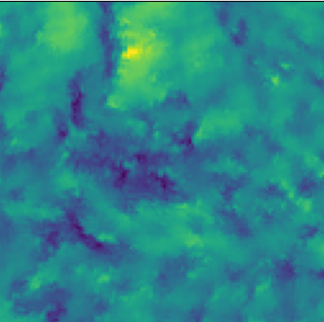
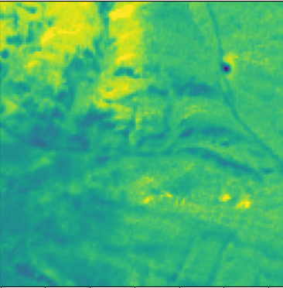
t
Pos Encoding
Time MLP
Relu
SAR
Encoding
Conv2D
Conv2D
Conv2D
Conv2D
Upsample
Batch Norm
Batch Norm
Downsample
Downsample
Downsample
Batch Norm
CONCATENATE
DECODER
Conv2D
Conv2D
ENCODER
BOTTLENECK
Conv2D
DECODER
ENCODER
Relu
Relu
ATTENTION
Relu
Conv2D
DECODER
Batch Norm
ENCODER
Conv2D
BOTTLENECK
=
ENCODER

