Slide 4

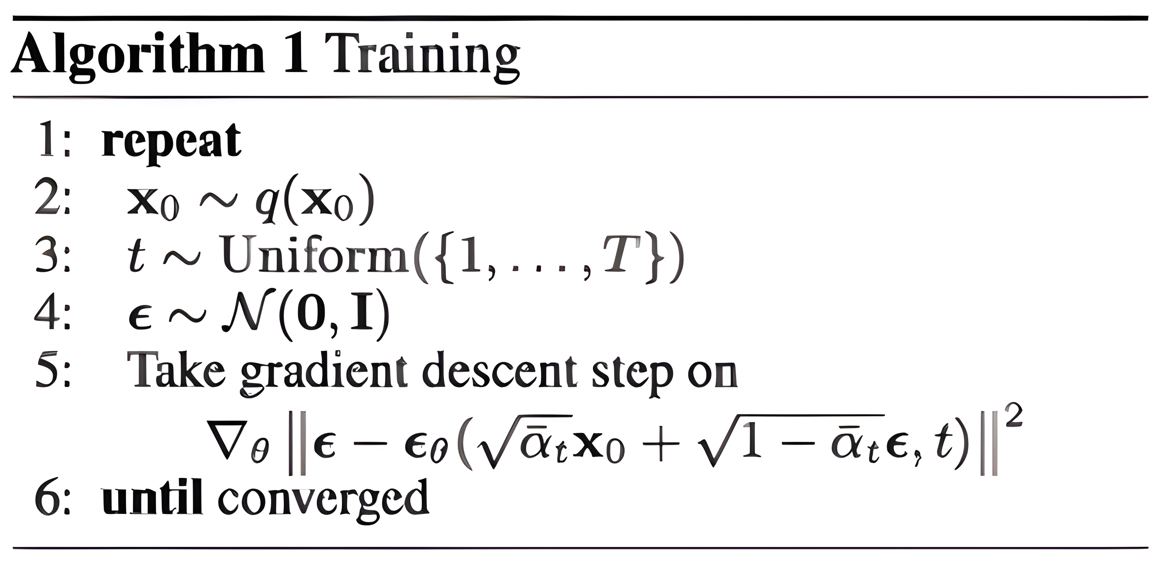
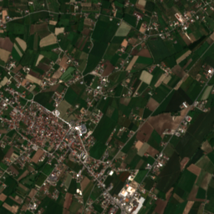
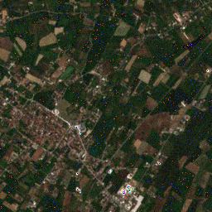
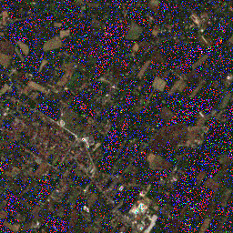
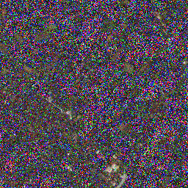


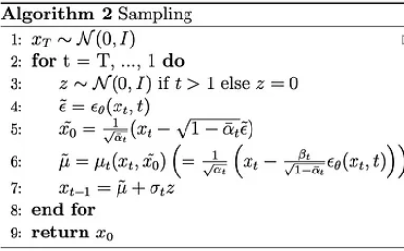

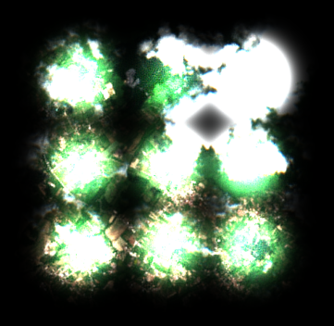
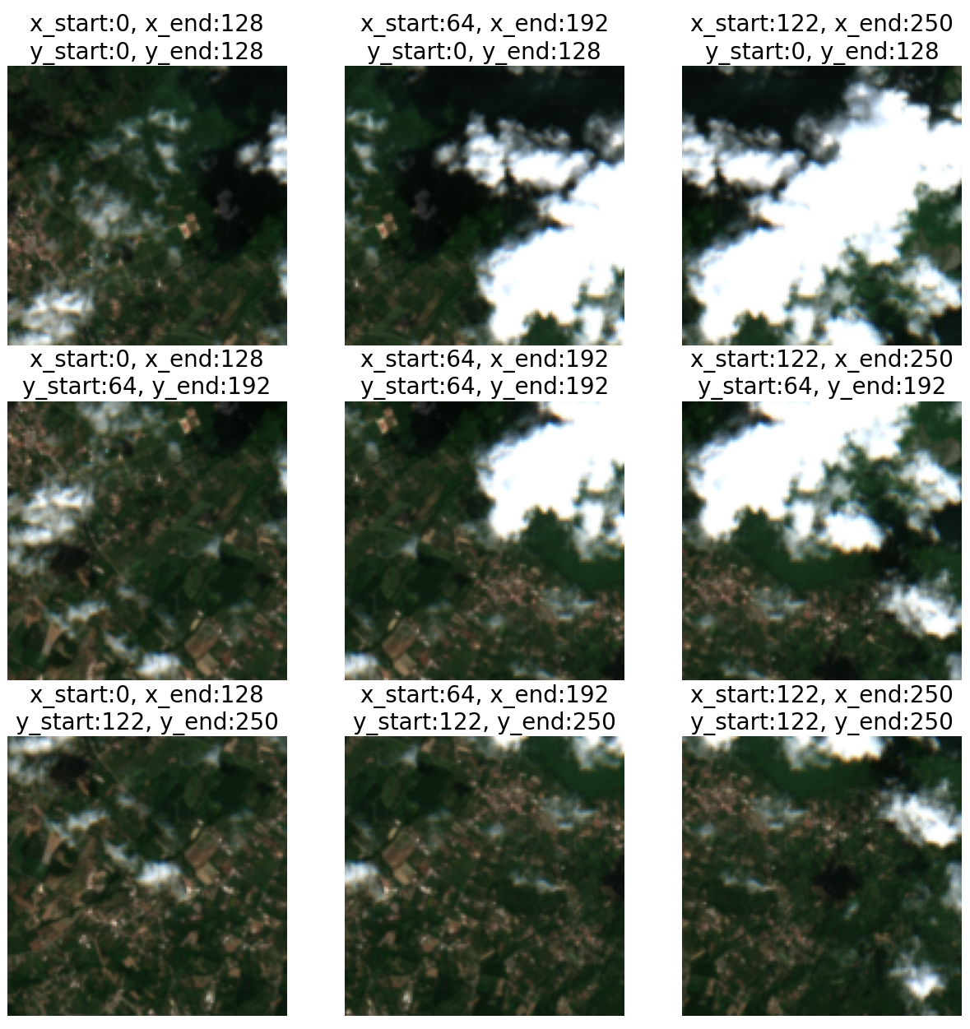
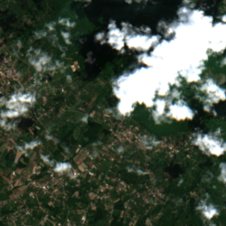
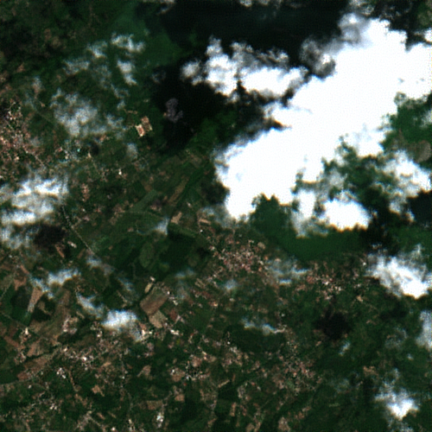
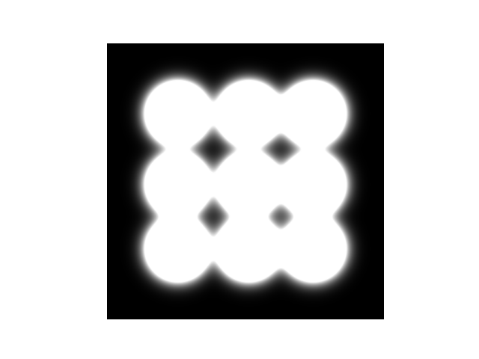








INTRODUCTION
With generative AI, we can perform multiple tasks on remote sensing images. The following are the ones that were studied in this work:
Generate new images: it is useful in remote sensing because labeled data can be scarce, because we can generate anonymized images for public release, mantaining the confidenciality of the original data and also to reduce the need for frequent satellite surveys which are expensive.
Image super resolution: Multispectral images provide detailed information about the composition and condition of the Earth's surface but typically have lower spatial resolution compared to panchromatic images. Enhancing these images by inferring the missing spectral bands from the highresolution panchromatic images would be highly beneficial.
SAR to NDVI: NDVI images can be affected by bad weather conditions, such as clouds obstructing the view of the ground from the satellite. In contrast, SAR images use radar to capture data, making them available regardless of weather conditions. We can leverage generative AI to infer NDVI information from the corresponding SAR images.
DIFFUSION MODELS
Forward step
$x_{t}= \sqrt{\overline{α_{t}}} x_{0}+\sqrt{1−\overline{α_{t}}}$ $ε$
$q\left(x_{t} | x_{0}\right)=N(x_{t};$ $\sqrt{\overline{α_{t}}} x_{0}$, ($1−\overline{α_{t}}$)I)
😎
😎
😎
😎
…
Backward step
$x_{t−1}=\frac{1}{\sqrt{α_{t}}}\left(x_{t}−\frac{1−α_{t}}{\sqrt{1−\overline{α_{t}}}}ε_{θ}\left(x_{t},t\right)\right)+$ $\sqrt{β_{t}}ε$
$$X_{0}$$
$$X_{1}$$
$$X_{2}$$
$$X_{T−2}$$
$$X_{T−1}$$
$$X_{T}$$
😀
😌
🤔
😥
Ends with high
quality sample
Easier as there is
less and less noise
Not easy but some
clues appear
Starting the reverse
process is hard
$$p_{θ}\left(x_{\left\{t−1\right\}} | x_{t}\right)=N(x_{\left\{t−1\right\}};μ_{θ}\left(x_{t},t\right),Σ_{t})$$
AGGREGATION SAMPLING
SUPER RESOLUTION
IMAGES

