Slide 1
UNet base (no super-resolution)

Slide 2


t
Pos Encoding
Time MLP
Relu
y
Label Embedding
Conv2D
Conv2D
Conv2D
Conv2D
Downsample
Batch Norm
Batch Norm
ATTENTION
DECODER
DECODER
Conv2D
Batch Norm
Upsample
Conv2D
ENCODER
CONCATENATE
Batch Norm
ENCODER
Relu
Relu
Relu
Relu
ENCODER
DECODER

Slide 3
UNet for super-resolution

Slide 4

t
Pos Encoding
Time MLP
Relu
LR
Encoding
Interpolation
Conv2D
Conv2D
Conv2D
Conv2D
Conv2D
Downsample
Batch Norm
Batch Norm
ATTENTION
DECODER
DECODER
Conv2D
Batch Norm
Upsample
Conv2D
ENCODER
CONCATENATE
Batch Norm
ENCODER
Relu
Relu
Relu
Relu
ENCODER
DECODER
Conv2D

Slide 5





ATTENTION
$$W_{}:1x1x1$$
Conv2D
=
Batch Norm
$$ψ:1x1x1$$
=
Conv2D
Where 1x1x1 is the
convolution with
kernel_size = 1x1
stride = 1
g
$$W_{g}:1x1x1$$
Relu
$$ψ:1x1x1$$
Sigmoid
Channel Repetition
Interpolation
x
$$W_{x}:1x1x1$$

Slide 6
UNet for super-resolution concatenation
NOT WORKING WELL

Slide 7
t
Pos Encoding
Time MLP
Relu
LR
Encoding
Interpolation
CONCATENATE
Conv2D
Conv2D
Conv2D
Conv2D
Downsample
Batch Norm
Batch Norm
ATTENTION
DECODER
DECODER
Conv2D
Batch Norm
Upsample
Conv2D
ENCODER
CONCATENATE
Batch Norm
ENCODER
Relu
Relu
Relu
Relu
ENCODER
DECODER
Conv2D

Slide 8
UNet for super-resolution 2 (Attention Unet)

Slide 9
t
Pos Encoding
Time MLP
Relu
LR
Encoding
Interpolation
Conv2D
Conv2D
Conv2D
Upsample
Conv2D
Batch Norm
Batch Norm
Downsample
Downsample
Downsample
CONCATENATE
DECODER
Conv2D
Conv2D
ENCODER
BOTTLENECK
Conv2D
DECODER
ENCODER
Batch Norm
Relu
Relu
ATTENTION
Relu
ENCODER
DECODER
Conv2D
BOTTLENECK
=
ENCODER

Slide 10
UNet for super-resolution 3 (Residual Attention Unet)

Slide 11
t
Pos Encoding
Time MLP
Relu
LR
Encoding
Interpolation
Conv2D
Conv2D
Conv2D
Conv2D
Upsample
Batch Norm
Batch Norm
Downsample
Downsample
Downsample
Batch Norm
CONCATENATE
DECODER
Conv2D
Conv2D
ENCODER
BOTTLENECK
Conv2D
DECODER
ENCODER
Relu
Relu
ATTENTION
Relu
Conv2D
DECODER
Batch Norm
ENCODER
Conv2D
BOTTLENECK
=
ENCODER

Slide 12
t
Pos Encoding
Time MLP
Relu
LR
Encoding
Interpolation
Conv2D
Conv2D
Conv2D
Conv2D
Upsample
Batch Norm
Batch Norm
Downsample
Downsample
Downsample
Batch Norm
CONCATENATE
DECODER
Conv2D
Conv2D
ENCODER
BOTTLENECK
Conv2D
DECODER
ENCODER
Relu
Relu
ATTENTION
Relu
Conv2D
DECODER
Batch Norm
ENCODER
Conv2D
BOTTLENECK
=
ENCODER

Slide 13
Pos Encoding
Time MLP
t
Relu
LR
Encoding
Interpolation
Conv2D
Down
Down
Down
DECODER
DECODER
ENCODER
ENCODER
ENCODER
DECODER
Conv2D
BOTTLENECK
Conv2D
Conv2D

Slide 14
Relu
Relu
Batch Norm
Conv2D
Conv2D
Upsample
Conv2D
Batch Norm
Batch Norm
Conv2D
Relu
CONCATENATE
Relu
Relu
Batch Norm
Conv2D
Upsample
Conv2D
ATTENTION
Batch Norm
CONCATENATE
Conv2D
Relu
ATTENTION
Conv2D
DECODER
=
ENCODER
BOTTLENECK

Slide 15
UNet for super-resolution 3-bis (Residual Attention Unet)

Slide 16
t
Pos Encoding
Time MLP
Relu
LR
Encoding
ENCODER
Interpolation
Conv2D
Conv2D
Conv2D
Conv2D
Downsample
Downsample
DECODER
Conv2D
Batch Norm
Batch Norm
Downsample
Normalization
Interpolation
Interpolation
Conv2D
Conv2D
ENCODER
BOTTLENECK
Batch Norm
DECODER
ENCODER
Interpolation
CONCATENATE
Relu
Relu
MultiHeadAtt
Relu
Conv2D
DECODER
Batch Norm
ENCODER
Conv2D
BOTTLENECK
=
ENCODER

Slide 17
UNet for super-resolution 4 (Multihead Residual-Attention Unet)

Slide 18
t
Pos Encoding
Time MLP
Relu
LR
Encoding
ENCODER
Interpolation
Conv2D
Conv2D
Conv2D
Conv2D
Downsample
Downsample
DECODER
Conv2D
Batch Norm
Batch Norm
Downsample
Normalization
Interpolation
Interpolation
Conv2D
Conv2D
ENCODER
BOTTLENECK
Batch Norm
DECODER
ENCODER
Interpolation
CONCATENATE
Relu
Relu
MultiHeadAtt
Relu
Conv2D
DECODER
Batch Norm
ENCODER
Conv2D
BOTTLENECK
=
ENCODER

Slide 19
UNet for new data generation (Residual-Attention Unet)

Slide 20
t
Pos Encoding
Time MLP
Relu
y
Label Embedding
Conv2D
Conv2D
Conv2D
Upsample
Batch Norm
Batch Norm
Downsample
Downsample
Downsample
Batch Norm
CONCATENATE
DECODER
Conv2D
Conv2D
ENCODER
BOTTLENECK
Conv2D
DECODER
ENCODER
Relu
Relu
ATTENTION
Relu
Conv2D
DECODER
Batch Norm
ENCODER
Conv2D
BOTTLENECK
=
ENCODER

Slide 21
UNet for new super-resolution 5 (Residual-Attention Unet style DiffiT)

Slide 22
Time MLP
Swish - GN
SELF-ATTENTION
Conv2D

Slide 23
UNet for SAR_TO_NDVI (Residual-Attention Unet)

Slide 24
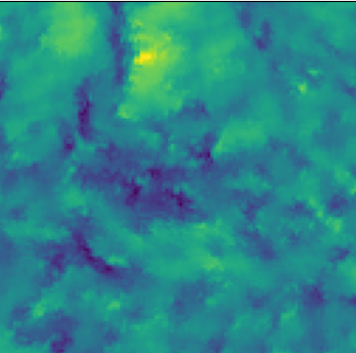
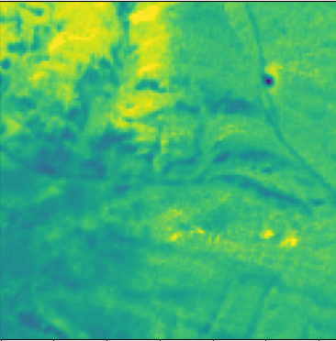
t
Pos Encoding
Time MLP
Relu
SAR
Encoding
Conv2D
Conv2D
Conv2D
Conv2D
Upsample
Batch Norm
Batch Norm
Downsample
Downsample
Downsample
Batch Norm
CONCATENATE
DECODER
Conv2D
Conv2D
ENCODER
BOTTLENECK
Conv2D
DECODER
ENCODER
Relu
Relu
ATTENTION
Relu
Conv2D
DECODER
Batch Norm
ENCODER
Conv2D
BOTTLENECK
=
ENCODER

