Slide 1
Forecasting the Solar Wind 72 Hours Ahead
SOLAR WIND FORECASTING
ACE · L1
Results and submission recommendation for our tournament entry
FDL BenchLab Solar Wind Prediction Tournament 2026 · Results review, 1 November 2026
Notes:
Results of our entry and the recommendation for the submission: a gradient-boosted hybrid model that forecasts ACE hourly solar-wind speed 72 hours ahead.

Slide 2




A hybrid booster beats every baseline, ready to ship
EXECUTIVE SUMMARY
BOTTOM LINE
Beats every baseline from 10 h on
72-hour RMSE of 91 km/s against 129 km/s for persistence
−23%
Solar images add real skill
error vs persistence
Coronal holes cut RMSE by 3.4 km/s overall and 5.5 km/s at 72 h
Test RMSE 75.3 km/s vs 97.8 km/s over 4,105 forecasts, Jan 2024 – Oct 2026, never used for training or tuning.
The learner is not the lever
Five boosting libraries land within 2 km/s; tuning adds 0.3
RECOMMENDATION
Submit the tuned LightGBM hybrid, with persistence for the first ~10 hours.
One open risk: the metric
Pooled TIMSE rewards over-forecasting; aggregation to confirm
Notes:
Four messages: the hybrid clearly beats the baselines; the solar images are worth their complexity; further gains will not come from swapping the learning library; and the official metric must be clarified before optimizing for it.

Slide 3




72-hour forecasts every 6 hours on 15 CPU minutes
THE CHALLENGE
72 h
6 h
15 min
TIMSE
Forecast horizon
Issuance cadence
CPU budget
Official metric
Hourly ACE solar-wind speed at L1, 72 values per issuance
A stateless Docker container is run by the organizers
Per run, CPU only: the model must be light to evaluate
Threshold-integrated MSE in (km/s)³: weights errors in fast wind
1 Nov Submission (today)
1–10 Nov Pre-deployment
11 Nov Live scoring starts
Notes:
Every 6 hours the organizers run our container with the data available at that time. It must return 72 hourly speeds within 15 minutes of CPU time.

Slide 4



One model fuses solar images, rotation and L1 data
APPROACH
L1 plasma (ACE)
Last speed and its age; 6, 24 and 72 h means; 24 h max and trend; density, temperature
Gradient-boosted trees
72 h
27-day recurrence
Speed one and two solar rotations before each target hour
One model for all 72 lead hours
51 features · 1.15 M training pairs
hourly speed forecast
Coronal holes (AIA 193 Å)
Dark-area fraction in six 15° longitude strips, images 0, 24 and 48 h old
Strictly causal: every input stops at t₀ − 1 h, the data latency in operations
Notes:
Each training row is one (issuance, lead hour) pair, with the lead hour as a feature. Train Feb 2011 – Dec 2021, validation 2022–2023, test Jan 2024 – Oct 2026 (appendix). A unit test checks that changing any data after the cutoff leaves the features unchanged.

Slide 5
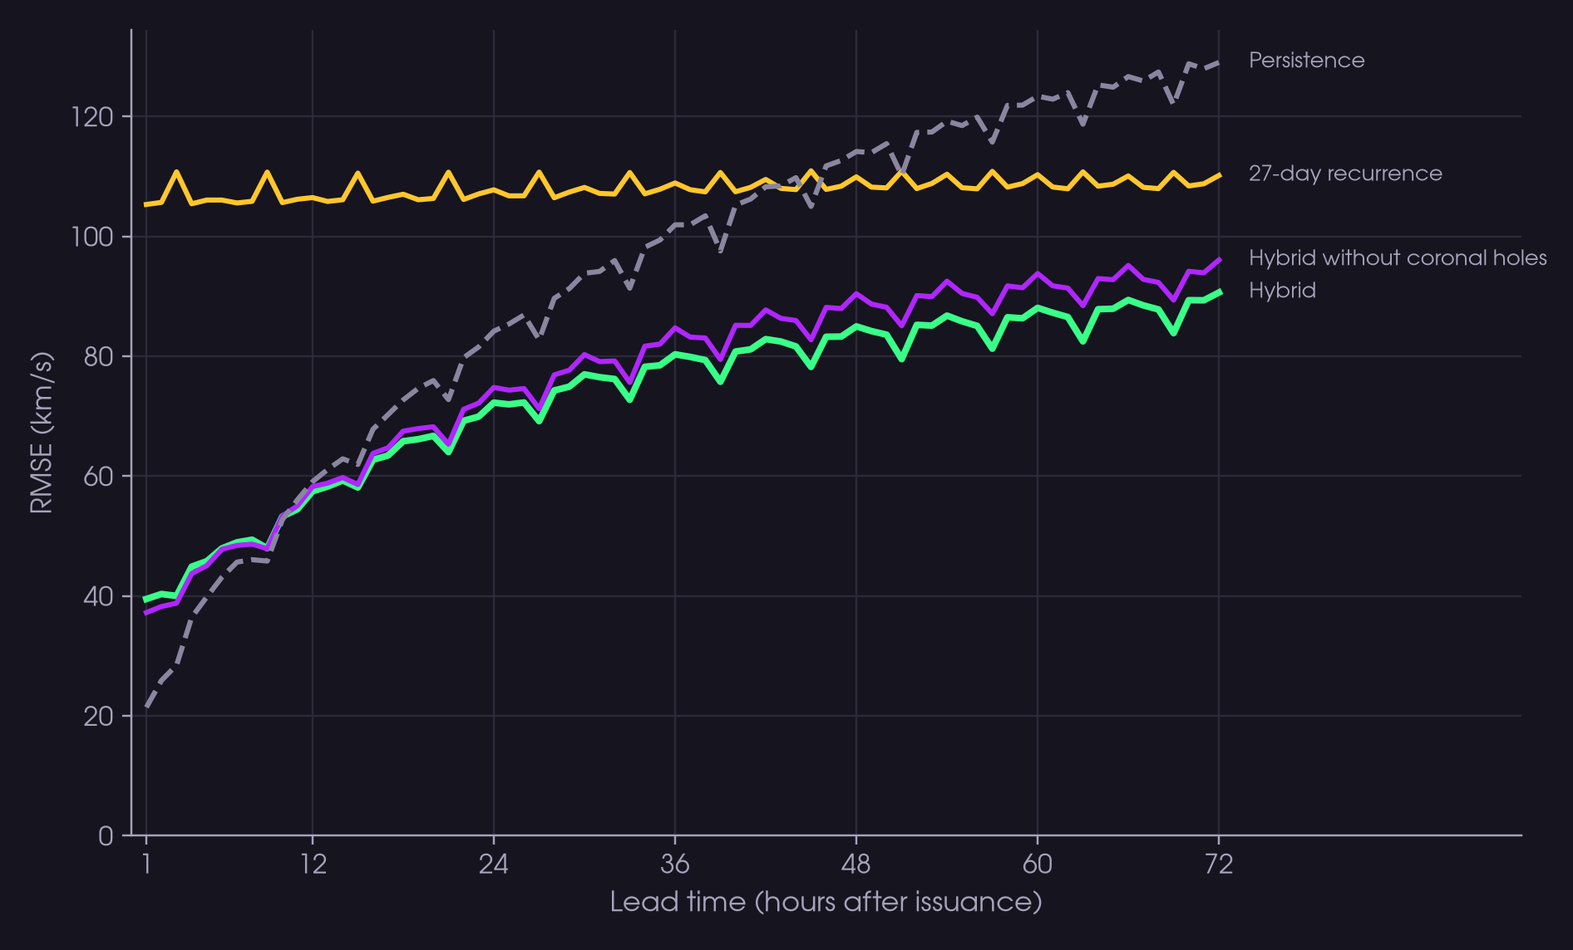
The hybrid cuts 72-hour error by 30% vs persistence
ACCURACY
91 vs 129
km/s RMSE at 72 h: hybrid against persistence
10 h
crossover: before it, persistence wins (21 vs 40 km/s at 1 h)
SO WHAT
Use persistence for leads under 10 h in the submission.
Test period Jan 2024 – Oct 2026, 4,105 issuances every 6 h. Hybrid = tuned LightGBM.
Notes:
Persistence is hard to beat in the first hours because the wind changes slowly; after about 10 hours the hybrid is the best model at every lead. Recurrence is flat around 105–110 km/s.

Slide 6
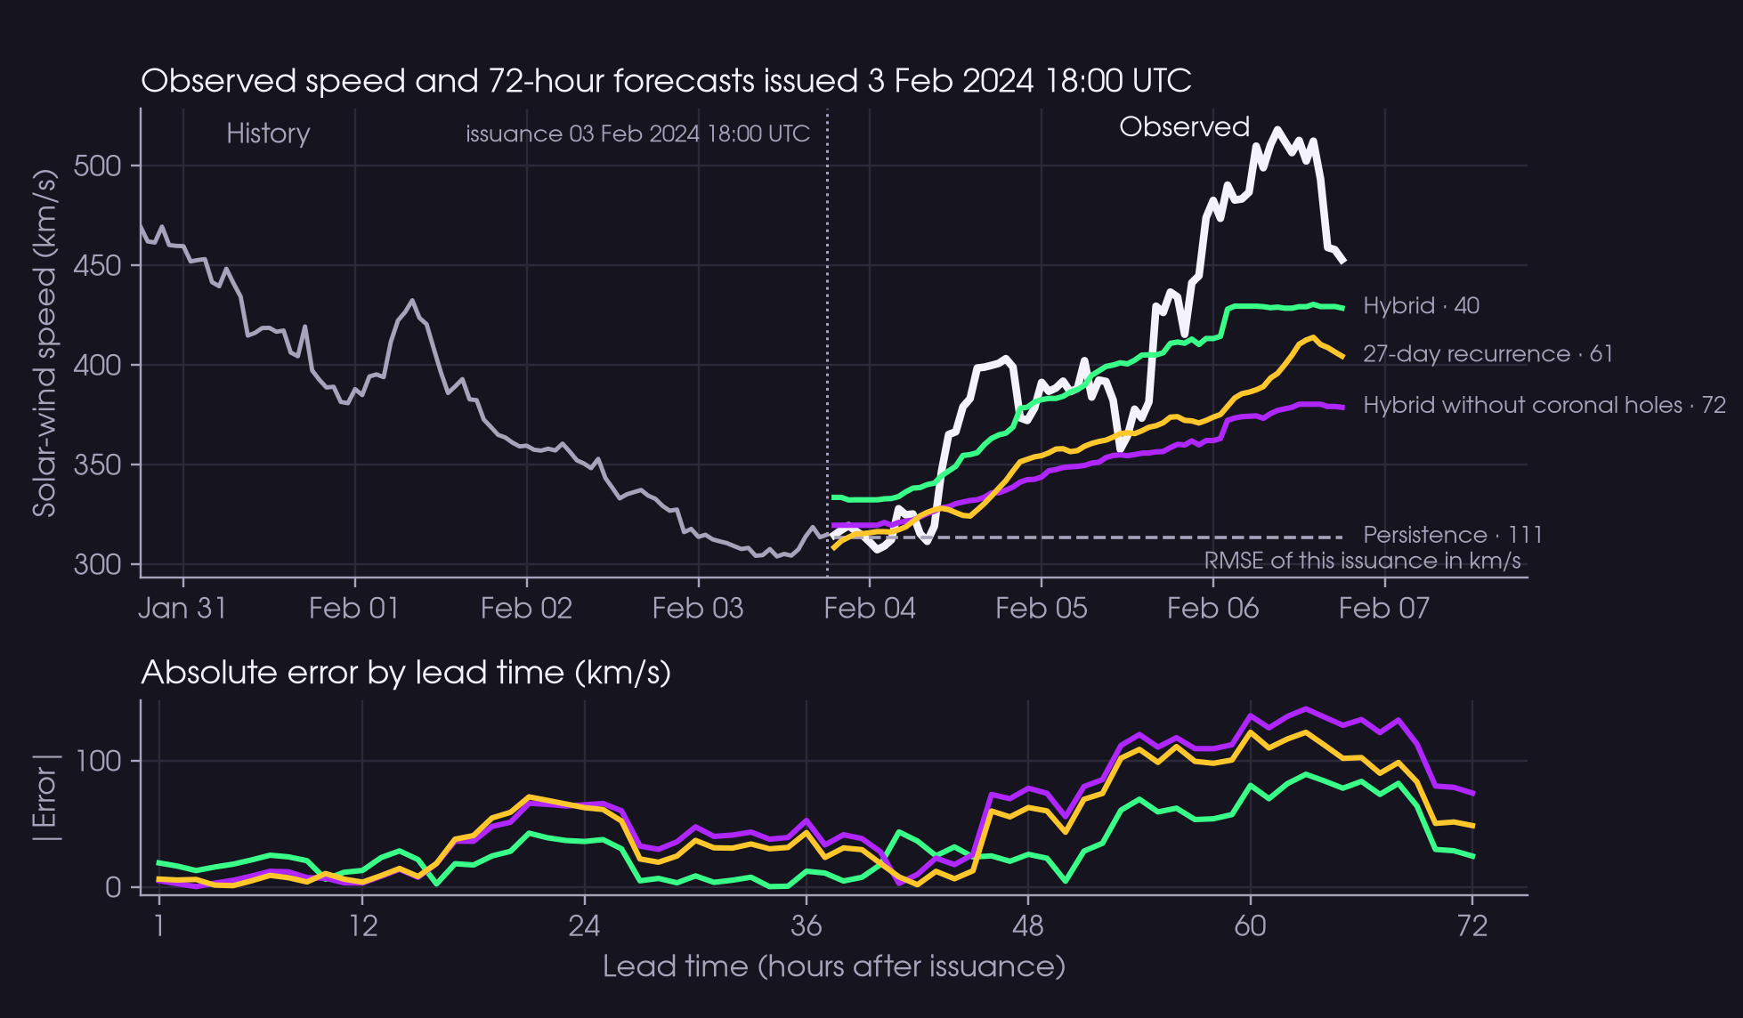
The model anticipates a fast-wind stream days ahead
CASE STUDY
40 km/s
hybrid RMSE, against 111 for persistence
72 km/s
same model without the solar images
SO WHAT
The coronal hole was visible on the Sun before the stream reached L1.
Forecast issued 3 Feb 2024 18:00 UTC, test period. Labels show the RMSE of this issuance in km/s.
Notes:
Chosen as the issuance with the largest coronal-hole gain among fast-wind arrivals; across the 41 such arrivals the median gain is 5 km/s and 66% of them improve. Persistence cannot anticipate the rise; recurrence sees it partly.

Slide 7
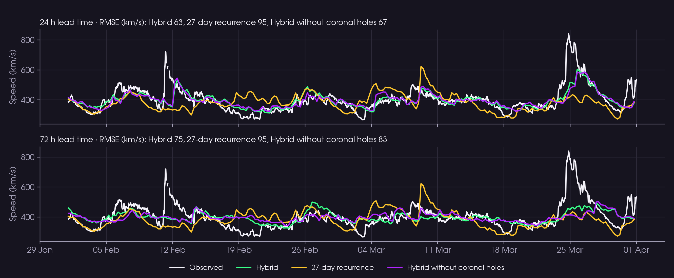
Two months of forecasts track the wind at 24 and 72 h
TRACK RECORD
1 Feb – 31 Mar 2024, test period. Each point is one 6-hourly issuance verified at a fixed lead time; panel titles give RMSE in km/s.
Notes:
At 24 h the hybrid follows most stream arrivals; at 72 h it still captures the timing of recurrent streams but underestimates peaks such as 25 March, a transient event that no input announces days ahead.

Slide 8
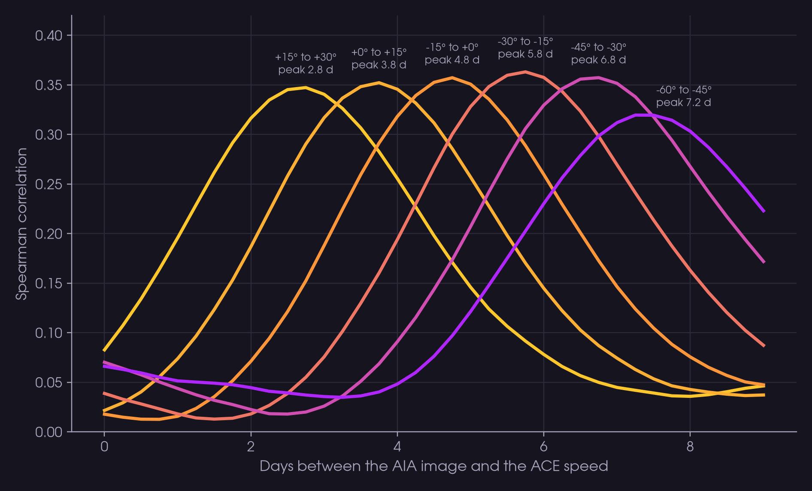
Coronal holes signal fast wind 3 to 7 days ahead
WHY IT WORKS
~1 day
later peak for every 15° strip further east, as the Sun rotates
−3.4 km/s
RMSE from the solar images (95% CI 1.4–5.5); −5.5 at 72 h
SO WHAT
The images pay most at long leads, where L1 data say least.
Spearman correlation of hole area per 15° longitude strip with later ACE speed, 2011–2026 (east = negative).
Notes:
Pixels are projected to heliographic coordinates with area weights. The lag matches solar rotation (13° per day) plus the transit to L1. The gain is consistent across all five libraries (2.1 to 3.4 km/s).

Slide 9
Five boosting libraries land within 2 km/s
MODEL CHOICE
≤ 0.7
km/s between XGBoost, HGB, LightGBM and CatBoost
+0.3
km/s from tuning: 75.6 → 75.3 (95% CI −0.3 to 1.0)
SO WHAT
Invest in inputs and the metric, not in the learner.
Same features, splits and tree size for every library; only LightGBM was tuned (40-trial random search).
Notes:
XGBoost is 0.6 km/s better than default LightGBM (CI 0.1 to 1.1); the other differences are not significant. NGBoost trades 1–2 km/s for a predicted spread and needs 2 hours to train.

Slide 10
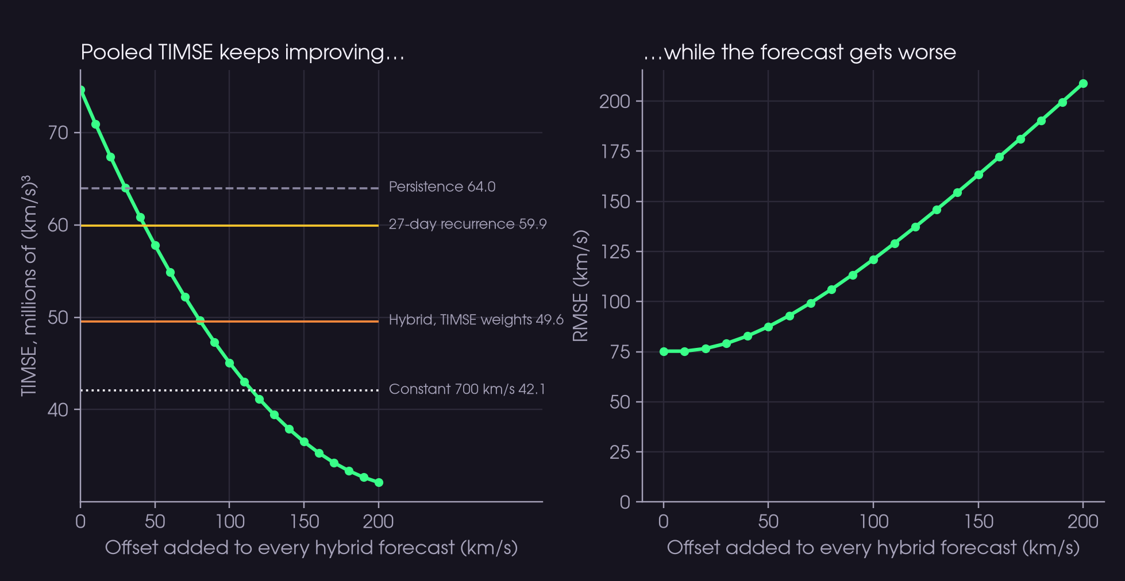
Pooled TIMSE rewards over-forecasting
RISK
42.1 M
TIMSE of a constant 700 km/s, better than the hybrid (74.6 M)
75–88%
of the score from thresholds above 700 km/s, 1.7% of hours
SO WHAT
Confirm the aggregation; keep the MSE model meanwhile.
Hybrid forecasts on the full test period plus a constant offset; TIMSE pooled over all hours.
Notes:
TIMSE integrates the tail MSE over speed thresholds. Pooled over the whole period it is dominated by a few extreme events, so pushing forecasts up reduces it. Scored per issuance, the bias stops paying.

Slide 11
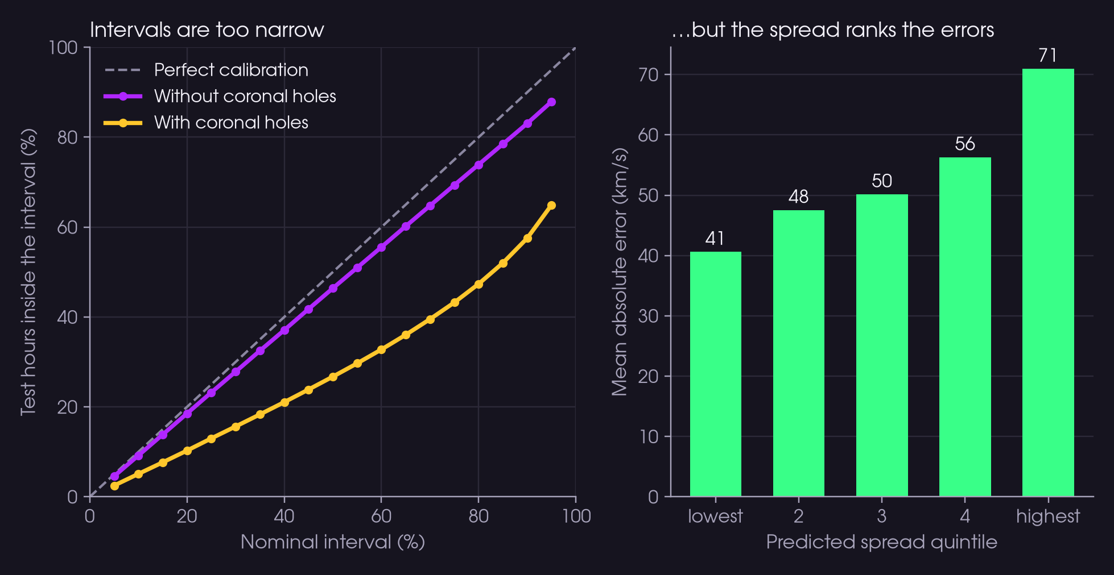
The spread ranks errors, but intervals are too narrow
UNCERTAINTY
65%
of hours fall inside the nominal 95% interval
41 → 71
km/s error from the lowest to the highest spread quintile
SO WHAT
Recalibrate the spread on 2022–2023 before use.
NGBoost hybrid with a normal distribution per hour, test period Jan 2024 – Oct 2026.
Notes:
The spread is informative but too narrow, especially with coronal-hole features: median spread 27 km/s against a mean absolute error of 53. The model hit the 2000-iteration cap, which likely over-sharpens the scale.

Slide 12

Submit the tuned hybrid today, then de-risk
RECOMMENDATION
DECISION
Ship the tuned LightGBM hybrid in the container, with persistence for leads under 10 h.
Today · 1 Nov
1–10 Nov
Before 11 Nov
After launch
01
02
03
04
Package and submit
Verify real-time inputs
Settle the metric
Add calibrated uncertainty
Replace the starter-kit example; check the run fits the 15-minute CPU budget
Compare near-real-time AIA features with the archive used for training
Ask how TIMSE is aggregated: pooled, per issuance or per window
Rescale the NGBoost spread on 2022–2023 and test quantile forecasts
Notes:
The submission pack still holds the starter-kit example, so packaging is the priority today. The other steps reduce risk before and during live scoring.

Slide 13



A clean temporal split, with the test period scored once
APPENDIX · VALIDATION
Train
Validation
Test
Feb 2011 – Dec 2021
2022 – 2023
Jan 2024 – Oct 2026
Fit the trees
Pick trees and hyperparameters
4,105 issuances, scored once
No leakage across splits
Block bootstrap
Operational inputs
Targets of one split end at least 72 h before the next one starts
95% CIs from 39 blocks of 27 days, one solar rotation each
Real-time product only instead of Level 2: RMSE 76.0 → 76.2 km/s
Notes:
After 9 July 2024 the targets come only from the operational SWEPAM product because Level 2 ends.

Slide 14
A 40-trial search moved validation RMSE by under 1 km/s
APPENDIX · TUNING
75.6 → 75.3
km/s test RMSE; 95% CI of the gain −0.3 to 1.0
2 h 19 min
on 32 cores via SLURM; the search resumes after a crash
SO WHAT
Best: step 0.03, 63 leaves, 500 per leaf, half the features per tree.
Green: best trial. Yellow: reference configuration. The axis starts at 67.5 km/s.
Notes:
34 of 40 trials fall between 67.9 and 68.5 km/s. Choosing trees by RMSE instead of TIMSE already moved the reference from 76.3 to 75.6.

