Slide 1
  Development of the SIG – ISAREG Application for Assessing Crop Irrigation Requirements at Regional Scale.
  Application in the Aral Sea Basin
Pedro Santos Fortes
Fevereiro 2003

Slide 2
Model ISAREG
*.OUT
Irrigation scheduling aimed at maximal ET and Yield;
Irrigation scheduling defining the irrigation timings and the application depths, including the application of restrictions in water volumes available and dates when restrictions apply;
Evaluation of a given irrigation scheduling where the irrigation timings and the application depths are known;
Optimization of an irrigation scheduling to cope with limited water supply;
Water balance for a rainfed crop;
Computation of crop irrigation requirements.

Slide 3
Model KCISA
Crop coeficientes for the initial, mid and end crop growth periods (Kc ini, Kc mid and Kc end);
Depletion fraction for no stress (p) for each crop growth period;
Effective root zone depth (Zr) for each crop growth period;
*.CUL
Creates the crop data files for ISAREG;
Creates the soil data files for ISAREG.
*.SOL

Slide 4
Interaction between KCISA and ISAREG
Characteristicsof the cropped fields
Crop irrigation requirements as a function of time
Input files for ISAREG
Meteo.
*.CUL
Soil
KCISA
Crop
ISAREG
*.OUT
*.SOL
Simulation unit
*.ET0
Irrigation Simulation Model
*.PRE

Slide 5
Computation of CIR at the Regional Scale
Scheme of the application SIG-ISAREG, GISAREG
Reading Results
of ISAREG
by the SIG
Themes of input in the SIG
Identification of the Simulation Units by the SIG
Call of Models KCISA and ISAREG
*.OUT
Tema Meteorológico
KCISA
dll
*.OUT
Tema de Solos
ISAREG
dll
*.OUT
Tema Parcelas Agrícolas
Spatial Distribution of CIR
*.OUT

Slide 6
Computation of CIR with the application SIG-ISAREG, GISAREG
1 – Creating spatial e non-spatial data bases
2 – Operating SIG to identify the characteristics of every cropped field realtive to weather, soil and crop (Identification of the Simulation Units)
Meteo.
Soil
Crop
3 – Creation of input files for KCISA through the SIG (KCISA Batch File)
4 – Executing KCISA to create the input files for ISAREG for every de simulation unit
*.CUL
*.SOL
5 – Executing ISAREG in each simulation unit;
*.OUT
6 – Reading results of model simulation and creation of maps relative to irrigation scheduling

Slide 7
Computation of CIR with the application SIG-ISAREG, GISAREG
1 – Creating spatial e non-spatial data bases
2 – Operating SIG to identify the characteristics of every cropped field realtive to weather, soil and crop (Identification of the Simulation Units)
Meteo.
Soil
Crop
3 – Creation of input files for KCISA through the SIG (KCISA Batch File)
4 – Executing KCISA to create the input files for ISAREG for every de simulation unit
*.CUL
*.SOL
5 – Executing ISAREG in each simulation unit;
*.OUT
6 – Reading results of model simulation and creation of maps relative to irrigation scheduling

Slide 8
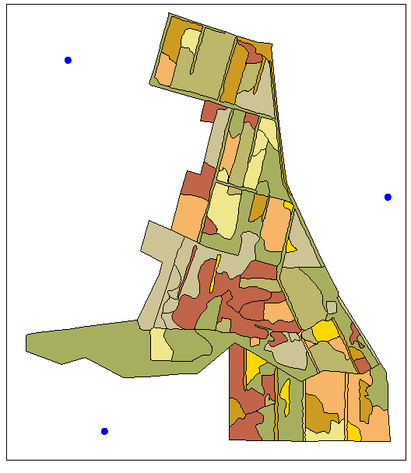
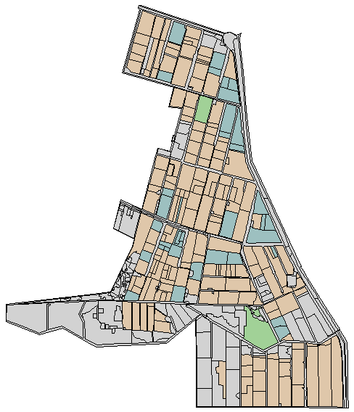
Spatial Input Data
Meteorological points theme and soils polygon theme
Crop fields polygons theme

Slide 9
Non-spatial Data
Meteorological Data stored in text files with format appropriate for ISAREG e KCISA
File *.ETo - reference evapotranspiration (mm/dia);
*.ET0
File *.PRE - precipitation (mm);
*.PRE
File *.VEN – wind velocity (m/s or km/h);
*.VEN
File *.RHI - minimum relative humidity (%),
or *.TPA and *.TPI - max. and min. temperature (ºC);
*.HRI
*.TPA
*.TPI
File *.NDA – number of rainfall (or soil wetting) days.
*.NDA

Slide 10
Non-spatial Data
MS Access data :
Soil Table with columns for the soil identification code and soil data from model KCISA;
Crops Table with columns for the crop identification code and crop data from model KCISA;
Characteristics of Irrigation Methods with columns for the irrigation methods identification code and data relative to model KCISA;
Crop pattern with definition of summer and winter crops that are successively cropped and the respective irrigation methods. Codes identify the crops succession, the winter crop and irrigation method, the summer crop and irrigation method.

Slide 11
Relating the spatial and non-spatial Data Bases
SPATIAL DATA BASE
NON-SPATIAL DATA BASE
ArcView 3.2
MS ACCESS DB
CROPPED FIELDS
CROP PATTERN TABLE
ID_SUC
1
2
3
(...)
ID_Wcrop
6
5
2
(...)
ID_Scrop.
3
4
7
(...)
ID_Wirrig.
1
1
1
(...)
ID_Sirrig.
2
1
4
(...)
(...)
---
---
---
(---)
2
ID_PAR
1
2
3
4
5
6
7
ID_SUC
3
2
1
1
3
2
2
(...)
---
---
---
---
---
---
---
1
3
4
5
6
7
CROPS TABLE
IRRIGATION METHODS TABLE
ID_CROP
1
2
(...)
7
NAME
Algodão
Trigo
Milho
(...)
---
---
---
(---)
ID_IRRIG
1
2
3
4
NAME
Precipit.
Aspersao
Gota-gota
Sulcos
(...)
---
---
---
(---)
SOILS
SOILS TABLE
ID_SOL
1
2
3
(...)
9
NOME
Arenoso
Aren-Franco
Franco
Argiloso
(...)
---
---
---
(---)
3
2
ID_SOL
2
3
(...)
---
---
ASCII METEOROLOGICAL DATA FILES
METEOROLOGICAL
2
ID_MET.
1
2
(...)
---
---
1.PRE
1.RHI
2.RHI
1
1.VEN
2.PRE
2.VEN
1.ET0
1.NDA
2.ET0
2.NDA

Slide 12
Computation of CIR with the application SIG-ISAREG, GISAREG
1 – Creating spatial e non-spatial data bases
2 – Operating SIG to identify the characteristics of every cropped field realtive to weather, soil and crop (Identification of the Simulation Units)
Meteo.
Soil
Crop
3 – Creation of input files for KCISA through the SIG (KCISA Batch File)
4 – Executing KCISA to create the input files for ISAREG for every de simulation unit
*.CUL
*.SOL
5 – Executing ISAREG in each simulation unit;
*.OUT
6 – Reading results of model simulation and creation of maps relative to irrigation scheduling

Slide 13
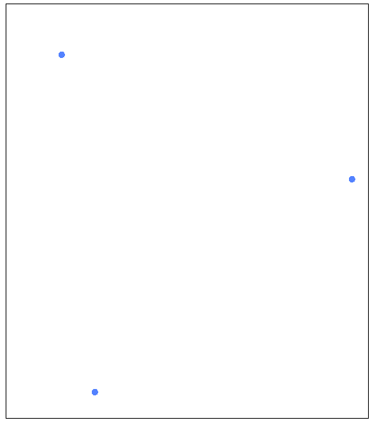
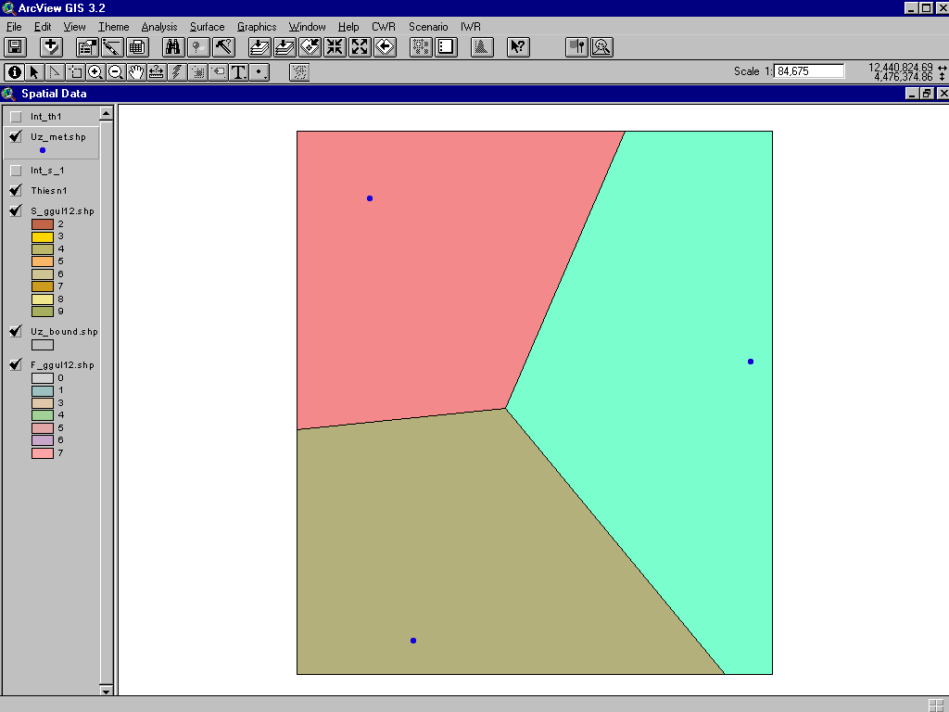
Identification of the Simulation Units
1) Creating the Thiessen poligons
Weather Stations Theme
Superposing the Weather Stations Theme with the Thiessen poligons

Slide 14
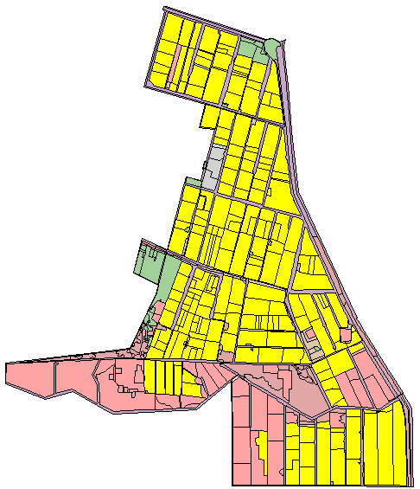
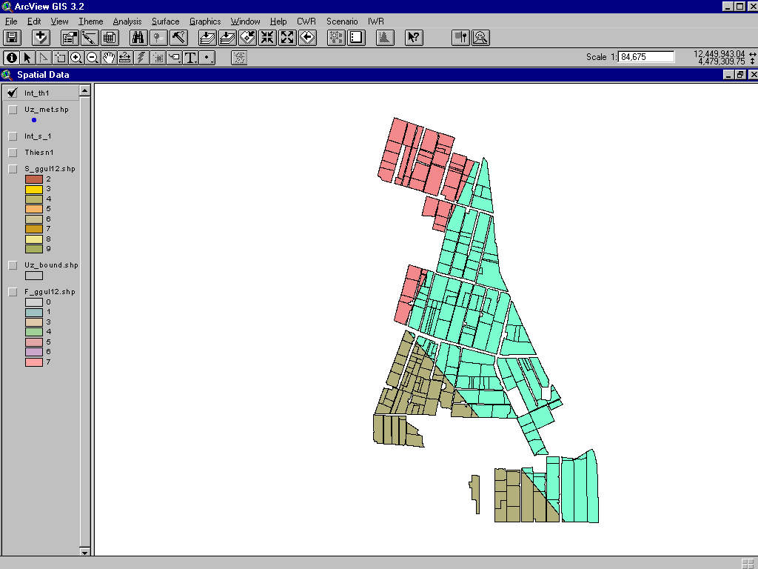
Identification of the Simulation Units
2) Intersecting cropped fields with the Thiessen poligons

Slide 15
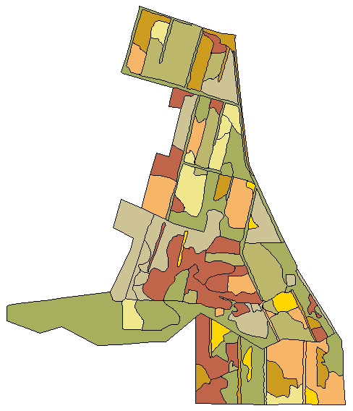
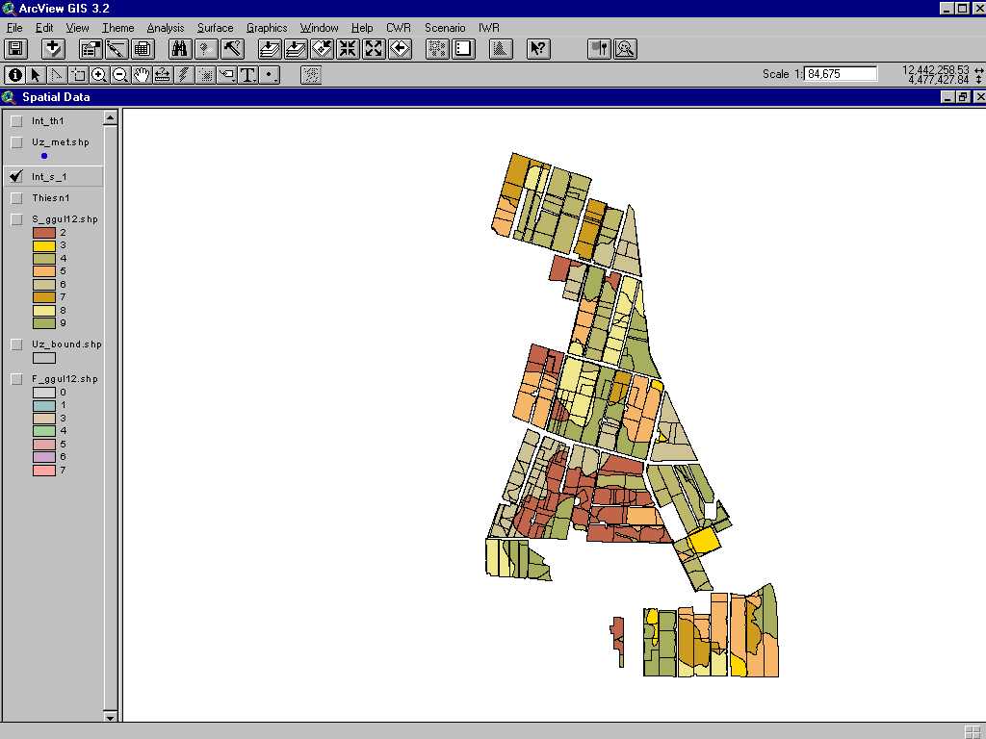
Identification of the Simulation Units
3) Intersecting soils with cropped fields

Slide 16
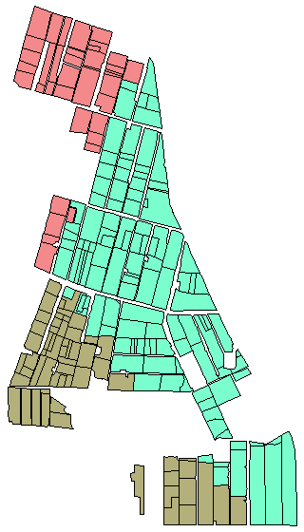
Identification of the Simulation Units
4.1) Identifying the Thiessen poligon dominant in each field

Slide 17
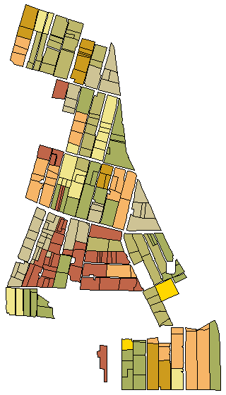
Identification of the Simulation Units
4.2) Identifying the soil dominant in each field

Slide 18
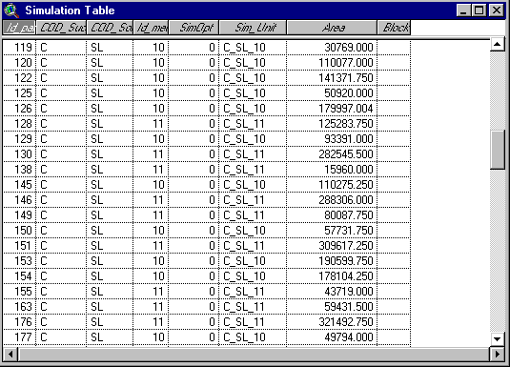
Identification of the Simulation Units
5) Creation of the “Simulation Table” (with the characteristics that prevail in each parcel and the respective Simulation Unit code)

Slide 19
Computation of CIR with the application SIG-ISAREG, GISAREG
1 – Creating spatial e non-spatial data bases
2 – Operating SIG to identify the characteristics of every cropped field realtive to weather, soil and crop (Identification of the Simulation Units)
Meteo.
Soil
Crop
3 – Creation of input files for KCISA through the SIG (KCISA Batch File)
4 – Executing KCISA to create the input files for ISAREG for every de simulation unit
*.CUL
*.SOL
5 – Executing ISAREG in each simulation unit;
*.OUT
6 – Reading results of model simulation and creation of maps relative to irrigation scheduling

Slide 20
Comunication SIG - ISAREG
ID Successive crops: SUC
Example of a Simulation Unit
ID Soil: SOL
ID Meteo station: MET
KCISA
dll
KCISA BATCH FILE
MET.VEN
MET.NDA
MET.RHI
SUC_SOL_MET.CUL
MET.ET0
SIG
SOL.SOL
ISAREG
dll
MET.PRE
ISAREG BATCH FILE
SUC_SOL_MET.OUT

Slide 21
SIG - ISAREG Application
Versão 1.0

Slide 22
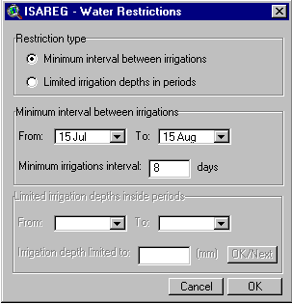
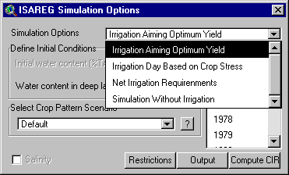
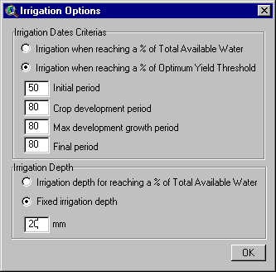
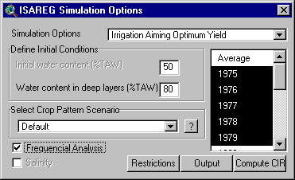
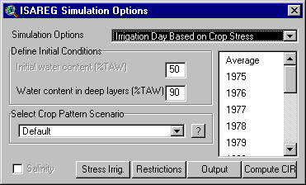
Options considered
Limited water availability
Frequential Analysis of CIR
Irrigation timing and depth

Slide 23
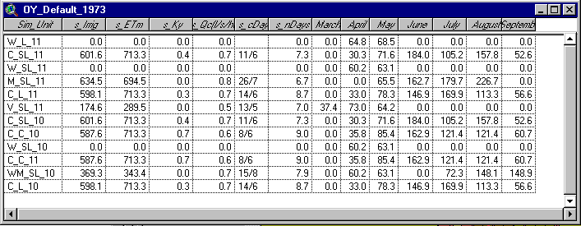
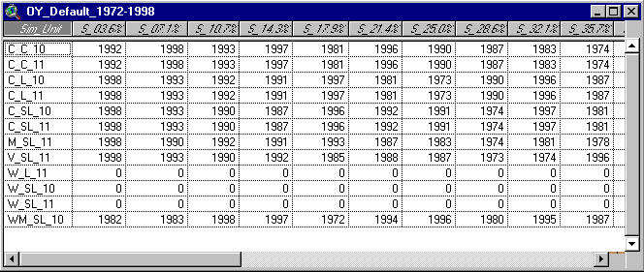
Output tables
maximal yield, 1973, default crop pattern
maximal yield, default crop pattern, frequential analysis,
1972-1998

Slide 24
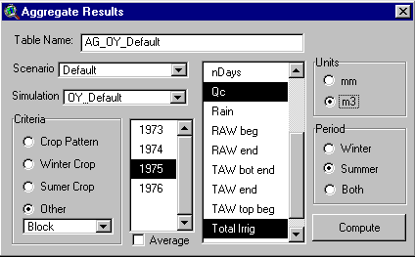
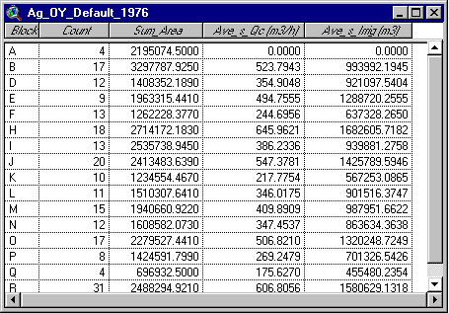
Output windows
Window to generate aggregated results
Table with aggregated results

Slide 25
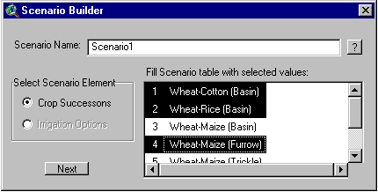
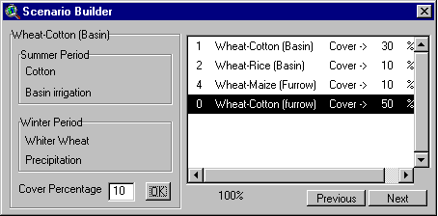
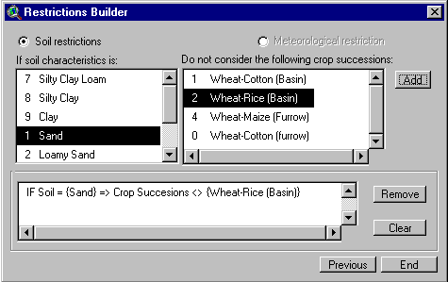
Defining crop pattern scenarios
#2 – Defining the crpping areas
#1 - Selecting crops
#3 – Introducing restrictions

Slide 26
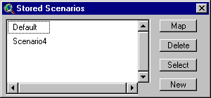
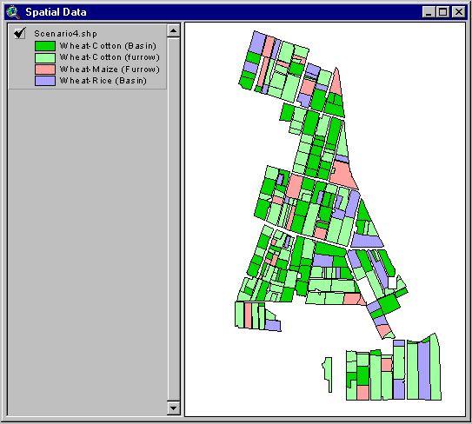
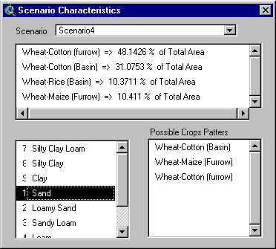
Visualizing characteristics of created scenarios

Slide 27
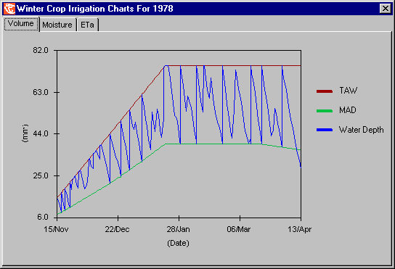
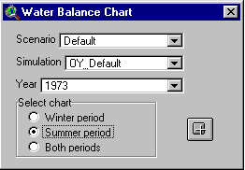
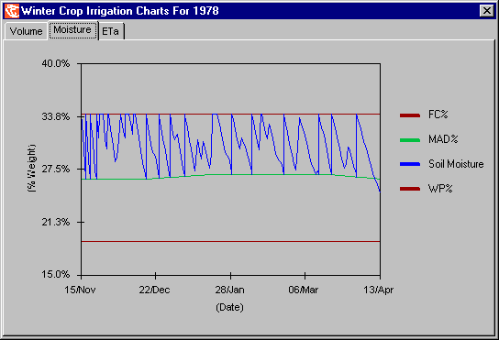
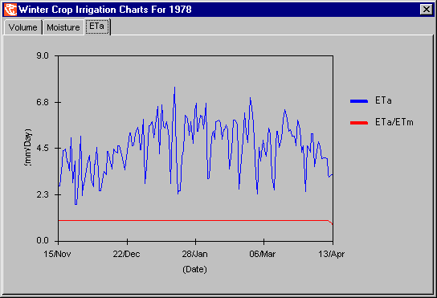
Outputs realtive to several simulation options applied to a simulation unit
Available soil wateralong a crop season
Soil water content along a crop season
ETa and ETa/ETm

Slide 28
  APLICAÇÃO
GISAREG 1.1

Slide 29
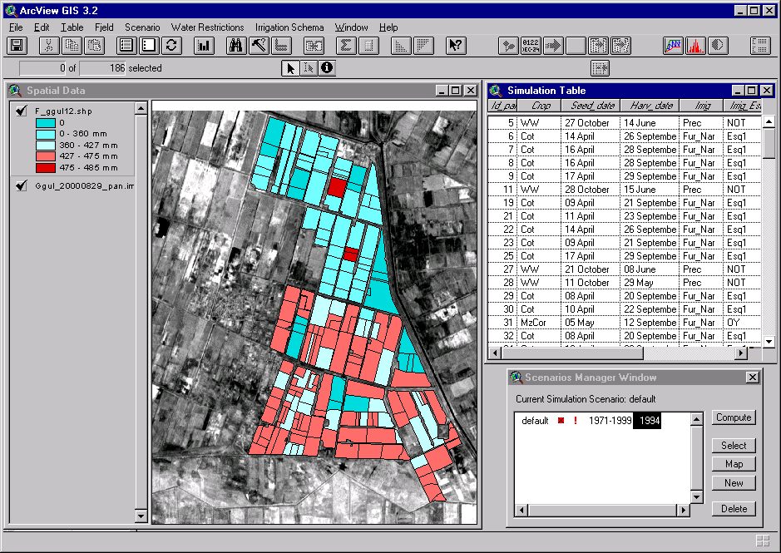
Crop irrigation requirements

