Slide 1





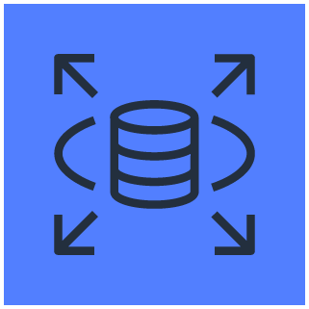




DNS
Private subnet
Public Subnet
Cliente
Cache Hit
Registro user
Security group
Load Balance
CadProd
WAF
WAF
Security group
Security group

