Slide 1

Controler Folder
Security File
Public Folder
Main Controler
Index.html.twig
Discordia

Slide 2
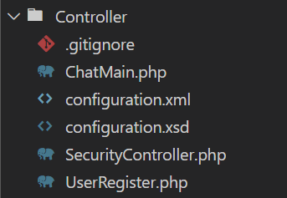
Controler
Folder

Slide 3
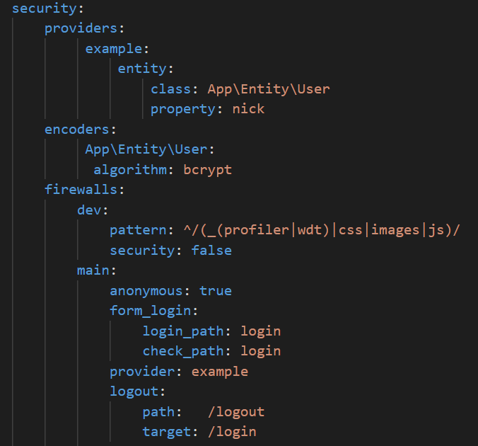
Security
File

Slide 4
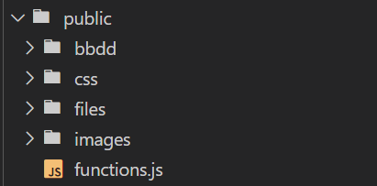
Public
Folder

Slide 5
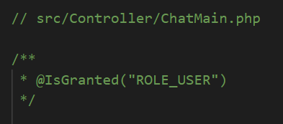
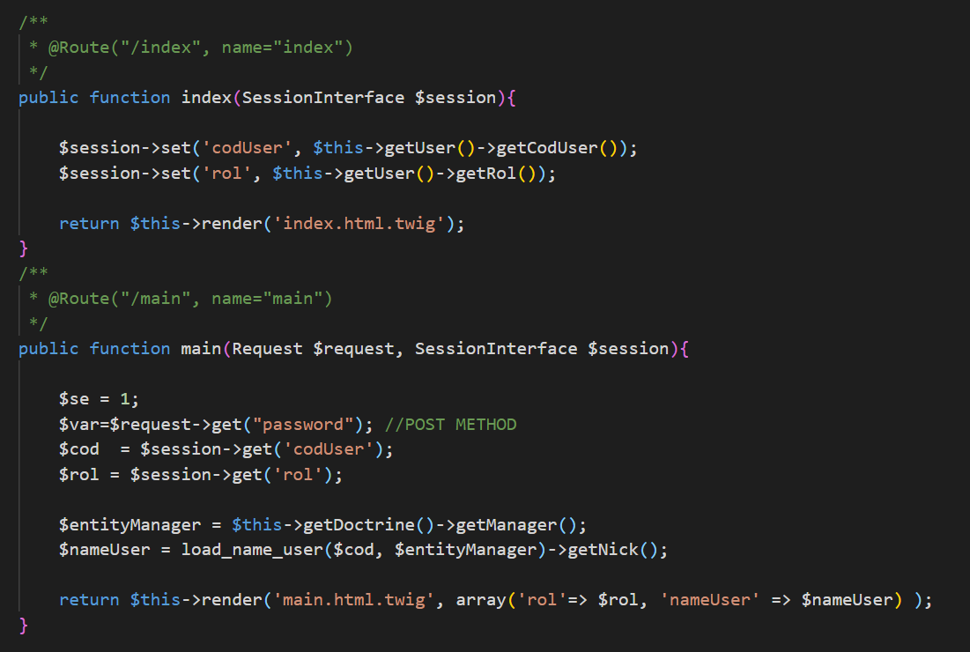
Main
Controler

Slide 6
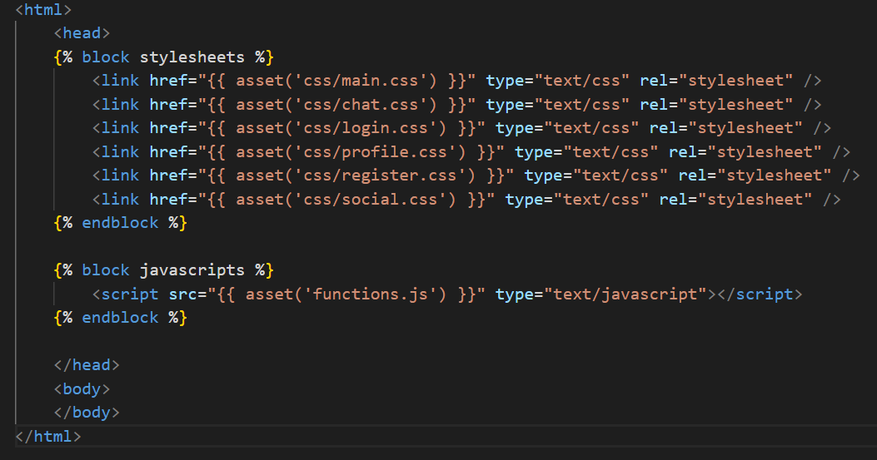
Index.html.twig

Slide 7
DEMO
DANIEL

