Slide 1

TimeSeries Prediction
Adriceda irsia
Hck - 004

Slide 2
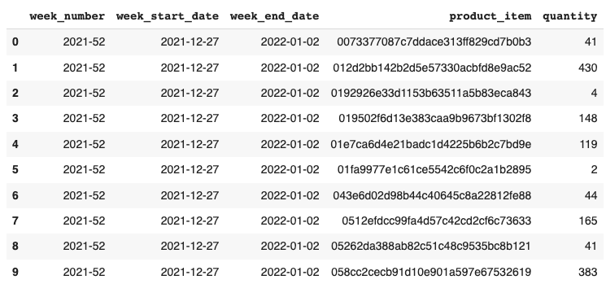
Problem
objective
ParagonCorp wants to optimize its financial management through predicting upcoming product quantity
Perform TimeSeries model to predict the quantity of products in the next time period.

Slide 3
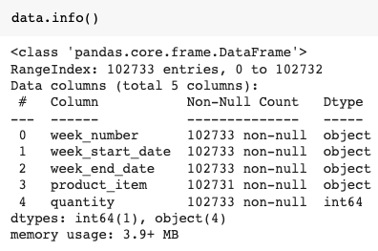

Slide 4
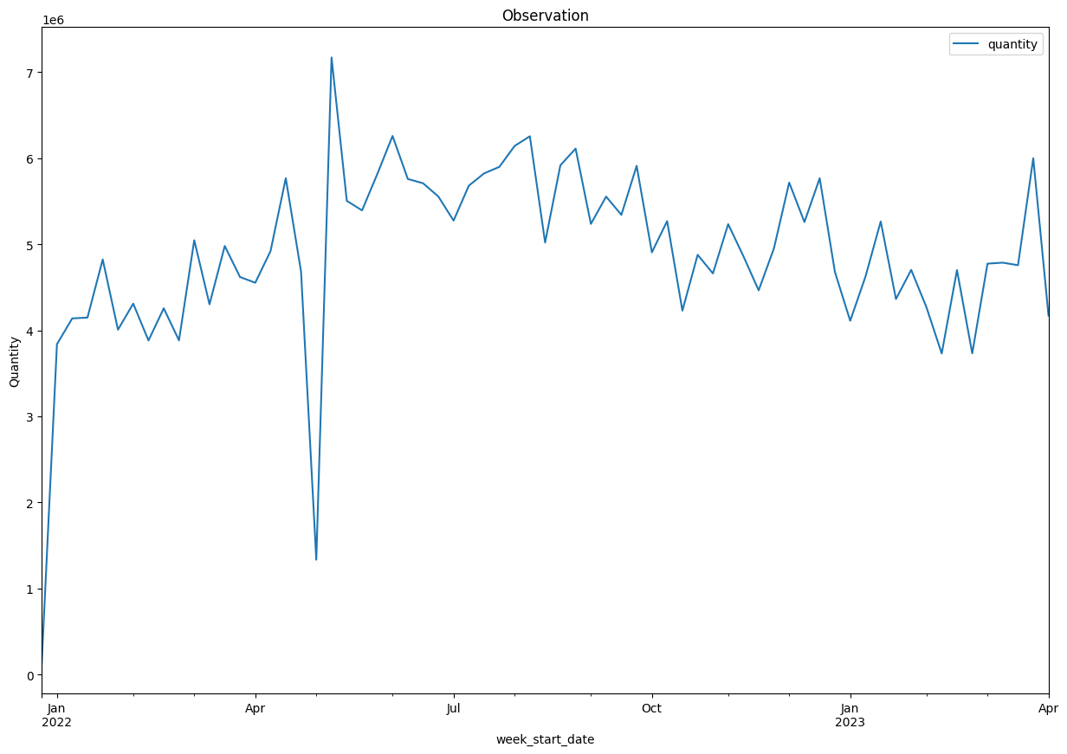

Slide 5
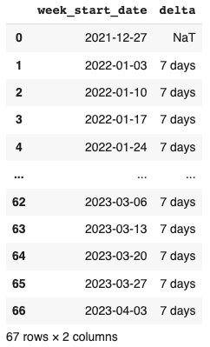
1 Week Intervals

Slide 6

DATA PROCESSING

Slide 7
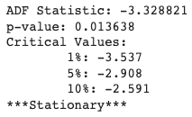
Data processing
DATA
TRAIN
TEST
MODEL
7

Slide 8
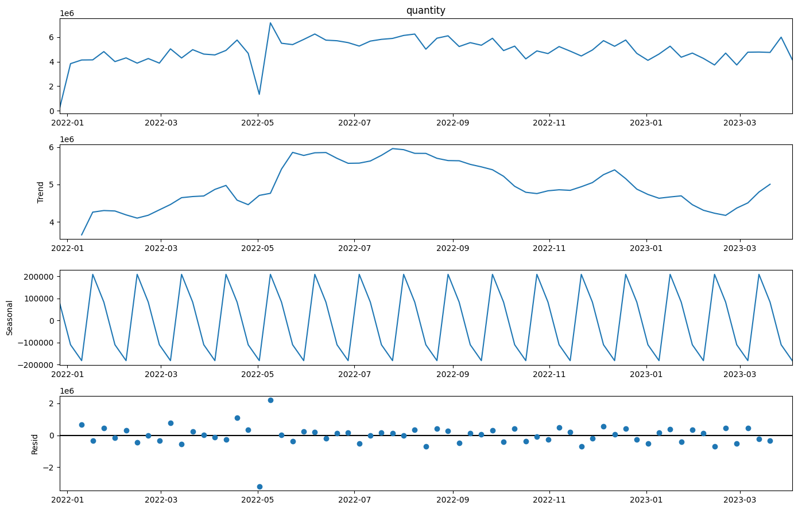
Data processing
Seasonal Decomposition: Additive

Slide 9
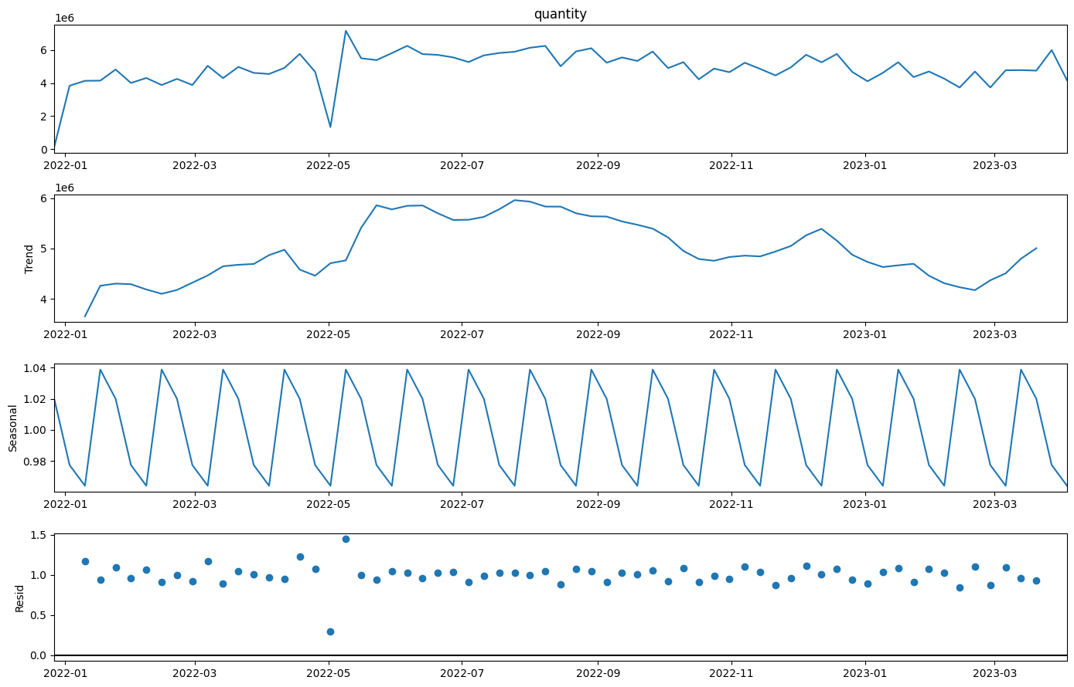
Data processing
Seasonal Decomposition: Multiplicative

Slide 10
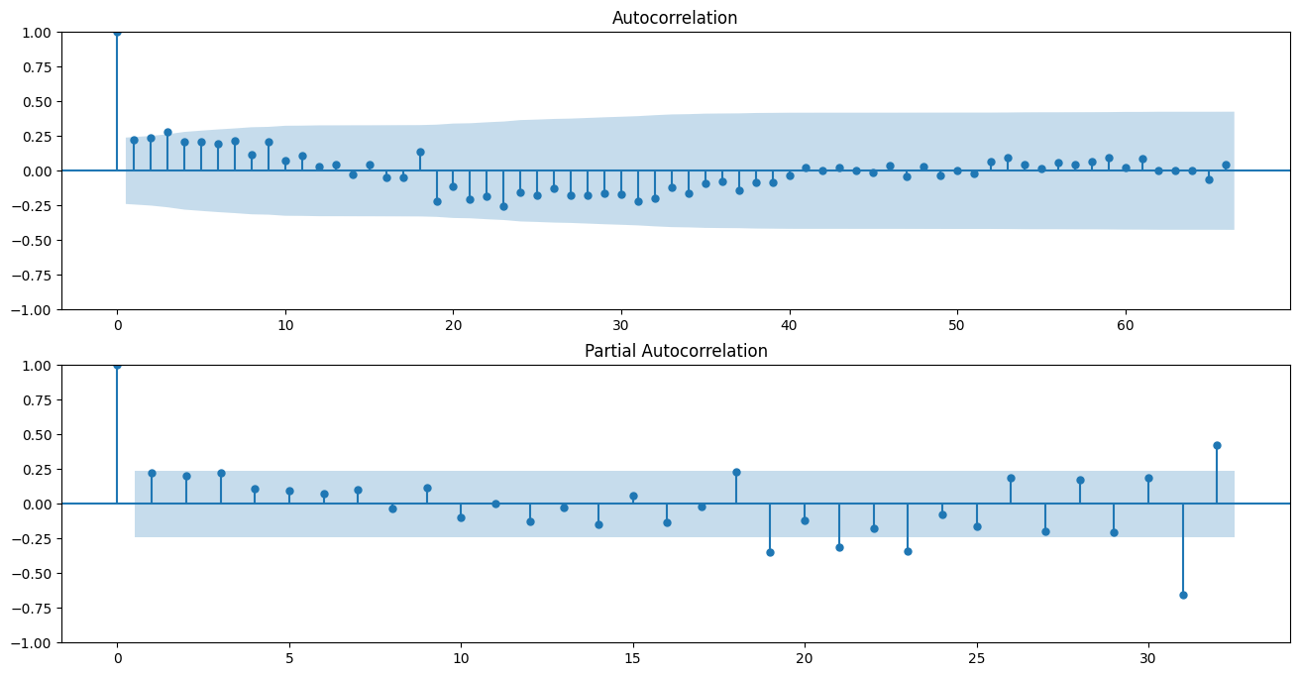
Data processing

Slide 11
MODEL

Slide 12
MODEL
NAÏVE APPROACH
SIMPLE AVERAGE
SIMPLE EXPONENTIAL SMOOTHING
HOLT LINEAR TREND
HOLT-WINTERS
AUTOREGRESSIVE
ARIMA

Slide 13
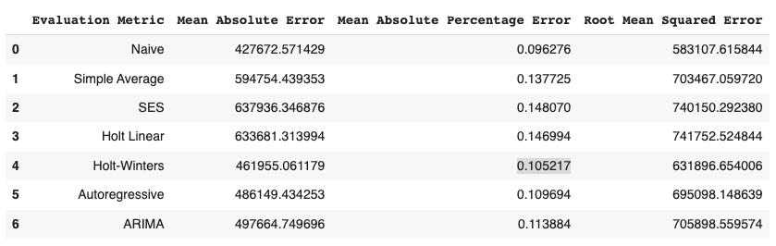
MODEL
1.
5.
7.
6.
2.
3.
4.
1.
4.
6.
7.
2.
3.
5.

Slide 14
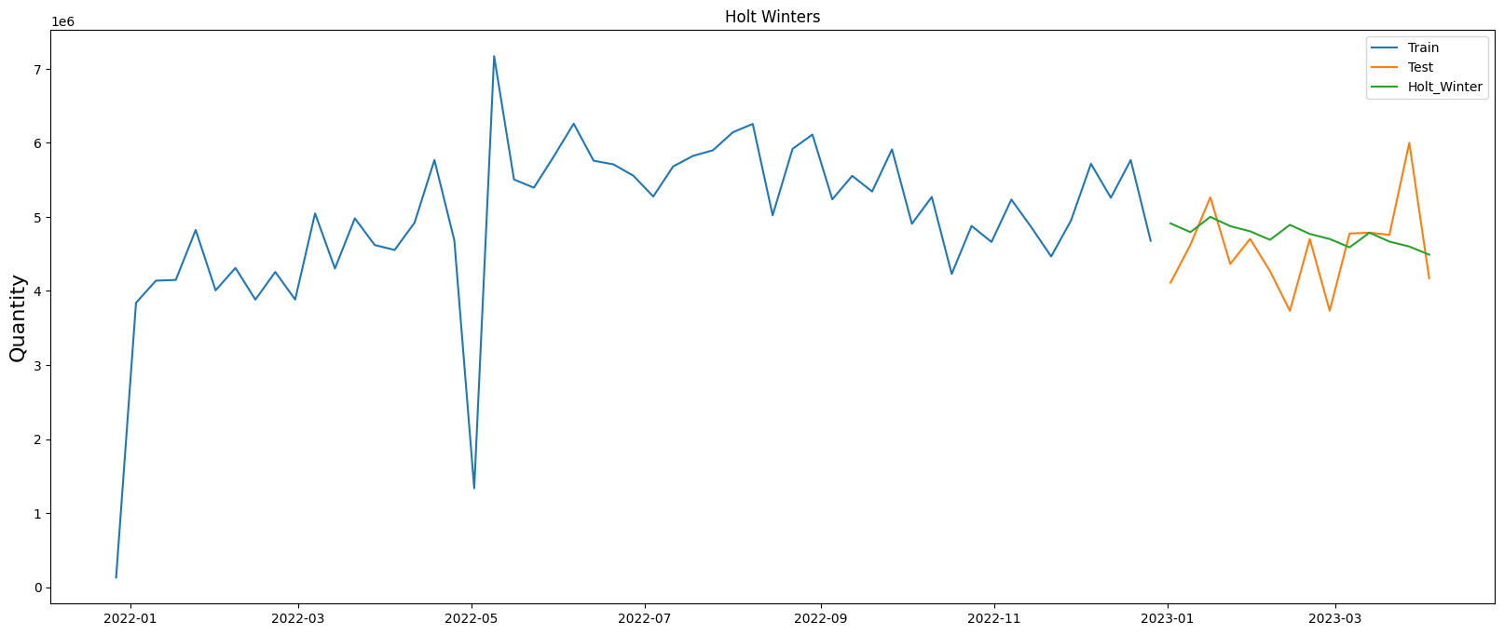
MODEL

Slide 15

Thank You

