Slide 1
TEAM SUBMISSION TEMPLATE
MINI MONSTER
HACK
Build your evidence as you go.
TEAM DETAILS
Team name / number:
________________________________
Team members:
• __________________________________
• __________________________________
• __________________________________
• __________________________________
Complete the core slides as you go. Each section also includes up to 2 optional evidence slides, so screenshots, charts and outputs can stay large and readable. Submit the matching Excel/code files at each checkpoint and collect raffle entries throughout the day.
MAXIMUM 15 SLIDES
UP TO 2 EXTRA EVIDENCE SLIDES PER SECTION
FULL IDs GO IN EXCEL
HUNT
BUILD
TEST
PREDICT
SHOWCASE
1
Explore manually
2
Create detector
3
Run on 10% test data
4
Find early signs in 10%
5
Best work

Slide 2
SECTION 1 — HUNT
HUNT
BUILD
TEST
PREDICT
SHOW
HUNT — How did you find the monsters?
We turned each Monster Guide clue into one rule and tested it on the 80% training data. The full P_ID + monster list is in the HUNT Excel.
1. Our approach
3. What did we find?
🎟
HUNT RAFFLE CHECK
LMS and video activity merged into one timeline in UK time, then one SQL rule per monster.
Every rule tested in variants (thresholds, time zones, endpoints); we kept the strictest reading the clue supports, because false positives cost points.
620 findings across 586 students, all 9 monster types.
1
HUNT slide(s) completed
1
HUNT Excel IDs submitted
2. What gave them away?
1
All monsters correctly identified +1 BONUS
Data slips: duplicated rows, activity after deregistering, copied rows under a new P_ID or module.
Behaviour: fading after week 4, 3 h non-stop sessions, mostly at night, repeated 5x bursts, 200+ pages in 12 h.
Use the HUNT Excel template for the full PID + monster type list.
RULE + EXAMPLE PER MONSTER: SLIDE 4
34 STUDENTS CAUGHT AS 2 MONSTERS
Both completed & monsters correct = 3 raffle entries

Slide 3
SECTION 1 — HUNT (OPTIONAL EVIDENCE 1 OF 2)
HUNT
BUILD
TEST
PREDICT
SHOW
HUNT — The clearest giveaways
Two findings no real student could produce, and one overlap worth knowing about.
Web Crawler: 529 pages in 2 min
Some students are two monsters
🎟
HOW WE CHECKED
P00010833 opened 529 distinct LMS items in 1 min 54 s on 14 Feb 2024. No human reads that fast.
23 of our 25 Zombies are also Vampires: their 3-hour non-stop runs mostly happen at night. Overlaps are allowed, so each is submitted under both types.
+
Counted every variant of each rule and compared the P_IDs it adds or drops
RULE: OVER 200 ITEMS IN 12 H · 16 FOUND
+
Read the raw rows of the edge cases before choosing a threshold
Doppelgänger: a perfect copy
P00002959 and P00336066 share the same 174 video views: same video, time, minutes and viewing type. Only the row IDs differ, and P00336066 isn't in person_dim.
Full P_ID list: HUNT Excel, MANUAL COMBINED.
30 PAIRS · BOTH P_IDS SUBMITTED
34 STUDENTS UNDER 2 TYPES

Slide 4
SECTION 1 — HUNT (OPTIONAL EVIDENCE 2 OF 2)
HUNT — What gave each monster away
One rule per monster, written from its Monster Guide clue, with one training example each.
MONSTER | WHAT GAVE IT AWAY (OUR RULE) | TRAINING EXAMPLE | P_IDS
Phantom | Two activity rows identical in every field except the row ID | P00000693: one LMS click recorded twice | 77
Ghost | Active in 3+ of weeks 1–4, then under 10% of that weekly rate | P00007556: 50 rows in weeks 1–3, then none | 148
Zombie | Over 3 hours of activity with no gap longer than 15 minutes | P00020056: 23:44 to 04:52, longest gap 14 min | 25
Vampire | More than 21 night-active dates, and more nights than days | P00013423: 273 night dates vs 236 day dates | 91
Undead Student | Any activity after the deregistration date | P00019372: 134 rows after deregistering | 92
Doppelgänger | All of one P_ID's activity reappears under another P_ID | P00002959 = P00336066: same 174 video views | 60
Werewolf | 2+ bursts in each term at 5x the student's usual day (40+ rows) | P00017160: usually 5 rows a day, bursts of 90–167 | 32
Web Crawler | More than 200 distinct pages and videos within 12 hours | P00010833: 529 pages in under 2 minutes | 16
Shape-shifter | Copied rows (_COPY_) on modules the student isn't registered on | P00006918: 22 copied rows on a D03 module | 79
TOTAL: 620 FINDINGS · 586 STUDENTS · FULL LIST IN THE HUNT EXCEL

Slide 5
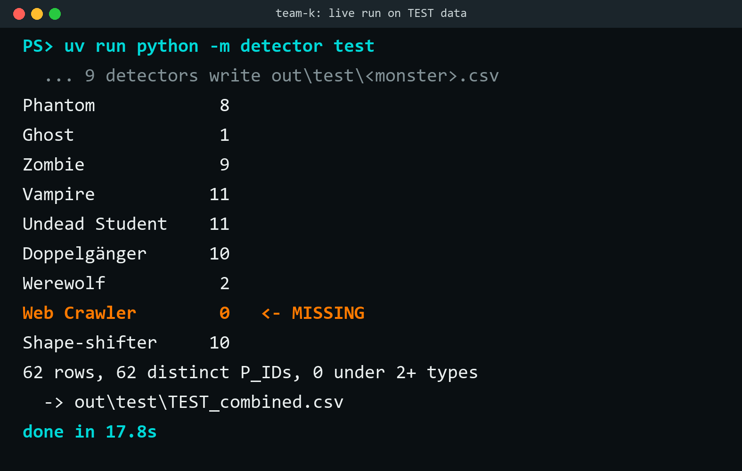
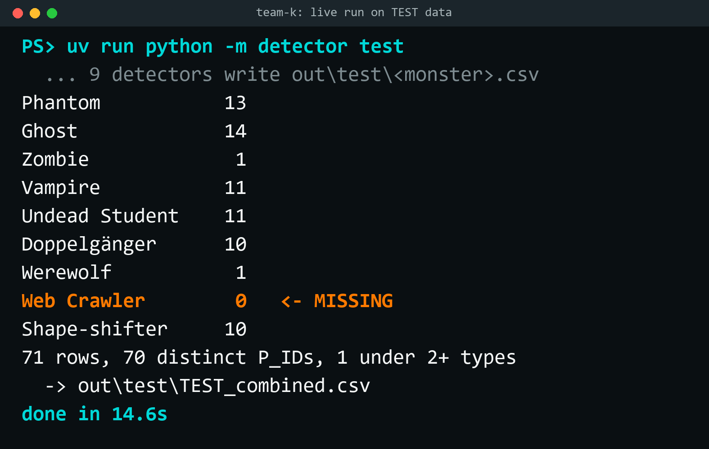
SECTION 2 — BUILD & TEST (PART 1)
HUNT
BUILD
TEST
PREDICT
SHOW
BUILD — Create your Monster Detector
Our nine HUNT rules became one detector that runs end to end with a single command.
1. What did we build?
3. Show it working
🎟
BUILD RAFFLE CHECK
A Python program reads the LMS and video logs, builds one timeline per student and runs 9 rules, one per monster, each written from its clue and tested on the training data.
Output: a paste-ready list of P_IDs and monster types.
Live run on the unseen TEST data · about 18 s
1
Working Monster Detector shown running on the 10% TEST data (call us over to show it to us live)
ONE COMMAND · 9 RULES · ABOUT 18 S
1
Working code submitted
2. What signals does it use?
→
TEST raffle checks continue on the next slide
Data slips: exact duplicate rows · _COPY_ IDs · one student's rows under a 2nd ID · activity after the deregistration date.
Behaviour: activity after week 4 vs before · longest run without a 15-min break · night vs day dates · days at 5x normal · distinct pages in 12 h.
FULL RULE PER MONSTER: SLIDE 4
62 FINDINGS · 62 STUDENTS · NO WEB CRAWLERS IN TEST
Both completed = 2 raffle entries

Slide 6
SECTION 2 — BUILD & TEST (PART 2)
HUNT
BUILD
TEST
PREDICT
SHOW
TEST — What did your detector find?
The same one command, run on the unseen 10% TEST data after every rule was scored against the HUNT answers. The full P_ID + monster list is in the TEST Excel.
1. TEST result summary
3. TEST findings by monster
🎟
TEST RAFFLE CHECK
62 findings across 62 students, 8 of the 9 monster types.
No Web Crawlers in TEST, and no student is flagged as two monsters.
P_IDs per monster type from the live run.
1
TEST slide(s) completed
62 FINDINGS · 62 STUDENTS · 8 OF 9 TYPES
1
TEST Excel IDs submitted
2. What did we notice?
1
All monsters correctly identified in TEST +1 BONUS
1
Tuned on HUNT first: five rules tightened, then 437 of 449 HUNT findings were right (97%).
Zero is a result: the Web Crawler rule was 15 of 15 right on HUNT, so we kept it strict instead of loosening it to find one.
Use the TEST Excel template for the full PID + monster type list.
LEAST CERTAIN: GHOST (1) AND WEREWOLF (2)
WEB CRAWLER 0 · NO STUDENT UNDER 2 TYPES
Both completed & monsters correct = 3 raffle entries

Slide 7
SECTION 2 — BUILD & TEST (OPTIONAL EVIDENCE 1 OF 2)
BUILD & TEST — Extra evidence
Use this optional slide if you need more room for a large screenshot, model output, chart, code/output evidence or test result.
Use the space for supporting BUILD or TEST evidence. Keep the required results on the core slides and use this only when the extra space makes your work clearer.
OPTIONAL EVIDENCE 1 OF 2 — DELETE IF NOT NEEDED
ADD OPTIONAL BUILD / TEST EVIDENCE HERE

Slide 8
SECTION 2 — BUILD & TEST (OPTIONAL EVIDENCE 2 OF 2)
BUILD & TEST — Extra evidence
Use this optional slide if you need more room for a large screenshot, model output, chart, code/output evidence or test result.
Use the space for supporting BUILD or TEST evidence. Keep the required results on the core slides and use this only when the extra space makes your work clearer.
OPTIONAL EVIDENCE 2 OF 2 — DELETE IF NOT NEEDED
ADD OPTIONAL BUILD / TEST EVIDENCE HERE

Slide 9
SECTION 3 — PREDICT (PART 1)
HUNT
BUILD
TEST
PREDICT
SHOW
PREDICT — What does “starting to transform” mean?
There is no single prescribed answer. Define the early-warning signs your team will look for before the full monster behaviour appears.
1. Monster(s) we chose
2. Our definition
🎟
PREDICT — PART 1
Which behavioural monster or monsters are you predicting?
What would “starting to turn into” this monster look like before the full monster behaviour appears?
+
Use the next slide for your predictions and evidence
+
1
WRITE YOUR DEFINITION
+
Large screenshots are welcome
1
3. Early-warning signals
Your final PID + predicted monster type list goes in the PREDICT Excel submission
Which trends, features or changes will your model look for? Explain why you think they are meaningful.
NAME THE MONSTER(S)
ADD FEATURES / LOGIC / EXAMPLES

Slide 10
SECTION 3 — PREDICT (PART 2)
HUNT
BUILD
TEST
PREDICT
SHOW
PREDICT — Who is starting to transform, and why?
Show us what your model found and justify the prediction. Use the space for clear visual evidence.
1. Who did we identify?
3. Evidence
PREDICT RAFFLE CHECK
Summarise the students your model identified and what they may be turning into. Keep the full list in Excel.
Show a chart, trend, feature importance, model output or another piece of evidence. Screenshots can be large.
1
PREDICT slide(s) completed
ADD SHORT SUMMARY / TABLE
ADD LARGE PREDICT VISUAL
1
PREDICT Excel predictions submitted
2. Why these students?
4. Bonus / advanced work
1
PREDICT working code submitted
Explain what your model is seeing and why those patterns support your prediction.
Front end, explainability, extra visualisations, advanced modelling or anything else you explored.
Use the PREDICT Excel template for the full PID + monster type list.
ADD 1–3 SHORT POINTS
OPTIONAL
All three completed = 3 raffle entries

Slide 11
SECTION 3 — PREDICT (OPTIONAL EVIDENCE 1 OF 2)
PREDICT — Extra evidence
Use this optional slide if you need more room for transformation evidence, charts, model outputs, feature explanations or additional examples.
Use this space for evidence that supports your prediction. Large screenshots and charts are encouraged when they make your reasoning easier to understand.
OPTIONAL EVIDENCE 1 OF 2 — DELETE IF NOT NEEDED
ADD OPTIONAL PREDICT EVIDENCE HERE

Slide 12
SECTION 3 — PREDICT (OPTIONAL EVIDENCE 2 OF 2)
PREDICT — Extra evidence
Use this optional slide if you need more room for transformation evidence, charts, model outputs, feature explanations or additional examples.
Use this space for evidence that supports your prediction. Large screenshots and charts are encouraged when they make your reasoning easier to understand.
OPTIONAL EVIDENCE 2 OF 2 — DELETE IF NOT NEEDED
ADD OPTIONAL PREDICT EVIDENCE HERE

Slide 13
SECTION 4 — SHOWCASE (PART 1)
SHOWCASE — Your best work
Our strongest output: the whole detector running live on the unseen TEST data, from one command to the paste-ready Excel list.
SHOW — PART 1 OF 2
One command, nine rules
62 findings across 62 students, 8 of the 9 monster types.
About 12–18 s on a laptop. Call us over and we'll run it live.
Scored on HUNT first: 437 of 449 HUNT findings right (97%).
UV RUN PYTHON -M DETECTOR TEST

Slide 14
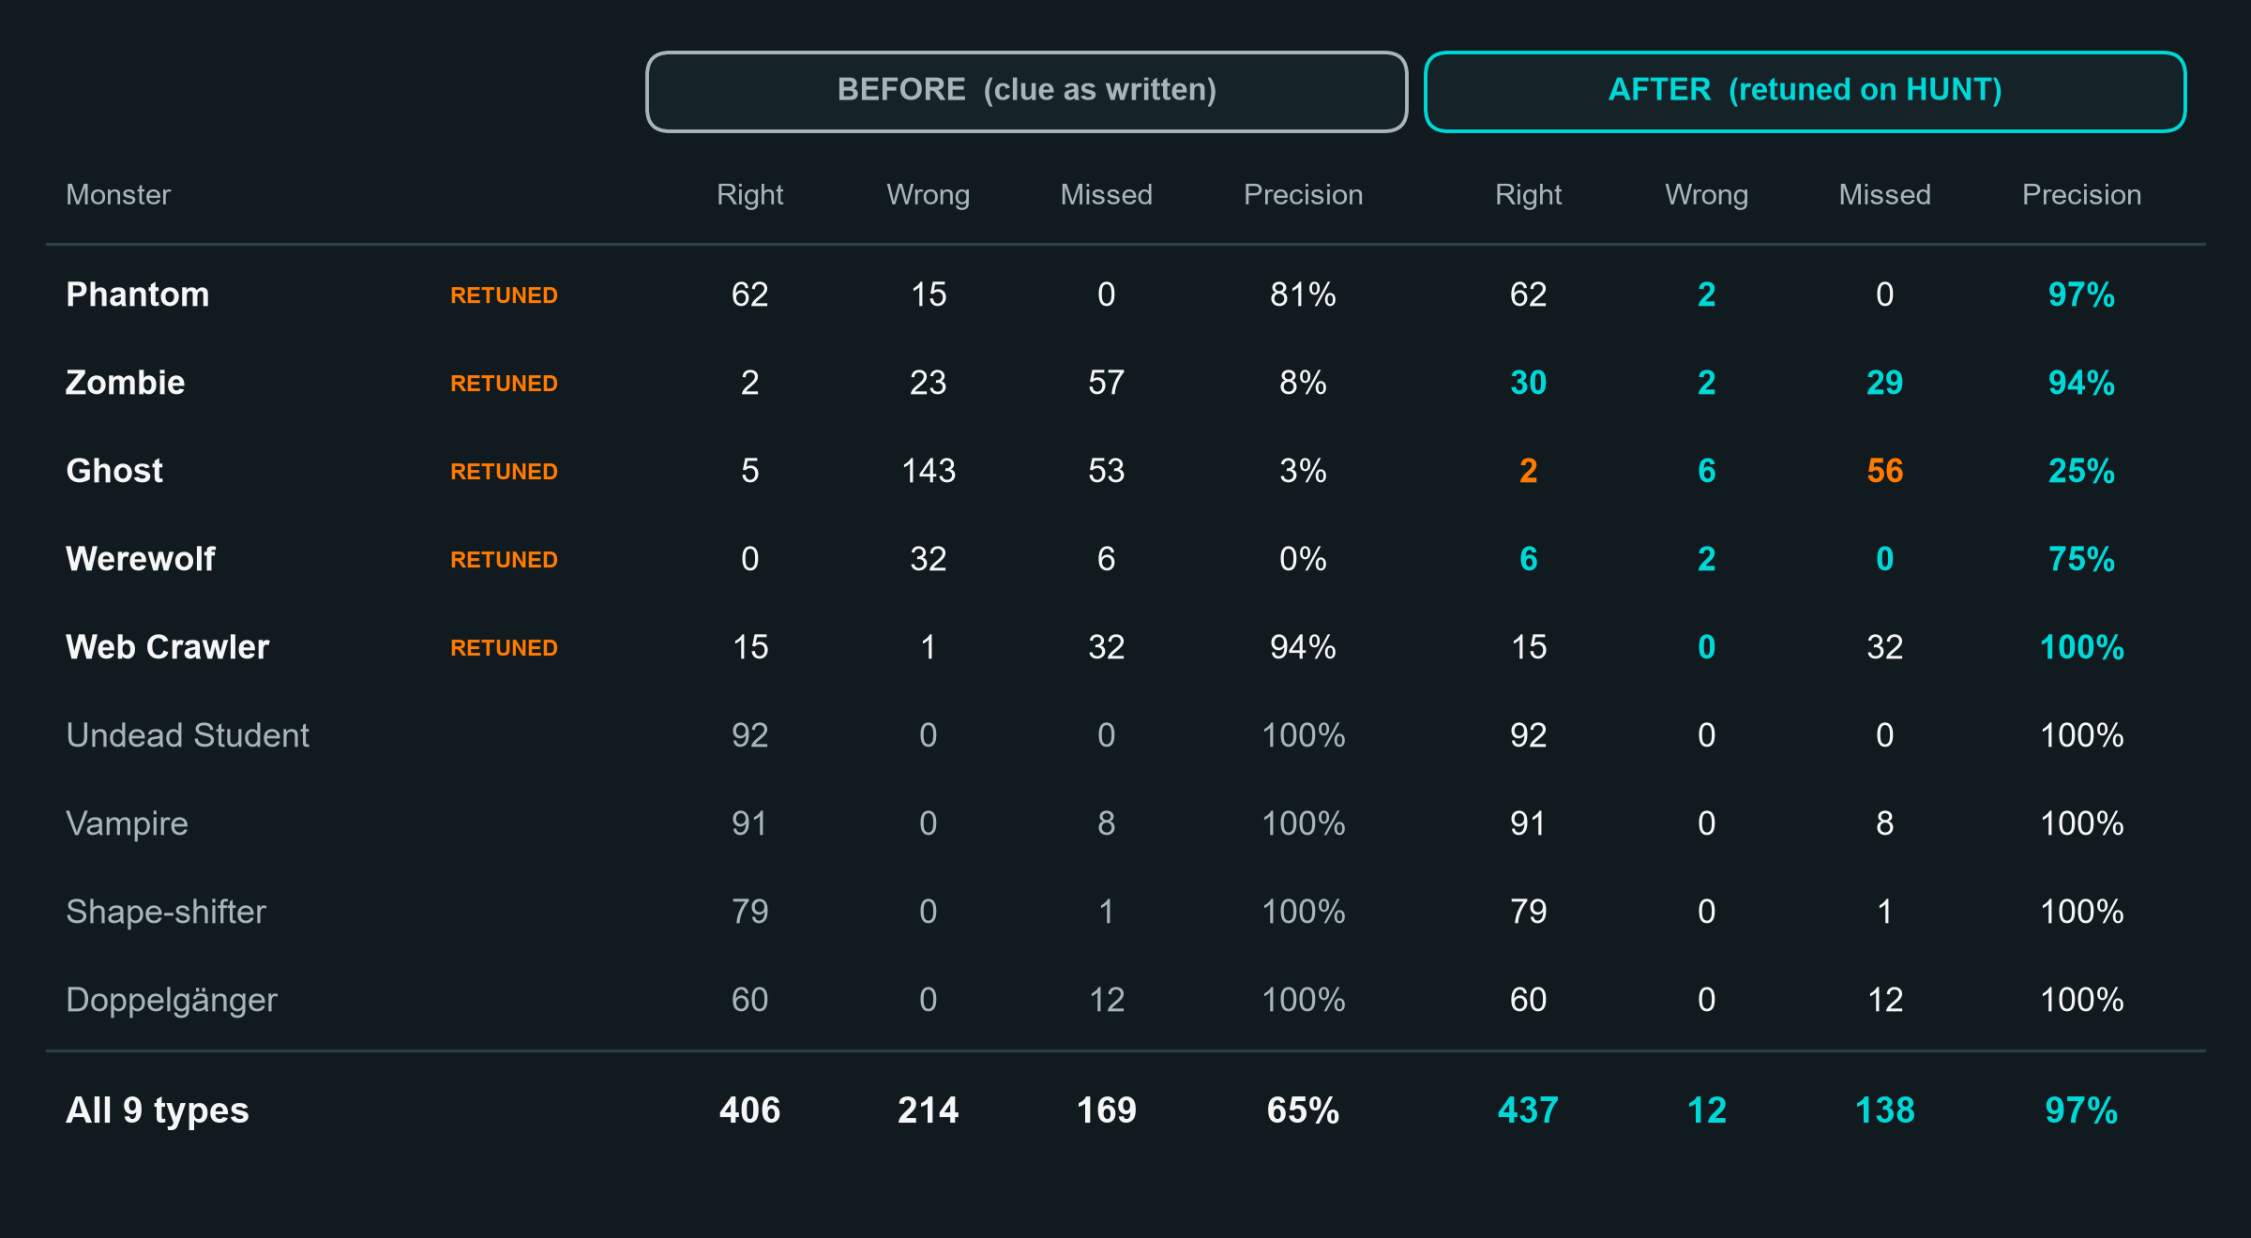
SECTION 4 — SHOWCASE (PART 2)
SHOWCASE — What should the judges remember?
Agents did the typing. Every rule had to earn its place against the released HUNT answers before it ran on TEST.
How we used AI
AI agents wrote the detector code, the SQL rules and drafts of these slides from our Monster Guide notes.
We had them build a Scoring script, so no rule reached TEST until it was checked against the HUNT answers.
What we checked ourselves
We chose each retune, and when to stop: Web Crawler stays strict (15 of 15 right) instead of chasing its 32 misses.
We flag the weak spots: Ghost and Werewolf don't follow their clues in the answers, so they're our least certain results.
HUNT PRECISION 65% → 97% AFTER FIVE RETUNES

Slide 15
SECTION 4 — SHOWCASE (OPTIONAL EVIDENCE 2 OF 2)
SHOWCASE — Extra evidence
Use this final optional slide only if you still need space for an important screenshot, chart, interface, monster example, model output or advanced work.
This is your final flex slide. Use it only for evidence that genuinely helps us understand your solution — you do not need to fill all 15 slides.
OPTIONAL EVIDENCE 2 OF 2 — DELETE IF NOT NEEDED
ADD OPTIONAL SHOW EVIDENCE HERE

