Slide 1
Plotluck
Where could your restaurant work?
IBM Z Datathon 2026 · Community Impact

Slide 2
Choosing where to open is hard
One big decision
For a small restaurant, the wrong location can be costly. It is hard to compare areas before signing a lease.
A place to start
Plotluck helps founders compare English postcode districts for the restaurant they want to open.
Built for independent founders, including people bringing under-represented cuisines to new areas.

Slide 3
From your idea to a shortlist
One description starts the search; Plotluck asks when a detail is missing
Describe
Clarify
Explore
Tell Plotluck what you want to open and where you want to look.
If a detail is unclear, answer a focused follow-up question.
See districts on a map and use the score threshold to narrow the list.
The answer-reading AI is experimental. An editable review card is planned but not yet wired in.

Slide 4
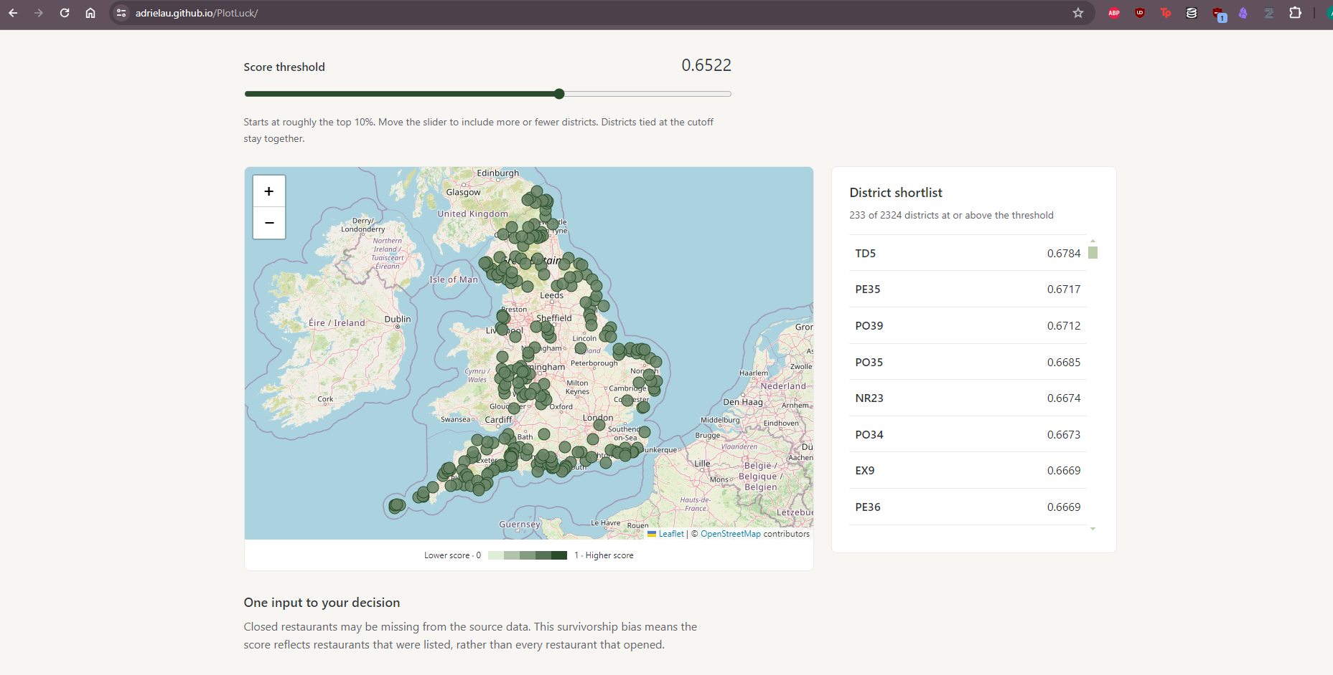
See promising districts at a glance
Earlier map capture; the current build draws district outlines
Source: docs/evidence/10-live-site.png · adrielau.github.io/PlotLuck/

Slide 5
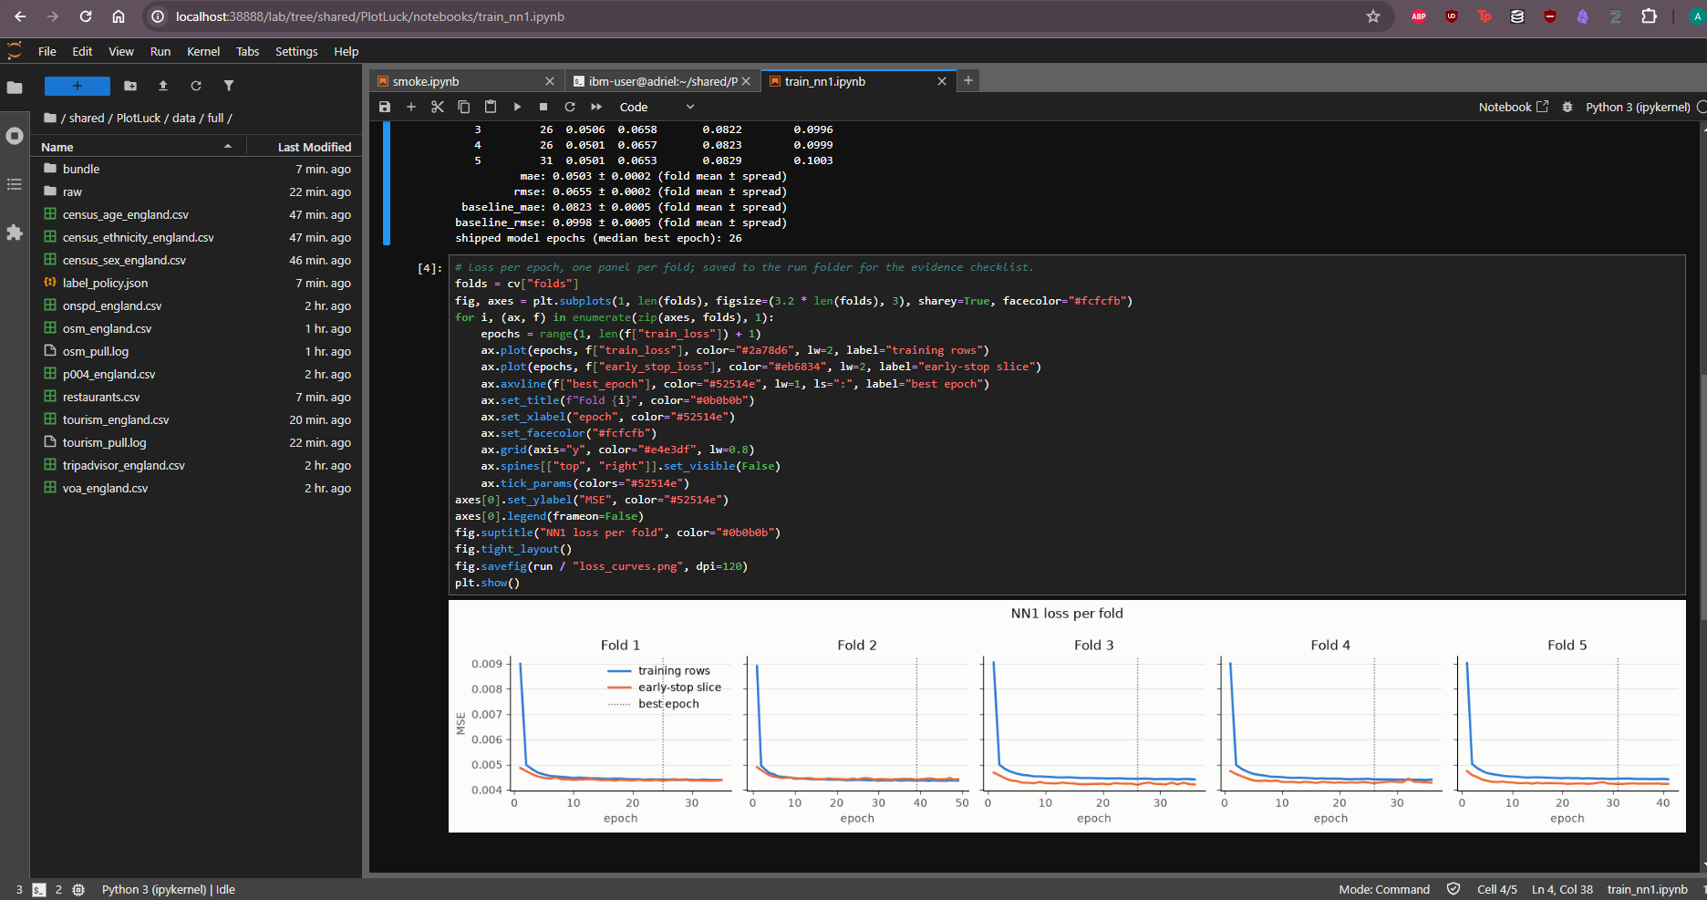
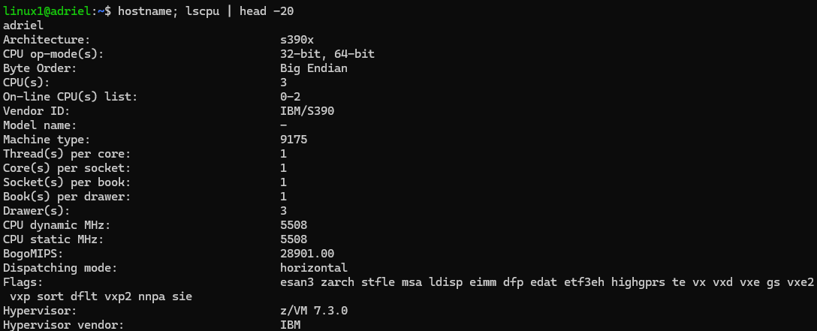
We trained the model on IBM LinuxONE
The screenshots show our Jupyter run and the s390x environment
After training
We exported the weights so the website can keep scoring after the VM expires.
Sources: docs/evidence/05-train-nn1.png; 01-ssh-lscpu.png

Slide 6
How well did the model predict?
Average prediction error across five district-grouped test folds; lower is better
0.0503
NN1 mean absolute error
0.0823
Baseline mean absolute error
The score uses customer ratings and review activity. It does not predict profit or whether a restaurant will survive.
Source: runs/2026-10-17-train-nn1-cleaned/metrics.json · 131,655 labelled restaurants

Slide 7
A shortlist, not a promise
Use it to decide where to look
The data may miss restaurants that closed. District averages cannot tell you what one street or lease will be like.
We still need to check how well the district ranking works for each cuisine. Founders should visit sites and check the numbers themselves.
The answer-reading AI and LinuxONE acceleration benchmark are still being tested.

Slide 8
Know where to look first
Plotluck gives independent founders a clearer starting point.
Live demo · adrielau.github.io/PlotLuck/
Code and evidence · github.com/AdrielAu/PlotLuck

