Slide 1
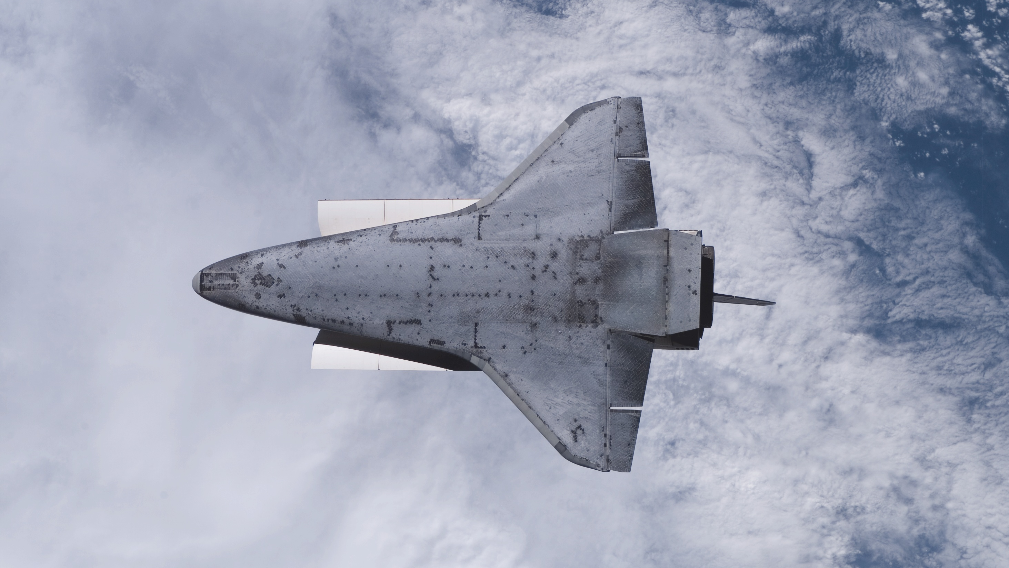
Lecture 1
Heatsink Performance
Spring 2026
Engg 114 Heat Transfer
Lecture 1: Heatsink Performance
423

Slide 2
Heat Sink for a CPU Chip
Forced-convection cooling concept, thermal model, DFMA refinement, and validation plan.
Mission
100 W
Design a forced-convection heat sink that keeps a 100 W CPU below the official 85°C limit while evaluating a derated 70°C design target.
maximum chip power
• Part 1: idealized 17-fin thermal baseline.
85°C
• Part 2: final 15-fin Al-6061 DFMA design.
official CPU limit
• Prototype validation is required before real-world performance claims.
70°C
derated target
Spring 2026
Engg 114 Heat Transfer
Lecture 1: Heatsink Performance
1
423

Slide 3
Official Problem Requirements
Requirement
Value
Design implication
CPU heat load
100 W
All resistance and temperature-rise calculations scale from this load.
Ambient air
25°C
Reference temperature for modeled heat rejection.
Official CPU limit
≤ 85°C
Pass/fail requirement for the project.
Derated target
≤ 70°C
Internal engineering target used for concept selection.
Validation
prototype test
Model and simulation must be checked against real hardware.
Course framing: design choices must be supported by simplified modeling, simulation evidence, and a test plan.
Spring 2026
Engg 114 Heat Transfer
Lecture 1: Heatsink Performance
423

Slide 4

Convert the temperature requirements into a resistance scorecard.
$$R_{\text{required}}=\frac{T_{\text{CPU}}−T_{\text{ambient}}}{Q}$$
Official limit
Derated target
(85 - 25) / 100 = 0.600 °C/W
Requirement: CPU ≤ 85°C
(70 - 25) / 100 = 0.450 °C/W
Target: CPU ≤ 70°C
Spring 2026
Engg 114 Heat Transfer
Lecture 1: Heatsink Performance

Slide 5
Three Concept Options
Concept A
Concept B
Concept C
Copper Pin-Fin /
Natural Convection
Aluminum Folded-Fin
with Heat Pipes
Extruded Al-6061 Plate-Fin /
Forced Convection
Rejected: natural convection is insufficient for 100 W, and copper is heavy.
Rejected: heat pipes improve spreading but add complexity, cost, and integration risk.
Selected path: forced-convection plate fins best balance thermal performance, cost, and manufacturability.
Spring 2026
Engg 114 Heat Transfer
Lecture 1: Heatsink Performance

Slide 6
Concept Selection Matrix
Original concepts are carried forward, then refined into the final DFMA plate-fin design.
Criteria
Copper Pin-Fin
Folded-Fin / Heat Pipe
17-Fin Plate
Thermal performance
Low for 100 W natural convection
Strong heat spreading
Best modeled cooling
Manufacturability
Heavy copper machining
Complex assembly
Tight ideal geometry
Airflow / spacing
Natural convection limited
Depends on pipe/fan packaging
Narrower spacing
Tool access / mounting
Heavy and awkward
More interfaces to mount
Less access margin
Mass / cost
High mass/cost
Higher cost
Cooler but higher mass
Prototype readiness
Reject
Reject
Thermal baseline only
Decision
REJECT
REJECT
BASELINE ONLY
Spring 2026
Engg 114 Heat Transfer
Lecture 1: Heatsink Performance
423

Slide 7
17-fin Al-6061 plate-fin baseline
61.487°C
61.487°C
Fusion 360 result under modeled boundary conditions.
Fusion 360 result under modeled boundary conditions.
17-fin
Spring 2026
Engg 114 Heat Transfer
Lecture 1: Heatsink Performance

Slide 8

Spring 2026
Engg 114 Heat Transfer
6

Slide 9
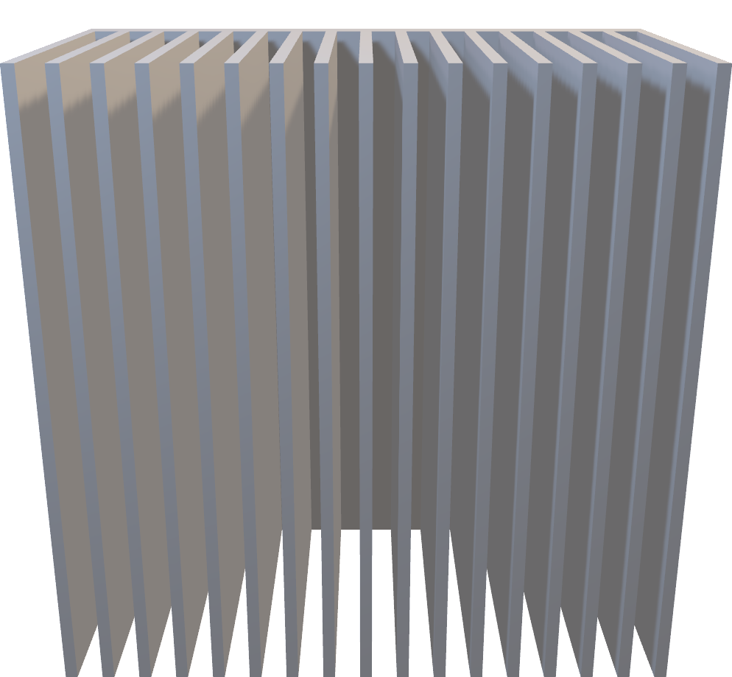

Slide 10
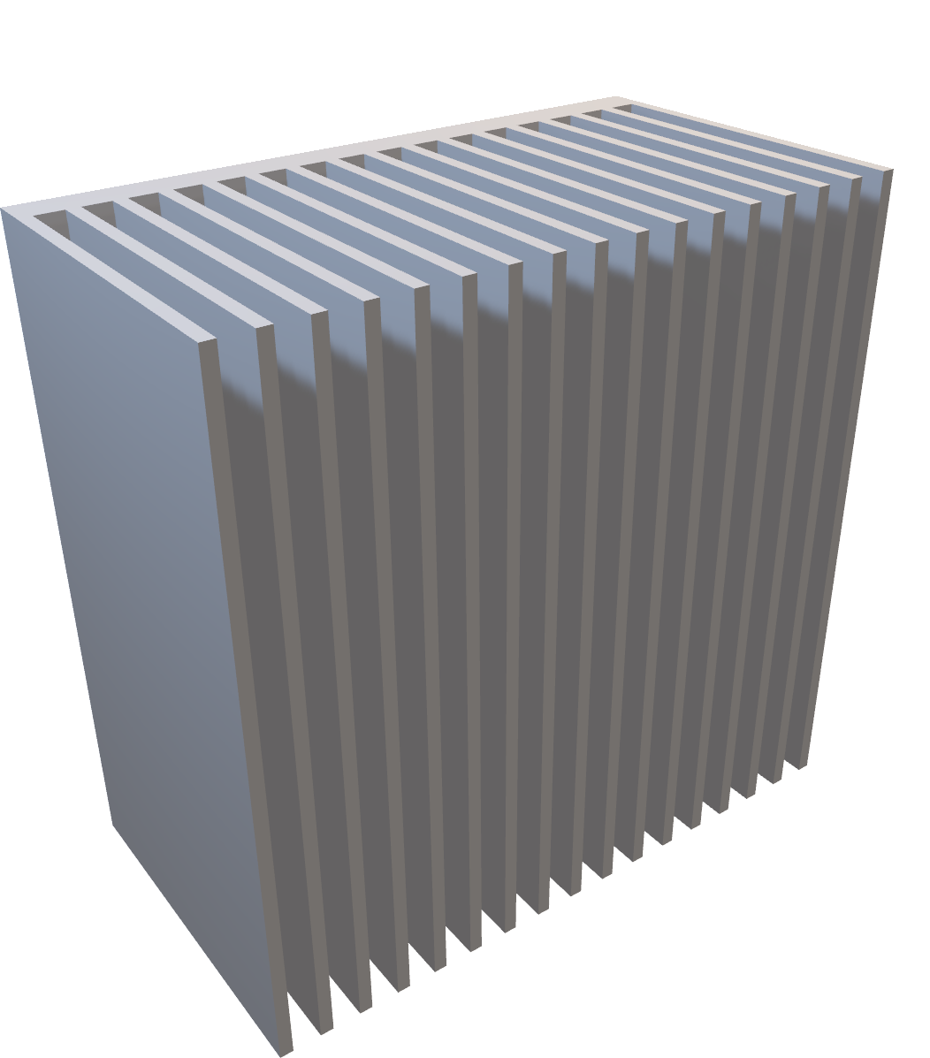

Slide 11
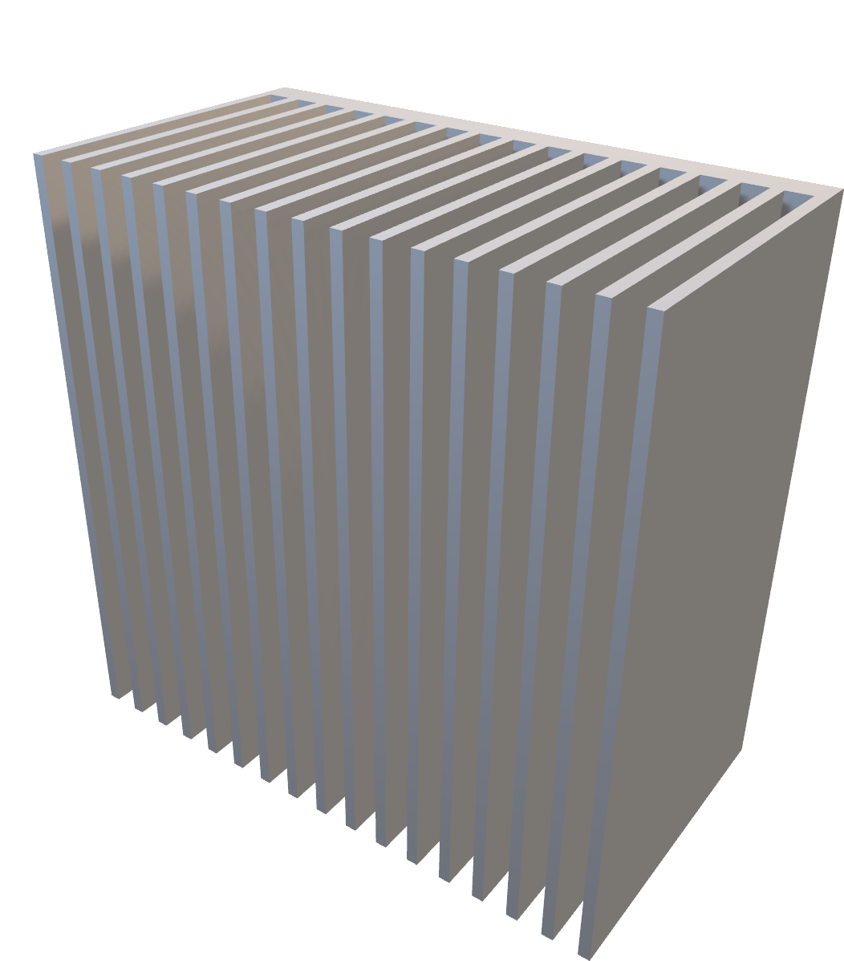

Slide 12


Slide 13


Slide 14
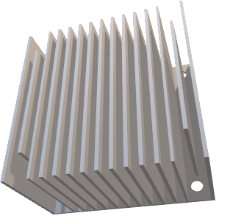
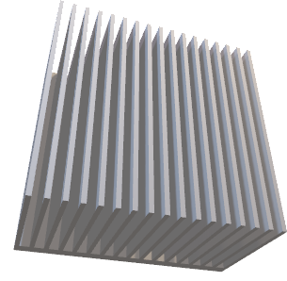
Why the Ideal Design Needed Redesign
The cooler baseline had to become a buildable thermal system.
17-fin ideal baseline
15-fin DFMA design
• Cooler simulation result: 61.487°C
• Narrower spacing and less access margin
• Thermal-first geometry, not final product geometry
DFMA
REFINEMENT
• MATLAB predicts 69.85°C
• Fusion 360 predicts 69.775°C
• 2.557 mm spacing improves airflow practicality and tool access
Engineering decision: keep the 17-fin model as the thermal baseline, then select the 15-fin design as the manufacturable product direction.
Notes:
Target time: 0:40. Use the transition line verbatim. Then explain the redesign reason: narrow spacing, tool access, mounting features, and real airflow make a thermal-only optimum incomplete. This slide is the handoff from classroom thermal resistance logic to DFMA design judgment.

Slide 15

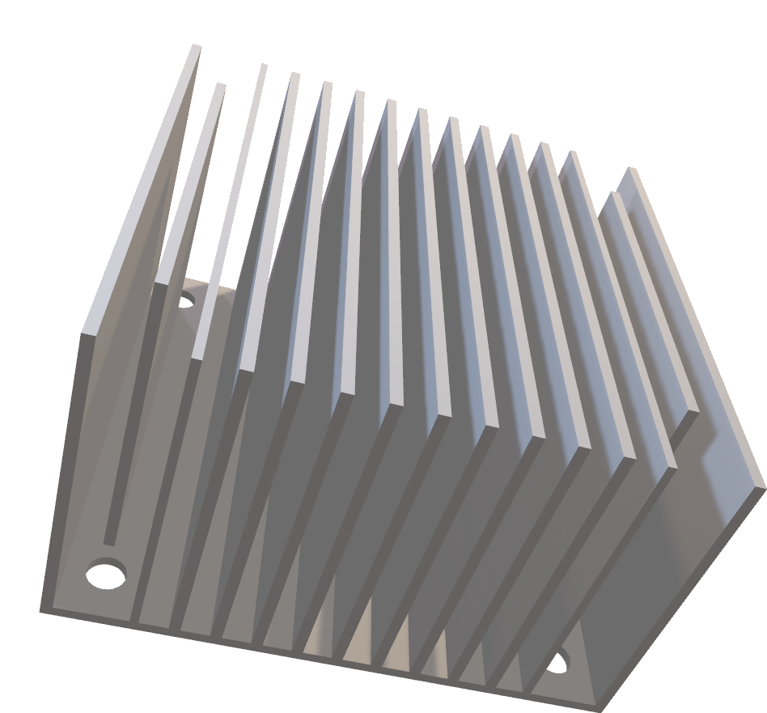
08
Notes:
Target time: 0:55. Introduce Part 2 and the final selected geometry. The final 15-fin DFMA design has 2.557 mm spacing, an estimated 54.6 g mass, MATLAB predicted 69.85°C, and Fusion predicted 69.775°C. Stress that the design narrowly meets the 70°C target in simplified modeling and comfortably meets the 85°C official limit.

Slide 16
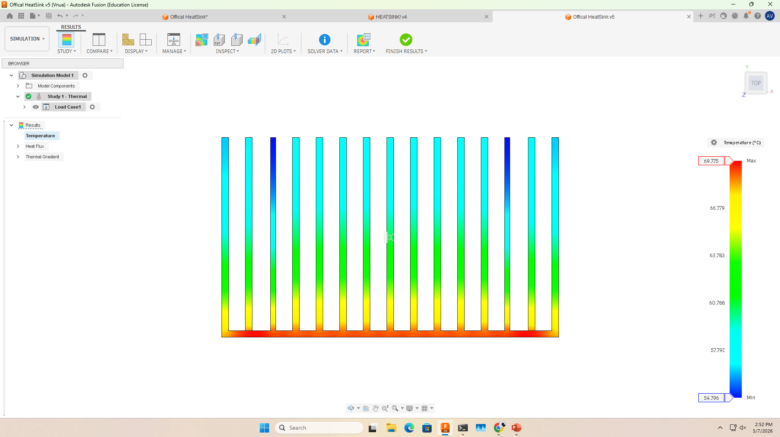
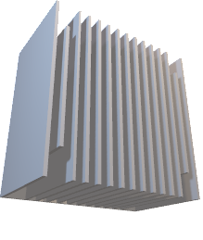
PART 2 / FINAL DFMA
08
The final 15-fin design trades peak cooling for buildable margin.
FINAL 15-FIN DFMA DESIGN
15
2.557 mm
fin count
clear spacing
54.6 g
0.4485
mass estimate
R_total °C/W
69.85°C
69.775°C
MATLAB predicted
Fusion 360
• Open channels improve spacing and tool access.
• Notch/access penalty included in the simplified MATLAB model.
• Selected for spacing, lower mass, tool access, and manufacturability.
ENGG 114 Heat Sink Review | modeled boundary conditions
Notes:
Target time: 0:55. Introduce Part 2 and the final selected geometry. The final 15-fin DFMA design has 2.557 mm spacing, an estimated 54.6 g mass, MATLAB predicted 69.85°C, and Fusion predicted 69.775°C. Stress that the design narrowly meets the 70°C target in simplified modeling and comfortably meets the 85°C official limit.

Slide 17
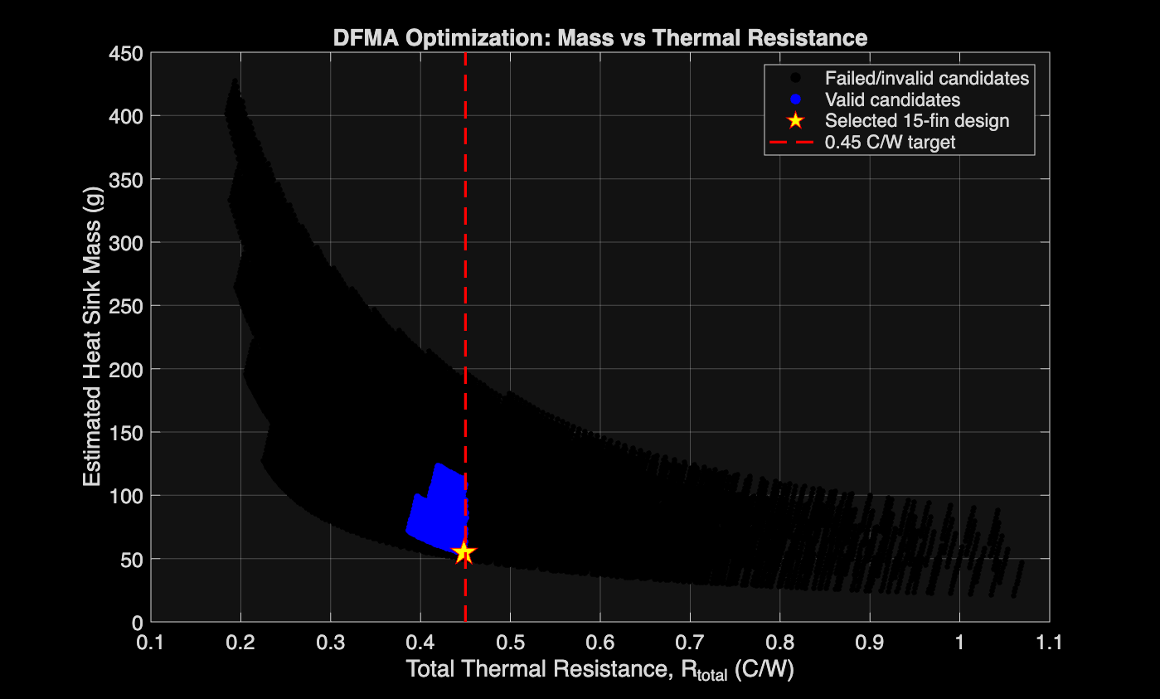
MATLAB OPTIMIZATION
09
MATLAB places the selected design just inside the 0.45°C/W target.
SELECTED POINT
0.4485
°C/W R_total
69.85°C
predicted CPU
54.6 g
estimated mass
• Candidate sweep filtered resistance, spacing, and positive mass.
• The selected point lies narrowly inside the 0.45°C/W target.
• Optimization supports the DFMA choice; prototype testing remains required.
ENGG 114 Heat Sink Review | modeled boundary conditions
Notes:
Target time: 1:00. Read the plot left to right. The black cloud is the broader candidate space, blue points are valid candidates, and the selected star sits just inside the 0.45°C/W target. The key professor-safe message is that the MATLAB sweep supports the 15-fin design, but the target margin is narrow.

Slide 18
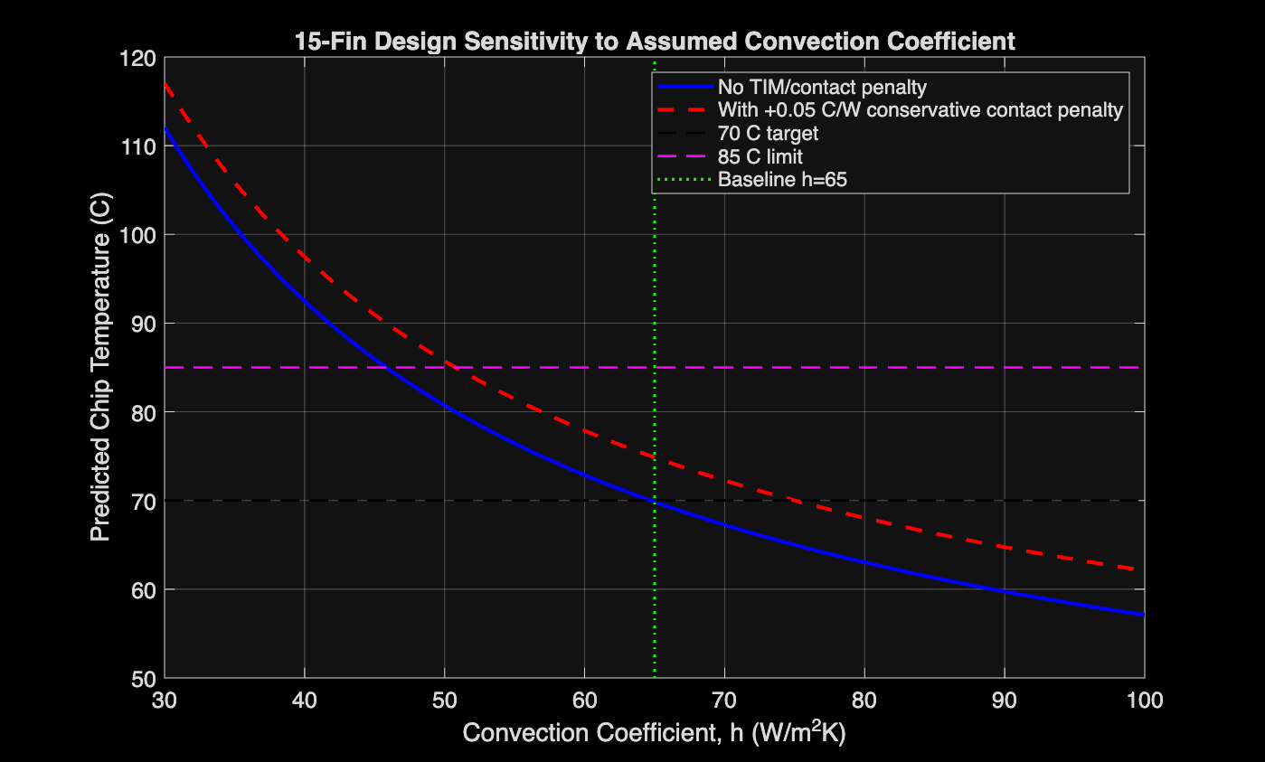
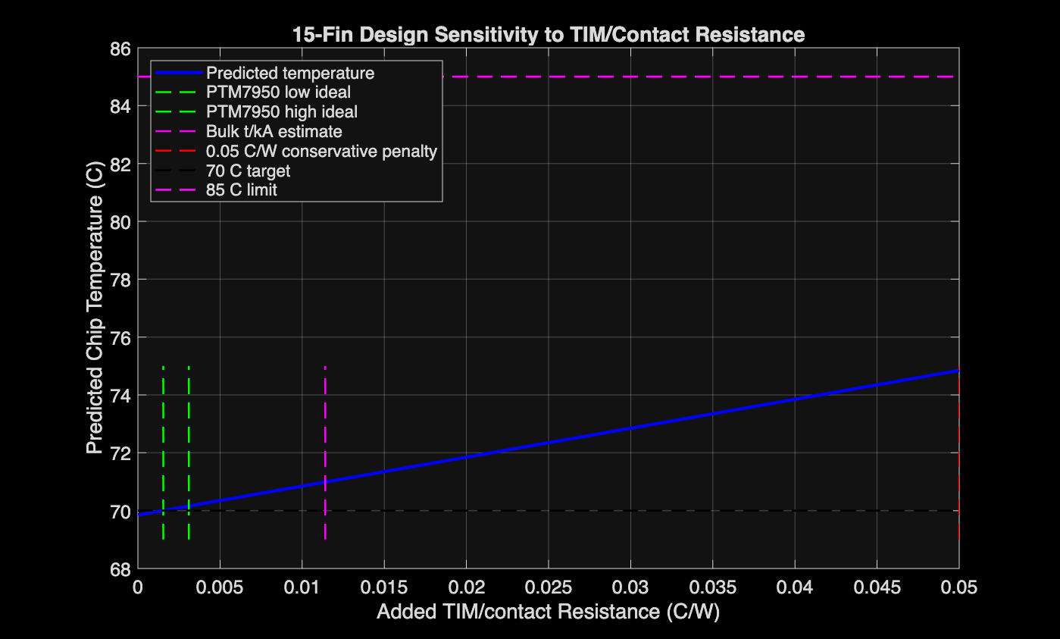
SENSITIVITY
10
The 70°C target is sensitive to airflow and contact resistance.
AIRFLOW ASSUMPTION
CONTACT RISK
Baseline h = 65 W/(m²·K); weaker airflow can erase derated margin.
+0.00155°C/W moves the model to about 70.00°C; +0.05°C/W gives about 74.85°C.
h = 65 W/m²K is an assumed convection coefficient, not proven fan performance.
ENGG 114 Heat Sink Review | modeled boundary conditions
Notes:
Target time: 1:05. Explain the sensitivity risk. The h plot shows that airflow assumptions matter, while the TIM/contact plot shows how small added resistance can push the design to the 70°C boundary. The design still has margin to 85°C, but the derated target depends on contact quality and fan performance.

Slide 19
DRAWING PACKAGE
11
Drawing package remains the key manufacturing gate.
• Show 50.8 mm footprint, fin count, height, thickness, spacing, base thickness, and notch geometry.
• Mass properties should reconcile to the 54.6 g MATLAB estimate.
• Mounting interface should verify existing hardware fit.
ENGG 114 Heat Sink Review | modeled boundary conditions
Notes:
Target time: 0:40. State plainly that the final SolidWorks drawing package and mass properties were not found in the working folder. The placeholder is intentional. The drawing package should lock the geometry, notches, base, fin spacing, and mounting interface before manufacturing or prototype ordering.

Slide 20
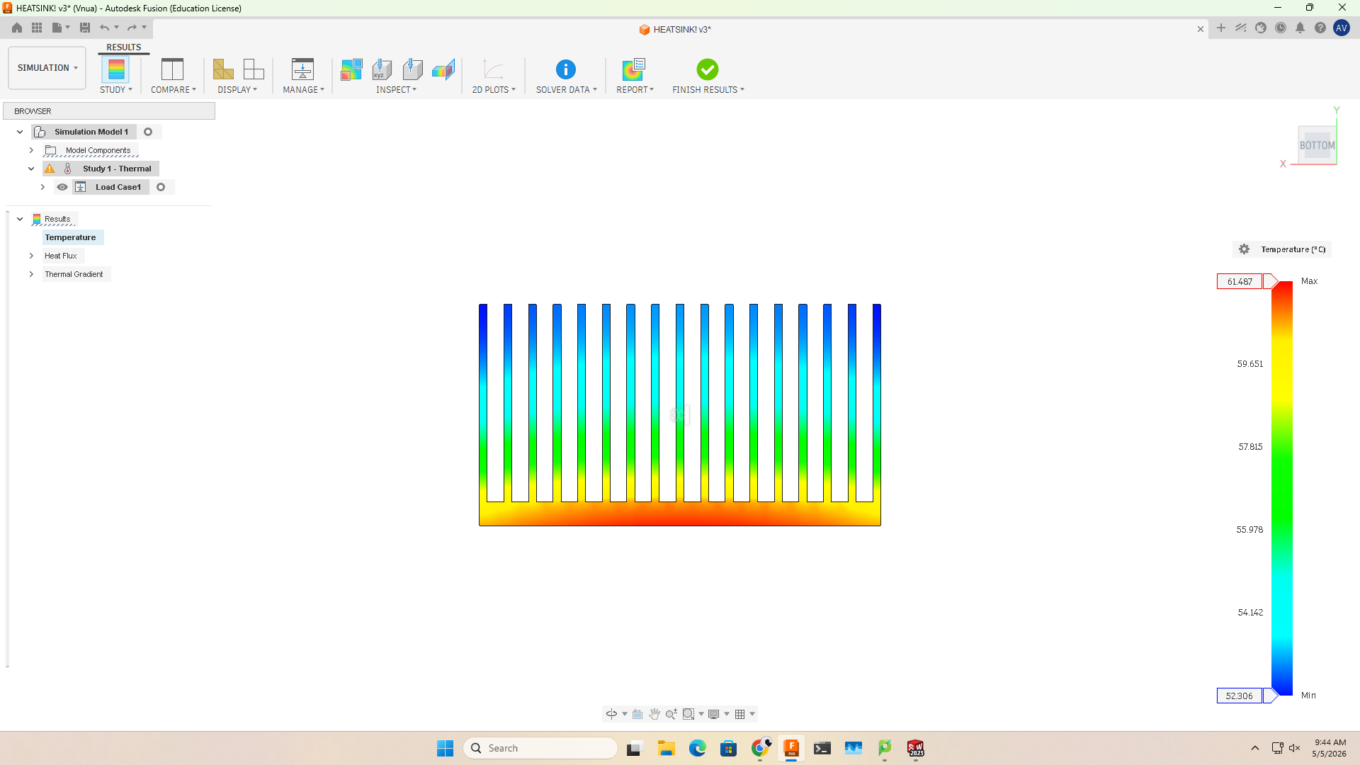
FUSION COMPARISON
Fusion 360 predicts these temperatures under modeled boundary conditions.
15-fin final DFMA design
17-fin ideal baseline
Max = 69.775°C
Max = 61.487°C
Selected for spacing, lower mass, tool access, airflow practicality, and manufacturability.
Thermally better, but retained as the baseline rather than the final manufacturable design.
ENGG 114 Heat Sink Review | modeled boundary conditions
12
Notes:
Target time: 0:55. Compare the two Fusion outcomes. The 17-fin ideal baseline is cooler at 61.487°C, but the 15-fin final DFMA model is still at 69.775°C under modeled boundary conditions. This is the evidence bridge between the simplified MATLAB model and the CAD simulation result.

Slide 21
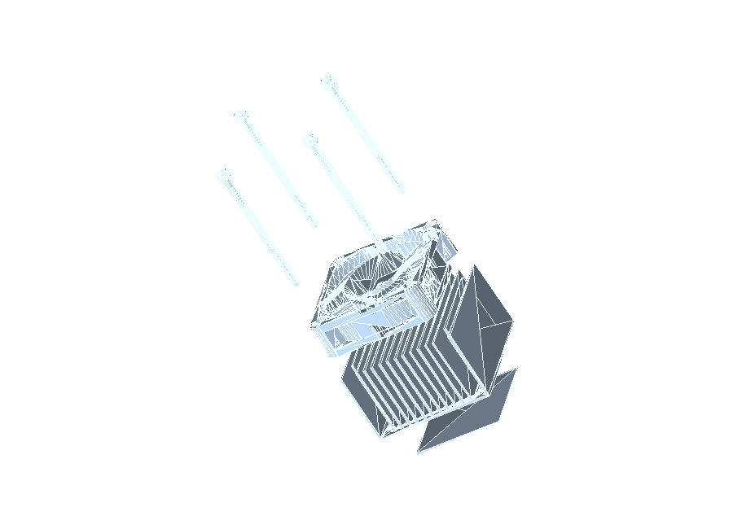

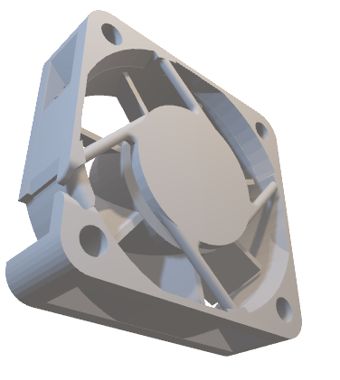
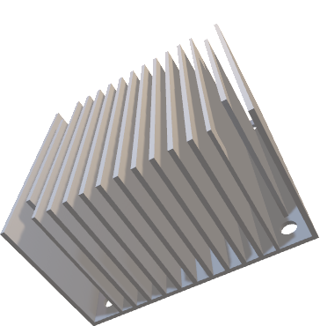
VISUAL BOM / ASSEMBLY
Visual BOM shows final assembly components. Prototype/test hardware is listed separately.
4× M3 screws /
standoffs
1× 50 mm
DC fan
1× Al-6061 15-fin heat sink
1× thermal pad /
TIM
optional full
assembly render
Final Product BOM
Prototype/Test BOM
Al-6061 15-fin heat sink | 50 mm fan | TIM / thermal pad | screws / standoffs / washers | fan guard if included
100 W heater block | thermocouples | data logger | fan power supply | test fixture / insulation | safety items
ENGG 114 Heat Sink Review | modeled boundary conditions
13
Notes:
Target time: 0:55. Present the BOM as two groups: final product parts and prototype/test hardware. Emphasize that a report-ready BOM should include vendor, part number, quantity, cost, and justification. In this deck, the table shows the needed line items and flags procurement details to finalize if not already in the report.

Slide 22
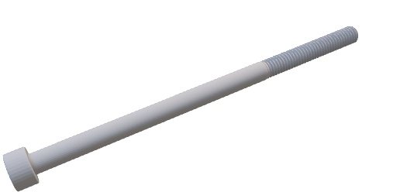
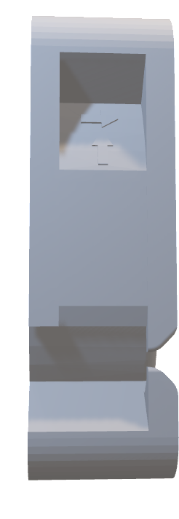
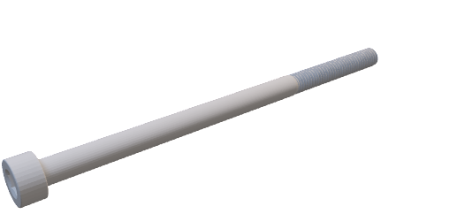
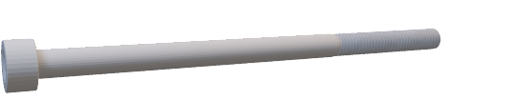

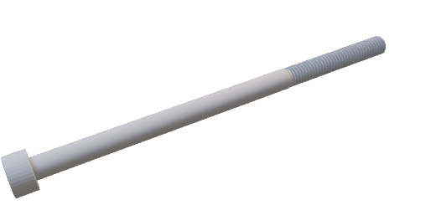
ENGG 114 Heat Sink Review | modeled boundary conditions
13
Notes:
Target time: 0:55. Present the BOM as two groups: final product parts and prototype/test hardware. Emphasize that a report-ready BOM should include vendor, part number, quantity, cost, and justification. In this deck, the table shows the needed line items and flags procurement details to finalize if not already in the report.

Slide 23

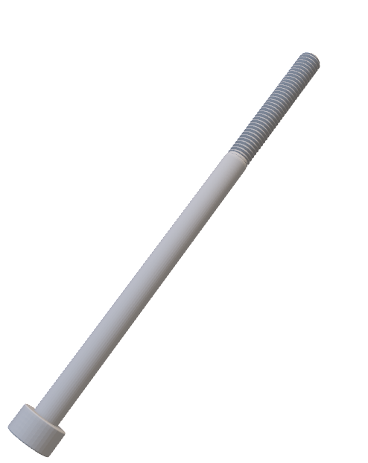
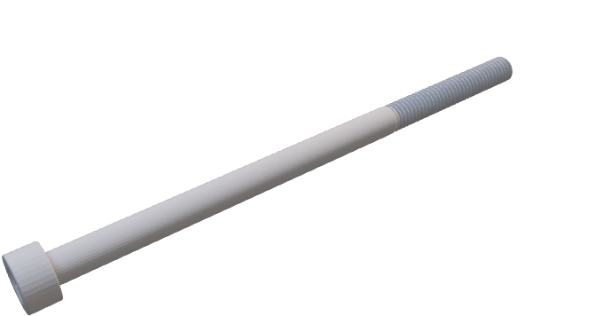
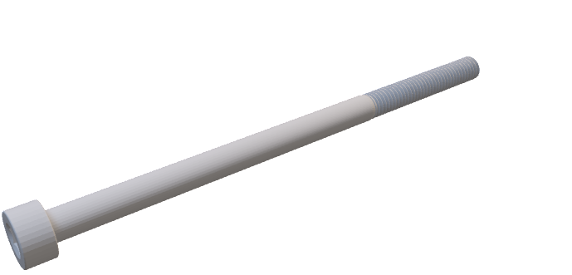
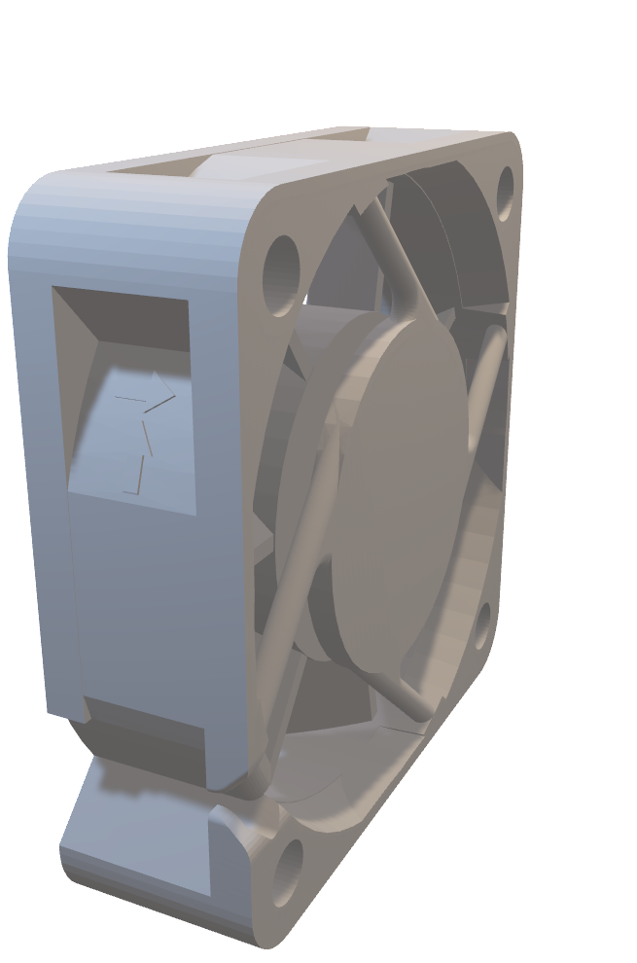
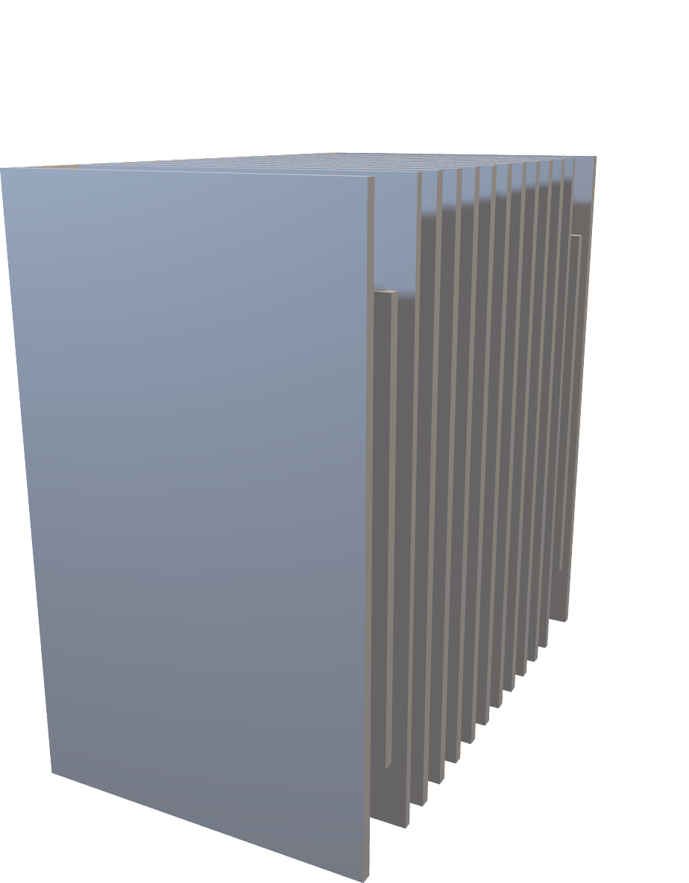
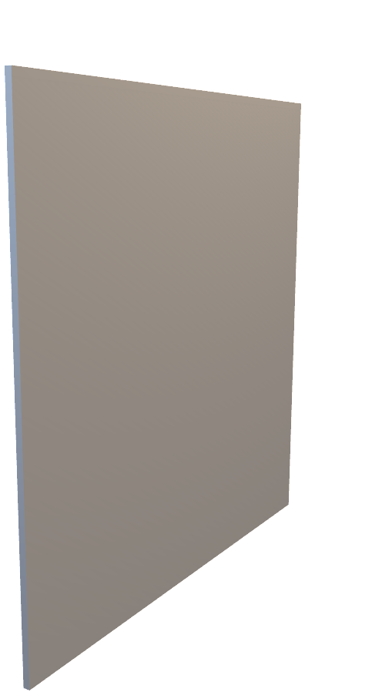
`
ENGG 114 Heat Sink Review | modeled boundary conditions
13
Notes:
Target time: 0:55. Present the BOM as two groups: final product parts and prototype/test hardware. Emphasize that a report-ready BOM should include vendor, part number, quantity, cost, and justification. In this deck, the table shows the needed line items and flags procurement details to finalize if not already in the report.

Slide 24
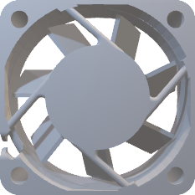


TEST PLAN
14
Prototype testing closes the gap between simplified model and real hardware.
1
2
3
4
5
Assemble
Instrument
Run
Compare
Decide
Heat sink, TIM, fan, and mounting hardware
CPU simulator, base, air inlet, and power
100 W steady state near 25°C ambient
Measured R_total vs MATLAB/Fusion
≤85°C required; ≤70°C derated target
• Record steady-state chip/base temperatures and airflow condition.
• Use measured R_total = (T_chip - T_ambient) / 100 W.
• If measured result misses the 70°C target, adjust fan, TIM, or geometry before claiming margin.
ENGG 114 Heat Sink Review | modeled boundary conditions
Notes:
Target time: 0:50. Use this slide to satisfy the prototype requirement. The test plan applies 100 W, records ambient near 25°C, measures steady-state temperatures, and compares measured R_total to MATLAB/Fusion predictions. The pass/fail logic is 85°C required and 70°C as the derated target.

Slide 25
FINAL VERDICT
The 15-fin DFMA design is selected; the 17-fin design remains the ideal baseline.
The final 15-fin Al-6061 heat sink is selected because it balances modeled thermal performance with spacing, lower mass, tool access, and manufacturability. MATLAB predicts 69.85°C, and Fusion 360 predicts 69.775°C under modeled boundary conditions. The 17-fin ideal baseline is cooler at 61.487°C, but it is less practical for tool access and manufacturability. Prototype validation is required before real-world performance claims.
69.85°C
69.775°C
61.487°C
≤85°C
MATLAB predicted
Fusion 360 predicted
17-fin baseline
official requirement
ENGG 114 Heat Sink Review | modeled boundary conditions
15
Notes:
Target time: 0:55. Deliver the verdict slowly and exactly. The final 15-fin Al-6061 design is selected because it balances the model results with DFMA concerns. Close by saying prototype testing is required for real-world validation, then invite questions so there is 2 to 3 minutes left for Q&A.

Slide 26
PROFESSOR Q&A BACKUP
Answer with assumptions, margins, and required testing.
Why not choose 17 fins?
How close is the 70°C target?
It is cooler, but the final 15-fin design gives better spacing, lower mass, tool access, airflow practicality, and manufacturability.
MATLAB predicts 69.85°C and Fusion predicts 69.775°C under modeled boundary conditions.
What is the largest uncertainty?
What must the prototype prove?
The assumed convection coefficient h = 65 W/m²K and TIM/contact resistance; both must be checked during prototype testing.
At 100 W, measured CPU temperature must be ≤85°C; the 70°C target should be checked against real fan and interface conditions.
ENGG 114 Heat Sink Review | modeled boundary conditions
17
Notes:
Backup only. Use if asked detailed professor questions. Keep answers conservative: modeled boundary conditions, simplified h assumption, contact resistance sensitivity, and prototype validation required.

