Slide 1
“AI in games” course
by
Adrien Dorise
Law Tech Productions

Slide 2
Course summary
Lesson: Introduction to reinforcement learning with value-based methods
Project: Deep Q-learning with Pytorch in the rolling ball gym
Lesson: Reinforcement learning with policy-based methods
Project: PPO with mlagents in the autonomous car gym
Lesson: Pathfinding and reinforcement learning
Project: Pathfinding in the autonomous car gym
Free project

Slide 3
Rolling ball Gym
The rolling ball gym is taken from the mlagent example library. https://unity-technologies.github.io/ml-agents/Learning-Environment-Create-New/
The agent is represented as a ball that tries to reach a square target.
The ball fails if it falls off the platform, or times run out.

Slide 4
Rolling ball Gym
Observations:
Ball position (x,y,z)
Target position (x,y,z)
Ball velocity (x,z)
5 discrete actions:
No movement
Left, right, up, down
Rewards:
+1 when reaching target (stop condition)
-1 when falling (stop condition)
+0.5 when times run out (stop condition)
+0.1 if distance with target decreased
-0.1 if distance with target increased

Slide 5
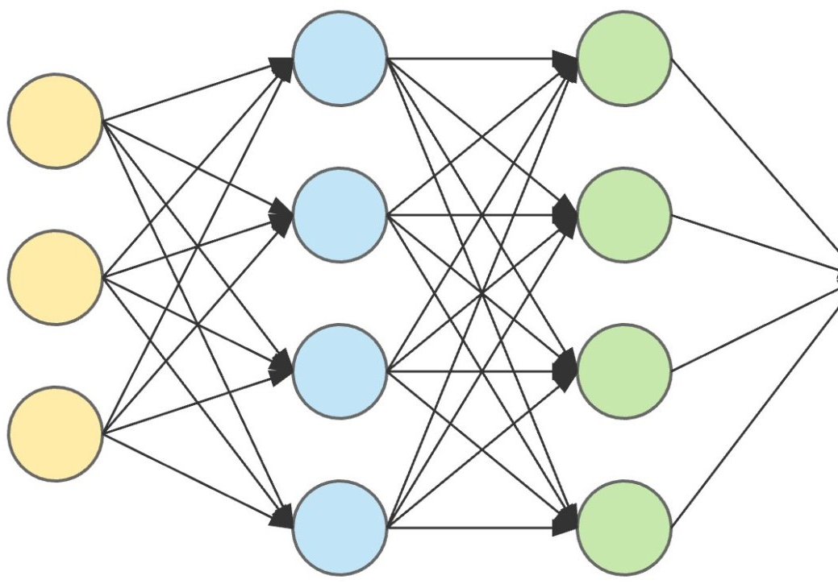
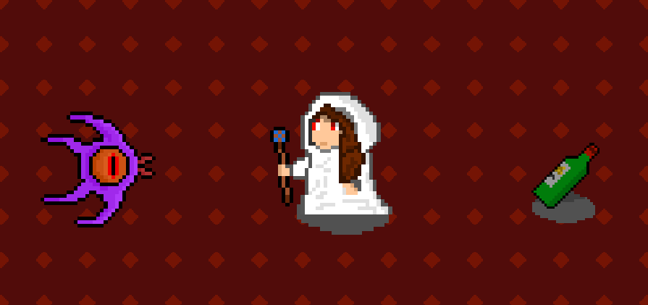
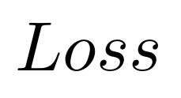




Deep Q-learning
DQN network
Observation of state $s_{t}$
$$O_{1}$$
$$O_{2}$$
$$O_{3}$$
Target network

Slide 6
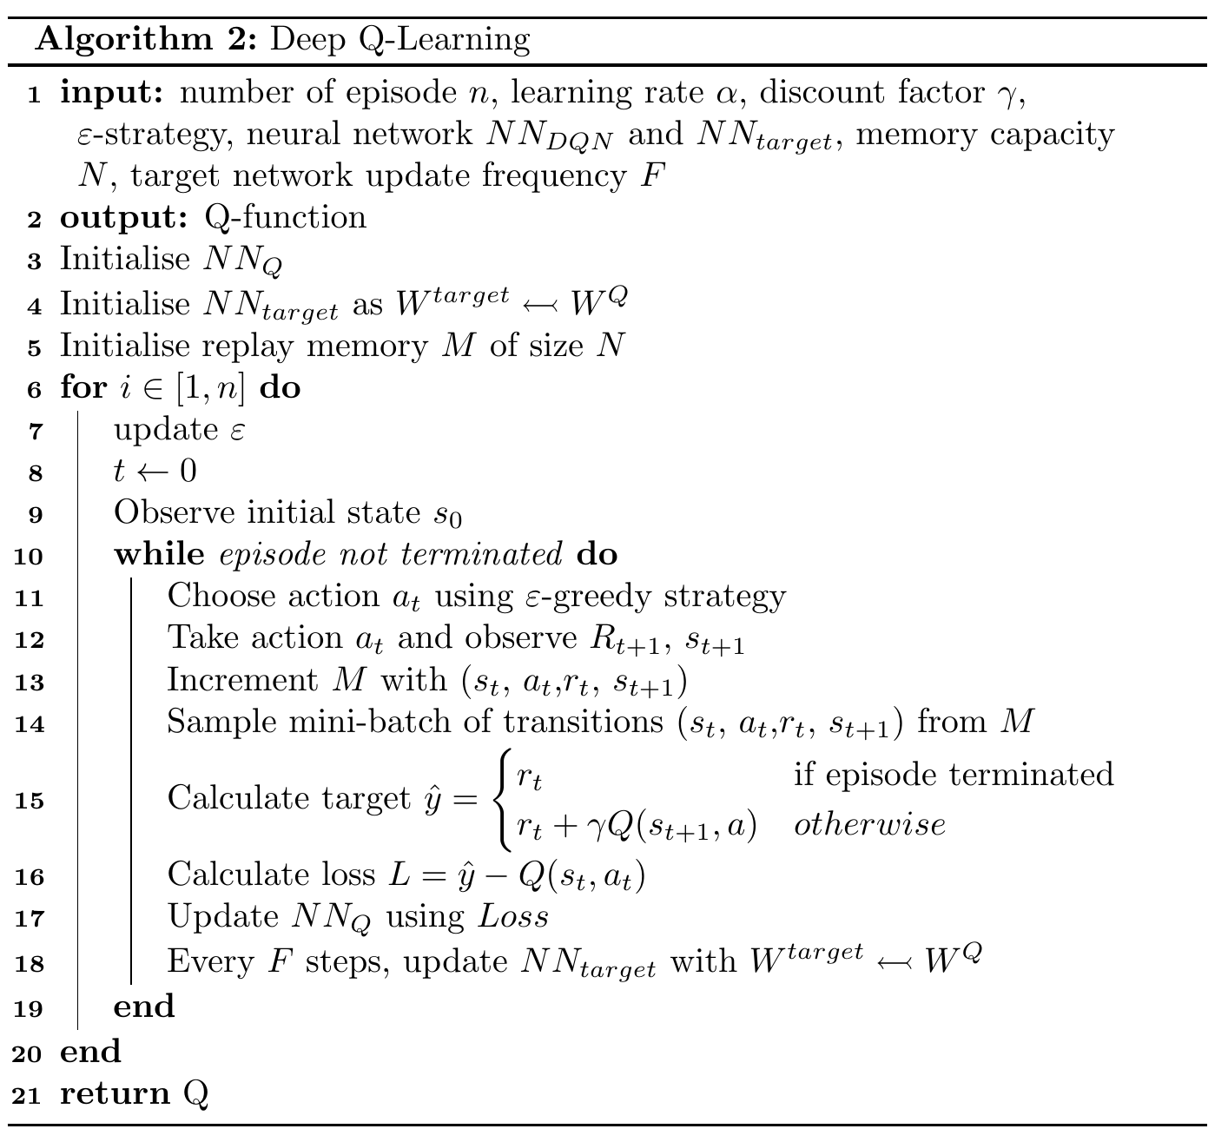
Deep Q-learning
Initialise networks weights
Choose and perform action
Get reward value
Calculate loss using target network
Update Q-network with Bellman equation

Slide 7
Project setup - Requirements
Latest version of Unity (see Unity Documentation)
Python 3.10.8
Python Packages
ray[rllib]
PyTorch (torch)
mlagents
Protobug 3.20.3
Unity Packages
Enable see pre-release (edit->project settings->package manager)
ML Agents 2.0.1

Slide 8
Project setup - Requirements
Unity 2022.3.X
Conda
conda create -n mlagents python=3.10 && conda activate mlagents
Python 3.10.12
Python Packages
mlagents
mlagents_envs
Torch gpu: pip3 install torch torchvision torchaudio --index-url https://download.pytorch.org/whl/cu118
Unity Packages
Enable see pre-release (edit->project settings->package manager)
ML Agents 2.0.1
ML agents extension

Slide 9
Install instructions: Python VENV
Doc: https://unity-technologies.github.io/ml-agents/Installation/
Install unity Hub and Unity 2022.3.X: https://unity.com/download
Install Python 3.10.11 (don’t forget to add Python to PATH)
https://www.python.org/downloads/release/python-31011/
In the project folder, create Python virtual environment
python3 -m venv venv
Clone repo with git (use tag –branch release_21 for last stable release)
git clone --branch release_21 https://github.com/Unity-Technologies/ml-agents.git

Slide 10
Install instructions: Unity VENV
Add mlagents package to unity -> In unity:
Window -> Package Manager
Click on “+” button of the package manager
Select Add package from disk
Locate the cloned ml-agents folder
Select “com.unity.ml-agents/package.json” file
Add mlagents_extensions package to unity -> In unity:
Repeat previous step
Select “com.unity.ml-agents.extensions/package.json” file
Play when Editor not focused
Edit -> project settings -> Player -> Resolution and presentation -> check “run in background”

Slide 11
Install instructions: Python setup
In a prompt:
Activate your virtual environment
Linux + venv: source venv/bin/activate
Windows + venv : ./venv/Scripts/activate
Install numpy
pip install numpy==1.23.5
Install torch
pip3 install torch~=1.13.1 -f https://download.pytorch.org/whl/torch_stable.html
If Windows: install C++ Redistributable (see https://pytorch.org/get-started/locally/)
Remove numpy 1.21.2 dependency
Go to ml-agents/ml-agents-envs/setup.py
Remove line "numpy==1.21.2“,
Install tensorflow
pip install tensorflow
pip install protobuf==3.19.6
Install mlagents
cd /path/to/ml-agents
python -m pip install ./ml-agents-envs
python -m pip install ./ml-agents
DONE! Run mlagents-learn to see if succesfull

Slide 12
Install instructions: Python setup
In a prompt:
Activate your virtual environment
Linux + venv: source venv/bin/activate
Windows + venv : ./venv/Scripts/activate
Install numpy
pip install numpy==1.23.5
Install torch
pip3 install torch~=1.13.1 -f https://download.pytorch.org/whl/torch_stable.html
If Windows: install C++ Redistributable (see https://pytorch.org/get-started/locally/)
Remove numpy 1.21.2 dependency
Go to ml-agents/ml-agents-envs/setup.py
Remove line "numpy==1.21.2“,
Install tensorflow
pip install tensorflow
pip install protobuf==3.19.6
Install mlagents
cd /path/to/ml-agents
python -m pip install ./ml-agents-envs
python -m pip install ./ml-agents
DONE! Run mlagents-learn to see if succesfull

Slide 13
Project
In this project, we will use a very common ML Python package: PyTorch.
It is divided into three files:
rollerAgentDiscrete.cs
Rolling ball agent controller
Rewards, observations an actions management in the Unity environment.
rolling_ball_gym.py
Python gym management
Link between Unity and Python environment
rolling_ball_DQN.py
DQN implementation
Network implementation
Replay memory implementation

Slide 14
Project
The project can be cloned at https://github.com/Adrien-Dorise/AI_in_games_course
Your work is to implement the DQN algorithm
To start the training, execute rolling_ball_gym.py, and start the rolling_ball_gym scene in the Unity editor.
When training starts to converge, it stops, and a figure is created to analyse the training.

Slide 15
What now?
To complete the DQN algorithm, fill in the blanks in rolling_ball_DQN.py and rolling_ball_gym.py
Complete the Network class
Define the network architecture in init(). Try first with a [input,512,output] layer architecture
Define the propagation function
Complete update() and learn() in the Dqn class
Add the new state to the replay memory
Update the target network at a frequency F
Calculate the Q-value at time t+1
Train the ball agent to get to the cube
Modify the parameters for better training
Change the rewards in rollingAgentDiscrete.cs

Slide 16
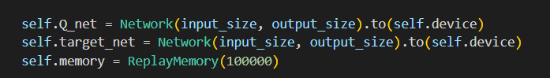
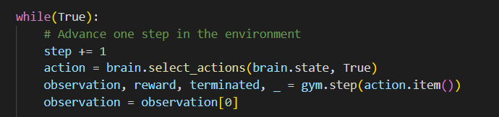
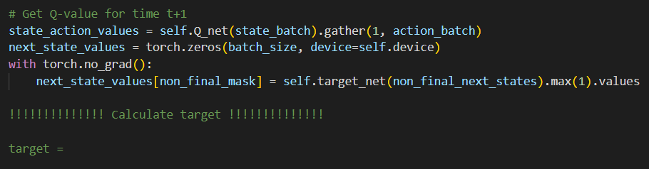
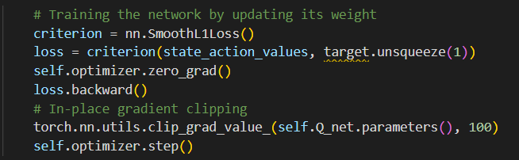
Cheat sheet
The Deep Q-learning is implemented as follow in this project.
Rolling_ball_DQN.py
Rolling_ball_gym.py
Rolling_ball_DQN.py
TO DO
Rolling_ball_DQN.py

Slide 17
Cheat sheet
A class managing replay memory is already implemented. You can interact with it with two methods
To implement a neural network class, the definition of the network as well as a forward function are needed (see PyTorch doc).
Replay memory
Network
Push(): add new state in memory
Sample(): Get batch of desired size
Init(): Define the neural network architecture with Linear module
Forward(): Propagate the input through the network

