Slide 1
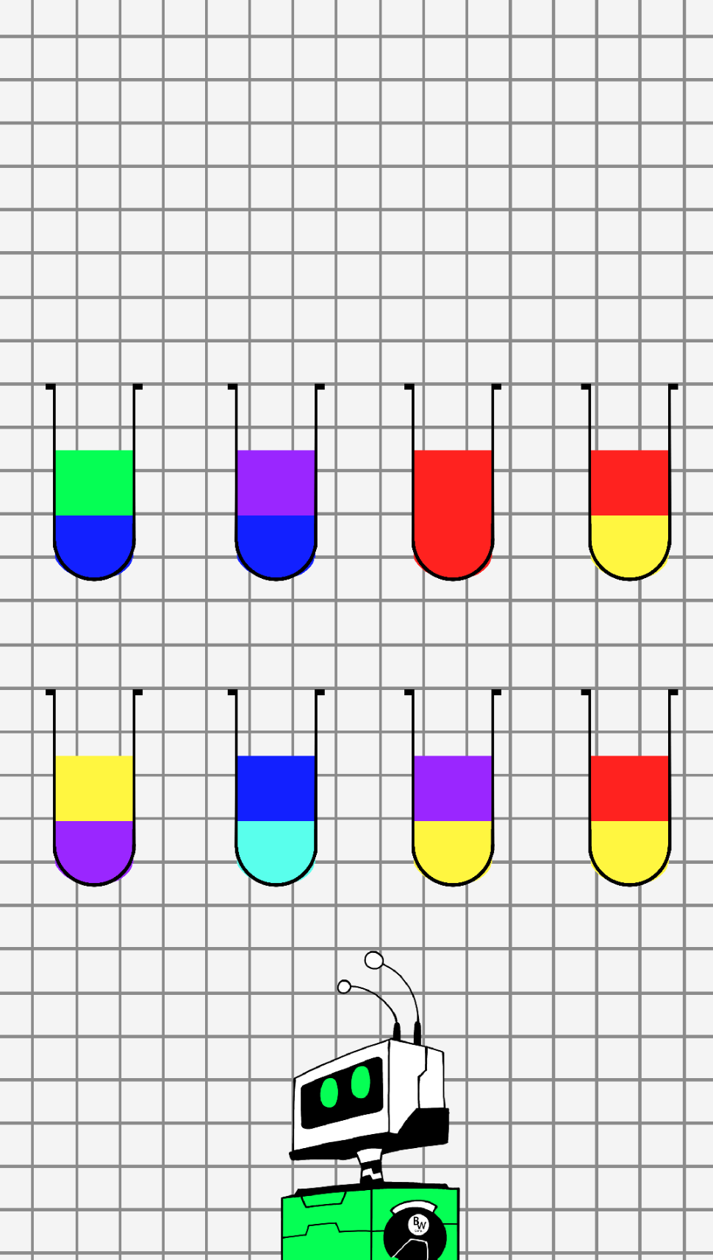
Color Sorter

Slide 2
Victory
Reset
Levels

Slide 3


