Slide 1
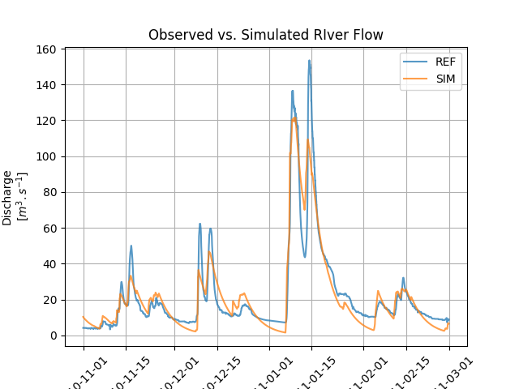
Optimised

Slide 2
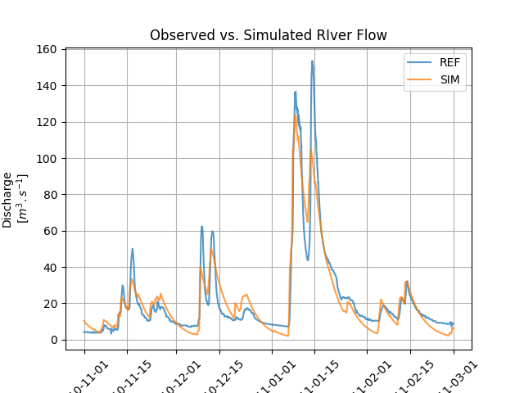
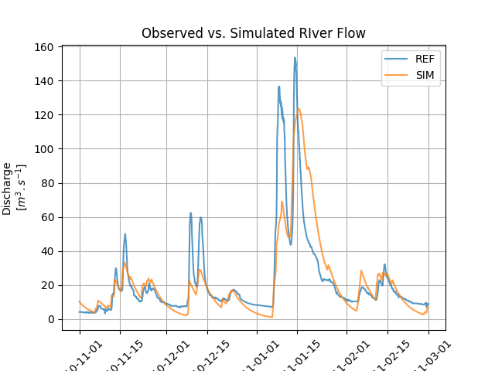
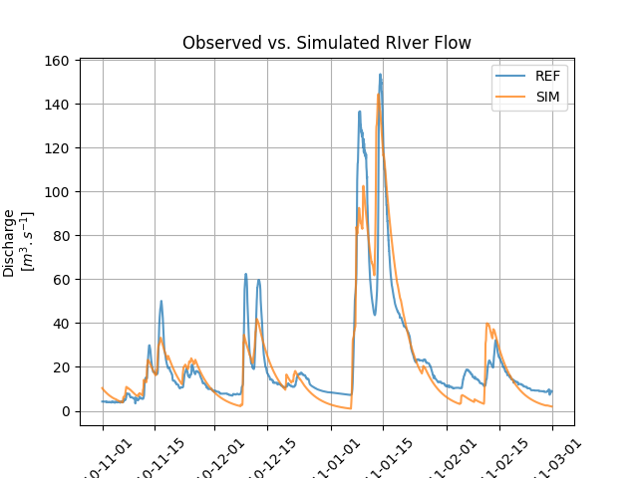
Snow
Snw_att
Snw_pmf
Snw_amf

Slide 3
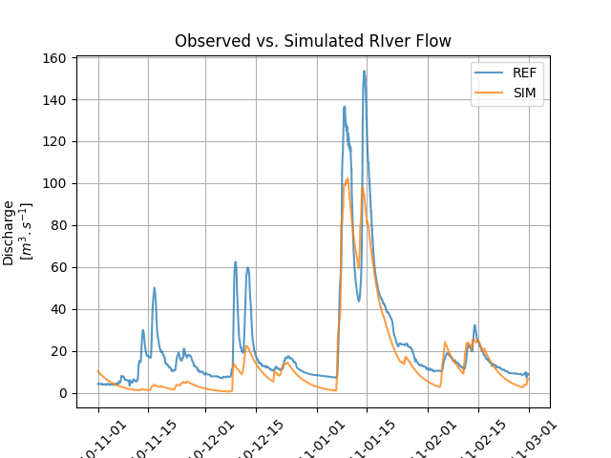
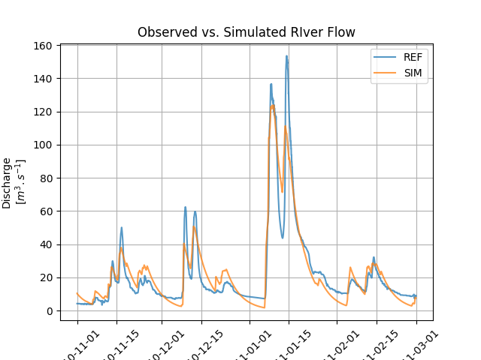
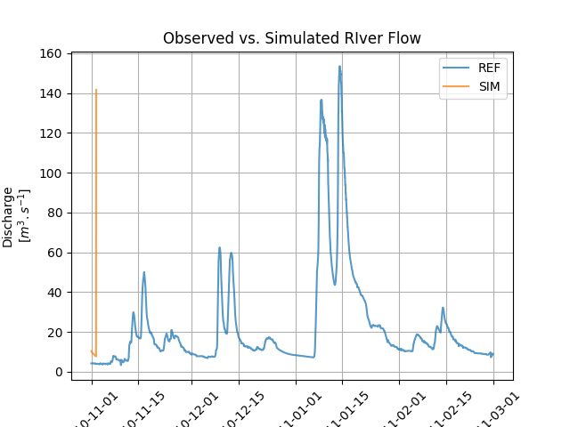
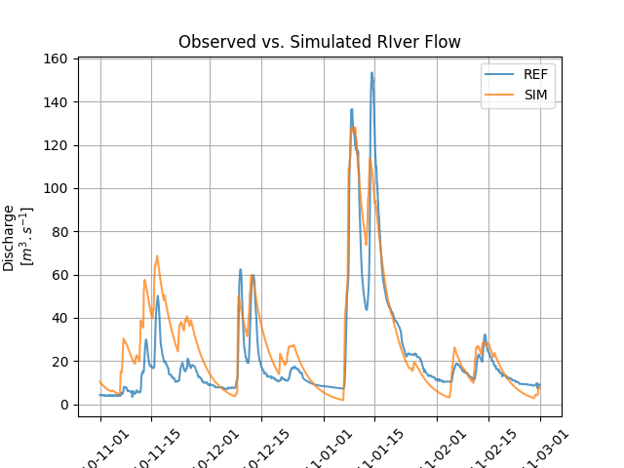
Soil
Slo_dth
Slo_pwp
Slo_fcy
Slo_bt0

Slide 4


Urr_dth
Lrr_dth

Slide 5

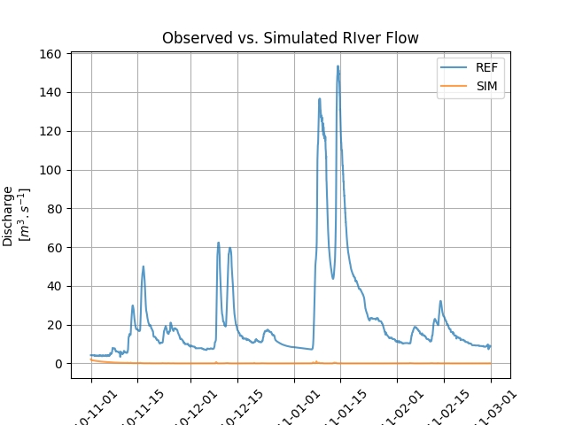
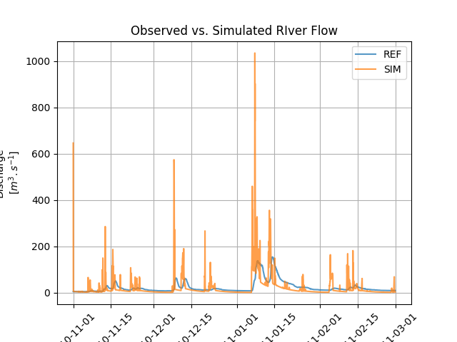

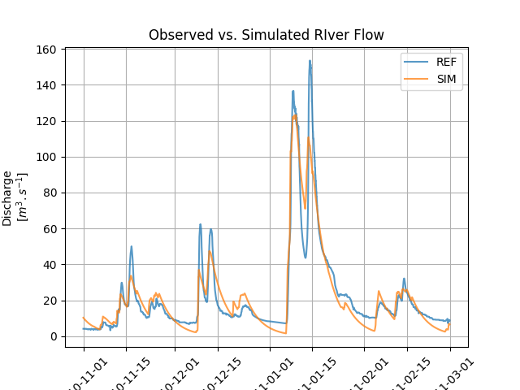
Urr_wsr
Urr_ulc
Urr_tdh
Urr_tdr
Urr_ndr
Urr_uct

Slide 6


Lrr_dre
Lrr_dct

