Slide 1
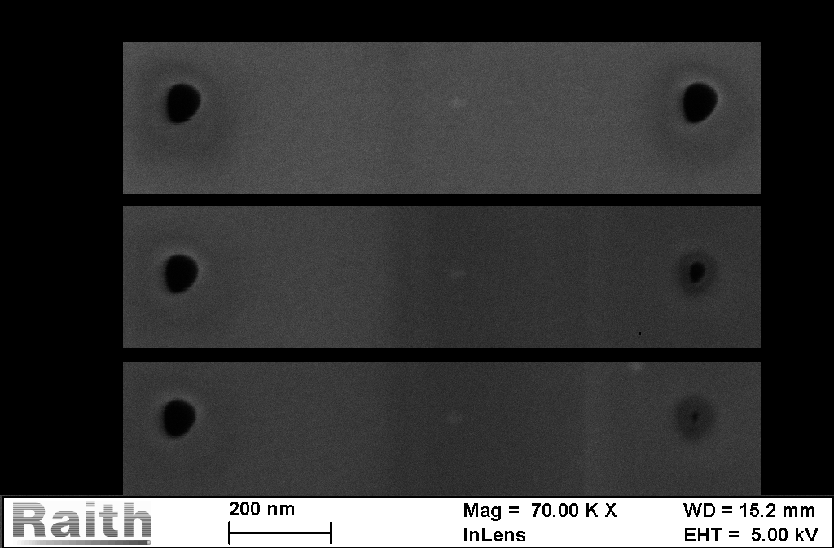
Closing holes
80nm
10nm

