Slide 1
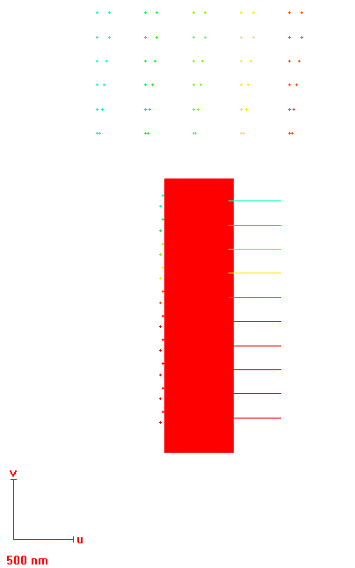
Dot DF: 0.6…1.4 (0.2)
100 nm
100 nm
200 nm
80 nm
60 nm
40 nm
20 nm
fprectangle
Line/dot DF: 0.6… 2.4 (0.2)
200 nm
Area DF: 6

Slide 2
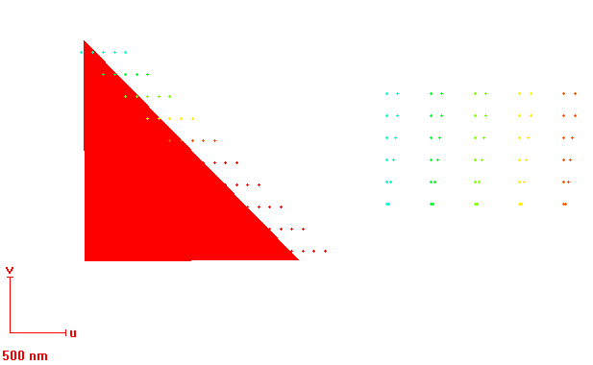
100 nm
Dot DF: 0.6… 2.4 (0.2)
Dot DF: 0.6…1.4 (0.2)
200 nm
100 nm
100 nm
200 nm
80 nm
60 nm
40 nm
20 nm
Area DF: 10
fptriangle

Slide 3
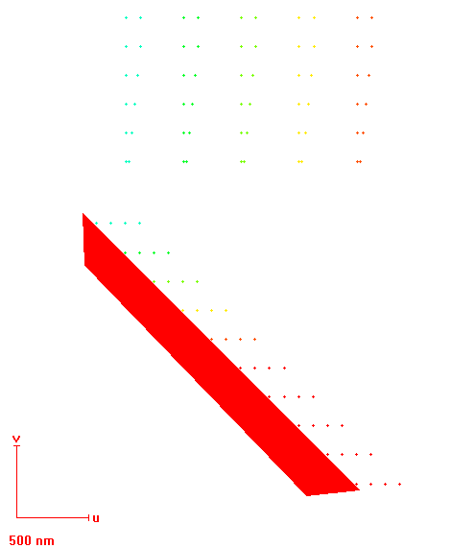
Dot DF: 0.6…1.4 (0.2)
100 nm
200 nm
100 nm
80 nm
60 nm
40 nm
20 nm
100 nm
Dot DF: 0.6… 2.4 (0.2)
200 nm
Fp triangle 2
Area DF: 10

Slide 4
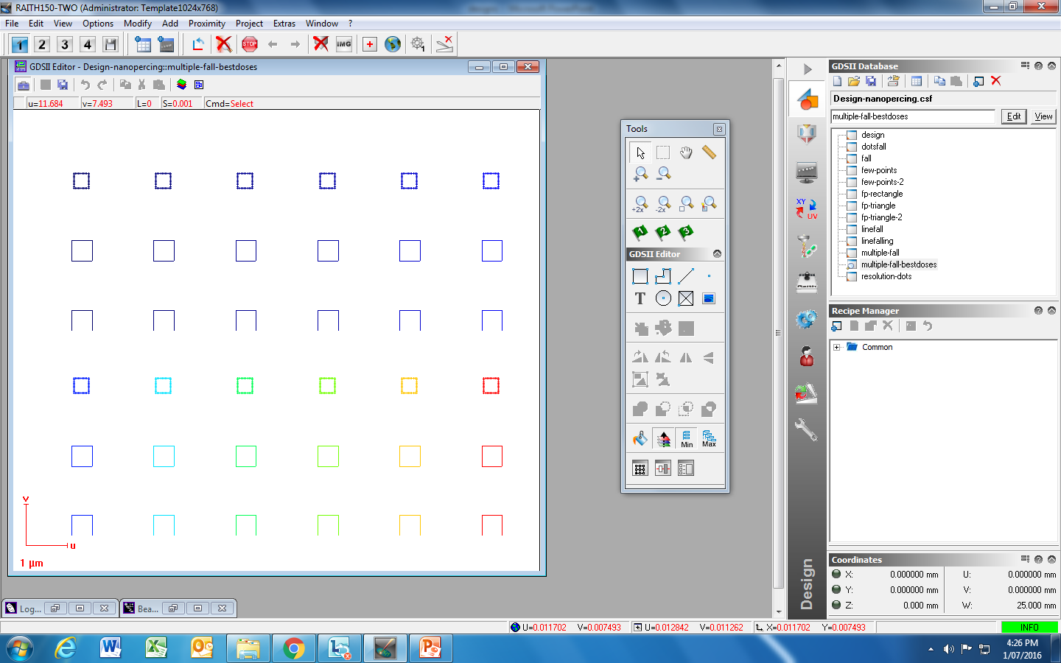
Dots/Line DF: 1
1,6
1,8
1,2
1,4
300 nm
500 nm
Multiple fall

Slide 5
Dots/Line DF: 0.1
0.4
0.6
0.8
0.2
0.3
300 nm
500 nm
Dots/Line DF: 1
4
5
6
2
3
Multiple fall best doses

Slide 6
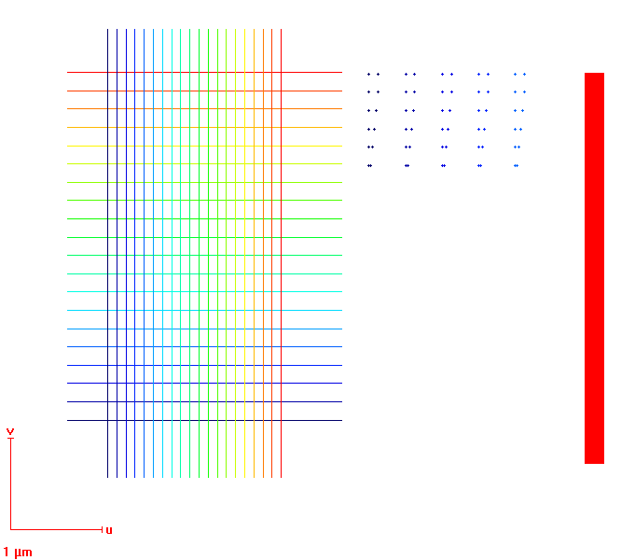
design
Line DF: 0.6…4.4 (0.2)
100 nm
Dot DF: 0.6…1.4 (0.2)
200 nm
100 nm
Line DF: 4.4… 0.6 (0.2)
100 nm
80 nm
60 nm
40 nm
20 nm

Slide 7
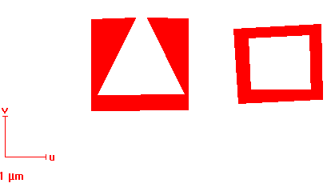
Fall
Area DF: 6

Slide 8
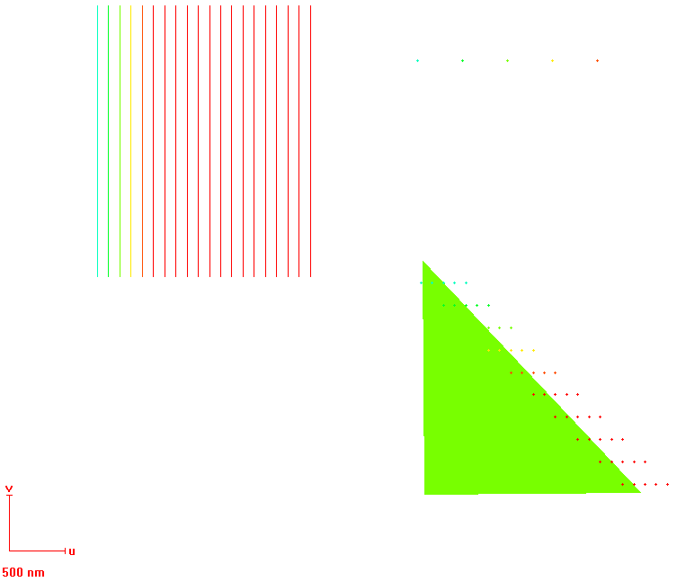
400 nm
Dot DF: 0.6…1.4 (0.2)
100 nm
Dot DF: 0.6… 2.4 (0.2)
100 nm
Line DF: 0.6…4.4 (0.2)
200 nm
Area DF: 1
Few Points 2

Slide 9
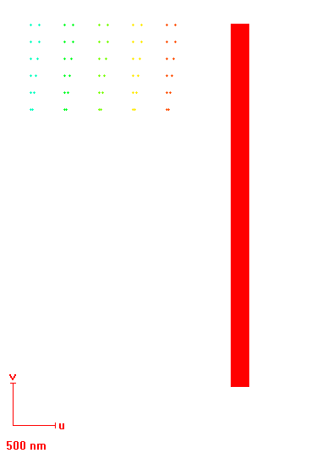
Dot DF: 0.6…1.4 (0.2)
100 nm
200 nm
100 nm
80 nm
60 nm
40 nm
20 nm
Resolution-Dots

