Slide 1
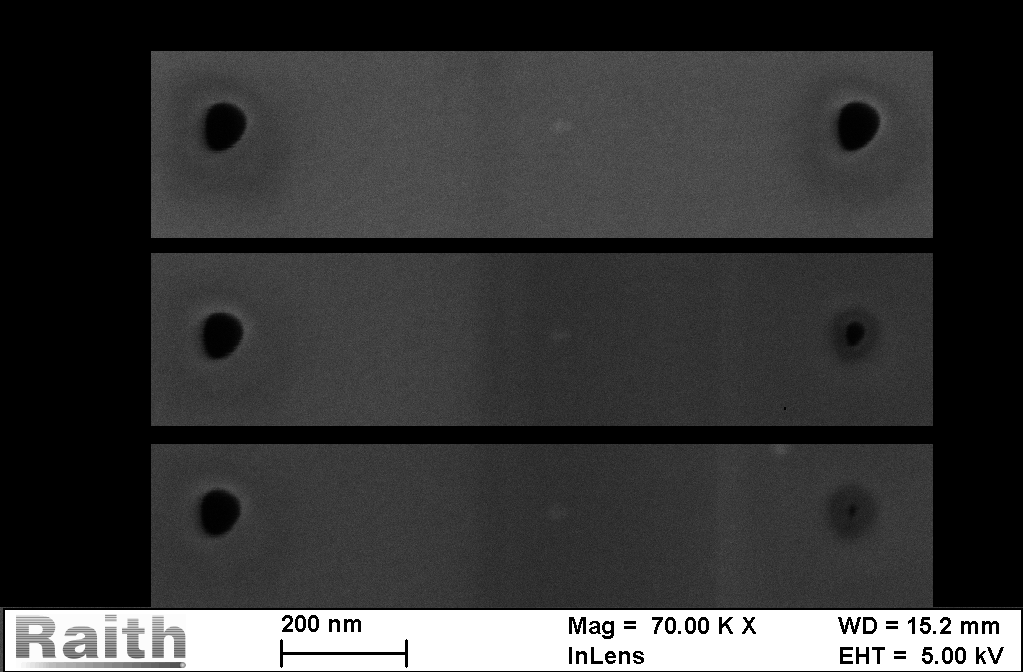
Closing holes
80nm
10nm
backside
frontside
With SEM we can close holes from both side of the membrane.

Slide 2
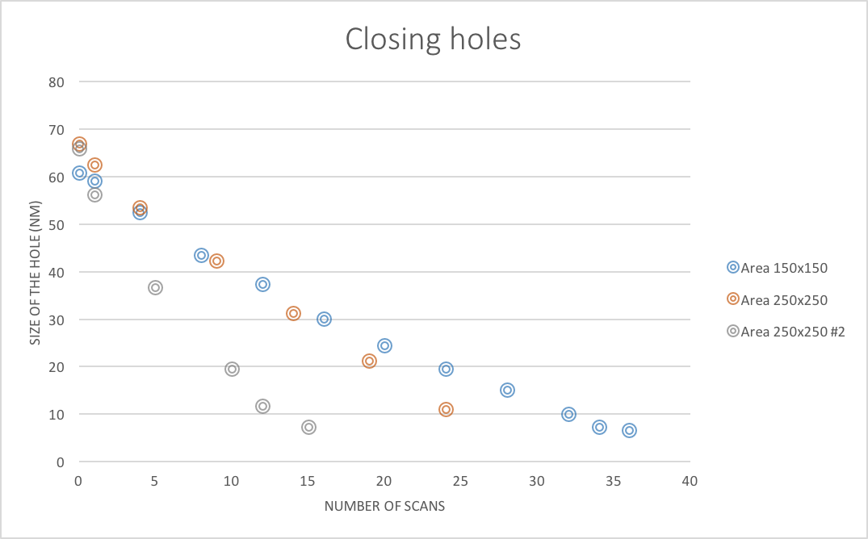
Closing holes
The size of the hole depends ~linearly of the number of scans

Slide 3
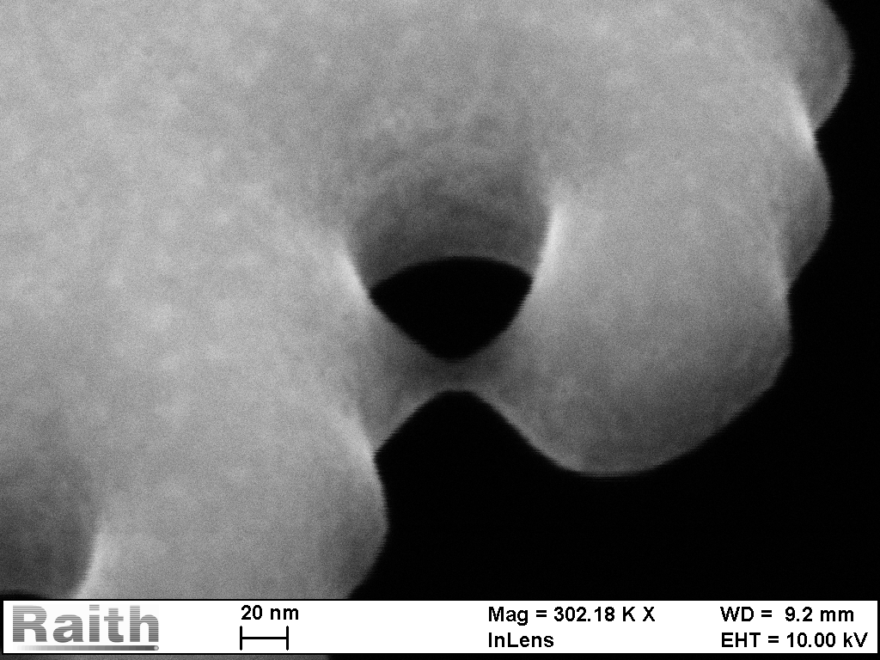
Profile of line and dot milling
45° view with SEM

Slide 4
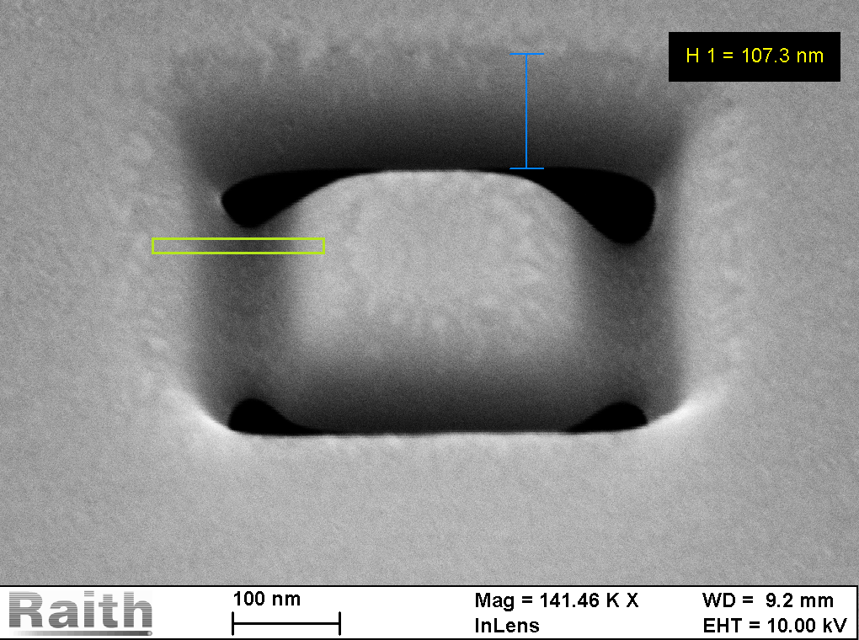
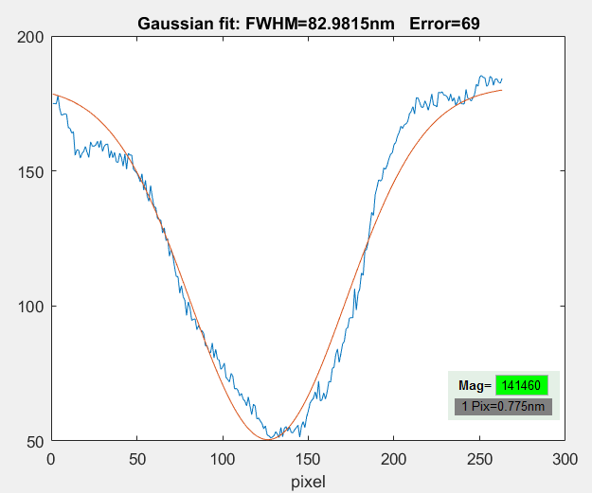
Profile of line and dot milling
SEM at angle revealed the profile of our milling: gaussian or hypergaussian

