Slide 1


FIB Milling of nano-thin SiN membranes
With the supervision of Armandas Balčytis and Saulius Juodkazis
Clémence Briosne-Fréjaville Adrien Mau

Slide 2
FIB Milling of nano-thin SiN membranes
Focused Ion Beam and membranes
Milling through the membrane
Resolution

Slide 3
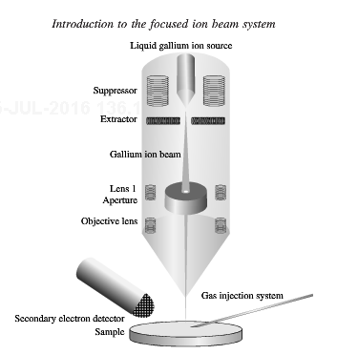
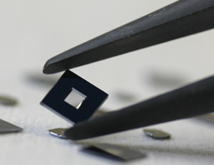
Focused Ion Beam and membranes
Thickness: ~100 nm
Coating: 5 nm Cr
Parameters:
Column: Voltage - Aperture – Current Dot, line and area doses (pC) Number of loops

Slide 4
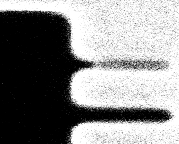
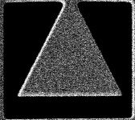
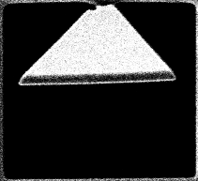
Milling through the membrane
Ion beam
Just a scratch
Pierced !
Use of contrast
Make-fall of a membrane
We can spot a hole with the contrast, or with the ability of the membrane to fall.
Two kind of designs

Slide 5
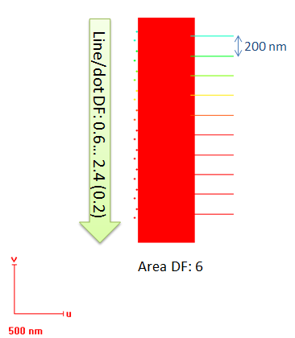
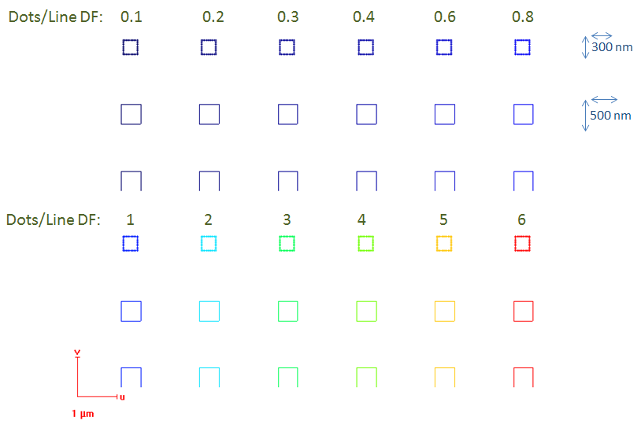
Milling through the membrane
Detect the breakthrough for holes and lines
Make-fall
Use of contrast

Slide 6
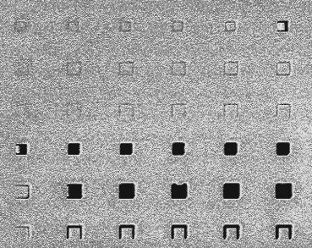
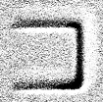
Milling through the membrane
Remarks:
If the number of loops is increased, we must increase the total charge to mill through.
Some line milling are inhomogeneous:
When we mill a large area, it boosts the milling of the surrounding membrane.
Dot dose to pierce is between 1.2 and 1.6 pC
Line dose is between 1152 and 2304 µC.

Slide 7
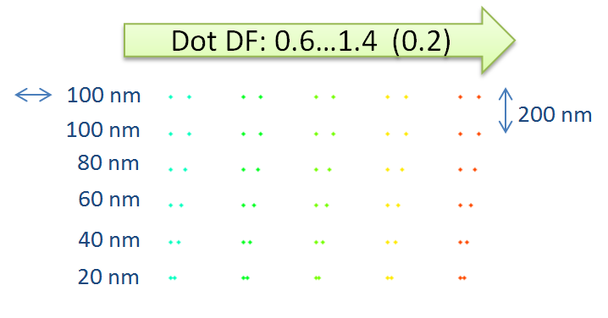

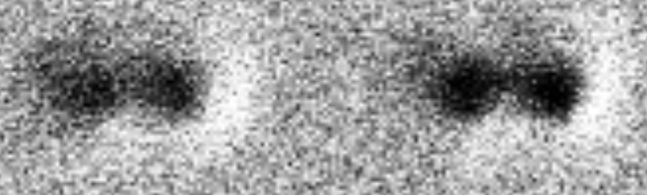
Tests of resolution
Repeatability
Step between dots
Total charge to mill through
Hole size
Distinguishable
Not milled through
~ Milled through
Not distinguishable

Slide 8
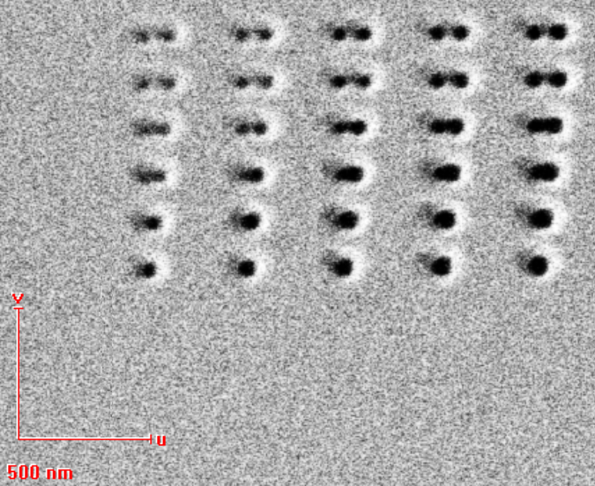
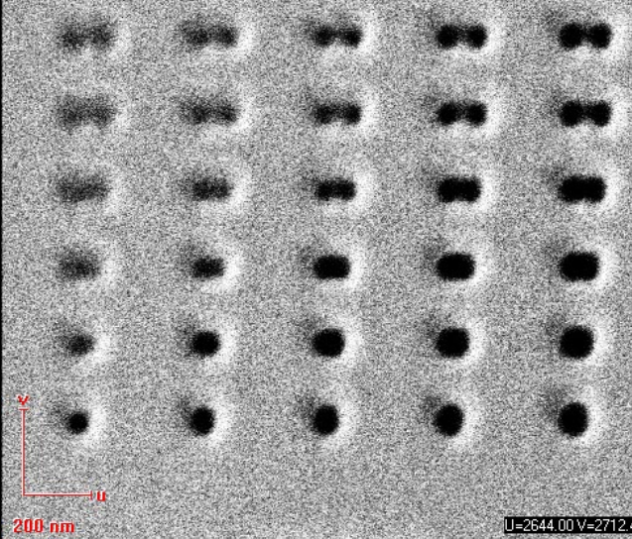
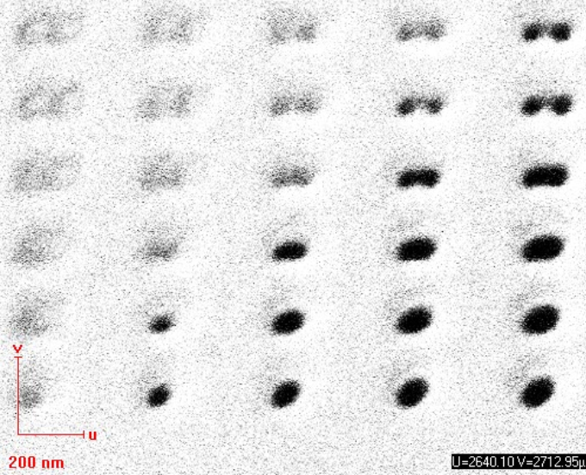
Tests of resolution
1 loop
Milled through for 1,6 pC
20 loops
Milled through for 2,4 pC
200 loops
Milled through for 2,8 pC
Hole size ~ 45 nm at 6,5 pA
SEM

Slide 9
Conclusion
Next weeks:
Use of SEM
Use the 1 pA column
Change the coating (10 nm Cr)
Milling at angle

