Slide 1
Milling holes in 10nm thin membranes
Adrien Mau and Clémence Briosne Fréjaville

Slide 2
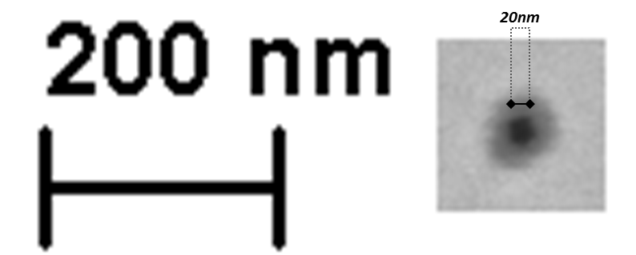
One of the holes we obtained without closing:

Slide 3
SEM – Frontside (direct milling)
We closed a bit those holes

Slide 4
SEM – Backside
Holes a bit closed

