Slide 1


FIB Milling of nano-thin SiN membranes
Main results:
Smallest holes achievable : 20nm
Ability to close holes up to ~10nm
Clémence Briosne-Fréjaville Adrien Mau

Slide 2
Backside view of a through-hole. On the other side the hole is 40nm wide

Slide 3
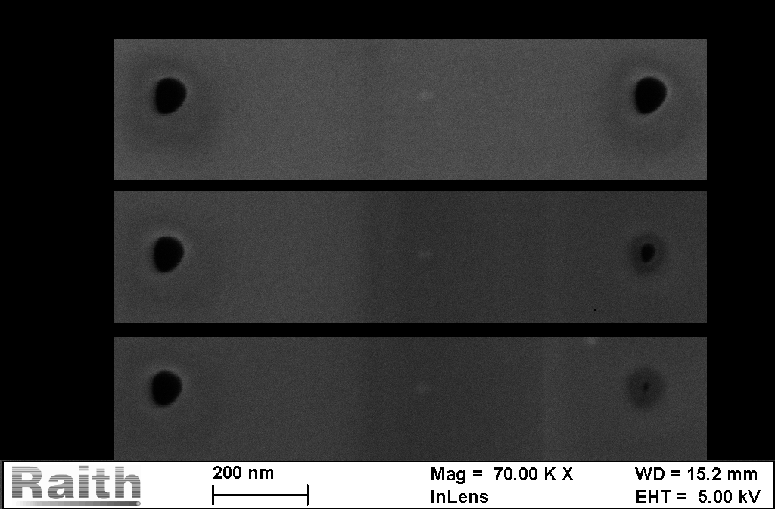
Closing holes
Successive SEM scans can slowly close the holes.
80nm
10nm

Slide 4

FLIM (fluorescence lifetime imaging microscopy )
50 nm holes
10x10 holes
Step: 500 nm
300 nm
100 nm
20 nm holes

Slide 5
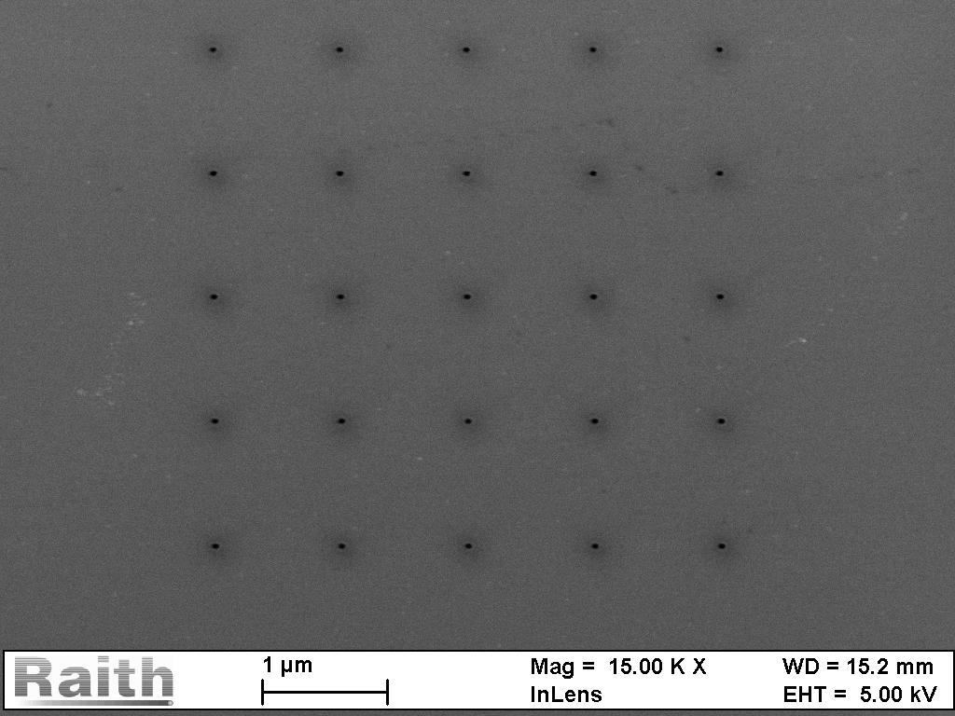
Repeatability?
Loop: 20 i=6,3pA
Total charge: 0,24pC
Hole size 40nm

Slide 6
Conclusion
We can achieve very small hole size. The challenge is to measure them, and to get a better repeatibility.
Coming soon:
Change the coating (10 nm Au)
Array of nanoholes for microscope use

