Slide 1


Entrepreneurship and Negotiation
1
Entrepreneurship: A Field— And An Activity

Slide 2
“Much of our progress has been the product of the individual who had an idea; pursued it; fashioned it; tenaciously clung to it against all odds; and then produced it, sold it and profited from it.”
--Hubert Humphrey, 1966

Slide 3
A Definition
Entrepreneurship seeks to understand how opportunities to create something new arise and are discovered or created by specific persons who then use various means to exploit or develop them, thus producing a wide range of effects.

Slide 4
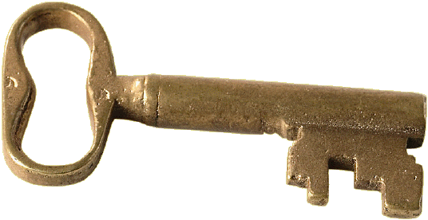
Key Activities
Identifying an opportunity
Exploiting or developing this opportunity
Running a new business successfully

Slide 5

Intrapreneurs
Persons who create something new, but inside an existing company rather than through a new venture.

Slide 6
Trend toward Entrepreneurship
Media accounts of success
Change in “employment contract”
Change in basic values

Slide 7
Foundations in Other Disciplines
Sociology
Technology
Psychology, cognitive science
Behavioral science
Business and finance
Law
Economics
Political science

Slide 8

Macro and Micro
Micro perspective—focuses on the behavior and thoughts of individuals
Macro perspective—focuses primarily on environmental factors
Both are key in understanding the entrepreneurial process

Slide 9
The Process
Recognition of an opportunity
Deciding to proceed and assembling resources
Launching a new venture
Building success
Harvesting the rewards

Slide 10

A Confluence of Factors
Social
Change
New
Markets
Opportunity
Economic
Change
Technology

Slide 11




Variables
Individual
Entrepreneurial
Process
Societal
Group

Slide 12

The Essence of Entrepreneurship
The intersection of valuable opportunities and enterprising individuals is the essence of entrepreneurship.

Slide 13
“There are three principal means of acquiring knowledge: observation, reflection and experimentation. Observation collects facts; reflection combines them; experimentation verifies the result of that combination…”
--Diderot

Slide 14
Systematic Observation
Observe aspects of the world systematically
Generate and test hypothesis
Use this information as a basis for conclusions
Doesn’t resolve question of causation

Slide 15

Experimentation
Systematically changes one variable in order to see if changes affect one or more other variables
Involves active interventions
Determines causation
Not often used in the study of entrepreneurship

Slide 16
Reflection
Combining facts in a careful and systematic way to reach conclusions
Central to case method and other qualitative methods of research

Slide 17
Theory
Moves beyond efforts to merely describe phenomena
Moves to the point at which we can explain why and how things happen as they do
Prospect theory of decision making

Slide 18
Developing a Theory
A theory is proposed
Hypothesis is made
Hypotheses is tested by research
Positive results increase confidence in accuracy; negative results lead to modification of theory and further testing
Theory is accepted or rejected

Slide 19

Two Final Points
Theories are never proven in any final, ultimate sense
Research should never be undertaken to prove or verify a theory

Slide 20

“’Tis a sort of duty to be rich, that it may be in one’s power to do good…”
--Lady Mary Montagu

Slide 21
To Do Good
Entrepreneur’s products and services improve the lives of countless millions of persons
Entrepreneurs are often extremely generous in their donations to worthy causes

Slide 22
SUMMARY OF KEY POINTS - ENTREPRENEURSHIP
As a field of business seeks to understand how opportunities arise and how individuals develop them into producing a wide range of effects
In recent years, the allure has increased so much that more people are choosing it as a career.
As a branch of business has roots in many other disciplines – economics, sociology, behavioural science.
Is a process
Happens when there is a “collision” at the crossroads of valuable opportunities and enterprising individuals

Slide 23
Activity 1
If you are given a chance to be an entrepreneur,
What would be your preferred industry? Why?
What product would you be offering?
Who would be your target markets?
What are the possible marketing/advertising channels?
What would be your tagline?

Slide 24
Activity 2
Do you think Universities should own patents for inventions or scientific advances made by students?

Slide 25
Activity 3
 | Criteria | Y/N | Y/N | Y/N
1. | Can you handle uncertainty?
2. | Are you energetic?
3. | Do you believe in yourself and your abilities?
4. | Can you handle failures and reversals well?
5. | Are you passionate about goals & visions?
6. | Are you good with other people?
7. | Are you adaptable?
8. | Are you willing to take risks or leaps of faith?

