Slide 1


Entrepreneurship and Negotiation
2
Uncovering Opportunities: Understanding Entrepreneurial Opportunities and Industry Analysis

Slide 2
“In great affairs we ought to apply ourselves less to creating chances than to profiting from those that offer.”
--La Rouchefoucauld, Maxims, 1665

Slide 3
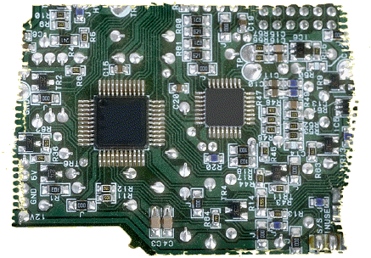
Better Opportunities
Some industries are more favorable to new firms than others
Some types of opportunities are better than others for new firms to pursue

Slide 4
Changes Make It Possible…
To make new products
To develop new production processes
To organize in new ways
To open up new markets
To use new raw materials

Slide 5
Opportunities from Information
Entrepreneurial opportunities exist because people have different information.
Different information leads to different decisions.
Superior information leads to better decisions.

Slide 6
Opportunities from Change
Truly valuable entrepreneurial opportunities come from an external change that either
Makes it possible to do things that had not been done before.
Makes it possible to do something in a more valuable way.
(Josef Schumpeter)

Slide 7

Change Leads to Potential
New technology
Political and regulatory shifts
Social and demographic change

Slide 8

Technological Change
Makes it possible for people to do things in new and more productive ways.
Larger technological changes are a greater source of opportunity.

Slide 9

Political and Regulatory Change
Makes it possible to develop business ideas to use resources in new ways that are either more productive, or that redistribute wealth from one person to another.

Slide 10
Opportunities from Political and Regulatory Change
Deregulation
Regulations that support particular types of business activities
Regulations that increase demand for particular activities or subsidize firms that undertake them

Slide 11
Social and Demographic Change
Alters demand for products and services
Makes it possible to generate solutions to customer needs that are more productive than those currently available

Slide 12

New Businesses
Entrepreneurs who create new businesses primarily focus on
New products and services
New markets

Slide 13
New vs. Established Firms
Entrepreneurs founding new firms are usually the ones to introduce new products and services.
Established firms are usually the ones to introduce new production processes and ways of organizing.

Slide 14
Success of New Firms
Industry differences influencing new firm success:
Knowledge conditions
Demand conditions
Industry lifecycles
Industry structure

Slide 15
Knowledge Conditions
New firms do better in:
Industries that have greater R&D intensity
Industries in which public sector organizations produce most of the new technology
Industries in which small firms are the better innovators

Slide 16
Demand Conditions
New firms do better in:
Larger markets
Rapidly growing markets
More heavily segmented markets

Slide 17
Industry Life Cycles
New firms do better
When industries are young
Before a dominant design emerges

Slide 18
Industry Structure
New firms perform more poorly in
Capital-intensive industries
Advertising-intensive industries
Concentrated industries (versus fragmented industries)
Industries composed of mostly large firms

Slide 19

Advantages of Established Firms
The learning curve
Established reputation
Positive cash flow
Economies of scale
Complementary assets

Slide 20
Advantages for New Firms
Competence destroying change
Discrete products and services
Ideas embedded in human capital

Slide 21
Competence Destroying Change
Large Companies
Locked into old ways of thinking
Must cannibalize existing business
Hindered by established routines
Must seek to satisfy existing customers
Small Companies
Can think in new ways
No concerns with existing business
Can form new routines easily
No existing customer base to satisfy

