Slide 1


Entrepreneurship and Negotiation
4
Acquiring Information: Why “Look Before You Leap” Is Truly Good Advice for Entrepreneurs

Slide 2
“The facts: nothing but the facts: worship of the facts leads to everything, to happiness first of all, and then to wealth.”
--Edmond de Goncourt Edmond, 1888

Slide 3
Why Failure?
Many entrepreneurs who found new ventures to develop products or services do not do their homework: they fail to acquire essential information before beginning.

Slide 4

Crucial Information
Marketing information
Government regulations and policies
Laws

Slide 5
“We read advertisements…to discover and enlarge our desires. We are always ready…to discover, from the announcement of a new product, what we have all along wanted without really knowing it.”
--Daniel J. Borstein, 1961

Slide 6
Marketing Information
Who are the potential customers?
How will potential customers react to the new product of service?
What can you learn about specific markets or geographic areas?

Slide 7

Direct Techniques
Survey
Perceptual mapping
Focus groups

Slide 8
Customer Surveys
Potential customers compare your product with existing ones
Target group rates different dimensions of the product on a scale from low to high
Assumes you know the dimensions customers use to evaluate products

Slide 9
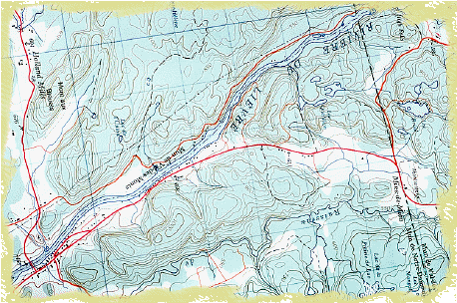
Perceptual Mapping
  A map that reveals the key dimensions along which potential customers perceive products and evaluate them

Slide 10
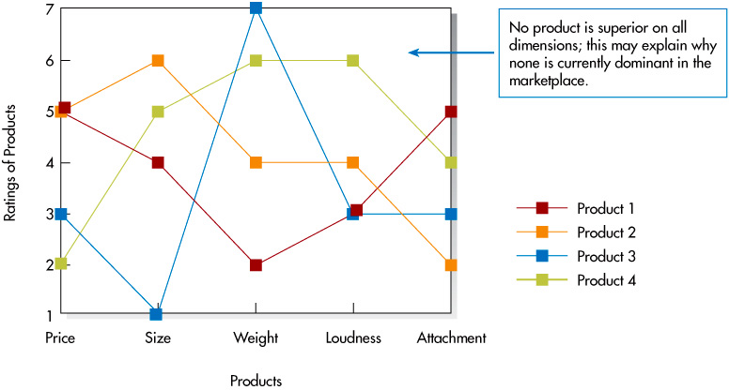
Perceptual Maps for Object Locators

Slide 11
Focus Groups
Groups of 8 to 12 people similar to potential customers
Meet for one to two hours to describe their perceptions of and reactions to relevant products
Identify the key dimensions along which focus group members perceive and evaluate various products

Slide 12
Repertory Grid
Each product is listed on a separate index card
Three cards are chosen
Group members describe ways in which any two products are similar and the third is different
Identifies dimensions along which people perceive the product

Slide 13
Indirect Techniques
Examine secondary data including
Sales of competing products
Demographic data
Trends (economic, lifestyle, etc.)

Slide 14
Government Policies and Regulations
May make it harder or easier to start and run a new venture
Gather relevant information on the government policies and regulations that will affect a new business

Slide 15
Taxes
Reduction of Marginal Tax Rates
Growth of New Ventures

Slide 16
Legal Forms and Taxes
Regular C corporation—profits and losses remain in the company and the corporation pays taxes
Sub-Chapter S Corporation—profits and losses flow through to shareholders, and they pay taxes

Slide 17
Tax Incentives
Depreciation
Location in certain geographic regions
Renovation and improvement of older buildings
Tax credits

Slide 18
Government Policy
Small Business Regulatory Enforcement Fairness Act
Unfunded Mandates Reform Act
Small Business Innovation Research (SBIR) program
8(a) Business Development Program
Small Disadvantaged Businesses
HubZone Empowerment Contracting Program

Slide 19
Health and Safety
Occupational Safety and Health Act of 1970 (OSHA) requires employers to
Provide safe and healthy work environment
Comply with specific standards
Keep records of occupational injuries and illnesses

Slide 20
Discrimination
Title VII of the Civil Rights Act of 1964 prohibits employers from basing employment decisions on race, color, religion, sex, or national origin
Americans with Disabilities Act of 1990 prohibits discrimination against persons with disabilities

Slide 21
Forms of Discrimination
Disparate treatment—people belonging to protected groups are treated differently because they belong to these groups
Adverse impact—the same standard applies to all employees, but that standard affects members of a protected class more negatively

Slide 22
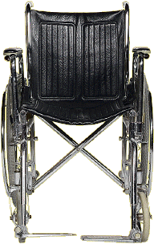
Americans with Disabilities Act
Protects persons with disabilities who are able to perform the essential functions of the job
Requires employers to provide reasonable accommodation for such persons

Slide 23
Group Decision Making Pitfalls
Implicit favorite—final decision is the one favored by initial majority
Group polarization—tendency to shift toward more extreme views
Groupthink—groups gathers around a specific decision, rejecting contrary information
Ignoring unshared information—tendency to consider only information shared by more or all members

Slide 24
Improving Group Decisions
Use the devil’s advocate technique
Ask group members to list all pertinent information known to them before beginning discussion
Appoint individuals with technical or business experience to a Board of Advisors

