Slide 1


Entrepreneurship and Negotiation
6
Financing New Ventures

Slide 2
Information Asymmetry Problems
Entrepreneurs have information about their business that investors don’t have. This creates three problems:
Investors must make decisions on limited information
Entrepreneurs can take advantage of investors
Adverse selection

Slide 3

Uncertainty Problems
Investors must make judgments based on little actual evidence
Entrepreneurs and investors disagree on value of new venture
Investors want collateral

Slide 4
Solutions to Venture Finance Problems
Self financing
Contract provisions
  Covenants
  Convertible securities
  Forfeiture and anti-dilution
  Control rights
  Vesting periods

Slide 5
Solutions to Venture Finance Problems
Specialization
  By industry
  Be development stage
Geographically localized investing
Syndication

Slide 6

Capital Questions
How much money do I need?
Where should I get that money?
What type of arrangements do I need to make to obtain that capital?

Slide 7
Start-Up Capital
How much do you need?
60% of all new ventures require less than $5,000 of capital to get started
Only 3% require more than $100,000
(Source: U.S. Census Bureau)

Slide 8

Financial Analysis Tools
List of startup costs and use of proceeds
Proforma financial statements
Cash flow statements
Breakeven analysis

Slide 9
Startup Costs
All costs incurred to get the business off the ground
Determine the capital you need
Determine what you’ll do with the capital once you get it

Slide 10
Proforma
Project the financial condition of the new venture
Estimate profit and loss
Show financial structure of the business
Allow investors to conduct ratio analysis

Slide 11
Income to Cash Flow
Take your net profit and add back depreciation
Subtract increases or add decreases in accounts receivable
Subtract increases or add decreases in inventory
Add increased or subtract decreases in accounts payable
Subtract increases or add increases in notes/loans payable

Slide 12
Improve the Flow
Minimize accounts receivable
Reduce the raw material and finished products inventory
Control your spending

Slide 13

Breakeven Analysis
Calculate the amount of sales you need to achieve to cover your costs
Determine the increase in sales volume you need to have in order to increase fixed costs

Slide 14
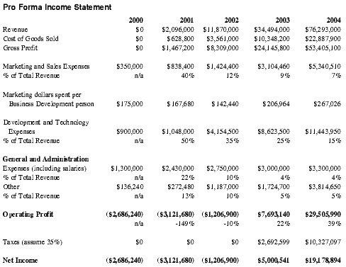
Proforma Financial Statement

Slide 15
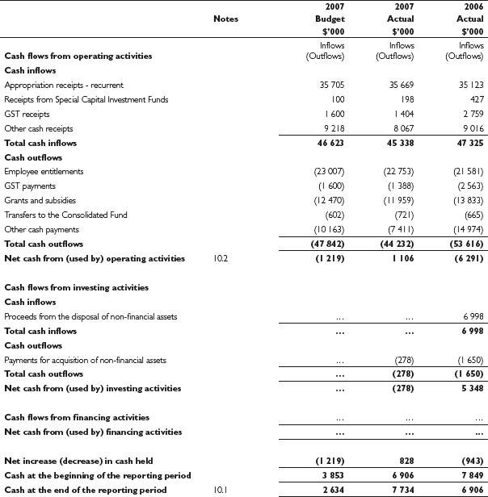
Cash Flow Statements

Slide 16
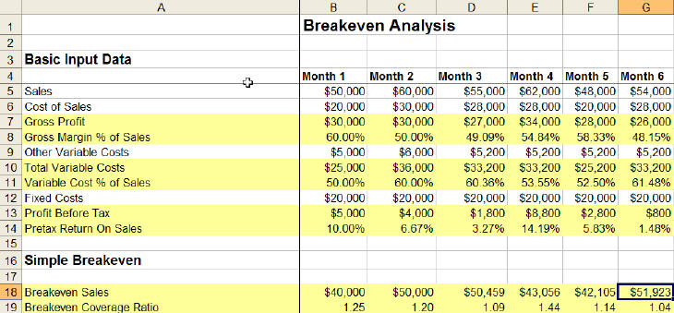
Breakeven Analysis

Slide 17
Debt vs. Equity
Debt—financial obligation to return capital provided plus a scheduled amount of interest
Equity—a portion of ownership receive in an organization in return for money provided

Slide 18
Financing with Equity
New ventures tend to be financed by equity because
New ventures have no way to make scheduled interest payments until they have positive cash flow
Debt financing at a fixed rate encourages people to take risky actions

Slide 19

Debt Financing
Debt guaranteed by the entrepreneur’s personal assets or earning power
Asset-based financing
Supplier credit

Slide 20
Sources of Capital
Savings
Friends and family
Business angels
Venture capitalists
Corporations
Banks
Asset-based lenders
Factors
Government programs

Slide 21
Criteria for Venture Capitalists
Operate in high growth industry
Have proprietary advantage
Offer a product with a clear market need
Be run by experienced management team
Plan to go public

Slide 22

What Are Investors Looking For?
An excellent venture team with
Motivation
Passion
Honesty
Experience

Slide 23
What Are Investors Looking For?
An excellent business opportunity with
Large market
Appropriate strategy
Compelling product description
Externally observable competitive advantage

Slide 24

Due Diligence
Investigation of
The business
The legal entity
The financial records

Slide 25
Staging of Financing
Staging of financing allows investors to
Minimize their risk
Gather more information over time
Manage the uncertainty of investing

Slide 26
Rate of Return
The main factor that
determines the rate of
return for new
venture financing
The stage of
venture development

Slide 27
Venture Capital Method
Consider business plan’s forecasts
Calculate price-earnings ratio
Estimate terminal value
Calculate new present value of terminal value
Specify portion of ownership by dividing investment amount by net present value of the terminal value

Slide 28
Encouraging Investors
Use impression management techniques
Create a sense of urgency to generate momentum
Frame ideas to make them more appealing
Prepare a good business plan

