Slide 1


Entrepreneurship and Negotiation
9
Marketing in a New Firm

Slide 2
“Try novelties for salesman’s bait, for novelty wins everyone.”
--Goethe, Faust: Part I, 1808

Slide 3
Real Need
Successful products and services are based on real customer needs.
A real need exists when customers have a problem that needs to be solved and no existing products or services can do this.

Slide 4

Determining Need
Look for a customer problem.
Define a true solution.
Evaluate economics.
Identify alternatives offered by competitors.

Slide 5
Assessing Customer Preferences
Evaluate target market.
Determine the type of new product or service you’re developing.
Is your solution to customer needs already understood? Or is it a novel solution?

Slide 6

For a Known Target
Market or Solution
Use traditional market research methods:
Surveys
Focus groups

Slide 7
For Novel Markets and Solutions
Talk with industry experts
Create future scenarios
Extrapolate trends to determine product and service features

Slide 8
For a New Market or Solution
When either the target market or solution is known, but the other is not, blend traditional market research with futurist approaches.
  Anthropological expeditions
  In-depth interviews with early adopters
  Partnerships with customers to develop products

Slide 9
The Market Determines Research Techniques
 | EXISTING MARKET | NEW MARKET
Philosophy of market research | Deductive data analysis | Intuition
Techniques for gathering customer information | Focus groups, surveys, mall studies | Industry experts, trend extrapolation, future scenarios

Slide 10
The Entrepreneur’s Disadvantage
When markets or new products are known, existing companies have the advantage with
An existing customer base
A large amount of information about customer preferences

Slide 11
The Entrepreneur’s Advantage
When the market or solution is novel, existing companies face three major disadvantages:
Core rigidities
Tyranny of the current market
User myopia

Slide 12

The Lesson
Entrepreneurs do better when they launch products based on novel solutions to customer needs in new markets.

Slide 13
Market Dynamics
All markets are not equal. They vary in
Size
Rate of growth
Evolution (stage in life cycle)

Slide 14
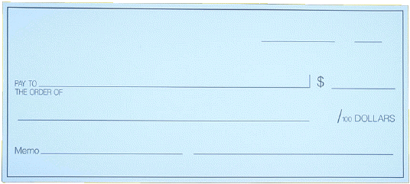
Market Size
The size of the market determines:
Ease of recouping start-up costs
Ability to go in “under the radar”

Slide 15
Market Growth
The rate of market growth determines:
Ease of capturing new customers
Potential volume of customers
Benefits of volume purchasing and scale economies

Slide 16
The S-Curve
Improvements
slow down
again
Improvements
come faster
Initially,
improvement
is slow

Slide 17
The S-Curve
Introduction stage
  Costs are very high
  Slow sales volumes to start
  Little or no competition
  Demand has to be created
  Customers have to be prompted to try the product
  Makes no money at this stage

Slide 18
The S-Curve
Growth stage
  Costs reduced due to economies of scale
  Sales volume increases significantly
  Profitability begins to rise
  Public awareness increases
  Competition begins to increase with a few new players in establishing market
  Increased competition leads to price decreases

Slide 19
The S-Curve
Maturity stage
  Costs are lowered as a result of production volumes increasing and experience curve effects
  Sales volume peaks and market saturation is reached
  Increase in competitors entering the market
  Prices tend to drop
  Brand differentiation and feature is emphasized
  Industrial profits go down

Slide 20
The S-Curve
Decline Stage
  Sales volume decline or stabilise
  Prices, profitability diminish
  Profit becomes more a challenge of production/distribution efficiency than increased sales

Slide 21
Timing the Market
Implications of the S-Curve:
Capital is required to sustain early product development
New product development is a function of effort, not time
Point of acceleration is critical for future planning

Slide 22
Adoption Patterns
Innovators
Early adopters
Early majority
Late majority
Laggards

Slide 23
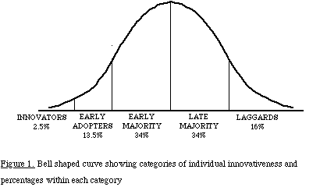

Slide 24

To Cross the Chasm
Build a complete customer solution to customer needs
Focus on a single niche
Communicate clearly to customers

Slide 25
Choosing Target Customers
Customers have a compelling reason to buy if the product or service
Improves their productivity
Reduces their costs
Gives them something they couldn’t have before

Slide 26

Dominant Design
All companies producing a product choose a common way of bringing together the different parts of a product or service.
New firms have an advantage in periods of radical breakthrough.

Slide 27
Setting the Technical Standard
Discount prices when product is introduced
Build relationships with producers of complementary products
Get to the market quickly

Slide 28

Personal Selling
Generate customer interest
Identify customer requirements
Overcome customer objections
Close the sale

Slide 29
Pricing New Products
Determine fixed and variable costs to set a price that generates a profit
Assess market conditions to ensure the price isn’t too high or low
Understand how customers trade off attributes and price
Factor in hidden costs or discounting

