Slide 1


Entrepreneurship and Negotiation
10
Strategy: Planning for Competitive Advantage

Slide 2
“What sets us against one another is not our aims—they all come to the same thing—but our methods, which are the fruit of our varied reasoning.”
--Saint-Exupery
Wind, Sand and Stars, 1939

Slide 3
Competitive Advantage
Precludes others from imitating the business idea perfectly
Allows the entrepreneur to capture the profits from exploiting the opportunity

Slide 4
Barriers to Competition
Maintain secrecy
Control resources
Establish legal barriers to imitation
Exploit the idea on a large scale
Establish a reputation
Innovate

Slide 5

It’s a Secret
Trade secret—piece of intellectual property
Causal ambiguity—knowing how to exploit the opportunity
Tacit knowledge—knowledge that isn’t codified

Slide 6

Legal Monopolies
Patents
Government permits

Slide 7
Opportunity Exploitation
Licensing—contract to use a business idea in return for a fee
Franchising—right to provide an existing firm’s product or service to end customers

Slide 8
Options for Exploitation
Market-based mode
  Best when different parts of the business are owned by different entities and connected by contractual relationships
Hierarchical mode
  Best when one party owns all parts of the operation

Slide 9
Factors in Selecting a
Market-Based Mechanism
Cost
Speed to market
Market-Based Mechanism
Capabilities
Information

Slide 10
Minimizing Cost
A market-based mode allows an entrepreneur to
Invest less capital in comparison to hierarchical modes
Tap franchisees as a source of capital
License ideas to finance development

Slide 11

Getting to Market
A market-based mode allows an entrepreneur to
Assemble the entire value chain in time to exploit it
Be the first mover
Leverage network externalities

Slide 12
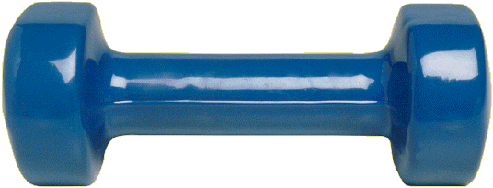
Leveraging Capabilities
A market-based mode allows an entrepreneur to
Compensate for areas of weakness
Increase performance by contracting with partners who have stronger capabilities

Slide 13
Managing Information
A market-based mode allows an entrepreneur to
Use patents to mitigate the disclosure problem
Codify a business idea in a contract

Slide 14
Benefits of Market-Based Methods
Contractual modes of opportunity exploitation can protect entrepreneurs from
Adverse selection
Shirking

Slide 15
Hazards of Market-Based Methods
Free riding—attempt to benefit from the work of another franchisee
Hold-up—attempt to opportunistically renegotiate the terms of a contract

Slide 16
Information Problems and Modes of Exploitation
PROBLEM | EXPLOITATION
Adverse selection of employees | Market-based
Shirking by employees | Market-based
Free riding by outlet operators | Hierarchical
Hold-up of outlet operators | Hierarchical
Disclosure of knowledge | Hierarchical
Tacit business idea | Hierarchical

Slide 17

Managing Uncertainty and Information Asymmetry
Growth from small scale
Forming alliances and partnerships with established firms
Creating legitimacy for the opportunity and the new venture

Slide 18
Starting Small
Uncertainty and information asymmetry make it necessary for entrepreneurs to start small because
Entrepreneurs must self-finance
Investors don’t give large sums all at once
Entrepreneurs must minimize risk

Slide 19
Finding Allies
Alliances and partnerships can provide:
The assets needed to pursue short-lived opportunities
The capital required to purchase needed resources
A brand name to give the business idea value

Slide 20
It’s Legit
Entrepreneurs demonstrate the legitimacy of their ideas by
Showing conformity to existing rules and norms
Imitating the routines and procedures of existing firms
Engaging in collective actions
Obtaining certification

