Slide 1


Entrepreneurship and Negotiation
11
Intellectual Property:
Protecting Your Ideas

Slide 2
“Every man with an idea has at least two or three followers.”
--Brooks Atkinson
Once Around the Sun, 1951

Slide 3
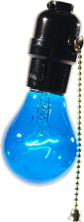
Intellectual Property
The core ideas about a new product or service
The only advantages (most of the time) entrepreneurs have over established firms

Slide 4
The Product Development Process
A difficult and uncertain process
Solution must be produced and marketed for less that the customer is willing to pay
May result in something different than people set out to produce

Slide 5
Established Firm Advantages
Better at manufacturing
Better access to capital
Tacit knowledge from experience
Economies of scale
Better at marketing
Established reputations
Established customers

Slide 6
New Firm Advantages
Superior product development
Develop new products more cheaply and easily
No bureaucratic structures and rules in place
Better incentives for employees
Greater flexibility

Slide 7
Why Is Imitation So Easy?
Competitors have a variety of methods for imitating intellectual property:
Reverse engineering
Hiring employees or suppliers from the entrepreneur
Assigning staff to copy the new product

Slide 8
Patents
To obtain a patent, an invention must:
Be novel
Not be obvious to a person in the field
Be useful
Be secret at the time of patent application

Slide 9
What Can You Patent?
YES
Process
Machine
Manufacture
Chemical formula
Design
Piece of software
Plants
NO
Business idea
Something that doesn’t work

Slide 10
Advantages of Patents
Helps to raise capital by demonstrating competitive advantage
Raises the cost of imitation
Provides a monopoly right
Prevents a second party from using the invention as a trade secret

Slide 11
Disadvantages of Patents
Requires disclosure of the invention
Provides only 20 year monopoly
Can be circumvented
Difficult and costly to defend
Less effective for most types of technology
Can be irrelevant if technology is fast moving
Requires world-wide patent application

Slide 12
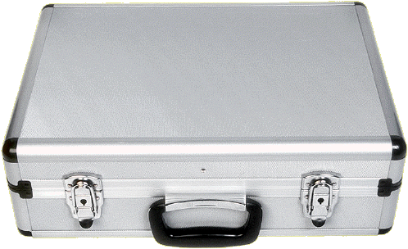
Trade Secrets
A piece of knowledge that confers an advantage on a firm and is protected by non-disclosure
Protect a competitive advantage without disclosing how an underlying technology works

Slide 13
Disadvantages of Trade Secrets
Must be kept hidden to remain valuable
Doesn’t provide a monopoly right
To enforce and claim damages in court, must show a loss of competitive advantage

Slide 14
Trademarks
A word, phrase, symbol, design that distinguishes the goods and services of one company from those of another
Obtained by using the mark or filing an application

Slide 15
Copyrights
A form of intellectual property protection provided to the authors of original works or authorship
Protect the right to reproduce, further derive, copy, or display the protected item
Extend 100 years after the death of the author

Slide 16
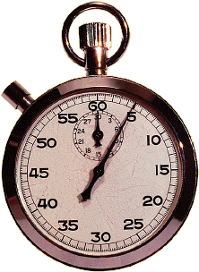
The Advantage of
Speed and Timing
First mover advantage
Lead-time advantage
Learning curve advantage

Slide 17
First Mover Advantage
First movers have an advantage when
They control scarce or intangible assets
More customers result in increased value
Customers pay a high cost for switching products
People are content with the status quo
Reputations are important
The learning curve for production is proprietary

Slide 18
Will a New Company Profit?
Three factors determine whether a new company will profit from introducing a new product:
The ability to secure a strong patent
The presence of absence of a dominant design
The presence of complementary assets in marketing and distribution
(David Teece)

Slide 19
Which Is Most Important?
Complementary Assets Are More Important… | Being Innovative Is More Important…
When patents are not very effective | When patents are very effective
When a dominant design exists | Before a dominant design exists
When learning curves are shallow or not proprietary | When learning curves are steep or proprietary
When knowledge is codified | When knowledge is tacit
When products are observable | When products are not observable

