Slide 1
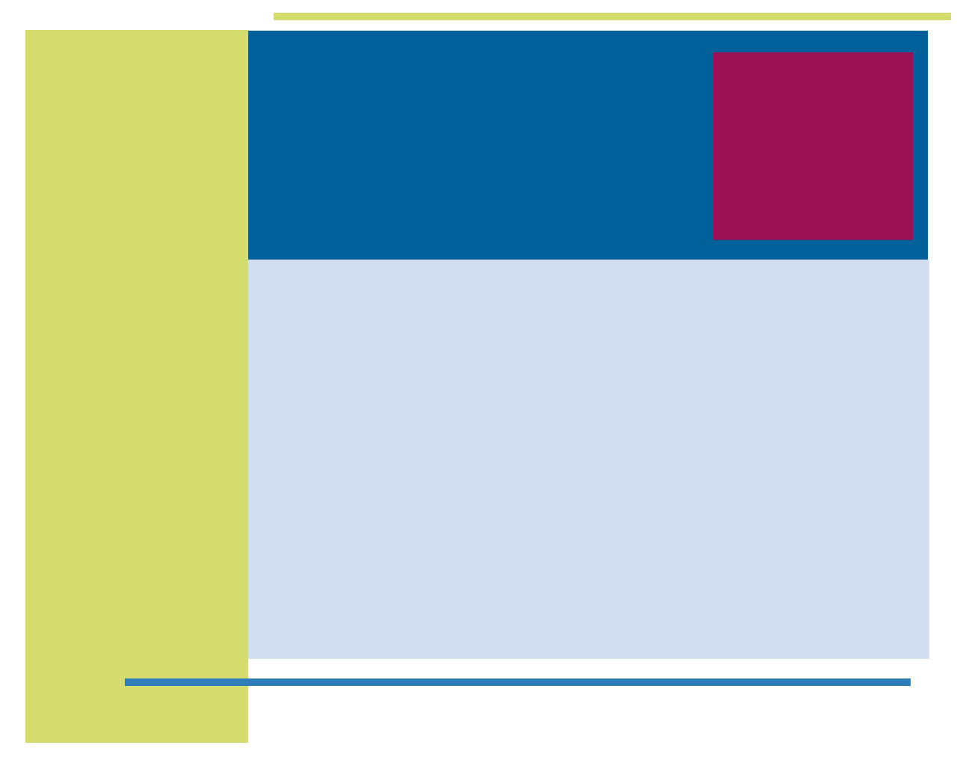
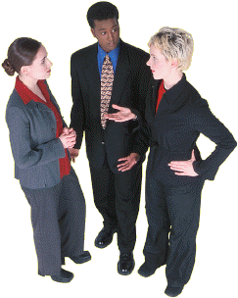
Entrepreneurship and Negotiation
12
Essential Skills for Entrepreneurs: Enhancing Social Competence, Creating Trust, Managing Conflict, Exerting Influence, and Dealing with Stress

Slide 2
“Marvelous is the power which can be exercised, almost unconsciously, over a company, or an individual, or even upon a crowd by one gifted person with good temper, good digestion, good intellects, and good looks.”
--Anthony Trollope, 1863

Slide 3
Social Capital
An important asset that derives from
Close relationships among individuals in organizations or other social structures
Relationships characterized by liking, mutual trust, and close identification

Slide 4
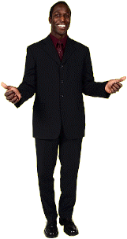
Social Competence
Social perception
Expressiveness
Impression management
Persuasion and influence
Social adaptability

Slide 5

Social Perception
Accuracy in perceiving others, including accurate perceptions of motives, traits, and intentions
Skill in “reading” others

Slide 6
Expressiveness
Skill at expressing one’s own reactions and emotions clearly so that they can be readily understood by others
Key in generating enthusiasm in others

Slide 7
Impression Management
Proficiency in the use of techniques for inducing positive reactions in others when we first meet
Making a good first impression

Slide 8

Persuasion and Influence
Skill at using various techniques for changing others’ attitudes or behaviors in desired directions

Slide 9
Social Adaptability
The ability to
Adapt to a wide range of social situations
Feel comfortable with individuals from a wide variety of backgrounds

Slide 10
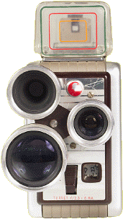
Improving Your Social Skills
Training programs focused on social skills
Help from friends or family
Videotape and study interactions

Slide 11
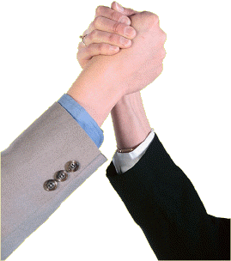
Team Success
The benefits of a team depend on
Cooperative working relationships
Ability to effectively handle conflict

Slide 12
Trust
Calculus-based trust—based on deterrence
Identification-based trust—based on relationship over time

Slide 13
Two Kinds of Trust
Calculus-based
trust
Expects
punishment
Complies only
when threatened
With punishment
Identification-
based
trust
Believes in
good will
Complies without
threat of
punishment or
surveillance

Slide 14
Building Identification-Based Trust
Act as you promise
Follow agreed-upon procedures
Practice organizational citizenship
Understand motives and needs

Slide 15
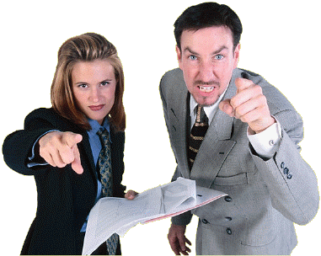
Conflict
Process in which one party perceives that another party has taken or will soon take actions that are incompatible with its interests

Slide 16
Types of Conflict
Affective conflict
  Involves strong feelings of anger or dislike toward the people involved
  Tends to be destructive
Cognitive conflict
  Focuses on issues, not on the people involved
  Tends to be constructive

Slide 17
Causes of Affective Conflict
Pre-existing grudges
Faulty attributions
Belief that views of others are biased
Personal traits or characteristics

Slide 18
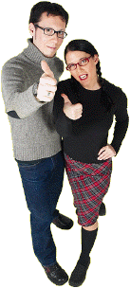
Negotiating to Resolve Conflict
To obtain a win-win
Avoid win-lose tactics
Uncover the real issues
Broaden the scope of issues considered

Slide 19
Tactics of Influence
Rational persuasion
Inspiration appeal
Consultation
Ingratiation
Exchange
Personal appeal
Coalition building
Legitimating
Pressure

Slide 20
Factors in Gaining Compliance
Friendship/liking
Commitment/consistency
  Foot-in-the-door tactic
  Lowball
Scarcity
  Playing hard to get
  Fast approaching deadline technique
Reciprocity
  Door-in-the-face tactic

Slide 21
Stress
Emotional
reactions
Demands
of
life events
Cognitive
appraisal
STRESS
Physiological
states

Slide 22
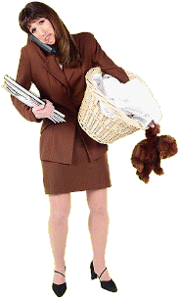
Sources of Stress
Juggling different roles
Responsibility for others
Lack of needed social support

Slide 23
Effects of Stress
Harmful to health
Interferes with performance
Desk rage
Burnout

Slide 24
Managing Stress
Eat a healthy diet
Exercise
Curtail excessive worrying
Consciously engage in an incompatible reaction
Take a step back
Avoid awfulizing

