Slide 1
RAMP PROject presentation: Predicting air passenger traffic
MSc Data Science for Business - MAP 536
Adrien Toulouse & Paul-Antoine Girard

Slide 2
Summary
Preprocessing
Adding external data
Machine learning algorithms tried and used

Slide 3
I. Data preprocessing

Slide 4
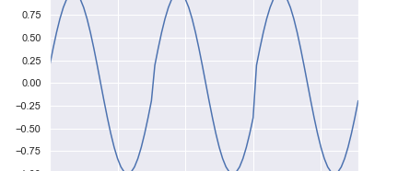
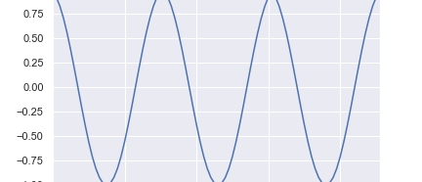
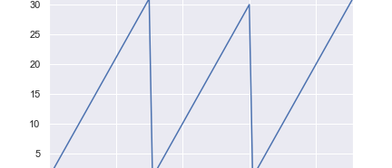
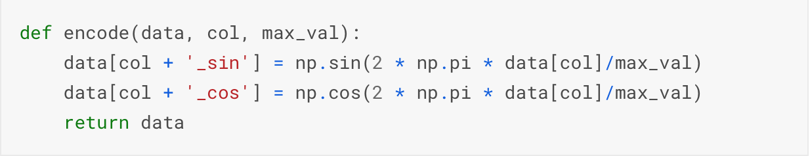
I. Data preprocessing
Initially the data wasn’t encoded continuously.
Algorithm didn’t know that January (represented by 1) follows December (represented by 12).
Transformation used:

Slide 5
I. DATA preprocessing
‘Airports’
Goals:
reduce number of columns used
Add information
Realizations:
One column per airport with positive value for departing flights and negative value for arriving flights
Mean encoding
‘Reservations’
Goals:
r

Slide 6
II. External data
External weather dataset

Slide 7
II. External data
Overall, we added the following four variables:
Distance in kilometer between the airports:‘Distance’
Number of inhabitants per city:‘Population’
Revenue per state of the arrival airport:‘Revenue’
Crude oil price:‘Oil_Price’
Afterwards, what we could have added:
TO CONTINUED

Slide 8
III. Machine learning algorithms

Slide 9
III. Machine learning algorithms
Blending technique
Combines information from multiple predictive models.
Technique used with XGBRegressor and LGMRegressor.
Stacking technique
combines information from multiple predictive models and uses another model that perform a prediction using the predicted values of the base models.
Technique tried with XGBRegressor, and LGMRegressor as base models, and KernelRidge as stacked model.
Advantages:
Learn from different algorithms
Reduce variance of predictions
Disavantages:
Increase complexity
Need to tune a lot of regressors
Increase running time

Slide 10
Conclusion

