Slide 1
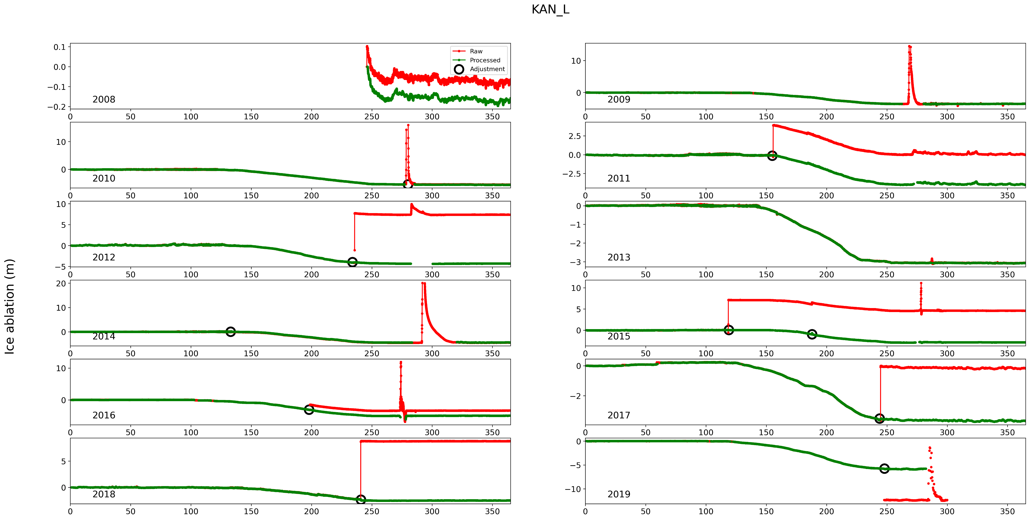
Adjust depth
Discard periods
Automatic filtering

Slide 2
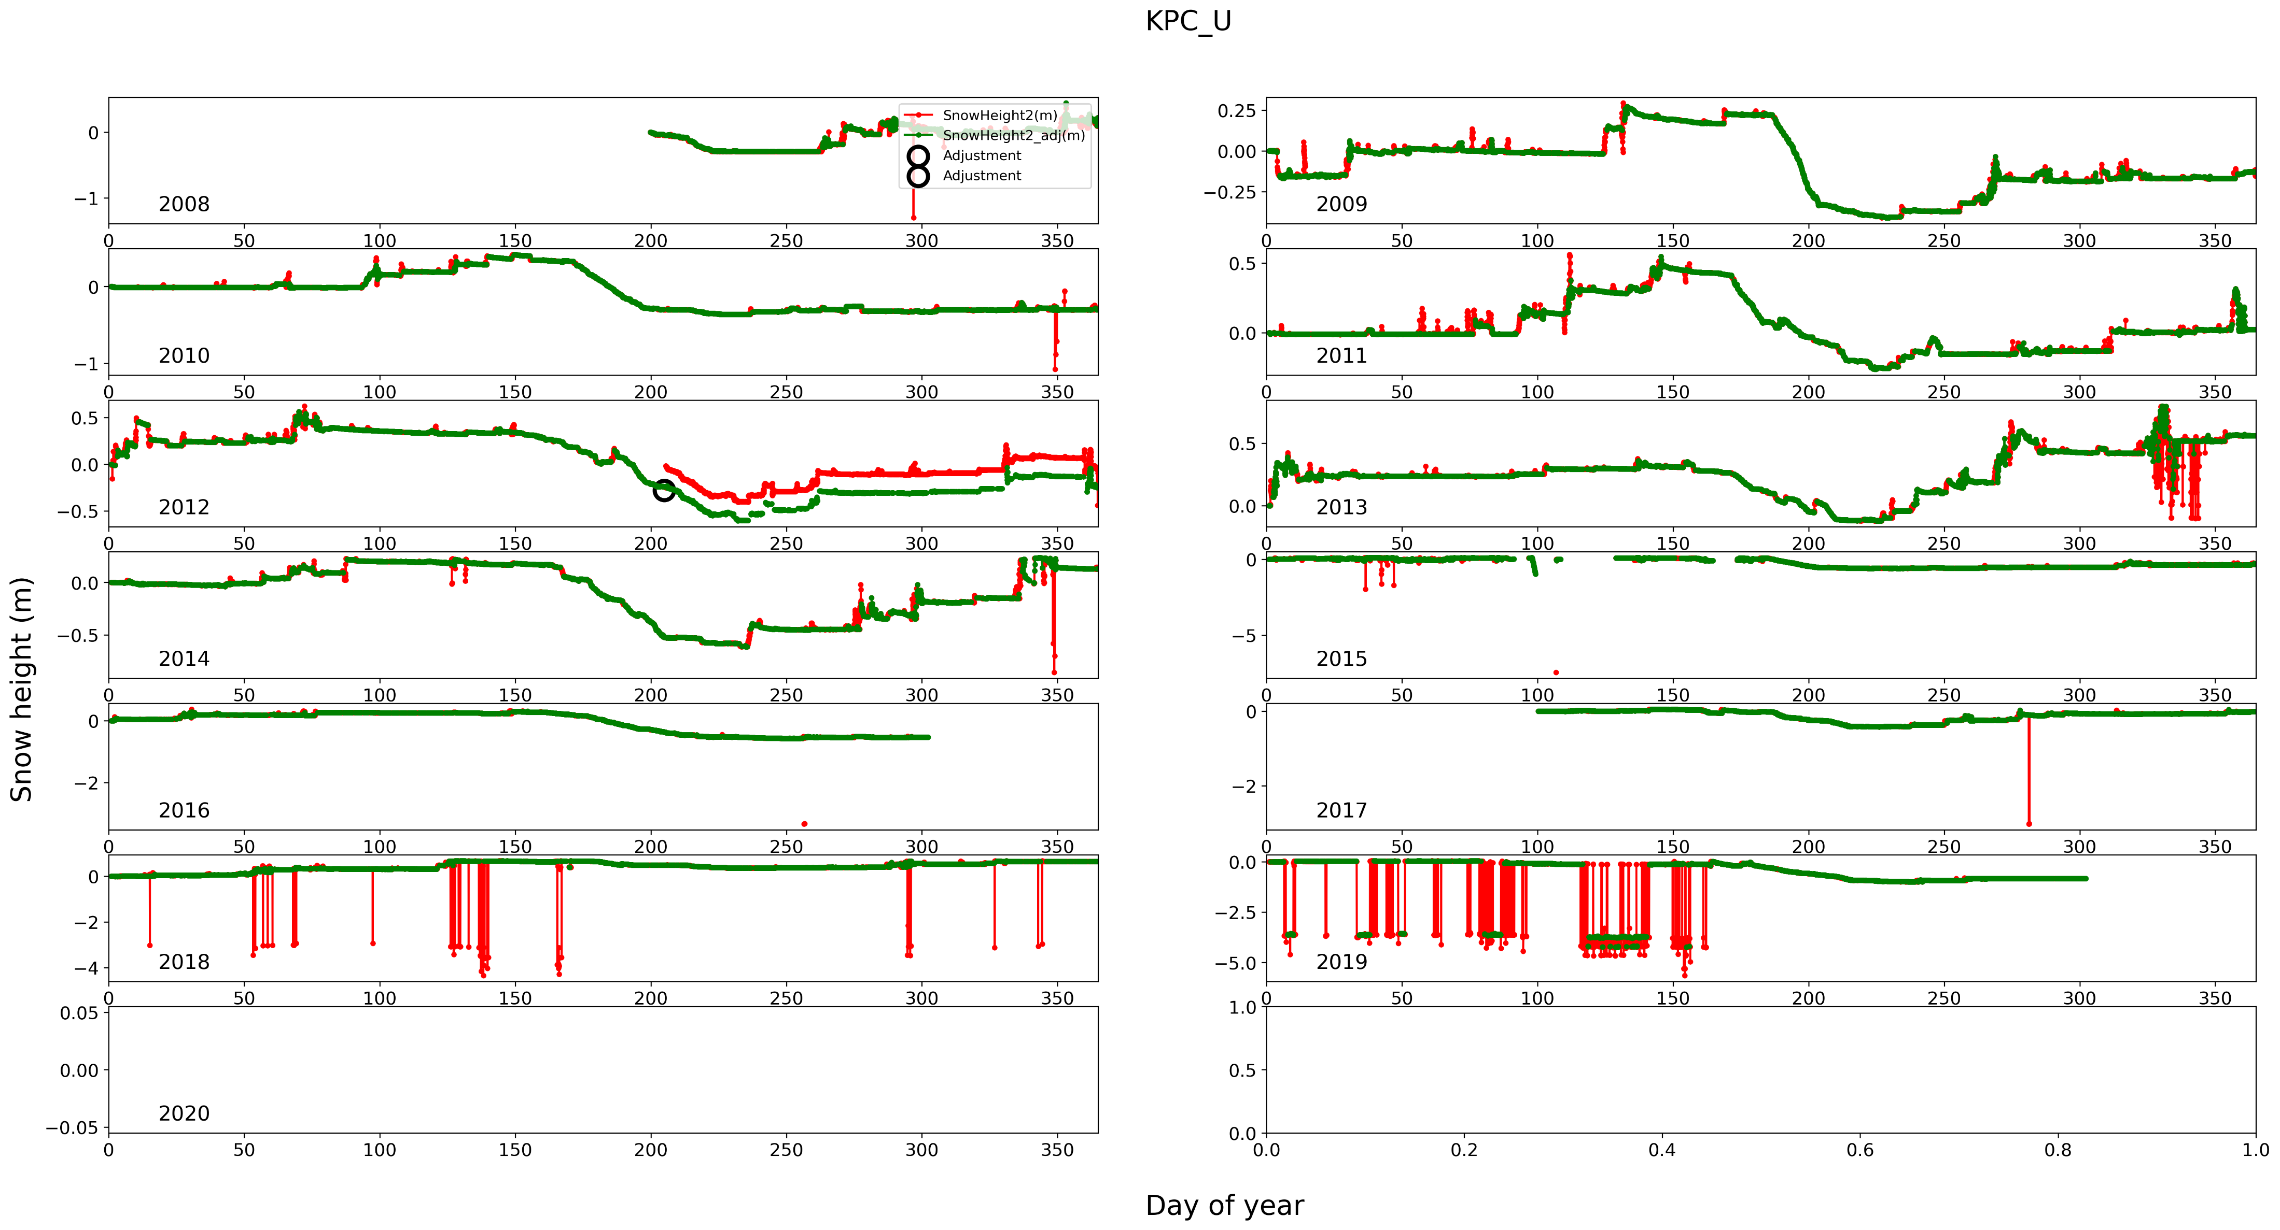
Adjust height
Automatic filtering

Slide 3
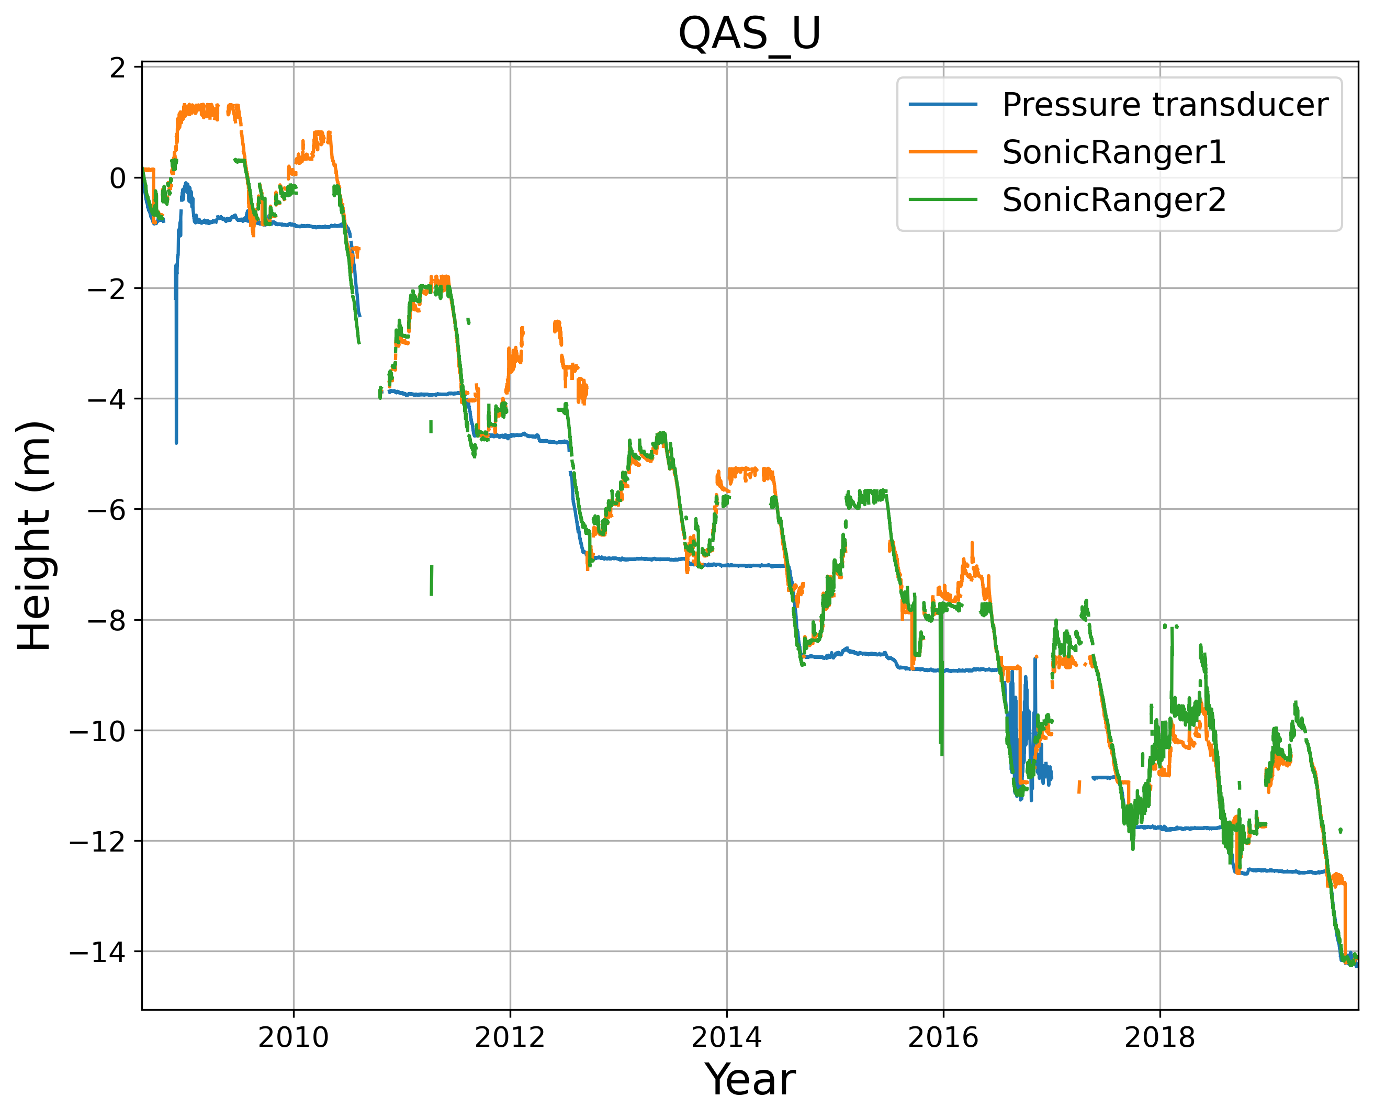
The two sonic rangers are adjusted each year based on Sept.-Oct. values
Sonic ranger on the AWS
is ”resetted” to the
post-ablation surface height
Ice surface
continuous from year
to year

