Slide 1
INTERVIEW CASE STUDY · INTERNATIONAL INCENTIVES
Smarter incentives,
built to land in a real organisation.
Turning a slow, meeting-heavy experiment process into a lean AI operating system that spends less, learns faster, and ships value in weeks, not quarters.
AI Systems, Personalization & Growth Manager · prepared for the Tripadvisor interview team
Adrien Enjalbert · AI Systems, Personalization & Growth
01
Notes:
One line: I read this brief less as an AI problem and more as an organisation problem. In a company this size the model is the easy part. What decides success is data you can trust, integration into the stack you already run, UX teams will actually adopt, and buy-in that survives shifting priorities. That is what this deck is built around.

Slide 2
THE REFRAME
In a big company, the model is the easy 10%.
A recommendation engine is a weekend prototype. Getting it used, trusted, and safe across teams is the year of work. So I would spend my effort on the four things that actually block value.
MODEL · 10%
THE 90% THAT DECIDES SUCCESS
Data & ETL
Integration
UX & adoption
Change management
Investigate, clean and pipe the data so results can be trusted.
Plug into the warehouse, tracking and Braze, not a side tool.
Embed AI where teams already work, so it gets used properly.
Small wins and coalition-building to earn resource and buy-in.
Adrien Enjalbert · AI Systems, Personalization & Growth
02
Notes:
This is the spine of the whole submission. I have shipped AI features before, so I know the demo is not the hard bit. In a lean org with competing priorities, the risk is a clever tool nobody adopts. These four pillars, data, integration, UX and change management, are where I would put the work, and every later slide maps back to one of them.

Slide 3
HOW TO READ THIS
Every question in the brief, answered and labelled.
Each slide carries a badge with the question it answers. Four green “in practice” slides sit next to the part they support, showing how it actually lands in a real org.
PART 1
PART 2
PART 3
PART 4
Data reasoning
AI systems design
AI debugging
Stakeholders
1.1
Segments + deeper analysis
2.1
End-to-end workflow
P3
5+ reasons the rec failed
P4
Aligning Finance & the Lead
1.1
Metrics I trust vs question
2.2
Which two to build first
+ how I'd investigate each
~300-word response
1.2
Extra data I'd request
2.3
Knowledge management
→
In practice: change mgmt
1.3
The next three experiments
2.4
AI personas
2.5
Measuring success
Adrien Enjalbert · AI Systems, Personalization & Growth
03
Notes:
Quick orientation so you can follow the mapping: the deck answers the brief in its own order, each slide is badged with its question number, and I close with the four things that make this work in a large organisation. Feel free to jump to any question.

Slide 4
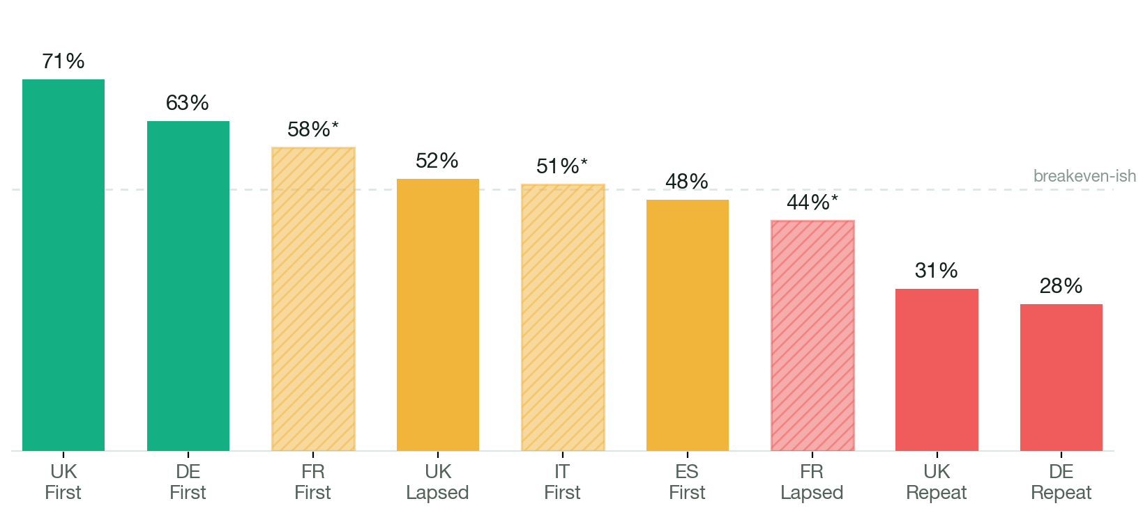
1.1
ANSWERING Which segments create or destroy value?
One flat rule is hiding two different businesses.
Read by incrementality, the pattern is clear: the newer the customer, the more the discount actually causes the booking. We pay the same 15% to people who need convincing and to people who were already coming.
VALUE CREATED
First purchase: UK 71%, DE 63% incremental. New customers we genuinely win.
VALUE DESTROYED
Repeat buyers: DE 28%, UK 31%. We subsidise people who would book anyway.
The metric that matters is incrementality, not redemption. UK repeat redeems the most and is nearly the least incremental.
Adrien Enjalbert · AI Systems, Personalization & Growth
04
Notes:
The headline insight. The flat discount averages two opposite realities. First-purchase discounts are genuinely incremental and worth protecting. Repeat discounts are largely deadweight, we are paying loyal customers to do what they would do anyway. The trap is redemption: UK repeat has the highest redemption and almost the lowest incrementality, so a busy-looking promo is quietly losing money.

Slide 5
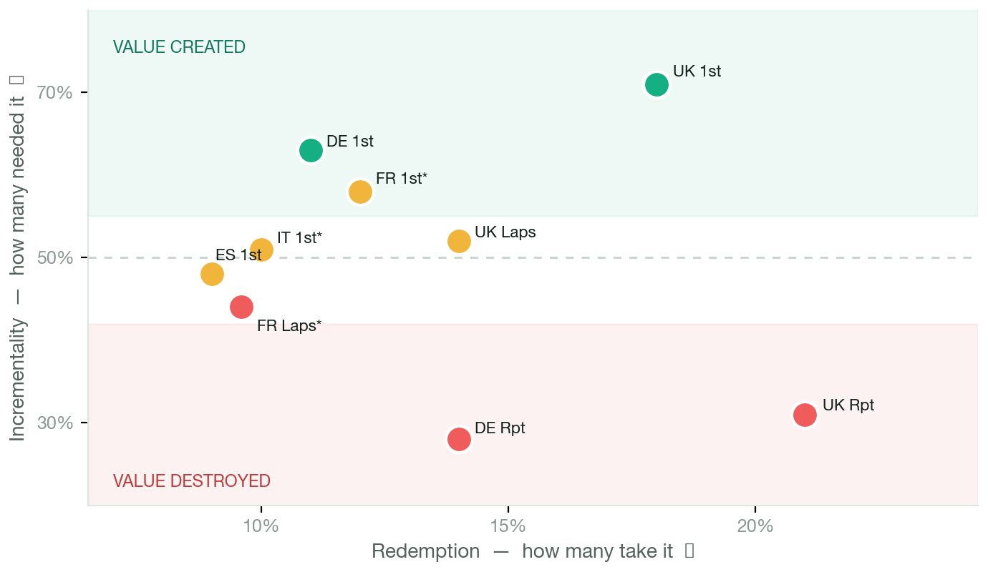
1.1
ANSWERING Going deeper: what advanced analysis reveals.
Redemption is a vanity metric. Map it against value.
Plot every segment two ways: how many take the discount (redemption) vs how many actually needed it (incrementality). Winners sit high; the money leaks bottom-right.
THE ANGLE
High redemption looks like success. But UK Repeat redeems the MOST (21%) and is nearly the least incremental (31%). That's spend, not growth, hiding as a busy promo.
THE MATHS BEHIND IT
Cost / incremental booking = promo ÷ incrementality → repeat costs ~3× more.
Deadweight = promo × (1−incr) → ~70% of repeat spend wasted.
Next, with more data: iROAS & LTV:CAC per segment, CUPED, uplift modelling.
Adrien Enjalbert · AI Systems, Personalization & Growth
05
Notes:
The angle here: redemption is a vanity metric, so I map every segment on two axes, redemption (how many take it) against incrementality (how many actually needed it). The winners sit high regardless of redemption; the value leaks in the bottom-right, where UK Repeat redeems the most and needs it least. Then I back it with the maths: cost per incremental booking (promo divided by incrementality) shows repeat costs ~3x more, and deadweight (promo times one-minus-incrementality) shows ~70% of repeat spend is wasted. With more data I'd add iROAS, LTV:CAC, CUPED for variance and uplift modelling to find who's actually persuadable.

Slide 6
1.1
ANSWERING Which metrics do you trust, and which would you question?
I trust the metric. I question the measurement.
The apparent contradiction resolved: incrementality is the right metric (it's causal). But a metric is only as good as the experiment behind it, and two of these were built on broken experiments.
TRUST — THE METRIC TYPE
QUESTION — THE MEASUREMENT
Incrementality is causal. A holdout gives the counterfactual (what people do with no offer), so it isolates cause, not correlation.
It beats redemption & CVR lift. Those are observational: they count what happened, not what we caused. Incrementality nets out the free-riders.
Where the holdout is clean (UK, DE), I'd act on it, it's the one number that separates real growth from subsidised habit.
FR & IT incrementality (the same metric). Targeting issues broke randomisation, so the estimate is biased, not just noisy. Directional only.
No sample size or confidence interval. Can't separate signal from noise; a 71% on a tiny cell isn't the same as 71% on 10k.
Attribution traps. Redemption is self-selected; last-click over-credits the offer; pooling markets risks Simpson's paradox.
Adrien Enjalbert · AI Systems, Personalization & Growth
06
Notes:
This directly answers the 'incrementality is in both columns' question. The resolution is the mark of someone who's done real experimentation: I trust incrementality as a metric TYPE because it's causal, but a causal metric is only as trustworthy as the experiment that produced it. France and Italy had broken randomisation, so their incrementality is biased, not merely uncertain. And with no sample sizes I can't attach confidence. So I trust the concept, and I interrogate the measurement. I'd also flag the classic attribution traps: redemption is self-selected, last-click over-credits, and pooling markets can flip the result via Simpson's paradox.

Slide 7
1.2
ANSWERING What additional information would you request?
Six things I'd ask for, and how each changes the call.
I wouldn't finalise on this table alone. Each of these moves a specific decision, not just adds detail. If a data point can't change what I do, I don't wait for it.
Customer lifetime value
Contribution margin
Sample size & confidence
First-booking value is a snapshot; LTV is the prize.
Promo cost is clear; the profit it eats isn't.
No n or intervals are shown.
Changes: A high-LTV first customer justifies a deeper discount, it's LTV:CAC, not first-order profit. Could flip 'marginal' ES/IT/FR into worth winning.
Changes: Sets the real breakeven discount depth, and whether a “negative” verdict is mild or severe.
Changes: Decides whether I roll out, retest, or ignore a row. Urgent given the France/Italy flags.
Traffic source
Device & app usage
Holdout integrity
A coupon-site redemption is low-incrementality by design.
App / logged-in users skew loyal and repeat.
The France/Italy targeting issue is the biggest unknown.
Changes: Changes targeting: I may exclude deal-seeker channels rather than re-discount the same people.
Changes: Changes eligibility: suppress the offer for high-frequency app users who convert without it.
Changes: Decides whether those markets earn an experiment slot, or a measurement fix first.
Adrien Enjalbert · AI Systems, Personalization & Growth
07
Notes:
This is the 'ask good questions before recommending' signal the brief rewards. The discipline is that every request is tied to a decision it would flip, not data for its own sake. CLV and margin decide whether marginal acquisition segments are worth it; sample size and holdout integrity decide what I'm even allowed to act on; traffic and device change targeting and eligibility.

Slide 8
1.3
ANSWERING Recommend the next three experiments.
Only three slots a quarter. Spend them on learning that pays.
01
02
03
Stop paying loyal customers
Fixed value vs percentage
How shallow can we go?
MARKET UK & Germany AUDIENCE Repeat buyers
MARKET Germany AUDIENCE First purchase
MARKET Spain AUDIENCE First purchase
Offer. Holdout: 15% vs 0% vs a non-cash perk.
Why. Repeat is the clearest value-destroyer (28–31%). Biggest, fastest saving for Finance.
Learn. How much repeat revenue is truly incremental.
Offer. A/B €15 voucher vs 15%. Cost matched on a €102 basket.
Why. Test the qualitative hypothesis on the proven segment, don't assume it.
Learn. Whether framing lifts incrementality at equal cost.
Offer. Depth test: 10% vs 15%, plus a €10-off-€75 threshold.
Why. Marginal (48%) but not flagged, lowest basket. Cleanest place to find the floor.
Learn. The discount elasticity that answers Finance directly.
Business risk. Some repeat bookings may be incremental. The holdout caps exposure; watch retention, not just next booking.
Business risk. Framing effect may be small, but cost is matched, so the downside is a slot, not budget.
Business risk. Under-discounting could slow acquisition. Measure downstream CLV, not just first bookings.
✋ Deliberately not France or Italy. Their data is flagged. Spending a scarce slot on numbers we can't trust would be the mistake. Fix the holdout first.
Adrien Enjalbert · AI Systems, Personalization & Growth
08
Notes:
Fewer, higher-quality experiments. Each protects the base while it learns and serves Finance's goal of spending less without losing bookings. The strongest signal here is what I refuse to test: France and Italy, because acting on flagged data is how you learn the wrong thing and waste a slot.

Slide 9
IN PRACTICE · PART 1 · THE DATA FOUNDATION
“Incrementality should be treated as directional.”
That one line in the brief is the whole job. France and Italy had targeting issues in the holdout, so their numbers cannot be trusted. You cannot automate on data you cannot trust, and this is not a rare event, it is the default state of data in a large org.
Raw tracking
ETL & clean-up
Validated experiment data
AI can act
Backend events, web & app, Braze sends
Dedupe, fix attribution, single source of truth
Holdout integrity, sample sizes, confidence
Only now is automation safe
Where I would start: a data investigation and clean-up sprint plus a re-run of the France/Italy holdout, before a single model ships. Realistically 60–70% of the effort. It is unglamorous, and it is the difference between an AI that helps and one that confidently misleads.
Adrien Enjalbert · AI Systems, Personalization & Growth
09
Notes:
This is the slide I would linger on because it signals I have actually shipped in a big org. The directional flag is a symptom of shaky experiment infrastructure. If we skip the data work and point a recommendation engine at it, we get exactly the Part 3 failure. So the first deliverable is not a model, it is trustworthy data and a clean holdout. That also happens to be the cheapest way to earn credibility.

Slide 10
2.1
ANSWERING Design the end-to-end AI workflow.
One operating system, built on CRISP-DM.
The framework I used to ship a multi-agent system at Indeed Flex. Business and data understanding come before modelling, which is exactly what the ~95% of failed enterprise AI projects skip. The loop is what turns one experiment into a system.
1
2
3
4
✓
5
Business understanding
Data understanding
Data preparation
Modelling
Evaluation
Deployment
The “is it worth it?” gate. Define the decision & metric. Sometimes the answer is a simple rule, not a model.
Trust the data first. The France/Italy lesson: no automation on data you can't trust.
ETL, clean, validated holdouts. The unglamorous 60–70%.
Draft the experiment / offer. Simplest model that works, not the fanciest.
Holdout, incrementality, significance + human sign-off before launch.
Launch, monitor, write the learning brief.
↻ It's a loop, not a line. Deployment feeds the next Business-understanding step, so every experiment makes the system sharper. AI drafts and recalls; humans own the judgement; async gates replace the review meetings (most of the 60%).
Covers all six: Inputs (hypothesis) · Data sources (warehouse + evidence base) · AI capabilities (recall, draft, QA, summarise) · Human review (Evaluation gate) · Outputs (spec, dashboard, brief) · Feedback loop
Adrien Enjalbert · AI Systems, Personalization & Growth
10
Notes:
I anchored this on CRISP-DM on purpose, it's the framework I used for my Level 7 AI project at Indeed Flex. The point I'd make live: the reason most enterprise AI fails isn't the model, it's skipping business and data understanding, and never closing the feedback loop. So phases 1 and 2 are highlighted, the 'is it worth it / do we even need a model' gate sits at the front, humans own the Evaluation gate, and the whole thing is a cycle that compounds. It also cleanly covers the six required elements.

Slide 11
2.2
ANSWERING Rank the AI investments. What would you build first?
Build one for quality, one for adoption.
The spec generator makes experiments better; the dashboard makes progress visible. Adoption and buy-in decide ROI, not cleverness — if you don't track it and show it, it's no use. The tempting one is deliberately last.
1
AI experiment specification generator
Biggest bite out of the 60%. Turns a hypothesis plus history into a powered, reviewable spec.
BUILD NOW
2
AI dashboard summarisation
The adoption engine. Visible, plain-English results win buy-in and drive change management. If it isn't shown, it isn't used.
BUILD NOW
3
AI learning-brief generator
The loop-closer: turns each result into graded knowledge in the evidence base. Low risk.
SEQUENCE NEXT
4
AI QA assistant for launches
The safety net that would have caught the German currency error. Fast-follow.
SEQUENCE NEXT
5
AI promotion recommendation engine
Most powerful, highest risk. It's what failed in Part 3. Needs the data, guardrails & QA first.
EARNS IT LATER
6
AI customer-persona simulator
Decision-support with confirmation-bias risk. Build after the loop is trusted.
EARNS IT LATER
Adrien Enjalbert · AI Systems, Personalization & Growth
11
Notes:
My re-ranked call: build one thing for quality (the spec generator) and one for adoption (the dashboard). I moved the dashboard up deliberately, because in a big org a system nobody can see the value of doesn't get resourced, visibility is how you earn change management and buy-in. The learning brief and QA follow fast. The recommendation engine is last on purpose: it's the flashiest and it's exactly what blew up in Part 3, so it only earns autonomy once the data, guardrails and QA exist.

Slide 12
2.3
ANSWERING Design the knowledge-management system.
Not a document store. A learning loop that grades its own evidence.
Simplest version that works: store every experiment as a graded record, keep one living belief per segment, and let two agents read and write it. The evidence base in the middle is the only thing that compounds.
raw/
context/
views/
THE LEDGER
THE EVIDENCE BASE · THE ASSET
AUTO-GENERATED, ALWAYS IN SYNC
Every experiment as a structured record: holdout, sample size, incrementality + confidence, cost, decision, caveats. Append-only; each record carries an evidence grade.
One living belief per market × segment × offer: current effect, uncertainty, grade and last-verified date. This is what compounds.
Dashboard, learning note and draft spec, rendered from the evidence base, never hand-written. Cheap, disposable, always current.
Analytics agent
grade · update · flag
Spec agent
retrieve · draft
A holdout › B flawed › C observed › D hunch
⚡ The rule that would have caught Part 3: a grade-D hunch can never overrule a grade-A holdout. Evidence quality decides, not recency or seniority.
Humans validate: a new belief lands as candidate → an analyst signs off and grades it → confirmed. Contradictions are flagged for review, never silently overwritten.
Measured by decision quality, not pages: did retrieved evidence change a call, was it right, is it still fresh. Plain files you own, not locked in a vendor.
Adrien Enjalbert · AI Systems, Personalization & Growth
12
Notes:
The upgrade from a plain 'second brain' is that this system grades its own evidence. Every experiment is stored as a structured record with an evidence grade: A for a clean holdout down to D for a qualitative hunch. The middle layer, the evidence base, is the only thing that compounds, one living belief per market-segment-offer with its effect size, uncertainty and how fresh it is. Two agents work it: an Analytics agent closes the loop (grade a finished experiment, update the belief, flag contradictions, regenerate the dashboard and note), and a Spec agent opens the next one (pull the graded priors, draft a reviewable spec). The one rule that matters, and the thing that would have prevented the Part 3 German failure, is that a grade-D hunch can never overrule a grade-A holdout. Humans validate through a candidate-to-confirmed sign-off, and success is whether retrieved evidence actually changed a decision, not how many pages it holds.

Slide 13
2.4
ANSWERING How would you build AI customer personas?
Five personas, built from behaviour, not stereotypes.
What a data-built profile that predicts how a market reacts. How from booking + holdout behaviour, not clichés. Why to pressure-test an offer before spending a scarce slot, always an input to a real test, never the verdict.
UK
Deal-aware, high basket
FR
Read with caution
DE
Framing-sensitive
IT
Read with caution
ES
Clean but marginal
Very incremental first (71%), wasteful repeat (31%).
Targeting issue makes 58% directional, not fact.
Strong first-purchase; prefers fixed value (qual).
Flagged; low basket (€79) shifts fixed-offer maths.
48% on the lowest basket (€75).
Use for: Where to stop discounting loyal buyers first.
Use for: What to fix before we test here.
Use for: Pre-test fixed vs % at equal cost.
Use for: Sequencing: measure first, spend later.
Use for: How shallow a discount still acquires.
HOW I KEEP THEM HONEST
WHEN I IGNORE IT
▸ Every trait traces to a booking or holdout number, not a stereotype.
▸ Log persona predictions vs live results and recalibrate. A persona that always agrees is a red flag.
▸ When a live holdout contradicts it. Real data always wins.
▸ On flagged markets, novel offers, or high-stakes one-way doors. It prompts a test, it doesn't replace one.
Adrien Enjalbert · AI Systems, Personalization & Growth
13
Notes:
Personas are the part most likely to be misused, so I'm deliberate: they generate hypotheses, they don't make decisions. Each is grounded in the segment data, France and Italy are explicitly low-trust because of the flag, and I bake in bias controls, tracking prediction vs reality, and clear rules for when to ignore it. That balance of automation and oversight is exactly what the brief asks for.

Slide 14
2.5
ANSWERING How would you measure success at six months?
Different metrics matter at different stages.
Time saved is the hypothesis that wins the go-ahead; quality proves it works; adoption proves it landed; ROI proves it was worth running.
1 BEFORE
2 DURING BUILD
3 AT LAUNCH
4 6 MONTHS
the hypothesis
does it work?
did it land?
was it worth it?
Time saved
System quality
Adoption
Revenue & ROI
▸ Analyst hours per experiment reclaimed
▸ Idea-to-launch time (−60% target)
▸ The business case that wins the go-ahead
▸ Spec accuracy & acceptance rate
▸ Experiment quality (reach significance)
▸ QA catch rate; recommendation hit-rate
▸ Active users & experiments run through it
▸ Rests on UX + enablement + change mgmt
▸ Then: stakeholder satisfaction
▸ Net incremental revenue per £ of promo
▸ Spend cut while bookings hold
▸ ROI net of run-cost (AI isn't free to run)
Adoption is the real leading indicator: a technically great system nobody uses returns nothing, which is why UX and enablement sit inside the metric, not beside it.
Adrien Enjalbert · AI Systems, Personalization & Growth
14
Notes:
I'd frame success as a maturity curve, not one number. Before we build, time saved is the hypothesis that justifies the investment, that's the business case. During the build I watch system quality: accuracy, experiment quality, QA catch rate. At launch the metric that matters is adoption, and adoption depends as much on UX, enablement and how we roll it out as on the model itself, which then shows up as stakeholder satisfaction. Only at six months do I judge revenue and ROI, and I'd net ROI against run-cost because these systems are genuinely expensive to operate. This mirrors how I measured my Indeed Flex project: adoption (queries/week) and ROI, not just accuracy.

Slide 15
IN PRACTICE · PART 2 · INTEGRATION
Integration, not islands.
The value only lands if this plugs into the systems teams already run. A standalone tool gets ignored. So the AI layer sits in the middle of the existing stack, reading clean data and writing back into the tools where work happens.
Data warehouse
Braze
Bookings, CLV, margin
ETL & clean-up
AI incentive layer
Lifecycle & CRM activation
Backend tracking
Trust layer
Spec · recall · QA · learning
Experimentation platform
Web & app events
Launch & holdouts
The unsexy truth: most of the build is connectors, schema and permissions, not prompts. I'd scope those dependencies on day one, because in a lean org an un-owned integration is where projects quietly die.
Adrien Enjalbert · AI Systems, Personalization & Growth
15
Notes:
Braze is an example of the lifecycle layer, the point is the shape: AI in the middle of the stack, not beside it. A marketer should get a recommendation inside the tool they already use to send campaigns, not in a separate dashboard they have to remember to open. I flag integration ownership early because that is the classic failure mode in big companies.

Slide 16
IN PRACTICE · PART 2 · UX & ADOPTION
Why this won't be “a chatbot”.
A generic prompt box is too vague to be used properly, so it gets abandoned. Adoption comes from AI that does one job, for one role, inside the tool they already work in.
✕ A GENERIC CHATBOT
✓ EMBEDDED, PER ROLE, PER WORKFLOW
Vague, blank-box prompts
No workflow, no context
“Interesting” once, then ignored
Trust never builds
Analyst
gets a drafted, powered spec inside the experiment tool.
Marketer
gets a vetted recommendation inside Braze, where they build sends.
Leadership
gets the plain-English learning brief inside the dashboard.
Adrien Enjalbert · AI Systems, Personalization & Growth
16
Notes:
This is the adoption argument and it is where a lot of AI initiatives fail. A chatbot puts the burden on the user to know what to ask. I'd flip it: the AI shows up already doing the job, in context, for a specific role. That is also a UX and design workload, writing the microcopy, fitting existing tools, which I'd resource deliberately rather than assume.

Slide 17
P3
ANSWERING Give 5+ reasons the AI recommendation failed.
The engine swapped 15% for a €10 offer in Germany. It flopped. Why?
First suspect: a flat €10 is less than the €15.30 that 15% gave on a €102 basket, and it was even quoted in pounds. It under-priced the offer.
1
Currency & basket mismatch
2
Applied to the wrong segment
3
Soft signal as a hard rule
Investigate → Recompute effective discount vs the 15% baseline; check the currency field (£ vs €).
Investigate → Break the live result by segment; confirm who received it vs where the signal came from.
Investigate → Pull the qual study's sample size, date and segment; test where the preference holds.
4
Correlation, not incrementality
5
No clean baseline
6
Confident on thin data
Investigate → Audit the objective & features; re-rank the pick on holdout incrementality only.
Investigate → Confirm a holdout existed; check seasonality, competitor promos and tracking breaks.
Investigate → Check training-data coverage for fixed-value offers and whether a confidence score was ignored.
The lesson: guardrails before autonomy. The QA assistant and an incrementality-first knowledge base would have caught this. That's why they rank above the engine.
Adrien Enjalbert · AI Systems, Personalization & Growth
17
Notes:
I'd investigate each with a specific check, but the pattern matters more than the list: the engine failed quietly because the offer was mis-priced, aimed at the wrong segment, and optimised on correlation rather than incrementality. This is the evidence for the build order on the previous slide.

Slide 18
P4
ANSWERING Align Finance and the Incentives Lead.
Finance wants proof. The Lead wants the waste gone. Both are right.
FINANCE
INCENTIVES LEAD · PRIVATELY
“It's delivering bookings. I'm uncomfortable reducing discounts before we have stronger evidence.”
“We're wasting promotional budget on customers who would have booked anyway.”
MY MOVE · TEST ON A SAMPLE · DECIDE ON THE NUMBERS · REPORT TO BOTH
▸ Sample, don't switch. A holdout on repeat buyers in 1–2 markets caps the downside. The promo runs everywhere else, so Finance's bookings stay protected.
▸ Pre-agree the decision rule. We write down now what result cuts, keeps or scales the discount, so evidence decides, not opinion or seniority.
▸ One live scorecard, both in the loop. Finance and the Lead see the same weekly read of spend, bookings and incrementality. Visibility replaces the debate.
Adrien Enjalbert · AI Systems, Personalization & Growth
18
Notes:
This is deliberately experiment-led and low-drama. I refuse the false cut-vs-keep choice. Instead: sample the risk with a holdout so we never bet the whole programme; pre-agree the decision rule up front so the result decides rather than whoever's most senior; and put both stakeholders on one live scorecard so we win by numbers, not opinion. It hits everything they're looking for, recognising uncertainty, reducing risk while learning, and communicating with both a finance and a commercial audience.

Slide 19
IN PRACTICE · PART 4 · CHANGE MANAGEMENT
Land it with small wins, not a big-bang rollout.
A large, resource-constrained org with shifting priorities rewards proof over promises. So I'd earn trust and budget in stages, keeping dependencies small at each step.
WEEKS 0–4
WEEKS 4–10
WEEKS 10–20
QUARTER 2+
Prove the data
Prove the loop
Prove the value
Expand
Data clean-up + re-run the France/Italy holdout. First visible win: numbers people trust.
Ship the spec + learning-brief generator with one friendly team. One experiment, start to finish.
Show time-to-launch down and a saving from the repeat-customer holdout. Take it to Finance.
Add QA, then earn the recommendation engine. Widen to more markets and teams.
No engineering ask yet
1 engineer, 1 team
Exec sponsor, scorecard
Wider resource, on evidence
Adrien Enjalbert · AI Systems, Personalization & Growth
19
Notes:
This is the part that most AI plans skip. In a lean org you do not get a blank cheque, you get a chance to prove something small. Each phase produces a win that unlocks the next and keeps dependencies minimal. The data clean-up is first precisely because it needs no engineering and instantly builds credibility with Finance and analysts.

Slide 20
THE ONE IDEA
The flat 15% isn't a discount strategy.
It's an un-tested assumption running across nine segments.
My whole submission is one move: make the assumption testable, build the loop that learns faster than we can argue, and land it with the data, integration, UX and buy-in that make it stick.
TO START, I'D NEED
✓ Access to warehouse & experiment data ✓ One engineer for the loop ✓ An exec sponsor + a friendly first team
Adrien Enjalbert · AI Systems, Personalization & Growth
20
Notes:
Close on the single idea and make the ask concrete. I'm not pitching a moonshot, I'm pitching a testable assumption plus a learning loop, delivered in stages. The three things I'd need are small and specific, which is deliberate: it signals I know how to start in a constrained org and build from a first win.

