Slide 1
Project Wireframe
By Adrienne Boyland

Slide 2
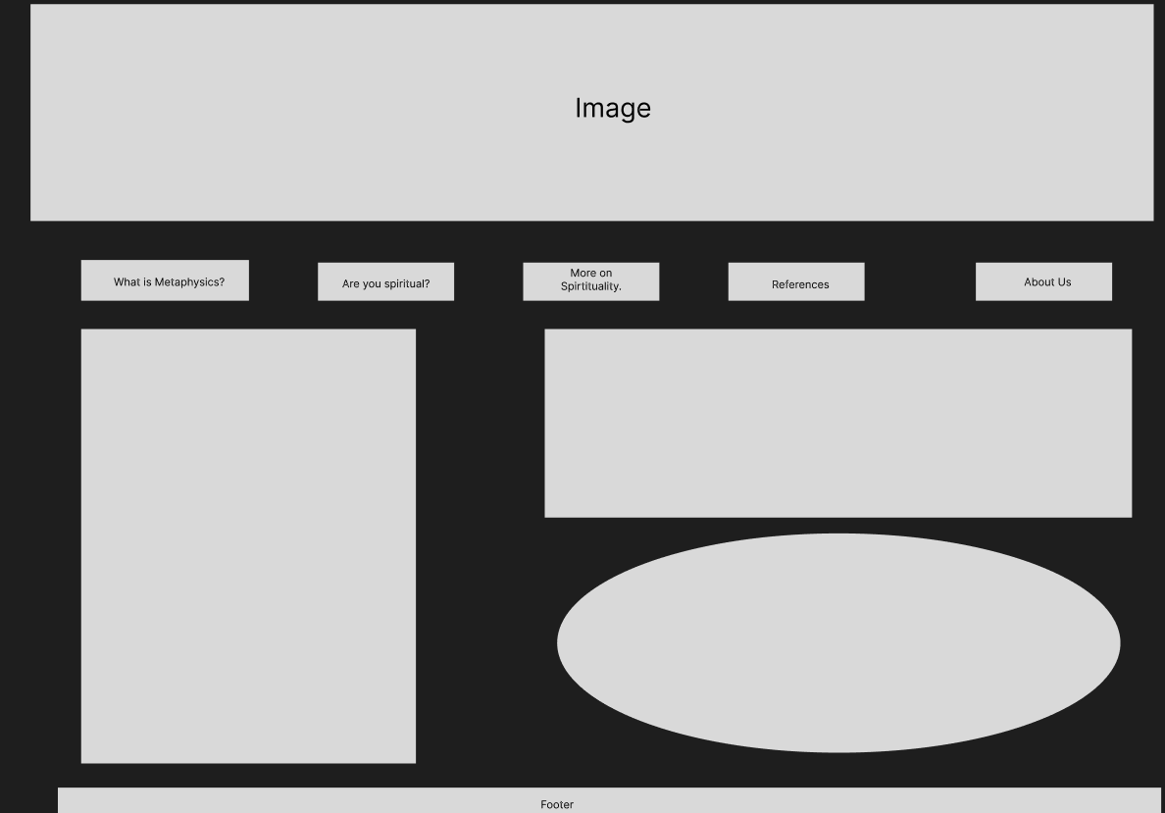
Home Page

Slide 3
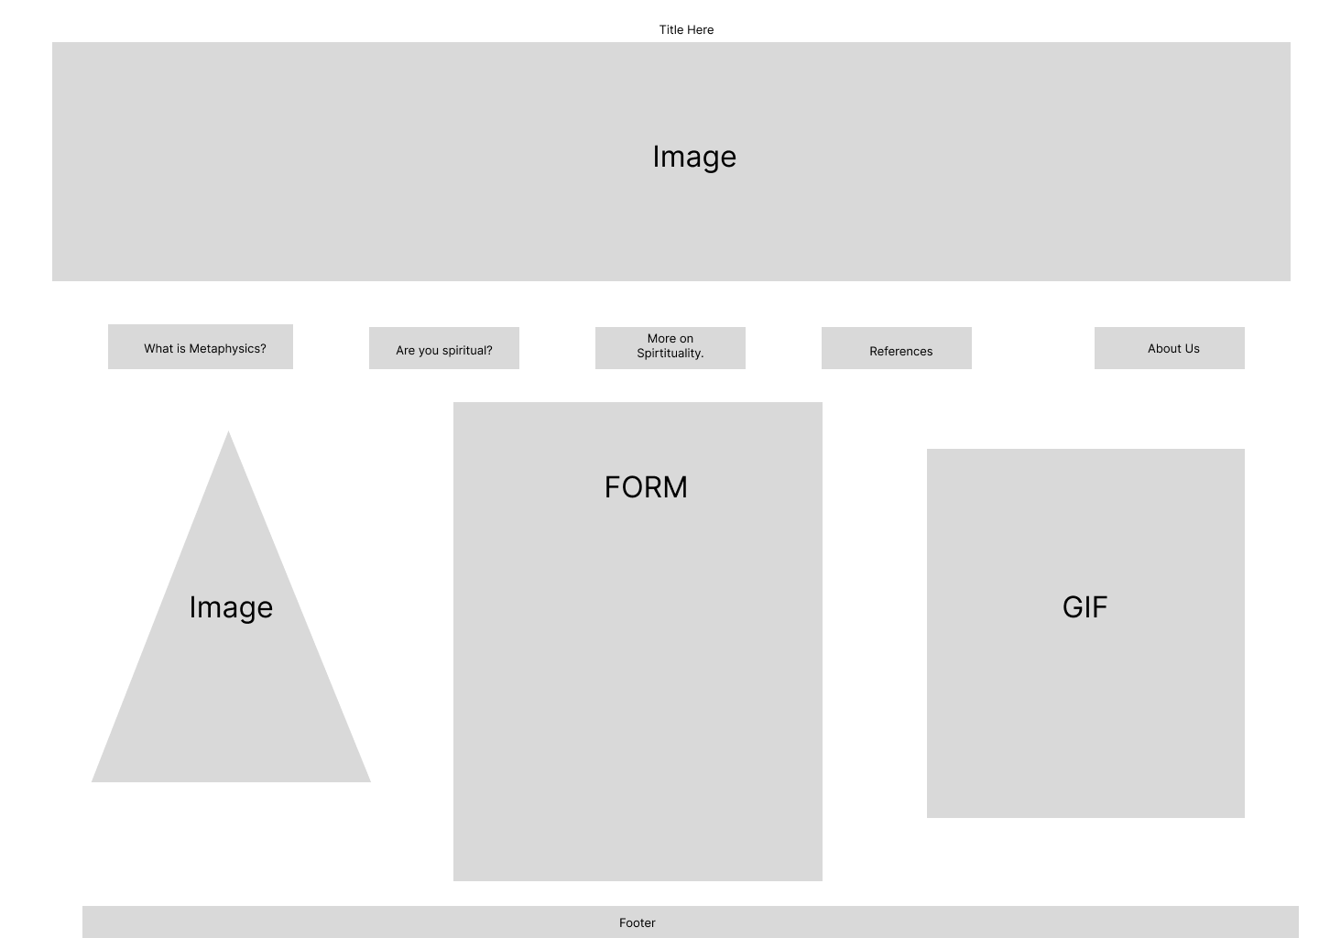
Page 2 (Are you Spiritual?)

Slide 4
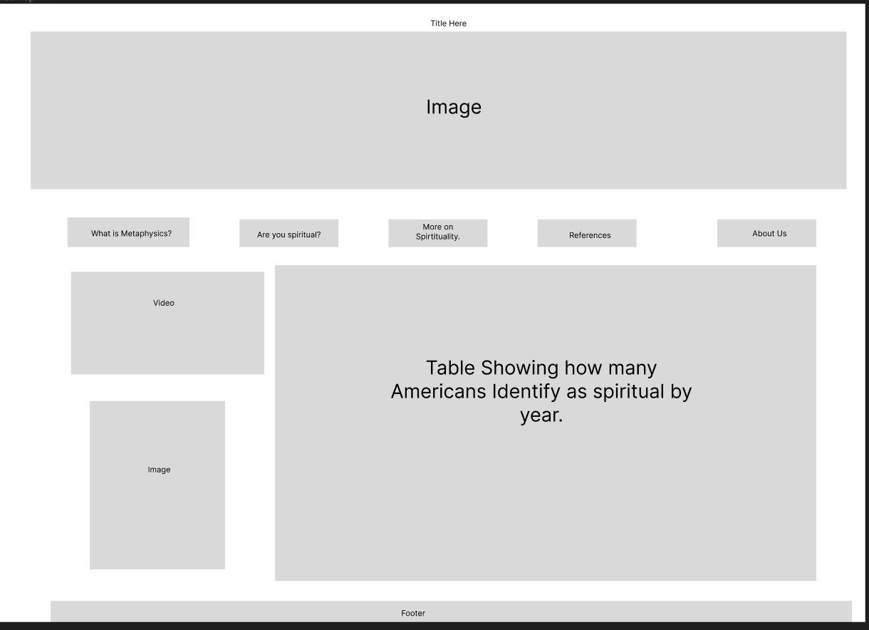
Page 3 (More on Spirituality)

Slide 5
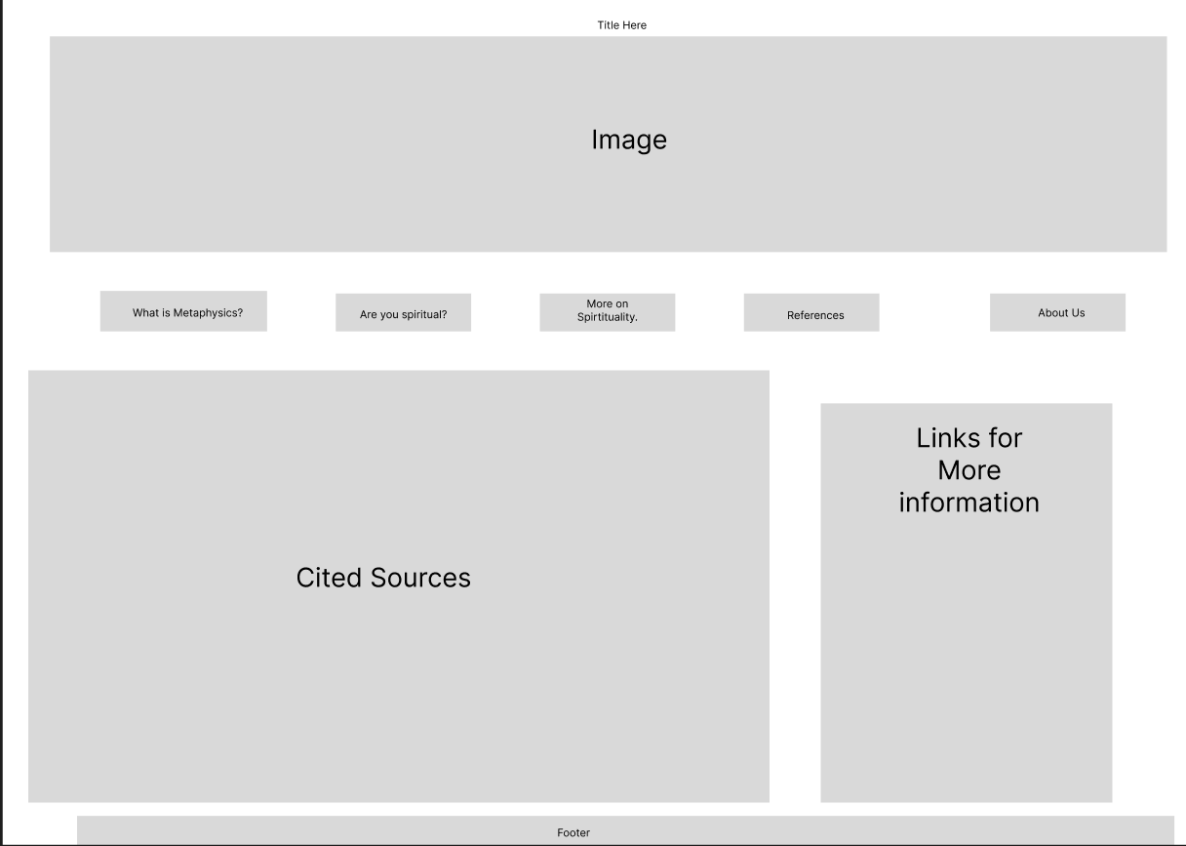
Page 4 (References)

Slide 6
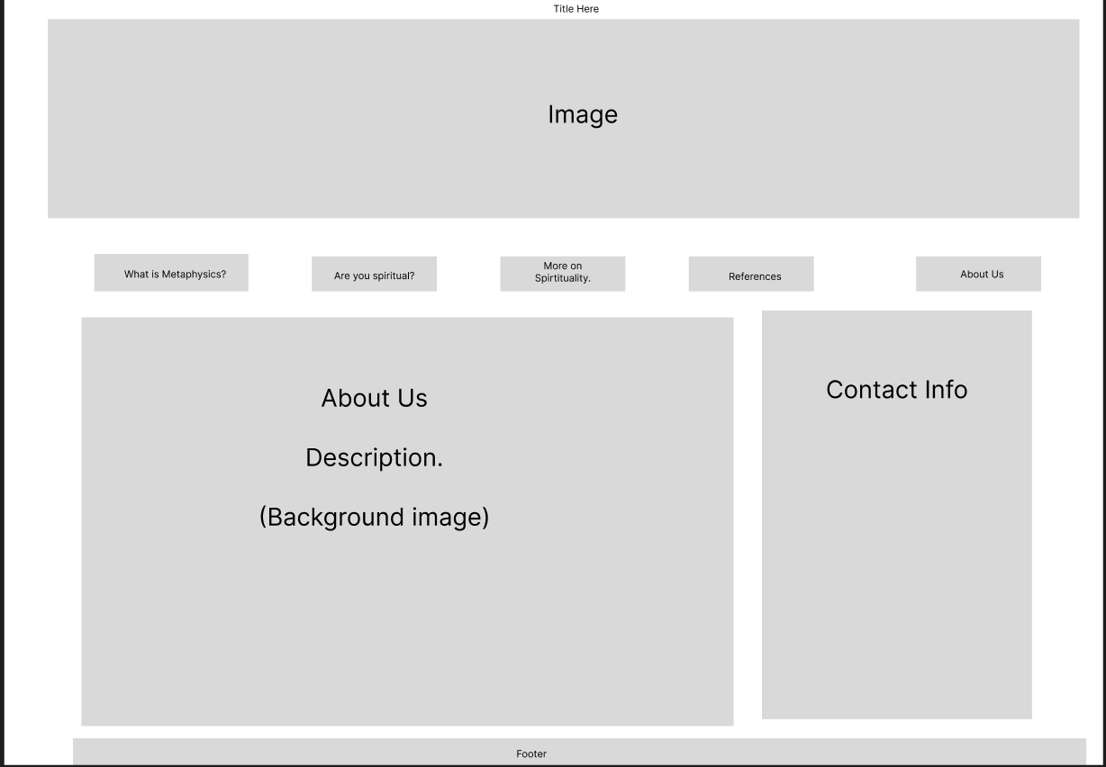
Page 5 (About Us)

