Slide 1
Estudios con Detección de Señales
a.k.a. ‘The Mirror Effect within Perception: Not another Recognition Mamory Study”
PAPIIT IN307214
PAPIME IE310016

Slide 2
Summary
I. Background: SDT (and its application to Recognition Memory)
II. The ‘issue’: The Mirror Effect reported in Recognition Memory.
III. Experiment: Looking for the Mirror Effect within a perceptual task.
IV. Data: Plotting the data
V. Results: Data analysis
VI. Discussion (?)

Slide 3
Signal Detection Theory
PARTE I

Slide 4
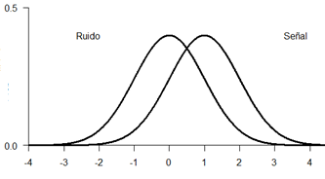
One single problem…
Is that the sound of a predator approaching?
Is this food eatable?
Is my mom mad at me?
Is there a bomb in this bag?
Noise
Signal
Is the target stimulus present?

Slide 5
To detect is a problem
Is this particular situation happening?
Stimulus
Category
World state
‘Yes/No’ situation

Slide 6
Problem #1: Uncertainty
Information is not precise:
Nothing appears exactly the same on each presentation.
Nothing is perceived exactly the same on each presentation.

Slide 7
Problem 2: Consequences
Mistakes cost and success pays
… and they tend to do it on a different scale.

Slide 8
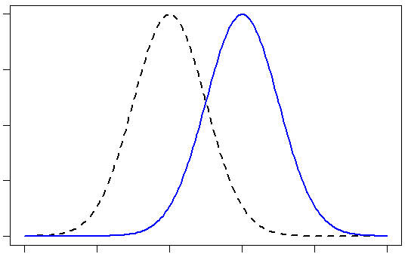
Signal Detection Theory
SEÑAL
Ruido

Slide 9
Two main ingredients of the SDT
Discriminability
D’
Bias
Beta
C

Slide 10
SDT as applied to Recognition Memory

Slide 11
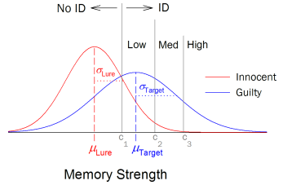
Recognition Memory
Study phase
Recognition Task
Incidental
Intentional
Have I seen this stimulus before?

Slide 12
Procedures
1. Yes|No Task
Have you seen this stimulus before?
2. Confidence Rating
How confident are you about your answer?
0 | 1 | 2 | 3 | 4 | 5
HIGH New | MEDIUM New | LOW New | LOW Old | MEDIUM Old | HIGH Old

Slide 13
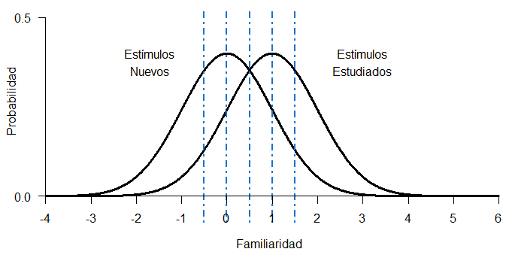
Confidence Criterion | p(Hit) | p(FA) | D’
Old-High |  |  | 1
Old-Medium |  |  | 1
Old-Low |  |  | 1
New-Low |  |  | 1
New-Medium |  |  | 1
New-High |  |  | 1

Slide 14
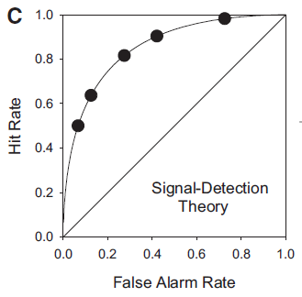
Confidence Criterion | p(Hit) | p(FA) | D’
Old-High |  |  | 1
Old-Medium |  |  | 1
Old-Low |  |  | 1
New-Low |  |  | 1
New-Medium |  |  | 1
New-High |  |  | 1

Slide 15
Mirror Effect on Recognition Memory
PARTE II

Slide 16
Mirror Effect
“If there are two classes of stimuli, and one is more accurately recogized than the other, then the superior class is both more accurately recognized as old when old and also more accurately recognized as new when new (…) means that the greater efficiency in recognizing is always twofold”
(Glanzer, Adams, 1990)

Slide 17
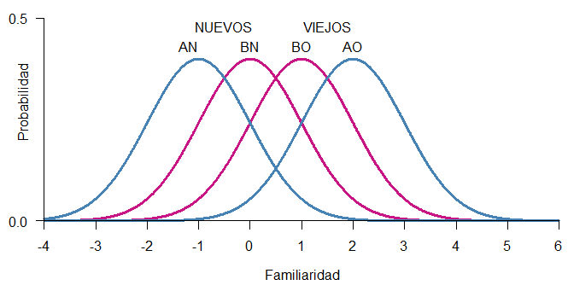
Mirror Effect
The greater efficiency in recognizing is always twofold.

Slide 18
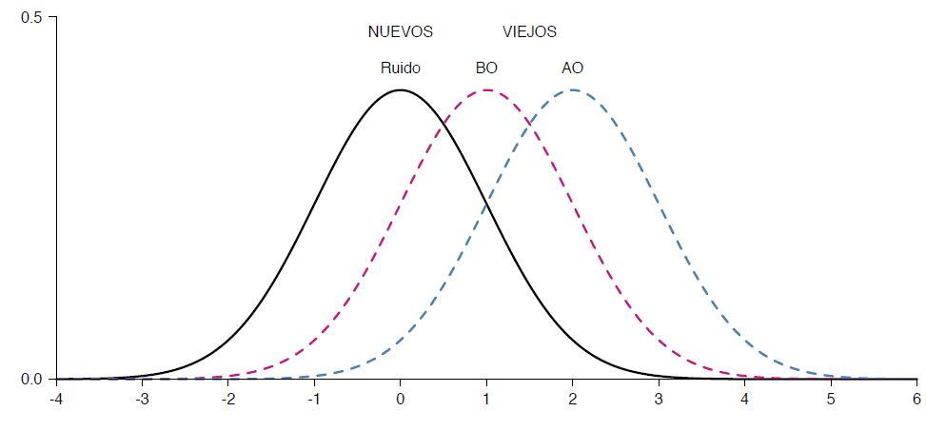

Slide 20

Yes/No Task
(Proportions)
The subject is assumed to make a decision by placing a criterion on the decision axis

Slide 21

Confidence Rating
(Mean)
The subject is assumed to place multiple criteria on the decisiona axis. The higher the criterion above which a test item falls, the higher the rating given it by the subject.

Slide 22
2Alternative-ForcedChoice
(Preferences)
When presented two items, the subject chooses as old the item whose value is higher on the decisiona xis.

Slide 23
Variables
A
Low-frequency words
Concrete words
Reversed words.
Pictures.
B
High-frequency words
Abstract words
Standard words.
Words.

Slide 24
Multiplicity
“The experimenter can produce as many separate mirror orders within a single data set as wished. All that has to be done is to impose effective variables factorially on the presented material and have a sufficient number of items in the study list.”
Extensiveness
“When two variables are used in a single experiment (…) produce an array of eight underlying distributions in mirror order”.

Slide 25
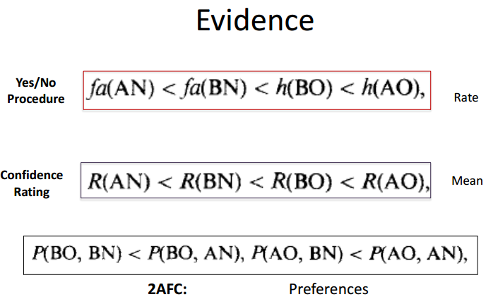

Slide 26
Research question
Is the Mirror Effect exclusively related to recognition memory?
Can we find evidence for the Mirror Effect in a perceptual task?
Is the Mirror Effect a property of SDT.

Slide 27
The Experiment
PARTE III

Slide 28
We designed a perceptual task with two levels of discriminability to test the generalizability of the Mirror Effect.
No pre-experimental task
No high-level processing
Is the Mirror
¿Es el Efecto Espejo un reflejo de lo que pasa a nivel del procesamiento de estímulos?

Slide 29


Slide 30
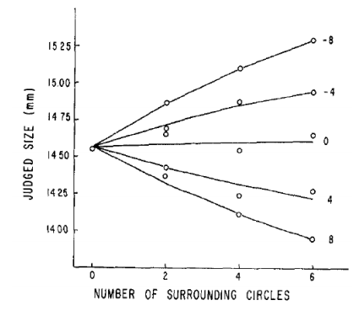

Slide 31
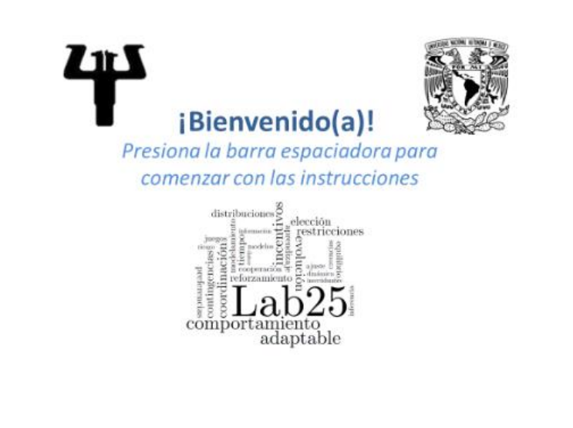

Slide 32
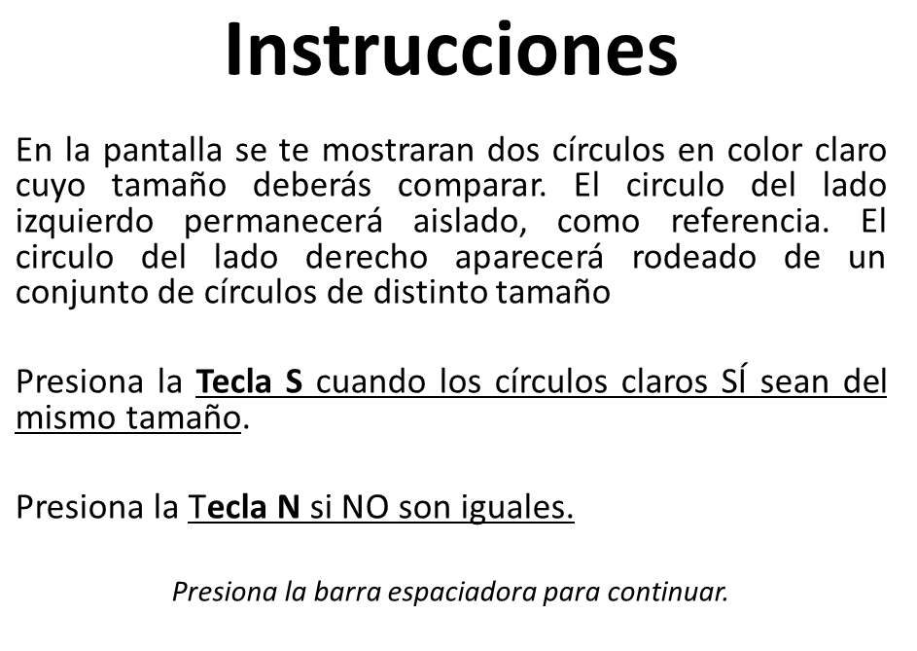

Slide 33
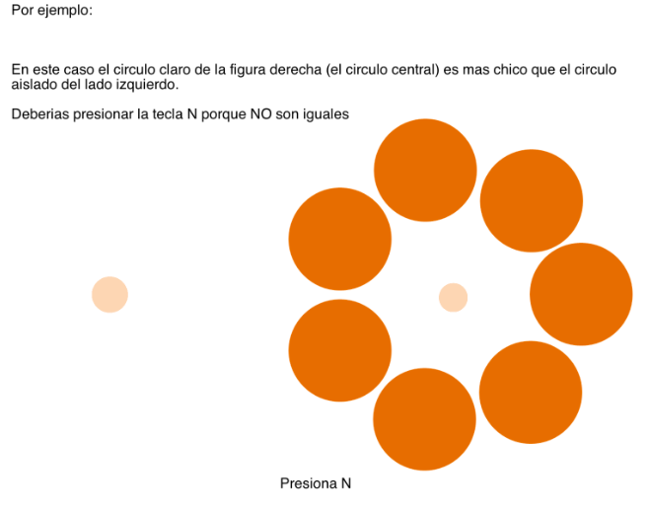

Slide 34
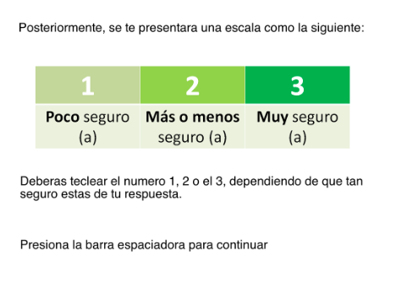

Slide 35
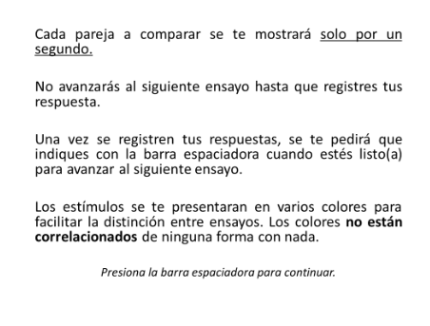

Slide 36
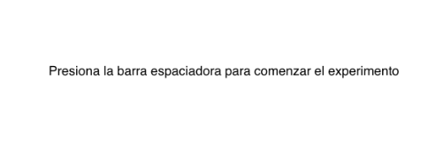

Slide 37
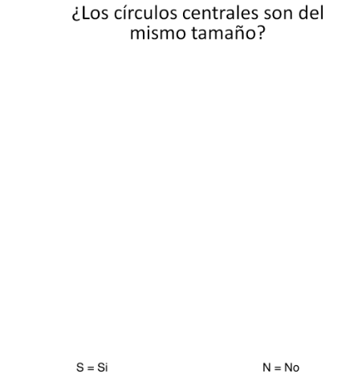
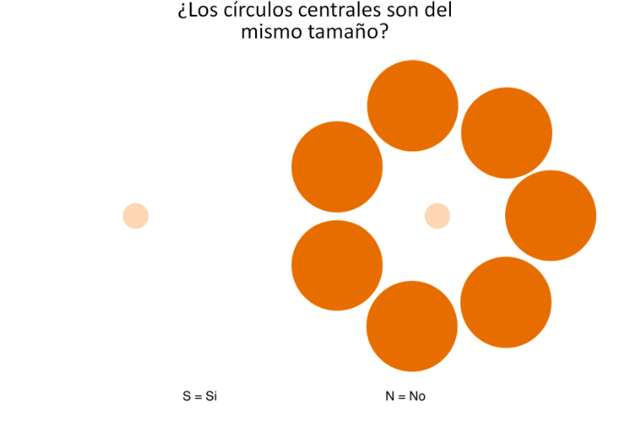

Slide 38
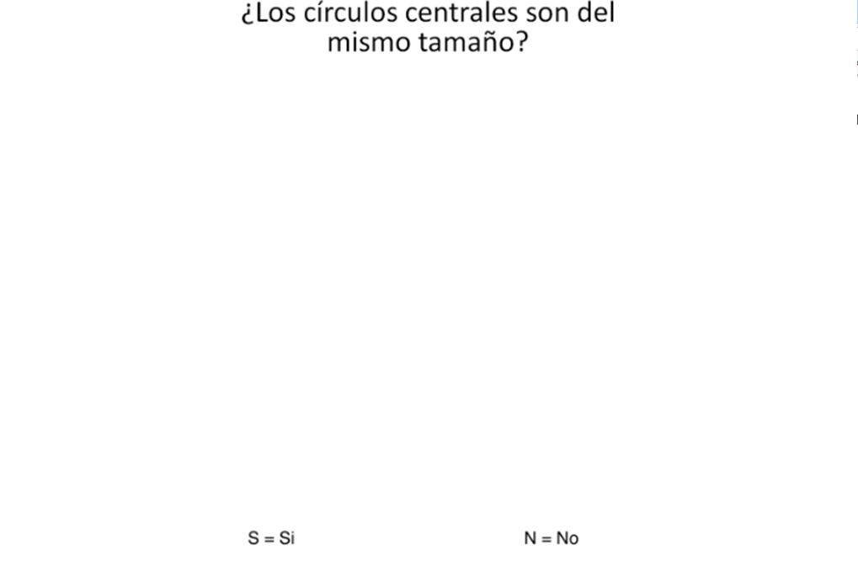

Slide 39
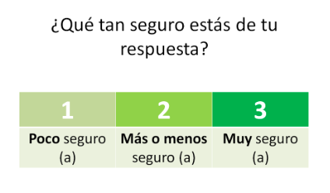

Slide 40
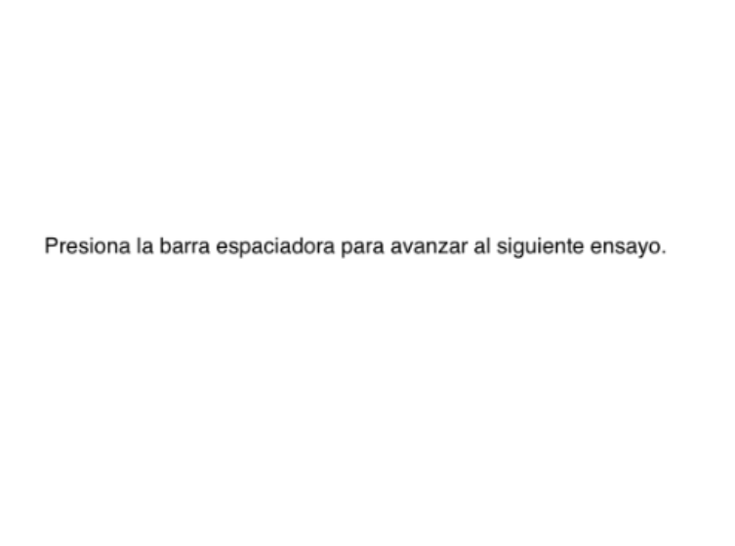

Slide 41
¿Los círculos centrales son del mismo tamaño?
Experimento 1
Experimento 2
Círculo aislado (constante)
Vs
Círculo central de Figura de Ebbinghaus
Círculo central de Figura de Ebbinghaus
(Sobrestimación)
vs
Círculo central de Figura de Ebbinghaus
(Subestimación)

Slide 42
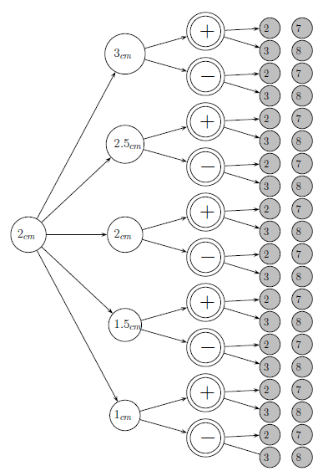
Experimento 1
Diseño Factorial 5x2x2
5 círculos centrales
2 ilusiones
2 niveles de número de círculo externo
… por Condición

Slide 43
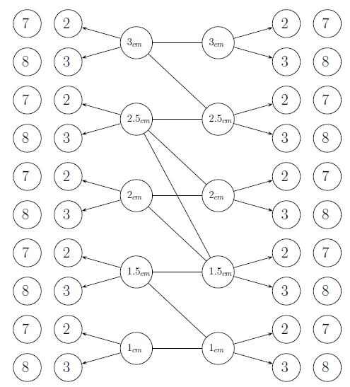

Slide 44
Datos
Parte V

Slide 45
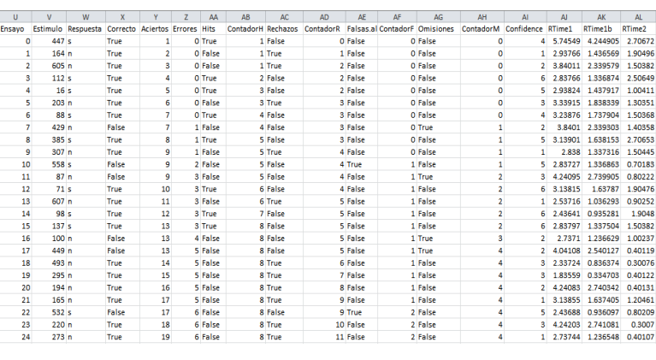

Slide 46
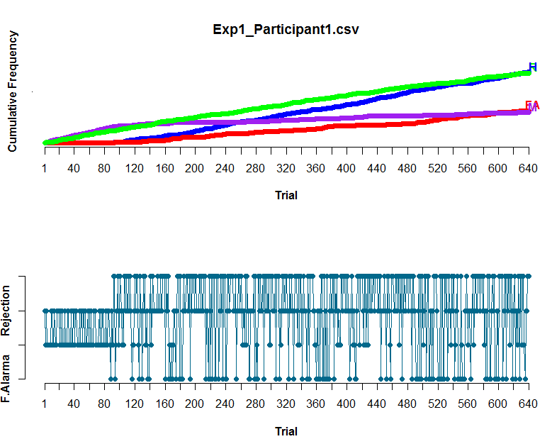

Slide 47
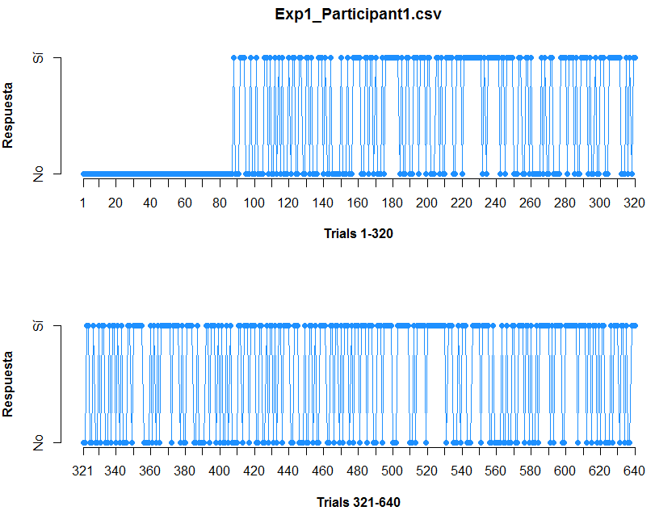

Slide 48
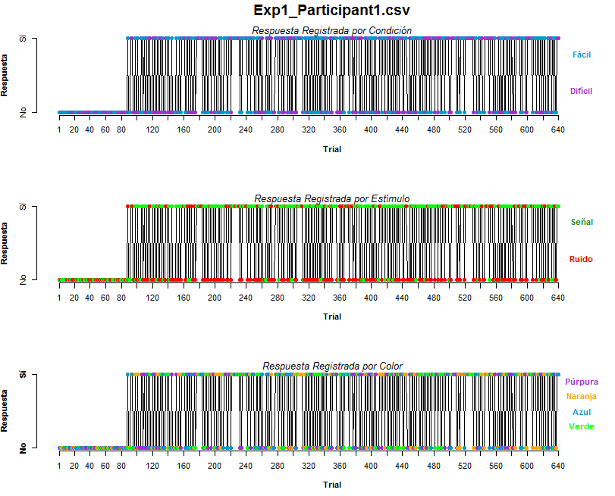

Slide 49
Resultados
Parte VI

Slide 50
To-do list:
Comprobar que las condiciones de d’ sean diferentes.
Comprobar diferencias entre:
a) Hits A vs Hits B
b) FA A vs FA B
Comprobar diferencias en Confidence Rates
Controles adicionales:
Diferencias en:
a) CR-Miss A vs CR-Miss B
2. Comprobar correlacion:
Tiempo de Respuesta - Condición

Slide 51
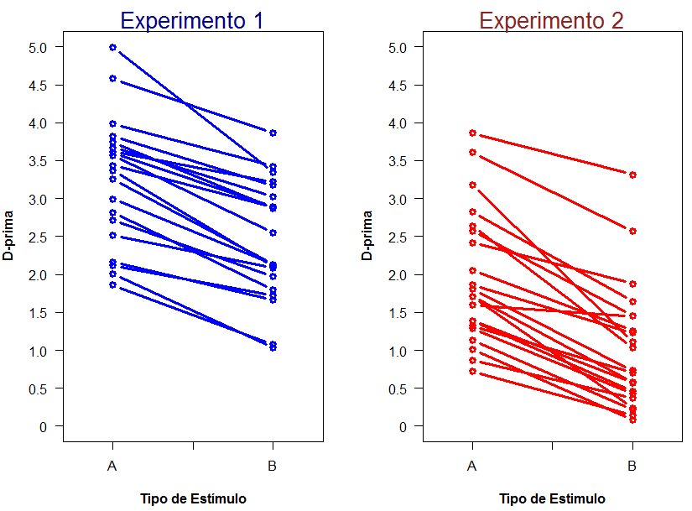
1. Verificar que se probaron dos condiciones de dificultad.

Slide 52
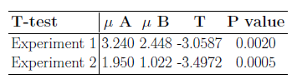

Slide 53
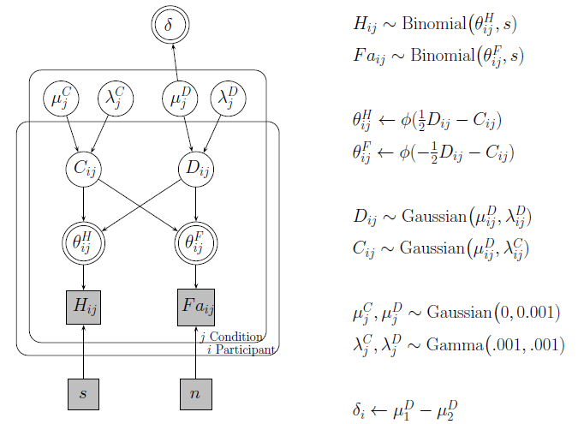

Slide 54
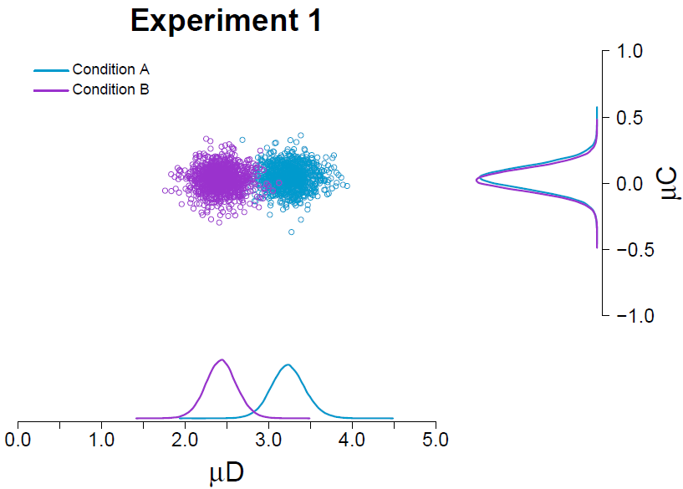

Slide 55
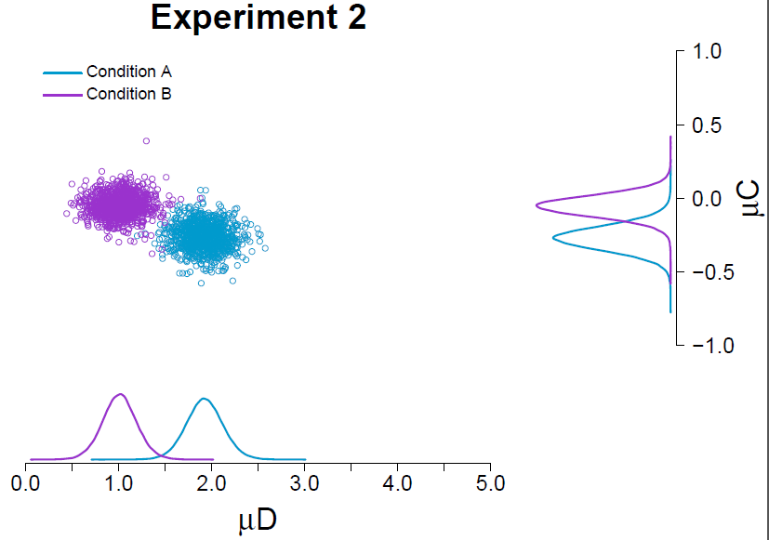

Slide 56
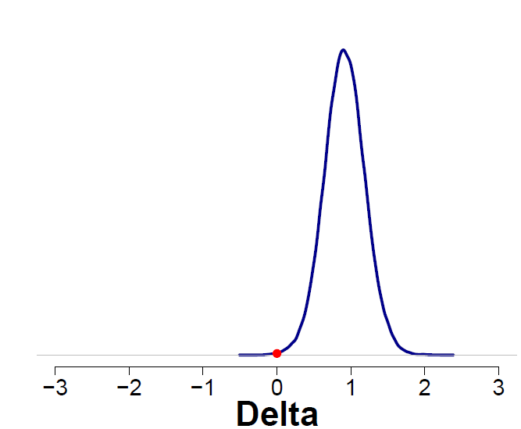
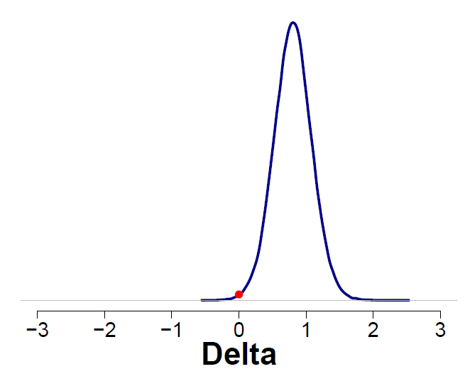
Experimento 1
Experimento 2

Slide 57
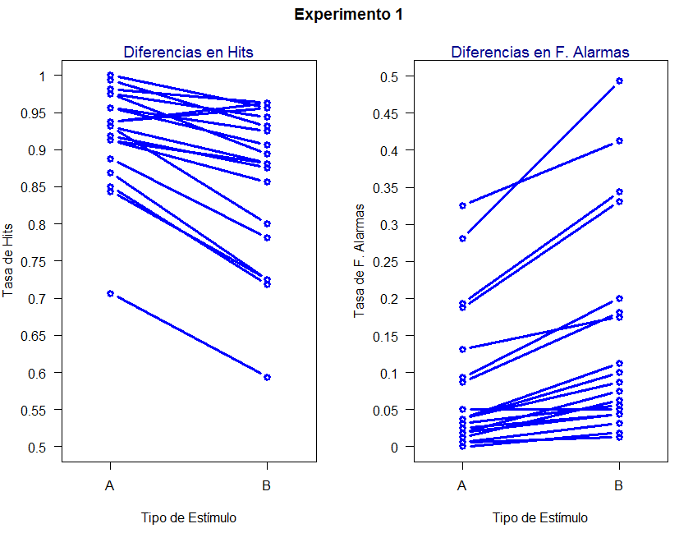
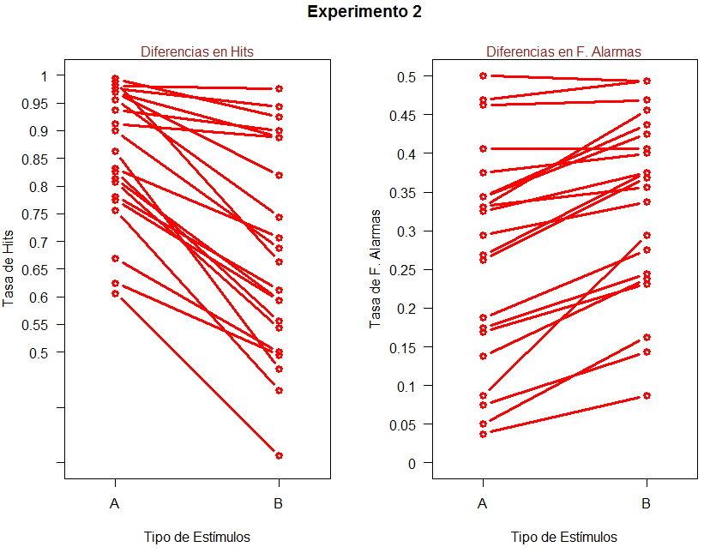
2. Comparar Tasas de Respuesta (Hits y Falsas Alarmas)

Slide 58
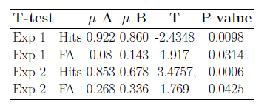

Slide 59
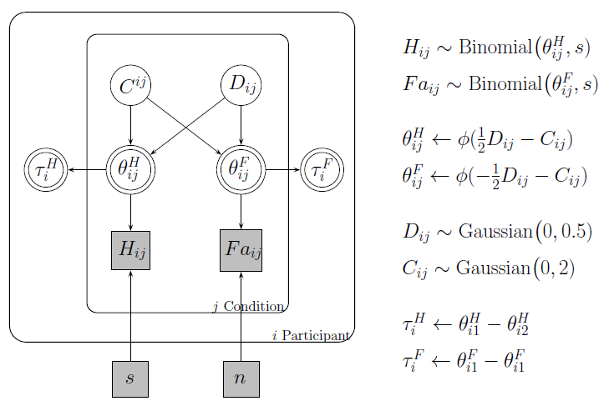

Slide 60
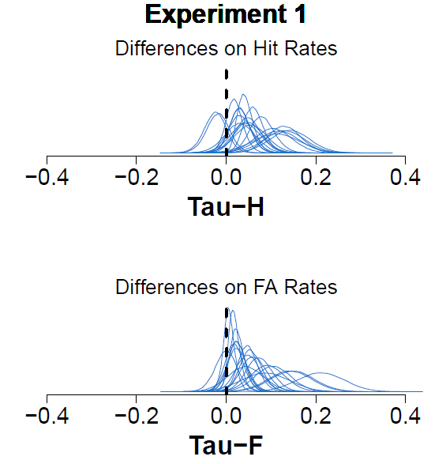

Slide 61
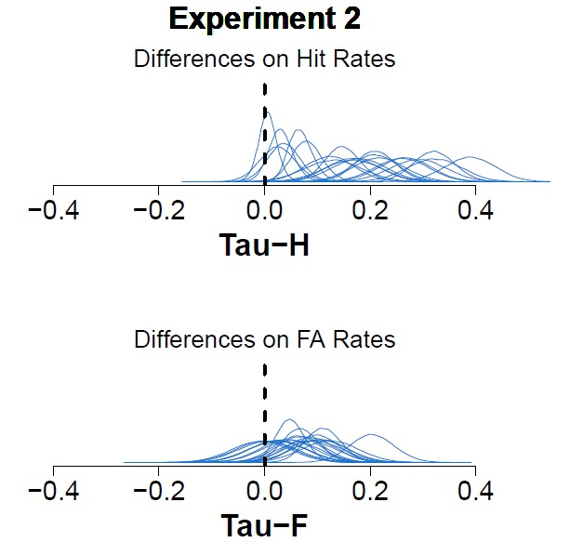

Slide 62
3. Comparar Confidence Ratings

Slide 63
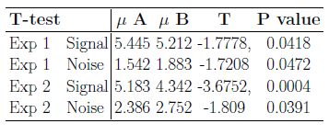

Slide 64
To-do list:
Comprobar que las condiciones de d’ sean diferentes.
Comprobar diferencias entre:
a) Hits A vs Hits B
b) FA A vs FA B
Comprobar diferencias en Confidence Rates
Controles adicionales:
Diferencias en:
a) CR-Miss A vs CR-Miss B
2. Comprobar correlacion:
Tiempo de Respuesta - Condición

Slide 65

Discusión
Parte VII

