Slide 1
The Mirror Effect within Perception: Not another Recognition Memory Study.
PAPIIT IN307214
PAPIME IE310016
Felisa Chávez; Lab 25

Slide 2
Summary
I. Background: SDT (and its application to Recognition Memory)
II. The ‘issue’: The Mirror Effect reported in Recognition Memory.
III. Experiment: Looking for the Mirror Effect within a perceptual task.
IV. Data: Plotting the data
V. Results: Data analysis
VI. Discussion (?)

Slide 3
Background
PARTE I

Slide 4
The problem of detection
Is this particular situation happening?
Stimulus
Category
World state
‘Yes/No’ situation

Slide 5
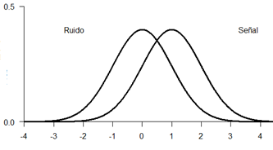
Is that the sound of a predator approaching?
Is this food eatable?
Is my mom mad at me?
Is there a bomb in this bag?
Noise
Signal

Slide 6
One single problem…
Is that the sound of a predator approaching?
Is this food eatable?
Is my mom mad at me?
Is there a bomb in this bag?
Noise
Signal
Detection tasks!

Slide 7
Problem #1: Uncertainty
Information is not precise:
Nothing appears exactly the same on each presentation.
Nothing is perceived exactly the same on each presentation.

Slide 8
Problem 2: Consequences
Mistakes cost and success pays
… and they tend to do it on a different scale.

Slide 9
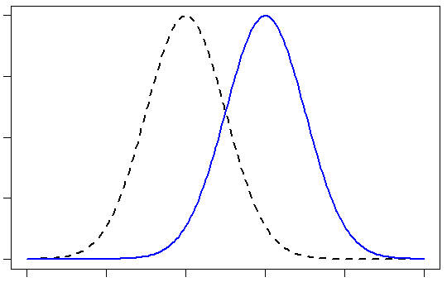
Signal Detection Theory
SEÑAL
Ruido

Slide 10
Discriminability
D’
Bias
Beta
C

Slide 11
SDT as applied to Recognition Memory

Slide 12
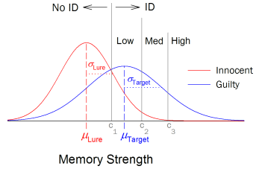
Recognition Memory
Study phase
Recognition Task
Incidental
Intentional
Have I seen this stimulus before?

Slide 13
Procedures
1. Yes|No Task
Have you seen this stimulus before?
2. Confidence Rating
How confident are you about your answer?
0 | 1 | 2 | 3 | 4 | 5
HIGH New | MEDIUM New | LOW New | LOW Old | MEDIUM Old | HIGH Old

Slide 14
Mirror Effect on Recognition Memory
PARTE II

Slide 15
Mirror Effect
“If there are two classes of stimuli, and one is more accurately recogized than the other, then the superior class is both more accurately recognized as old when old and also more accurately recognized as new when new (…) means that the greater efficiency in recognizing is always twofold”
(Glanzer, Adams, 1990)

Slide 16
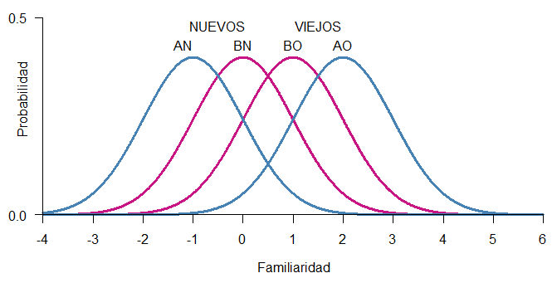

Yes/No Task
(Proportions)
The subject is assumed to make a decision by placing a criterion on the decision axis

Slide 17

Confidence Rating
(Mean)
The subject is assumed to place multiple criteria on the decisiona axis. The higher the criterion above which a test item falls, the higher the rating given it by the subject.

Slide 18
Mirror Effect
The greater efficiency in recognizing is always twofold.

Slide 19
Variables
A
Low-frequency words
Concrete words
Reversed words.
Pictures.
B
High-frequency words
Abstract words
Standard words.
Words.

Slide 20
Research question
Is the Mirror Effect exclusively related to recognition memory?
Can we find evidence of the Mirror Effect in a perceptual task?
Is the Mirror Effect a property of SDT?

Slide 21
The Experiment
PARTE III

Slide 22
We designed a perceptual task with two levels of discriminability to test the generalizability of the Mirror Effect.
No pre-experimental task
No high-level processing

Slide 23


Slide 24
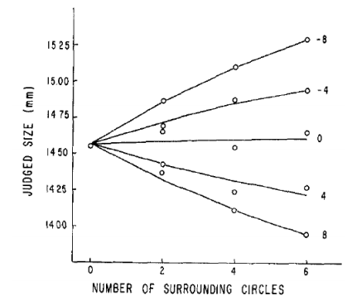

Slide 25
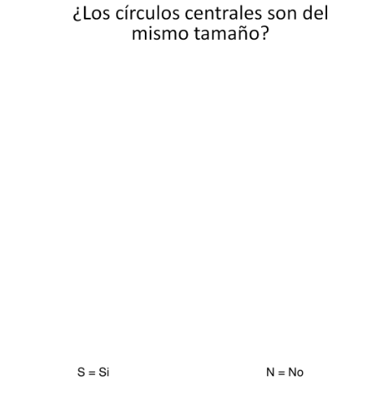
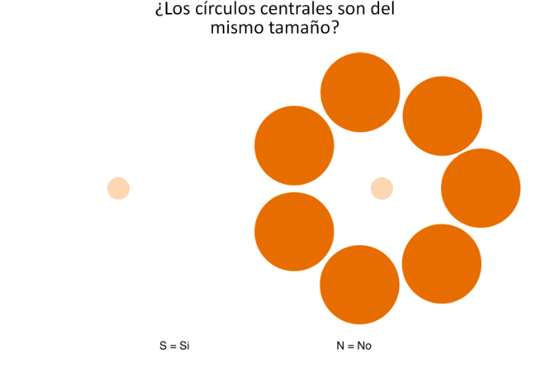

Slide 26
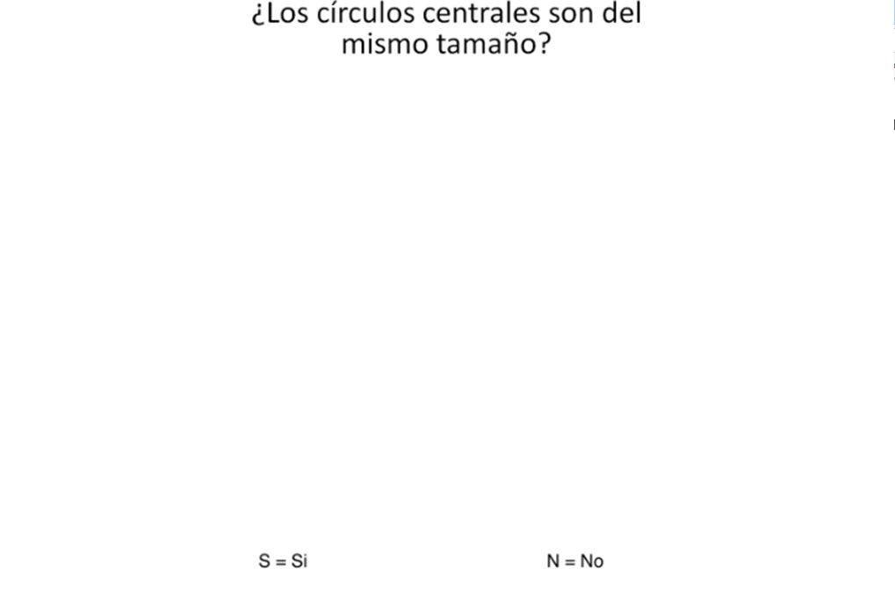

Slide 27
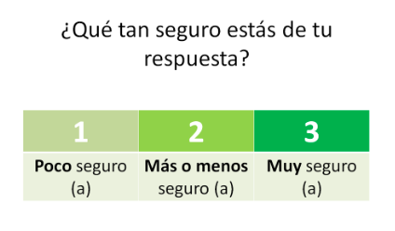

Slide 28
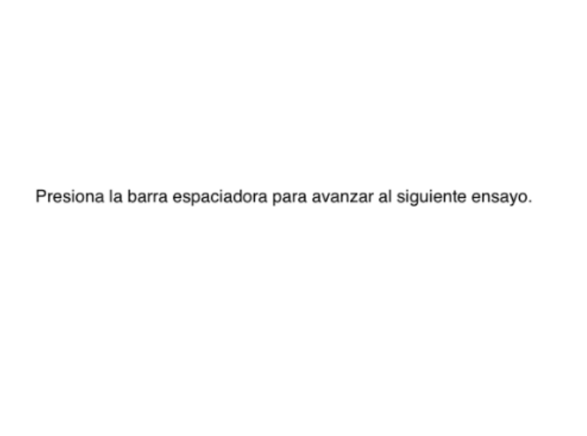

Slide 29
Do the central circles have the same size?
Aisle VS Ebbinghaus
Ebbinghaus VS Ebbinghaus
(Over) (Under)
Experiment 1
Experiment 2

Slide 30
Data
Parte V

Slide 31
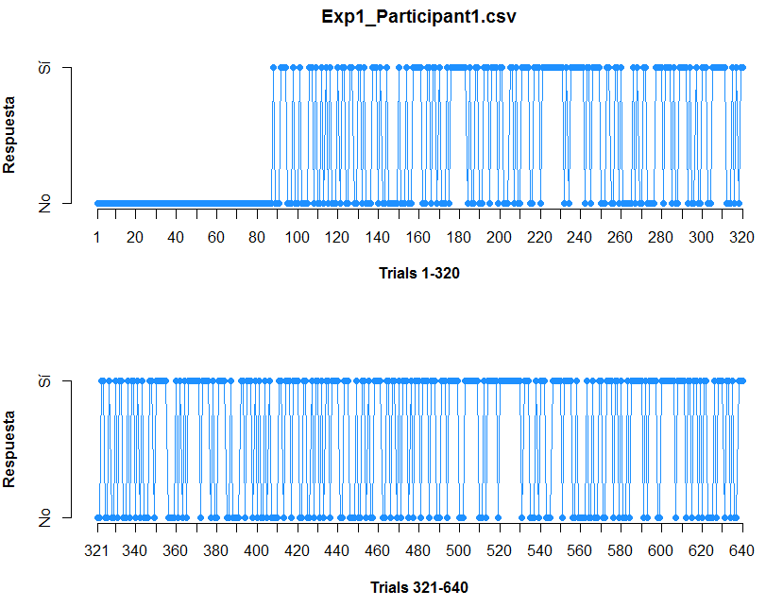

Slide 32
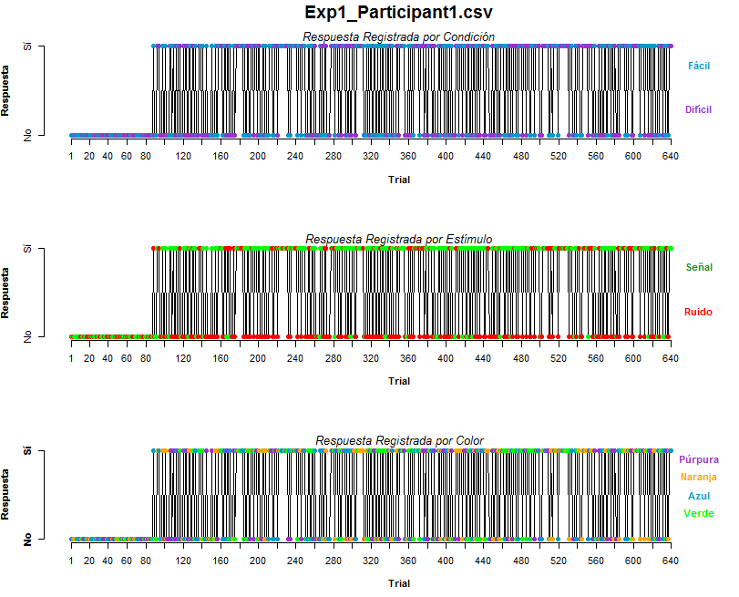

Slide 33
Results
Parte VI

Slide 34
To-do list:
Are d’ actually different between conditions?
Is the Mirror Effect pattern appearing in the Yes/No task
3. Is the Mirror Effect pattern shown in the mean Confidence Rating asigned per condition?

Slide 35
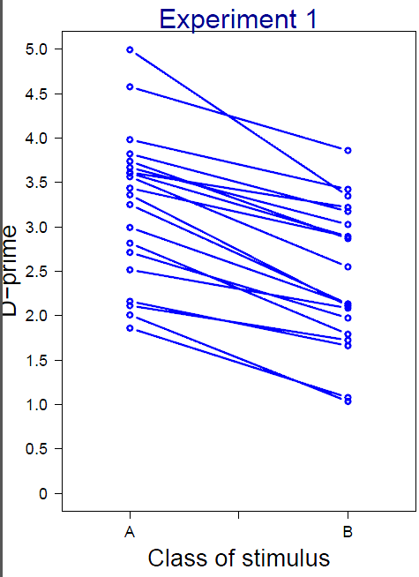
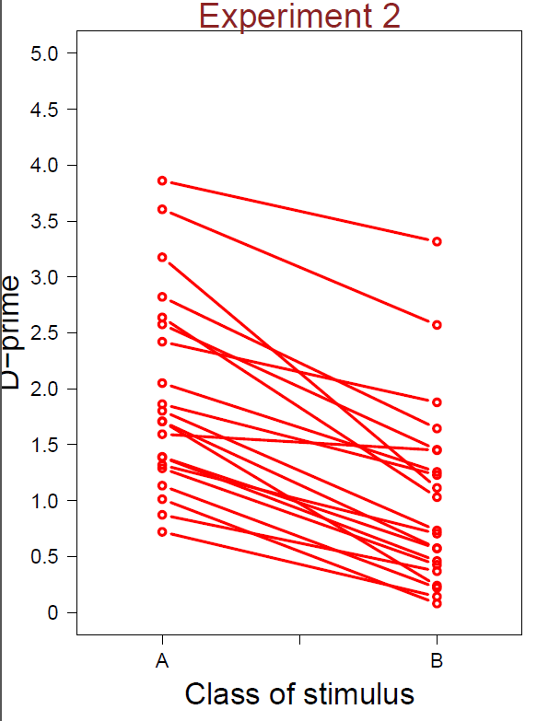
1. Are d’ different?

Slide 36
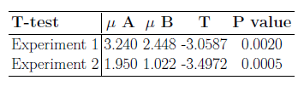

Slide 37
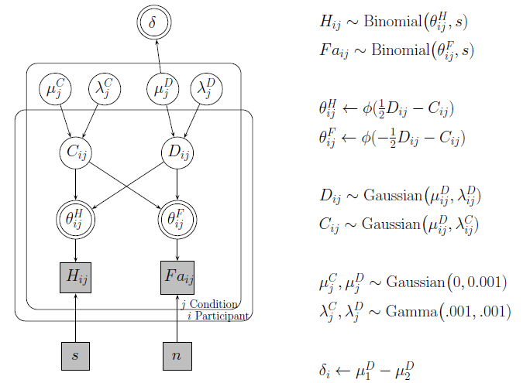

Slide 38
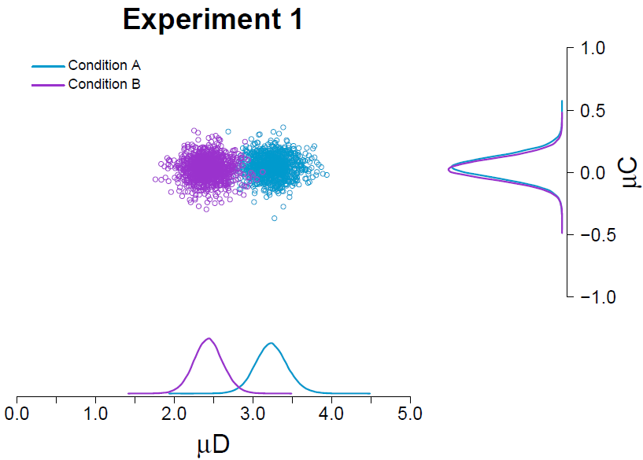

Slide 39
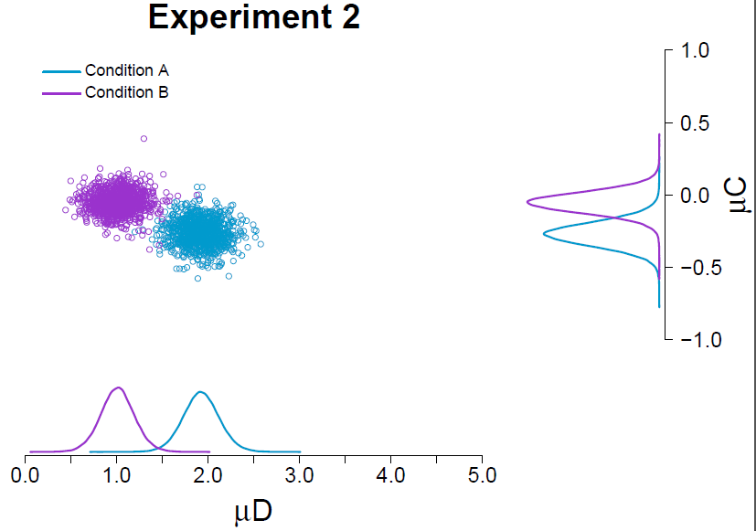

Slide 40
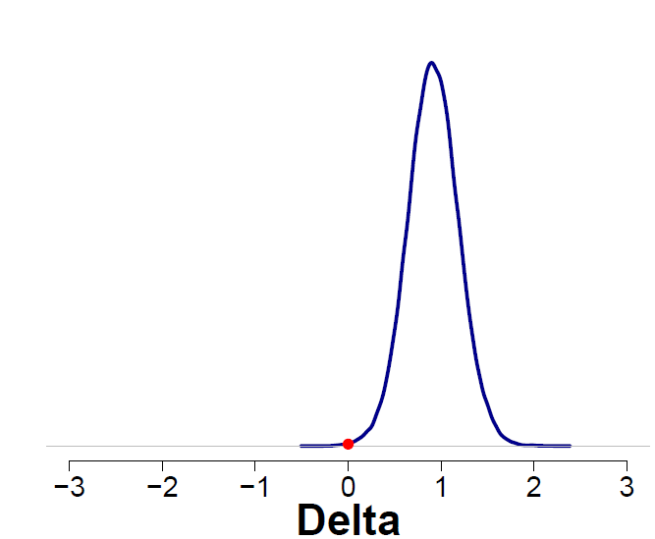
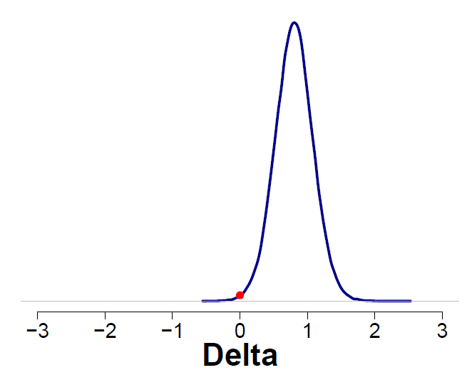
Experiment 1
Experiment 2

Slide 41
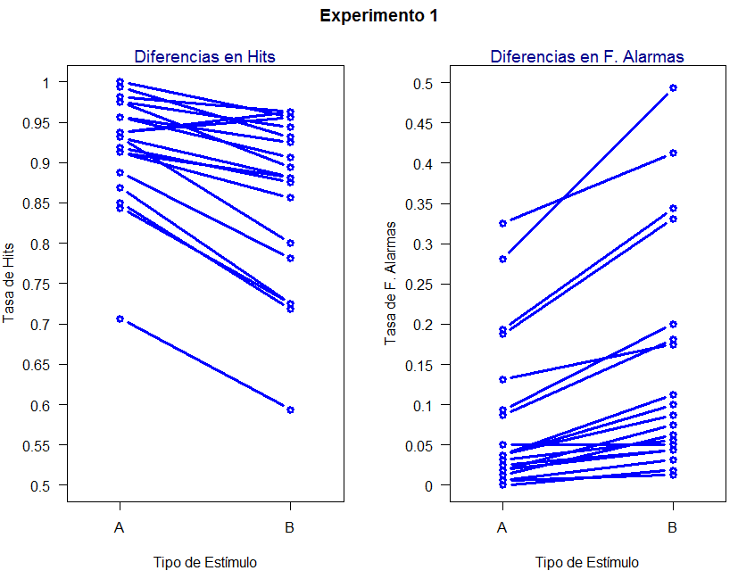
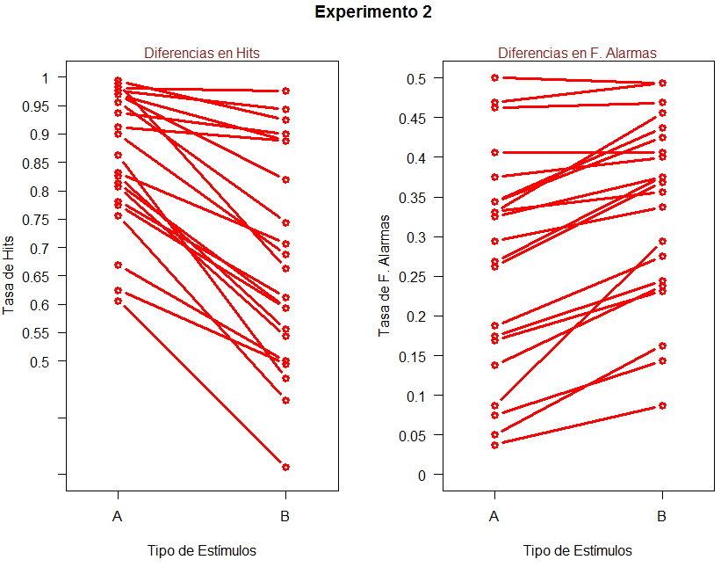
2. Comparar Tasas de Respuesta (Hits y Falsas Alarmas)

Slide 42
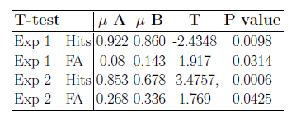

Slide 43
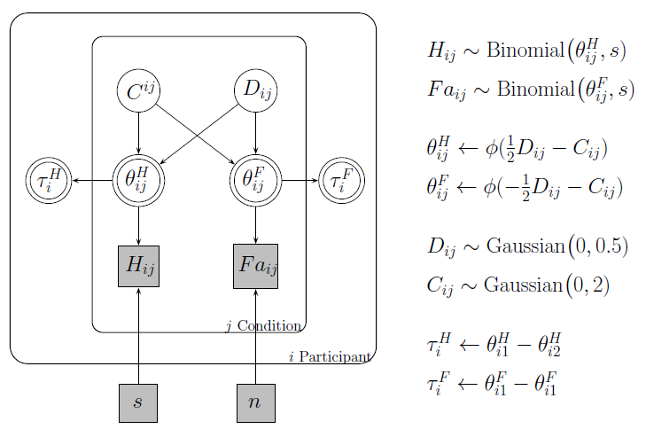

Slide 44
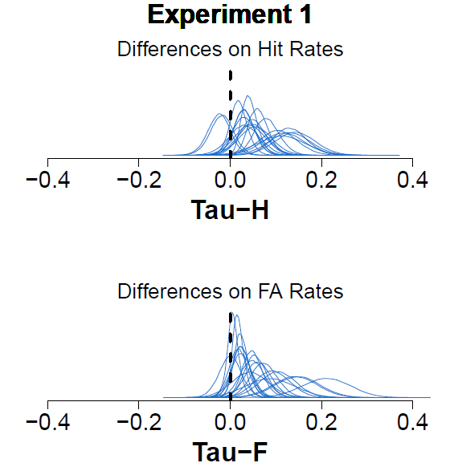

Slide 45
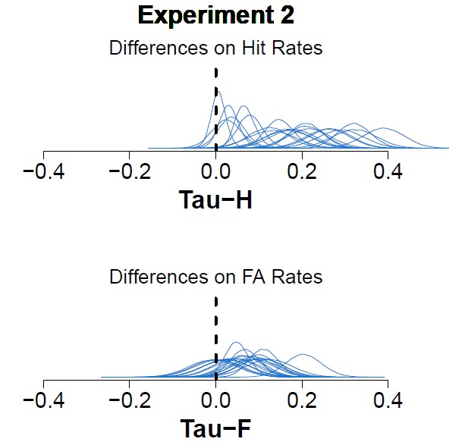

Slide 46
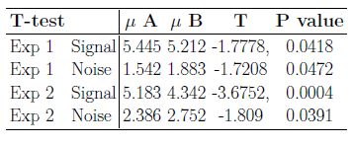
3. Confidence Ratings

Slide 47

Discussion
Parte VII

Slide 48
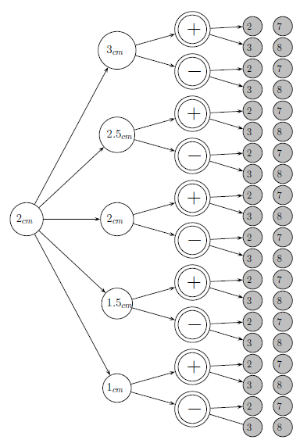
Experimento 1
Factorial design 5x2x2
5 central circles
2 illusion directions
2 levels of Number of External circles
… per Condition

Slide 49
