Slide 1
Sensibility as a source of Bias in a Detection Task using the Ebbinghaus Illusion
Signal Detection Theory
Adriana Felisa Chávez De la Peña
Facultad de Psicología; UNAM
Lab 25

Slide 2
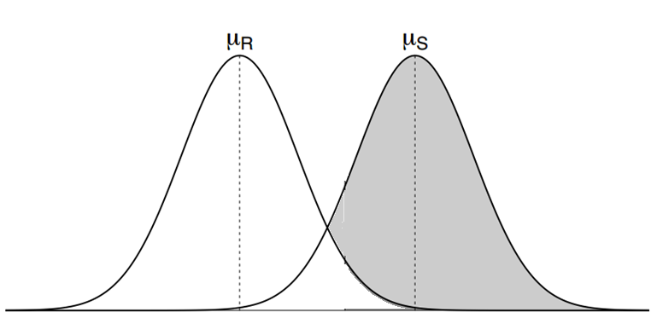
Signal Detection Theory
Noise
Signal
Evidence

Slide 3
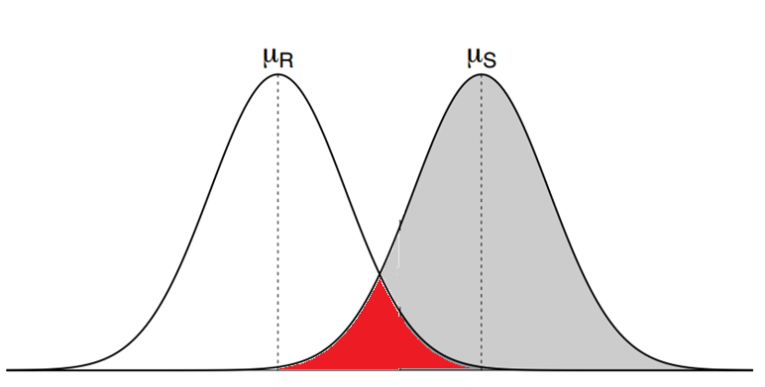
Signal Detection Theory
Noise
Signal
Uncertainity!
Risk!
Evidence

Slide 4
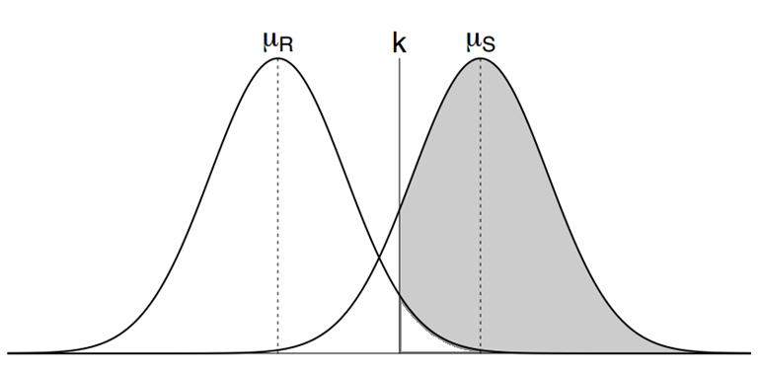
Signal Detection Theory
Criterion
Noise
Signal
Perception
=
Decision
Evidence

Slide 5
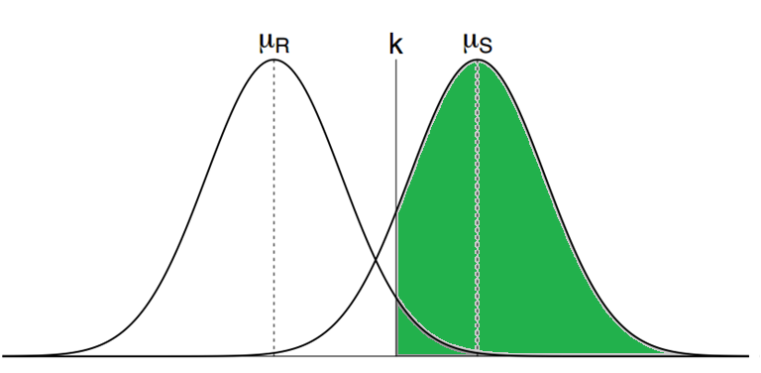
Signal Detection Theory
Criterion
Noise
Signal
Perception
=
Decision
Evidence

Slide 6
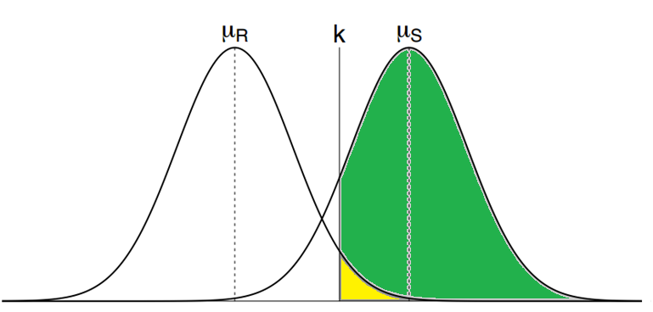
Signal Detection Theory
Criterion
Noise
Signal
Perception
=
Decision
Evidence

Slide 7
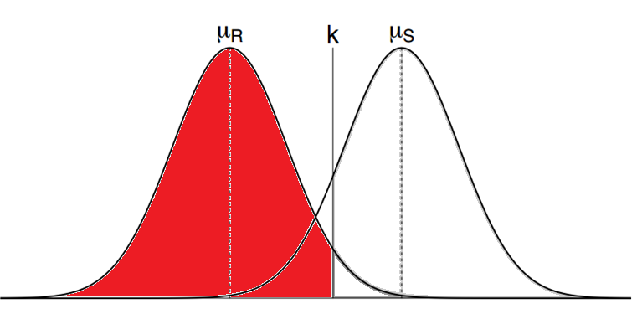
Signal Detection Theory
Criterion
Noise
Signal
Perception
=
Decision
Evidence

Slide 8
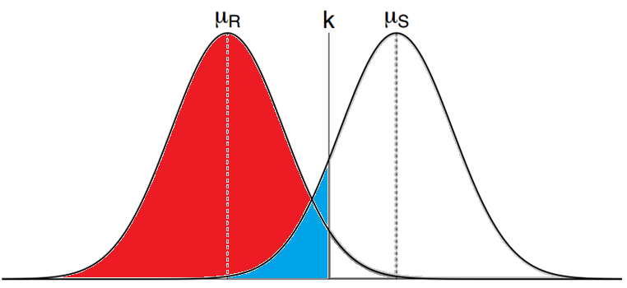
Signal Detection Theory
Criterion
Noise
Signal
Perception
=
Decision
Evidence

Slide 9
Parameters of Interest
Discriminability – Sensitivity (d’)
d’

Slide 10
Parameters of Interest
Criterion (k) – Bias (β)
β

Slide 11
Parameters of Interest
Criterion (k) – Bias (C)
C

Slide 12
How could you not love SDT ?!
Psychophysics + Statistics + Bayesian Inference
Perception.
Probabilistic Inference.
Detection.
Categorization.
Recognition.
All kind of systems

Slide 13
What have I done so far?

Slide 14
What have I done so far?
‘Sensitivity as a source of Bias in a Detection Task using the Ebbinghaus Illusion’
Brief experiment
30 participants
672 trials

Slide 15
Sensitivity and Bias
According to Lynn & Feldman (2014), the distinction between Sensitivity and Bias is clear in the SDT literature.
Bias as a function of…
Utility (Payoffs)
Knowledge (Probability)
What about ‘Bias as a function of Sensitivity’.
If Optimality is the goal, then the system should show more extreme behavior (Bias) when uncertainitiy is greater.
Reverse correlation between D’ and Bias.

Slide 16
What was I looking for??
Is there any difference in the tendency to respond in a particular direction when every task condition remain the same except for the discriminability of the signal.

Slide 17
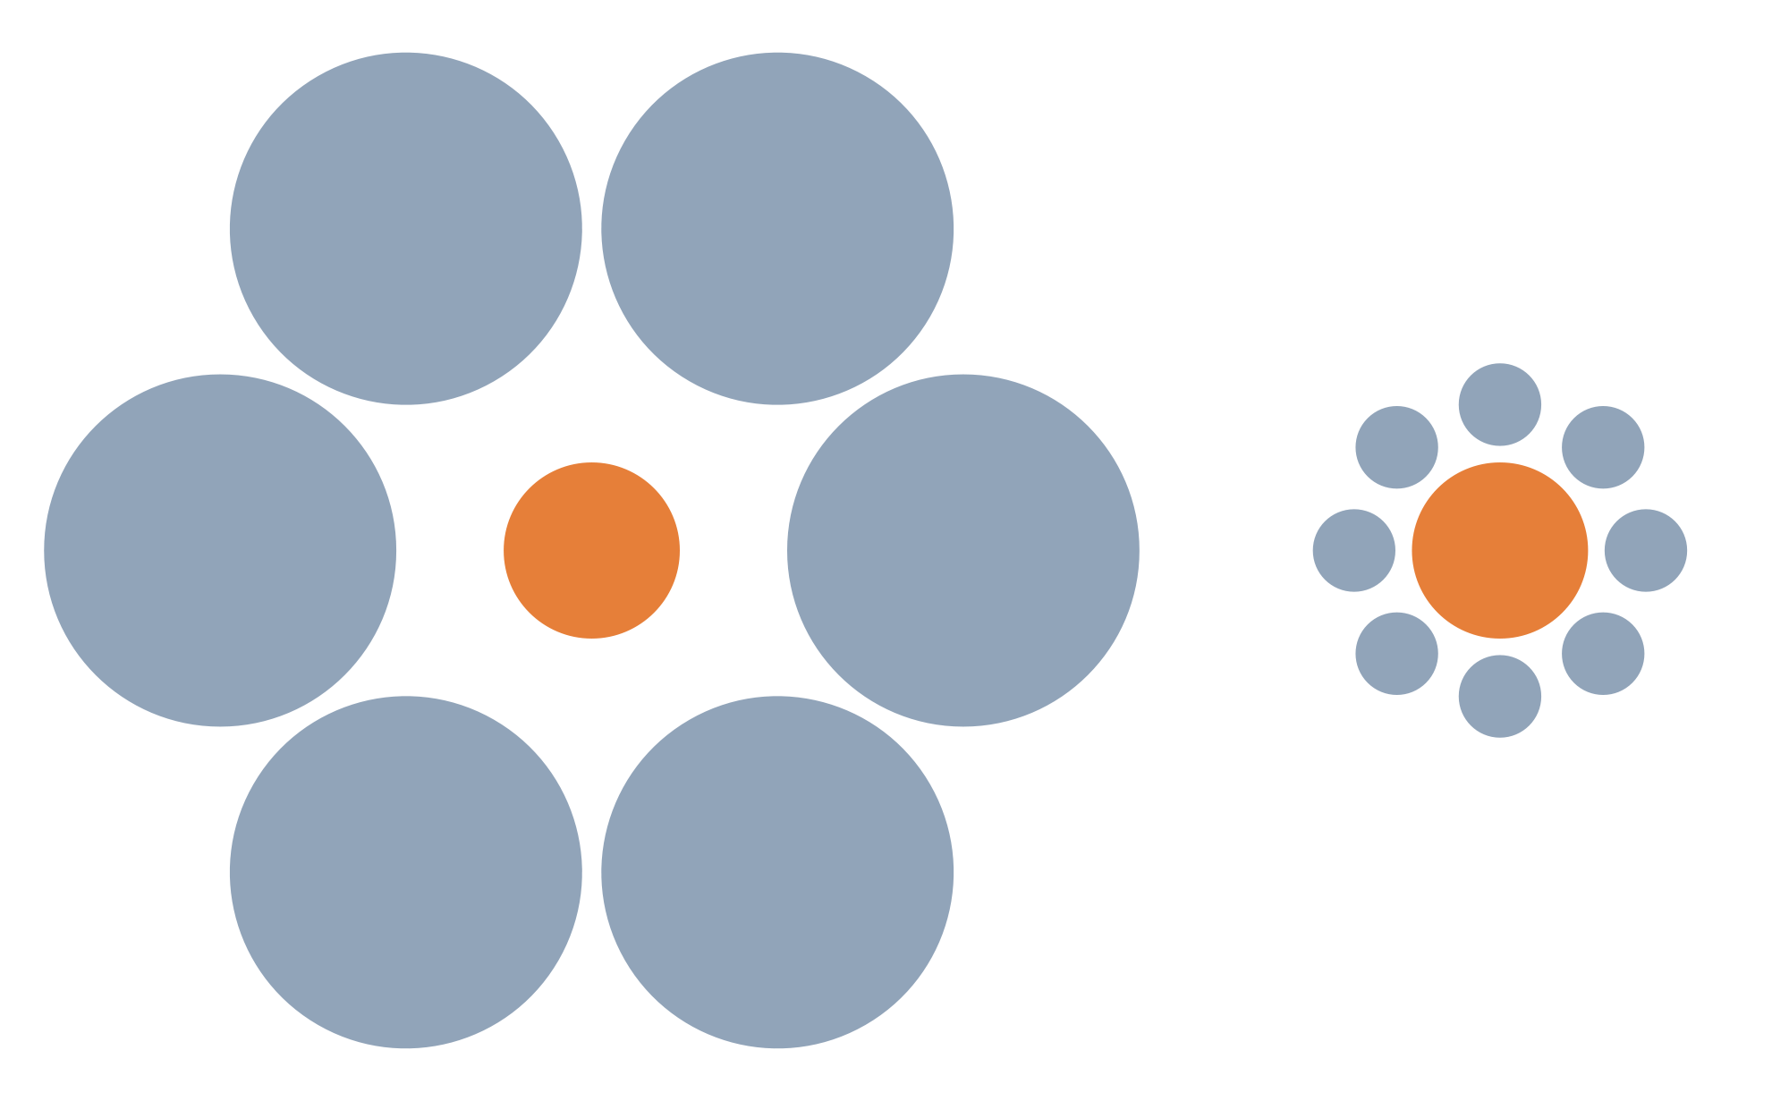
Ebbinghaus Illusion

Slide 18
Ebbinghaus Illusion
Disruption of subjective size estimation
It interferes with the cognitive mechanism that calculates subjective sizes by contrast. (Jaeger & Pollack, 1977).
Subjective judgement depends on:
Actual size of the central circle
Actual size of the external circles
Distance between the external and the internal circles
Number of circles surrounding the central one.

Slide 19
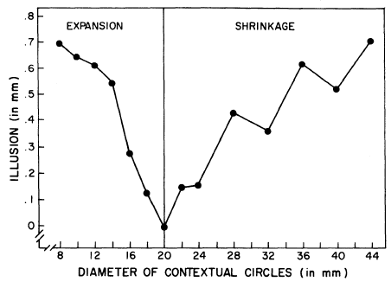
External circles (Size Effect)
Pressey, A., (1977). Measuring theTitchener circles and Delbouf Illusions with the method of adjustment. Bulletin of the Psychonomic Society. Vol. 10 (2), 118-120.

Slide 20
External Circles (Number Effect)
Massaro, D., Anderson, N. (1971). Judgmental model of the Ebbinghaus Illusion. Journal of Experimental Psychology. Vol. 89. 147 - 151

Slide 21
How is this related to d’?
According to what has been reported in the literature, in terms of which seems to be the main variables that contribute to the illusion:
Two different levels of Difficulty:
‘Hard’
6, 7 and 8 external circles
Easy’
2,3 and 4 external circles

Slide 22
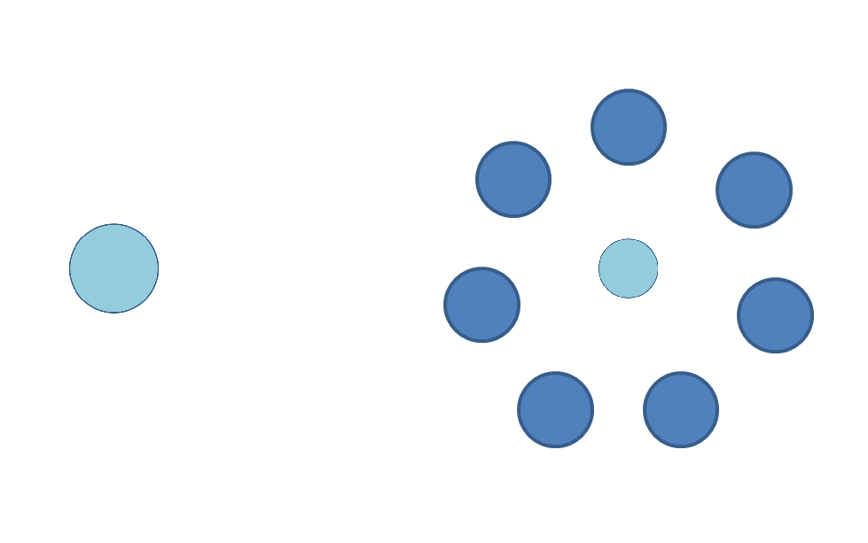
The Experiment

Slide 23
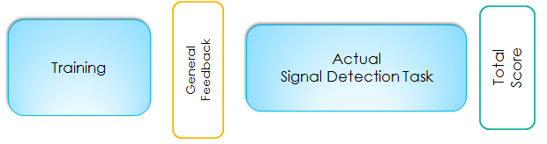
The Experiment
Baseline
336 trials
Feedback:
# Right
# Wrong
No learning
Just an estimation of d’
Experimental trials
336 trials
Paoffs
Total Score.

Slide 24
D’ conditions
VI: d’ (‘difficulty of the task’)
A: Smaller d’ (Hard)
6, 7 and 8 circles
B: Bigger d’ (Easy)
3, 4 and 5 circles

Slide 25
Stimulus Design
Reference circle (3 cm)
D1: 5 Comparison circles (.5 cm distance)
D2: Number of external circles (3 levels)
Easy – 2,3 and 4
Hard – 6, 7 and 8
D3: Size of external circles ( 2 levels)
Overestimation effect = 1.5 cm
Underestimation effect = 6 cm

Slide 26
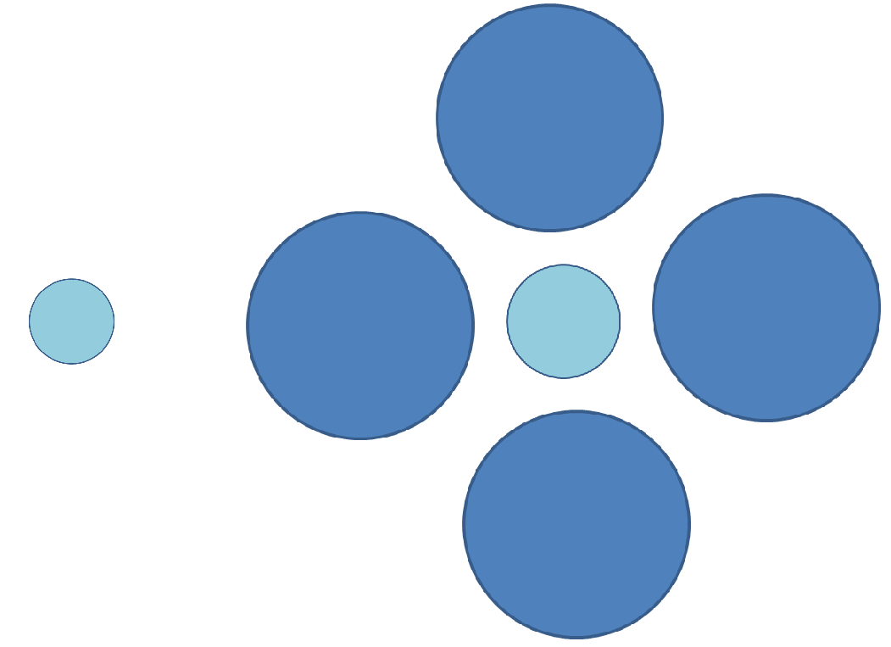

Slide 27
5x3x2 = 30 different kind of configurations
24 Noise configurations
6 Signal configurations
7 repetitions per configuration
Signal configurations appear 21 times each to promote Equiprobability
336 trials per session
336 training session
336 experimental session
672 total

Slide 28
Pilot
30 participants
 | Conservative Bias | Liberal Bias
Hard Task | 10 | 8
Easy Task | 10 | 8

Slide 29
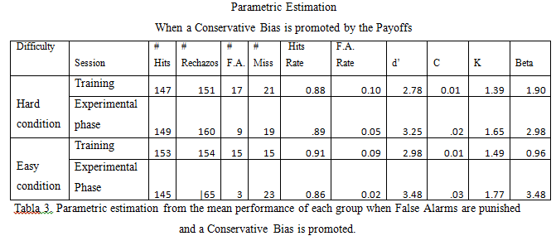
Mean differences – Conservative Bias

Slide 30
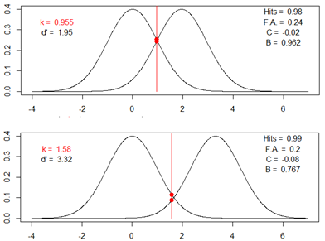
Participant #9 Hard Condition
 | # Hits | # C.R. | #F.A | #Misses
T | 166 | 127 | 41 | 2
E | 167 | 133 | 35 | 1

Slide 31
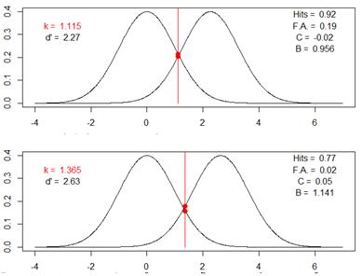
Participant #20 Easy Condition
 | # Hits | # C.R. | #F.A | #Misses
T | 155 | 135 | 33 | 13
E | 130 | 163 | 5 | 38

Slide 32
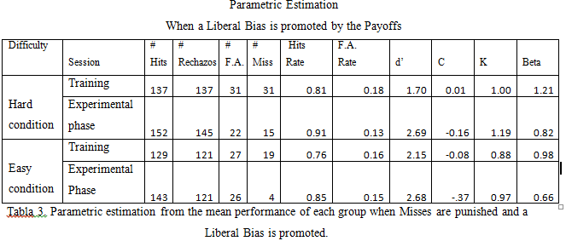
Mean differences – Liberal Bias

Slide 33
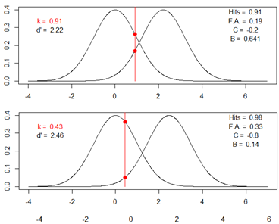
Participant #32 Hard Condition
 | # Hits | # C.R. | #F.A | #Misses
T | 153 | 136 | 32 | 15
E | 165 | 111 | 57 | 3

Slide 34
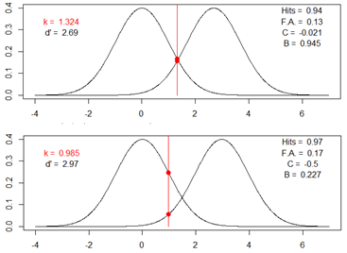
Participant #31 Easy Condition
 | # Hits | # C.R. | #F.A | #Misses
T | 158 | 146 | 22 | 10
E | 164 | 138 | 30 | 4

Slide 35
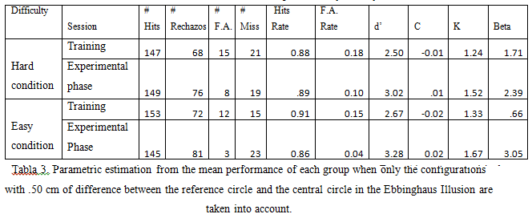

Slide 36
What am I doing now?
(Besides crying in the inside)

Slide 37
Thank you

