Slide 1
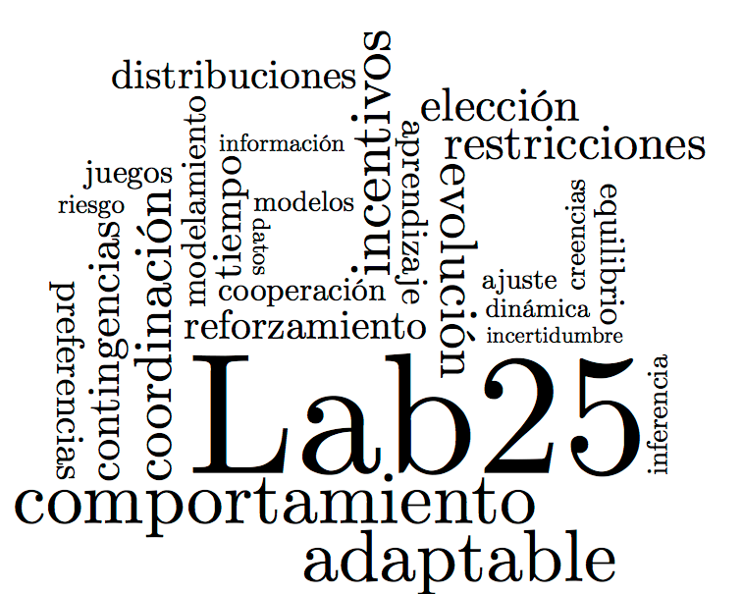

Bayesian cognitive and statistical modeling applied to Signal Detection Theory and the Mirror Effect in a perceptual task
Adriana F. Chávez De la Peña.
Michael Lee Arturo Bouzas Riaño

Slide 2

Introduction

Slide 3
Cognitive & Statistical Models within Psychology

Slide 4
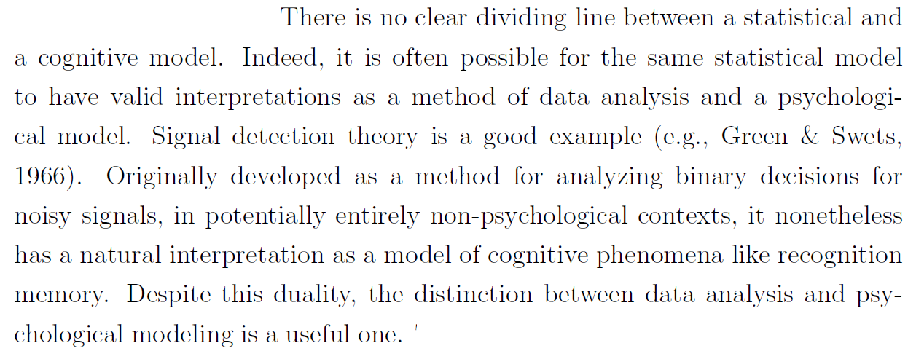
Lee, M. D. (2018). Bayesian methods in cognitive modeling. Stevens' Handbook of Experimental Psychology and Cognitive Neuroscience, 5, 1-48.

Slide 5
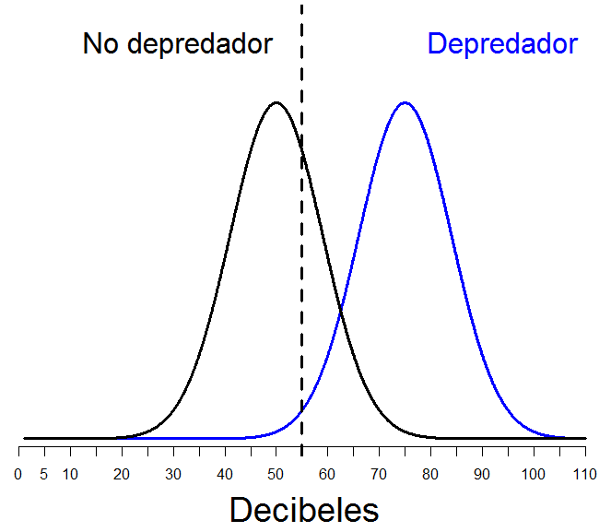
Signal Detection Theory
Noise
Signal
Decision axis

Slide 6
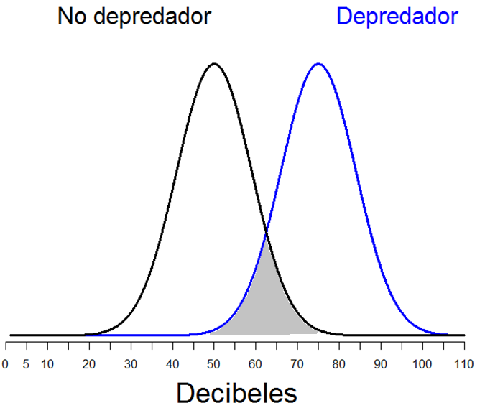
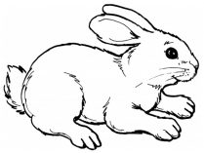
The world is full of noise and uncertainty….
Noise
Signal
Decision axis

Slide 7

The world is full of noise and uncertainty….
Noise
Signal
Other animal
Decision axis

Slide 8
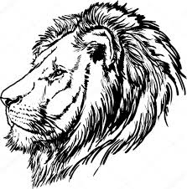
The world is full of noise and uncertainty….
Noise
Predator
Other animal
Decision axis

Slide 9
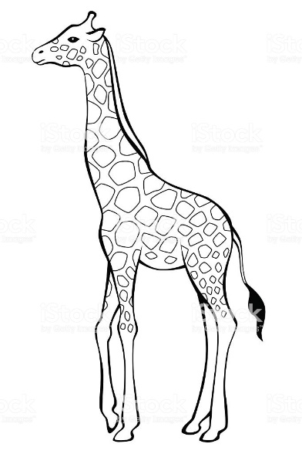
The world is full of noise and uncertainty….
Another animal
Predator
Other animal
Decision axis

Slide 10
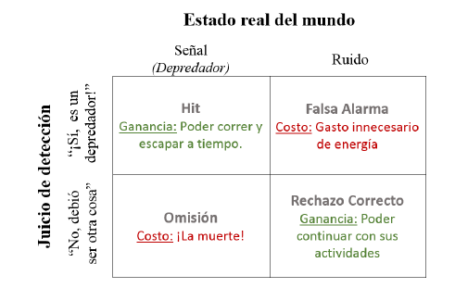


Getting it right, pays; getting it wrong, costs; and both things happen on their own magnitude
Actual situation
Hit
False Alarm
Judgement
Miss
Correct Rejection

Slide 11
Getting it right, pays; getting it wrong, costs; and both things happen on their own magnitude
Actual situation
Hit
False Alarm
Judgement
Miss
Correct Rejection

Slide 12

Getting it right, pays; getting it wrong, costs; and both things happen on their own magnitude
Actual situation
Hit
False Alarm
Judgement
Miss
Correct Rejection

Slide 13
Lee, M. D. (2018). Bayesian methods in cognitive modeling. Stevens' Handbook of Experimental Psychology and Cognitive Neuroscience, 5, 1-48.

Slide 14
The Mirror Effect
It is a well-established pattern of responses reported in Recognition Memory studies where signal detection theory has been applied to analyse data coming from subjects’ performance.

Slide 15
Mirror Effect
“If there are two classes of stimuli, and one is more accurately recogized than the other, then the superior class is both more accurately recognized as old when old and also more accurately recognized as new when new (…) means that the greater efficiency in recognizing is always twofold”
(Glanzer, Adams, 1990)

Slide 16
Mirror Effect
STUDY phase
A class
<<Low Frequency words>>
B class
<<High Frequency words>>

Slide 17
Mirror Effect
STUDY phase
Recognition task
Is this a known stimulus?
A class
<<Low Frequency words>>
A Class
A Class
B class
<<High Frequency words>>
B Class
B Class

Slide 18
Mirror Effect
“If there are two classes of stimuli, and one is more accurately recogized than the other, then the superior class is both more accurately recognized as old when old and also more accurately recognized as new when new (…) means that the greater efficiency in recognizing is always twofold”
(Glanzer, Adams, 1990)

Slide 19
Binary Tasks (Yes/No)
Task:
Has this stimulus been shown to you before?
Yes / No

Slide 20
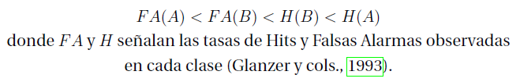
Binary Tasks (Yes/No)
Task:
Has this stimulus been shown to you before?
Yes / No

Slide 21
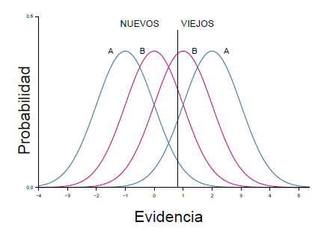
Binary Tasks (Yes/No)
Task:
Has this stimulus been shown to you before?
Yes / No

Slide 22
Binary Tasks (Yes/No)
Task:
Has this stimulus been shown to you before?
Yes / No

Slide 23
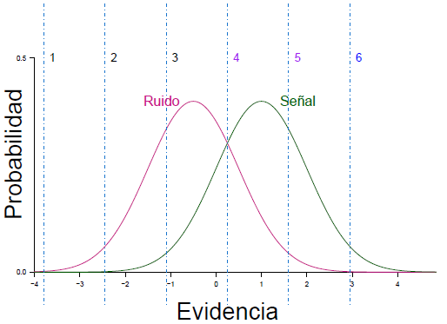
Confidence Scale task
1 | 2 | 3 | 4 | 5 | 6

Slide 24
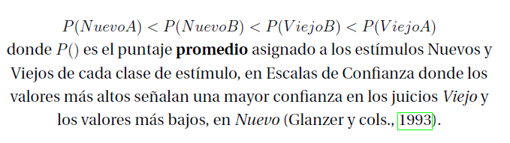
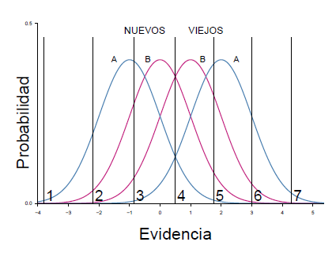
Confidence Scale task

Slide 25

Why is it important?

Slide 26
Why is it important?

Slide 27
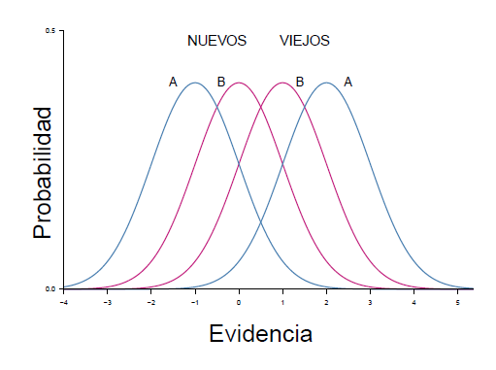
Why is it important?

Slide 28
Method

Slide 29
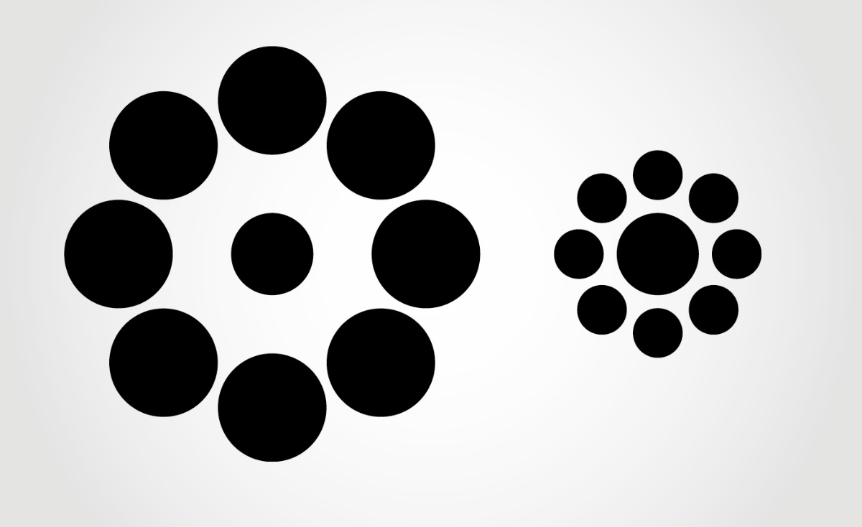
OBJETIVE: To test the generalizability of the Mirror Effect to other domains (a.k.a. a perceptual task).

Slide 30
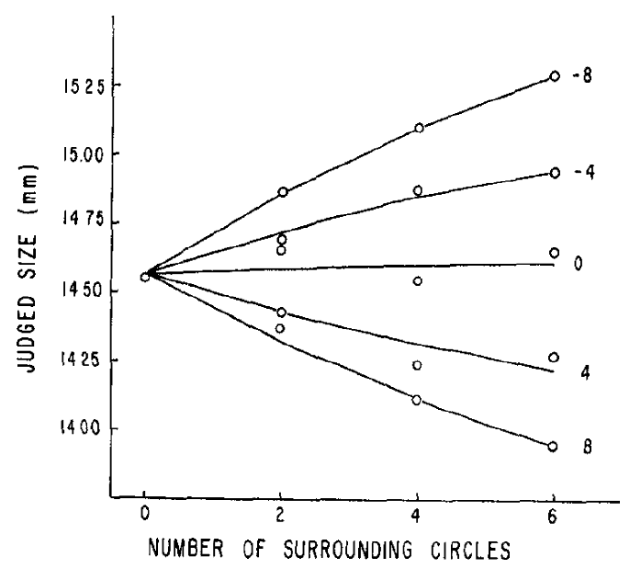
Experimental design
A and B clases of stimuli were created based on what’s known about optical illusions (Massaro & Anderson, 1971)

Slide 31
Experimental design
A Class: “Fewer” external circles
B Class: “More” external circles

Slide 32
Our Task
Are the two central circles on the screen of the same size?
Yes (signal) No (noise)
Experiment 1
Experiment 2
Ebbinghaus
Aisle Circle
Ebbinghaus
Ebbinghaus

Slide 33
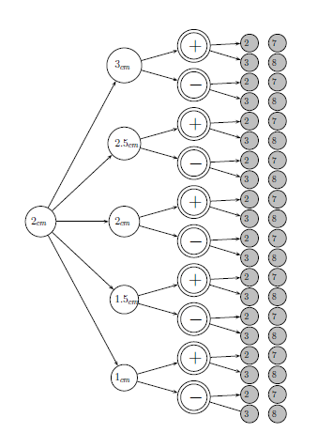
Stimuli design for Experiment 1
Factorial design 5x2x2
16 Noise stimuli
(160 en total)
4 Signal stimuli
(160 en total)
320 stimuli per class A and B
640 stimuli in total

Slide 34
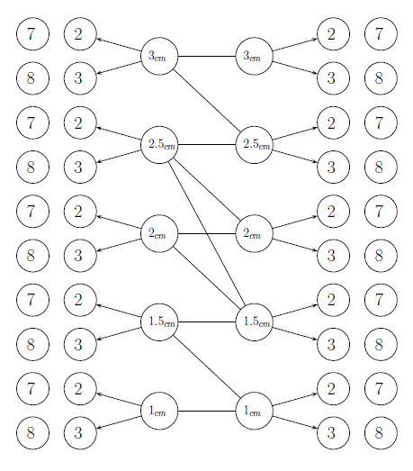
Diseño de Estímulos en el Experimento 2
10 pairs of external circles
5 signal pairs
5 noise pairs
4 posible combinations given by the number of external circles
Both Over and Under estimation effects are included
320 stimuli per class of stimuli
640 stimuli total

Slide 35
Participants
41 participants
20 on Experiment 1
21 on Experiment 2

Slide 36
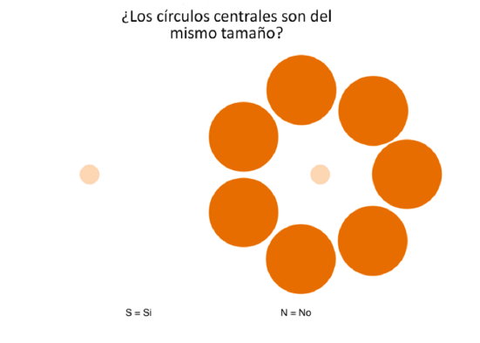
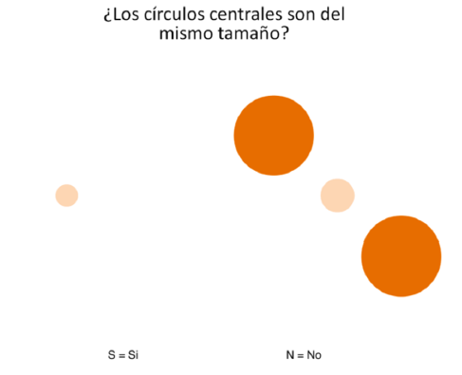
Procedure

Slide 37
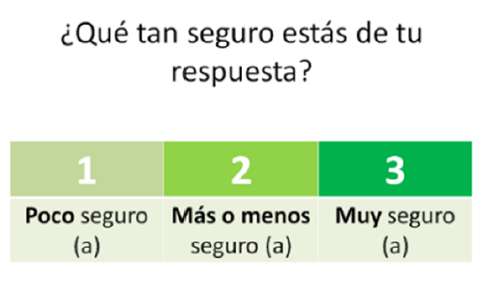

Slide 38
Results

Slide 39
Data!

Slide 40
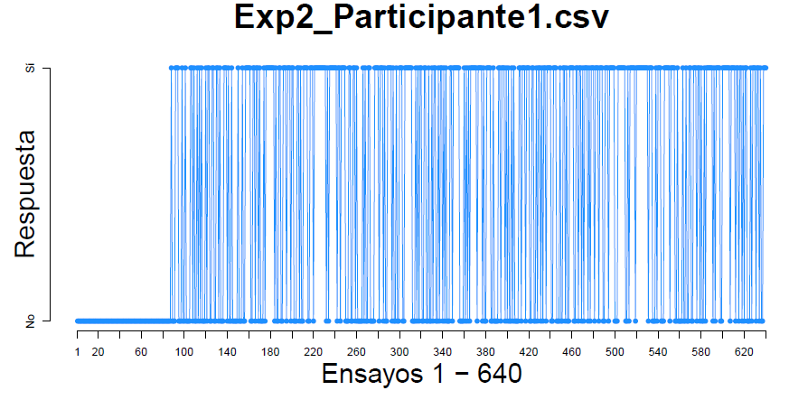
Data!

Slide 41
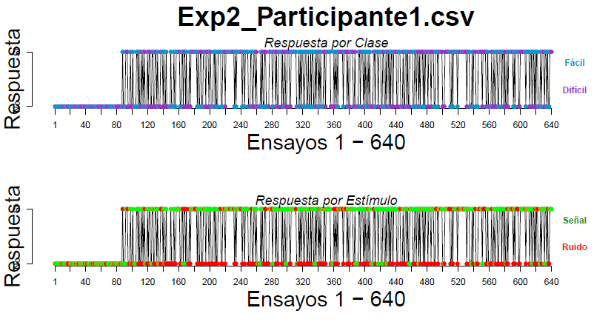
Data!

Slide 42
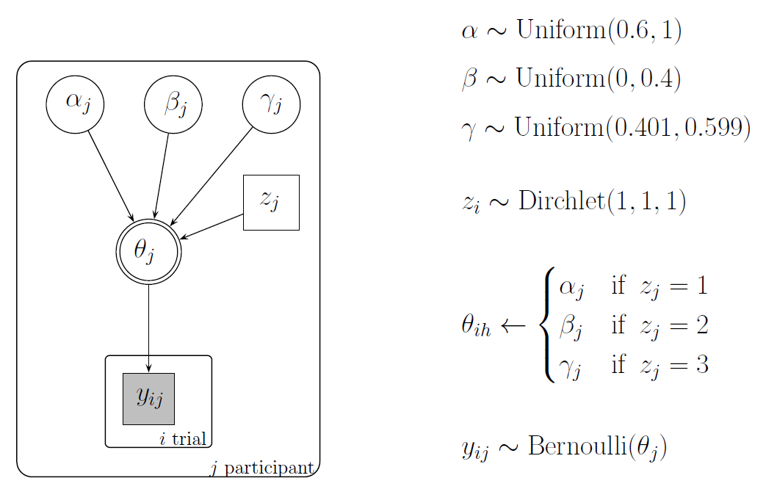

Slide 43
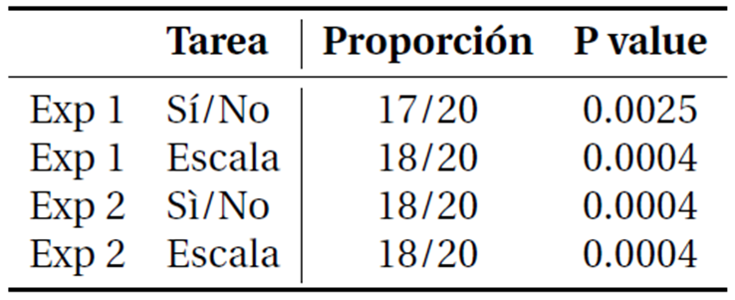
Proportion of cases of the M.E. found…

Slide 44

Replication of the reported analyses
1.- Make sure that:
d’(A) > d’(B)
2.- Comparing the Hit and F.A. rates to test the M.E. pattern of response
3.- Comparing the Mean confidence ratings assigned to each class of stimuli.

Slide 45
Replication of the reported analyses
1.- Make sure that:
d’(A) > d’(B)
2.- Comparing the Hit and F.A. rates to test the M.E. pattern of response
3.- Comparing the Mean confidence ratings assigned to each class of stimuli.

Slide 46
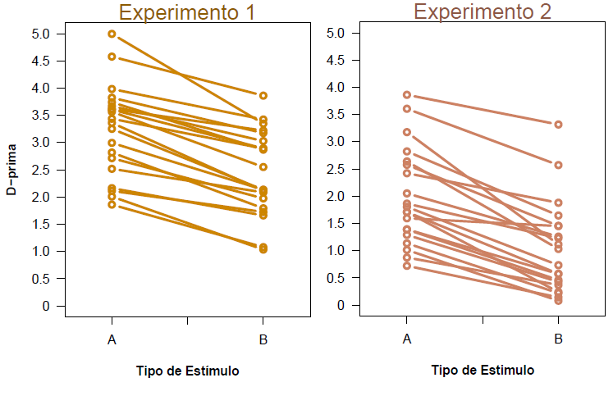
.

Slide 47
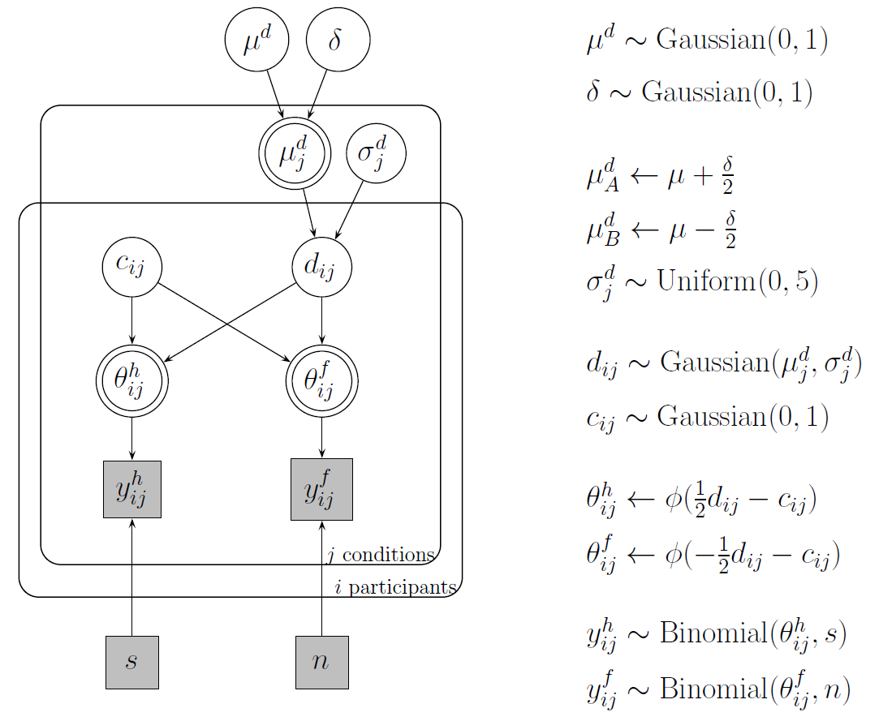

Slide 48
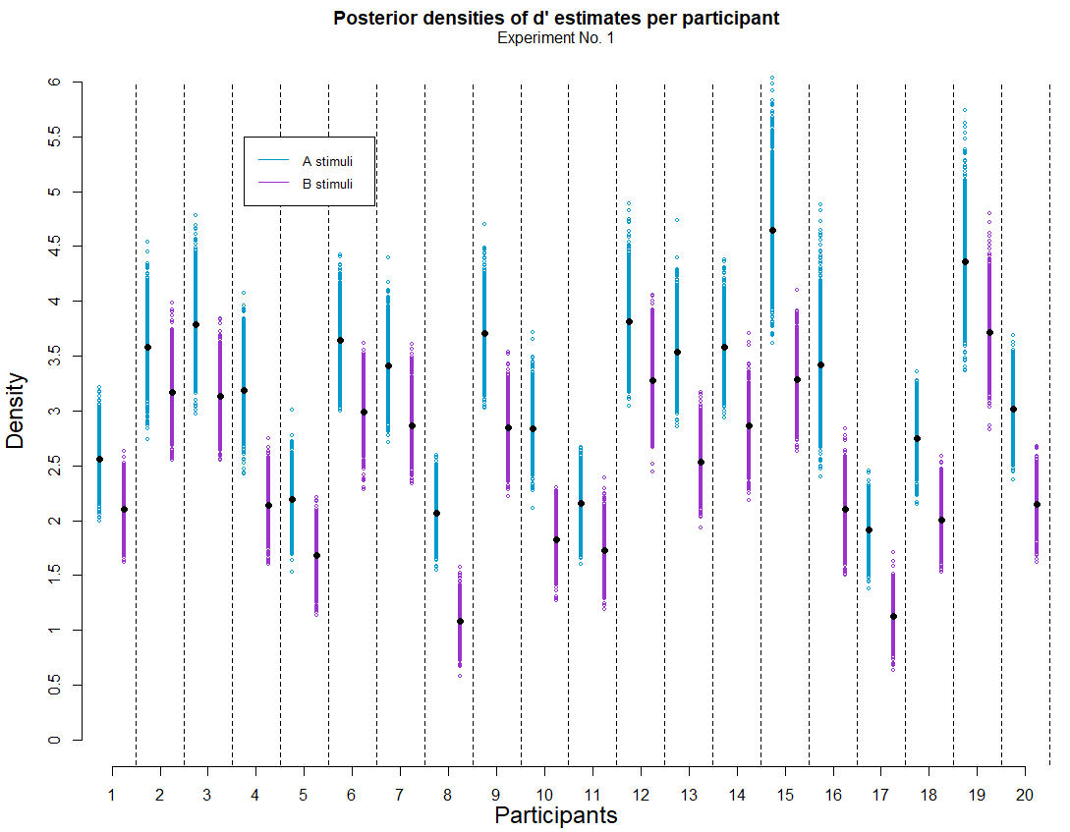
Plot 1
What’s important about this plot?
For all participants, d’ estimates are greater for A class stimuli than for B class.
Notes:
PS: Alex suggested me to use this kind of plot and I really liked it.

Slide 49
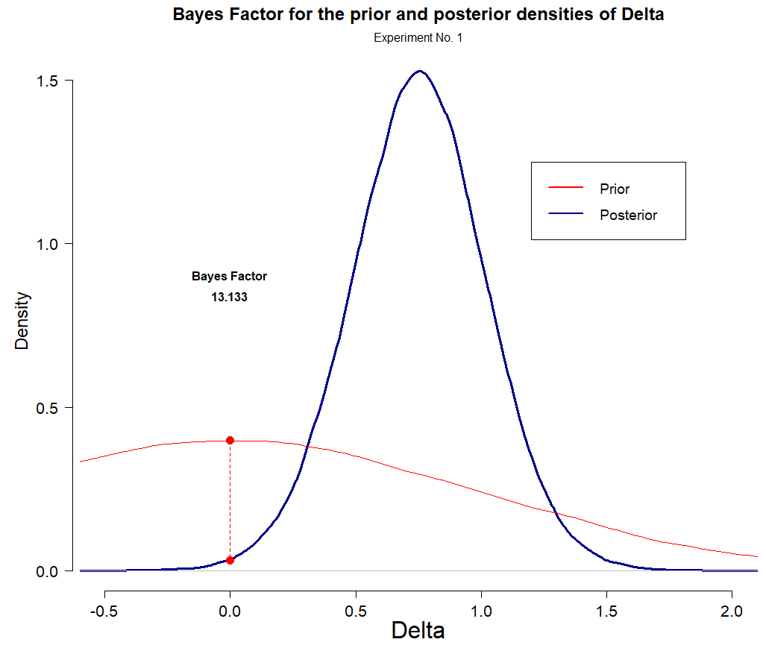
Plot 2
What’s important about this plot?
According to the Bayes Factor, the posterior estimates suggest that it’s 13 times lees likely that the difference between d’ across each class of stimuli is 0, than/from what had been stated on the prior.
Notes:
PS: Alex suggested me to use this kind of plot and I really liked it.

Slide 50
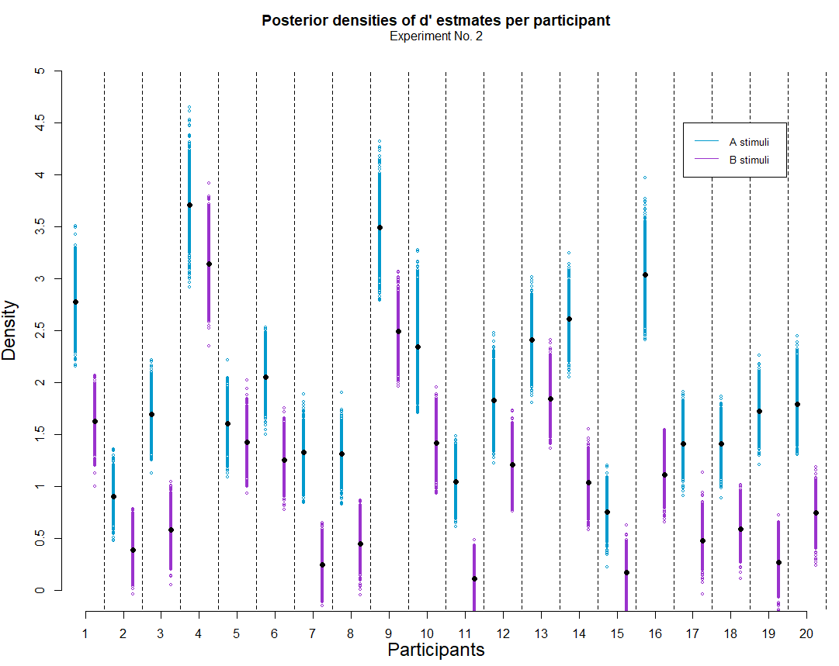
Plot 1
Same things happen in Experiment 2
For all participants, d’ estimates are greater for A class stimuli than for B class.
Notes:
PS: Alex suggested me to use this kind of plot and I really liked it.

Slide 51
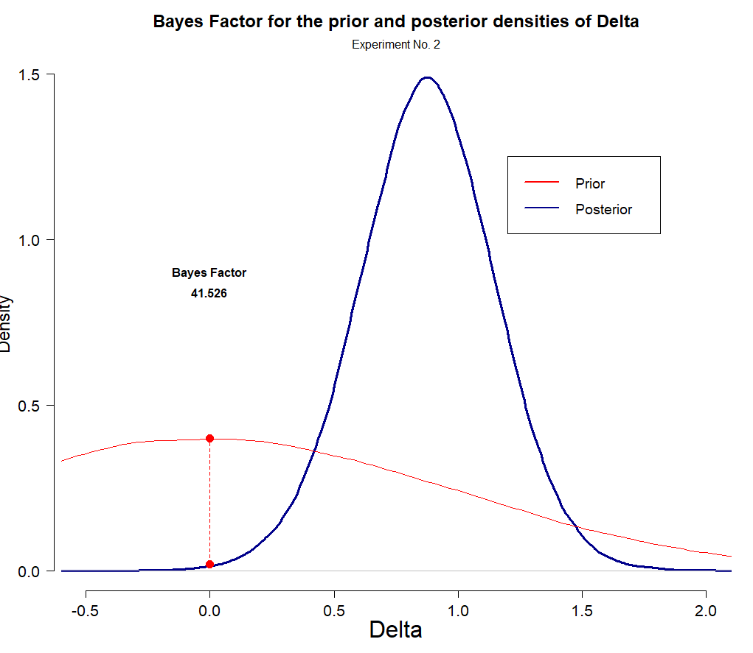
Plot 2
According to the Bayes Factor, the posterior estimates suggest that it’s 41.5 times lees likely that the difference between d’ across each class of stimuli is 0, than/from what had been stated on the prior.

Slide 52
Replication of the reported analyses
1.- Make sure that:
d’(A) > d’(B)
2.- Comparing the Hit and F.A. rates to test the M.E. pattern of response
3.- Comparing the Mean confidence ratings assigned to each class of stimuli.

Slide 53
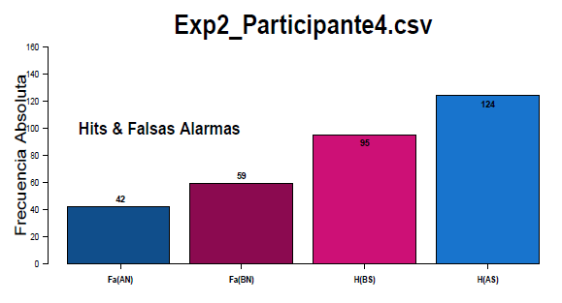
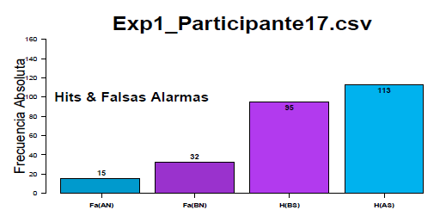
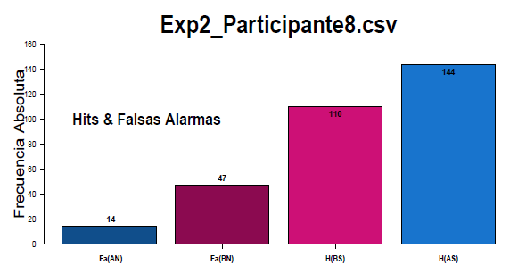
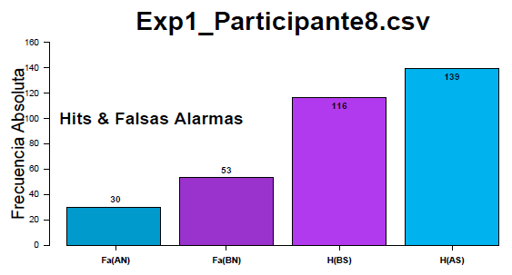

Slide 54
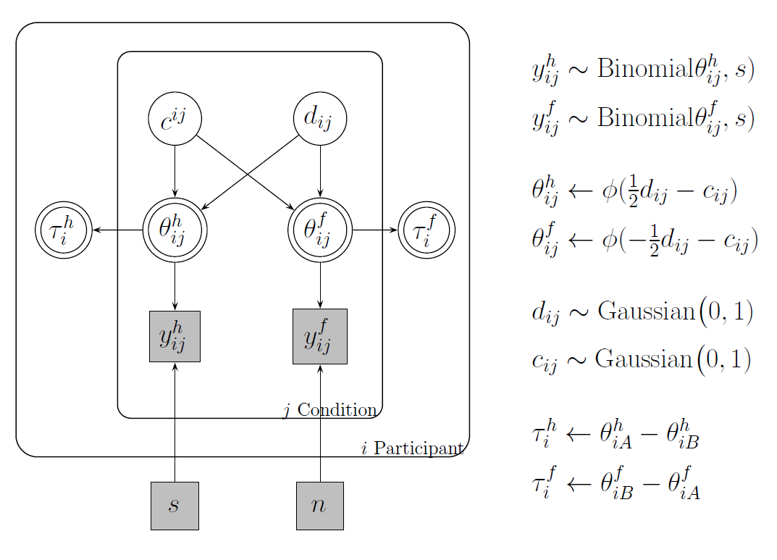

Slide 55
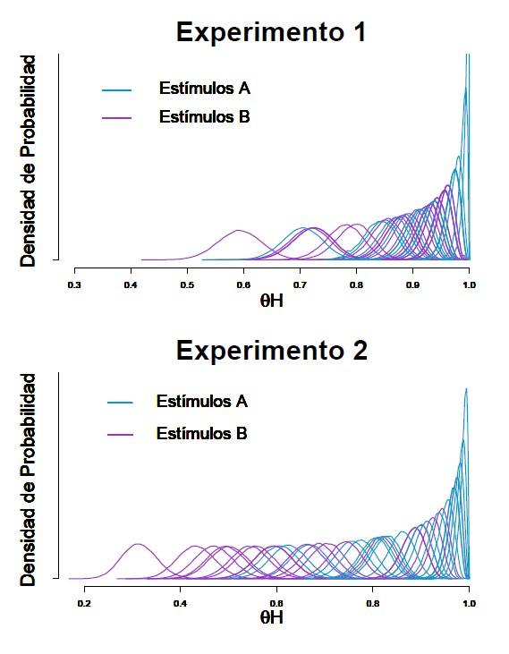
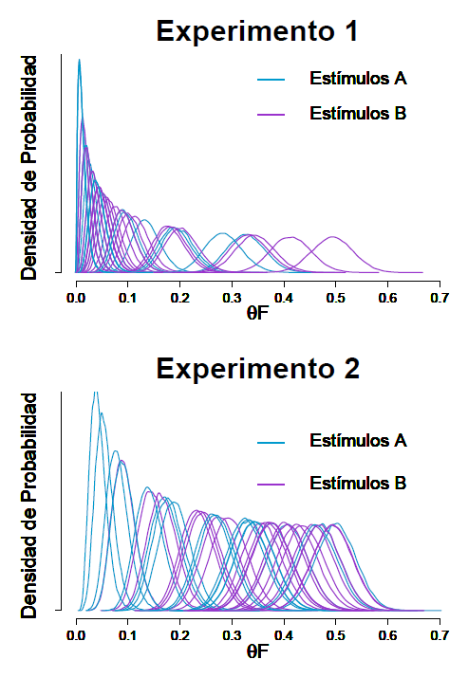

Slide 56
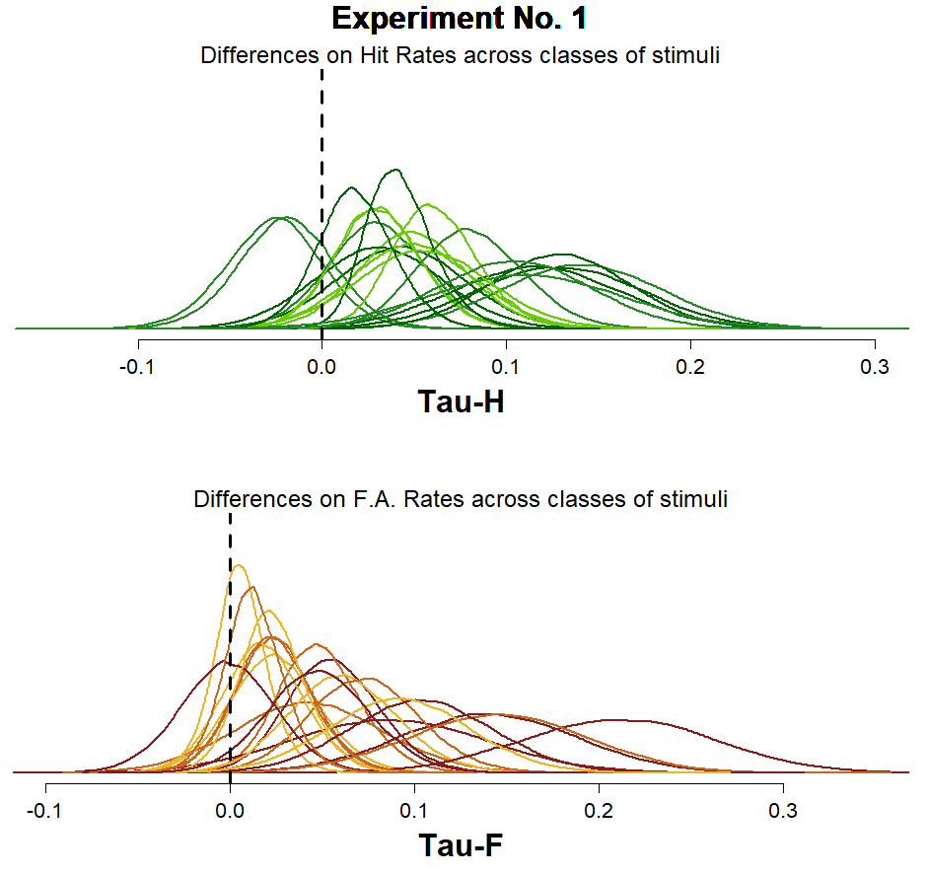
Plot 1
Based on the individual Tau-H and Tau-F posterior distributions being shown, it’s clear that there’s a lot of variability (even if “at first glance” one might be tempted to say that the majority of the posterior density lies to the right side of the “0 differences between classes” point).

Slide 57
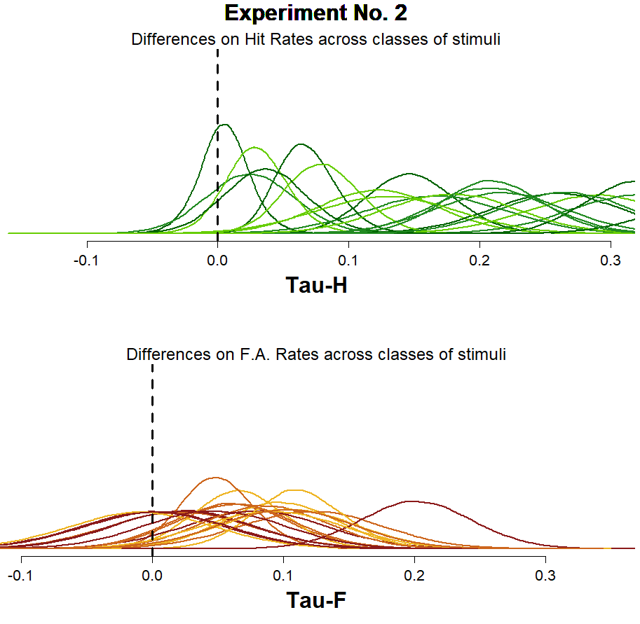
Plot 1
For Experiment 2, you can see that the estimates for the differences between the Hit Rates has clearly increased, at the same time that the estimates made for the differences between the FA rates seem to be a Little bit more clustered around 0.

Slide 58
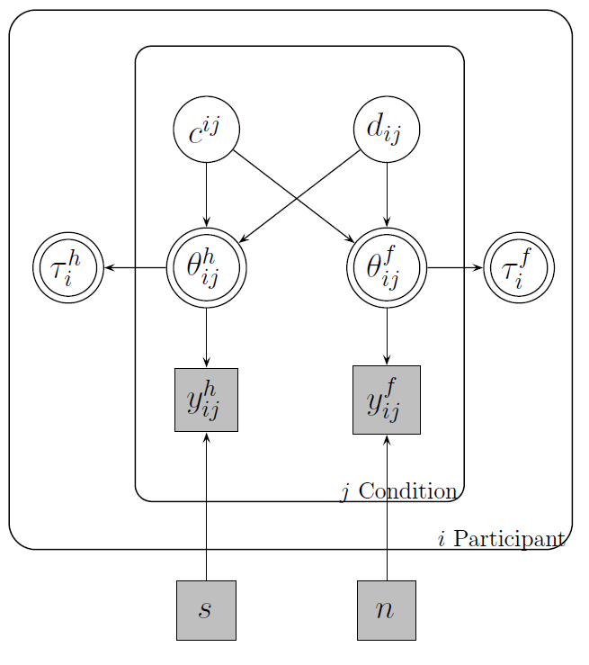

Given that this particular model was constructed so that both Taus are deterministically estimated, based on the indiviual estimations made for $θ_{ij}^{H}$ and $θ_{ij}^{F}$, conducting a Bayes Factor or any other density ratio measure might not seem like a straight-forward thing to do.

Slide 59
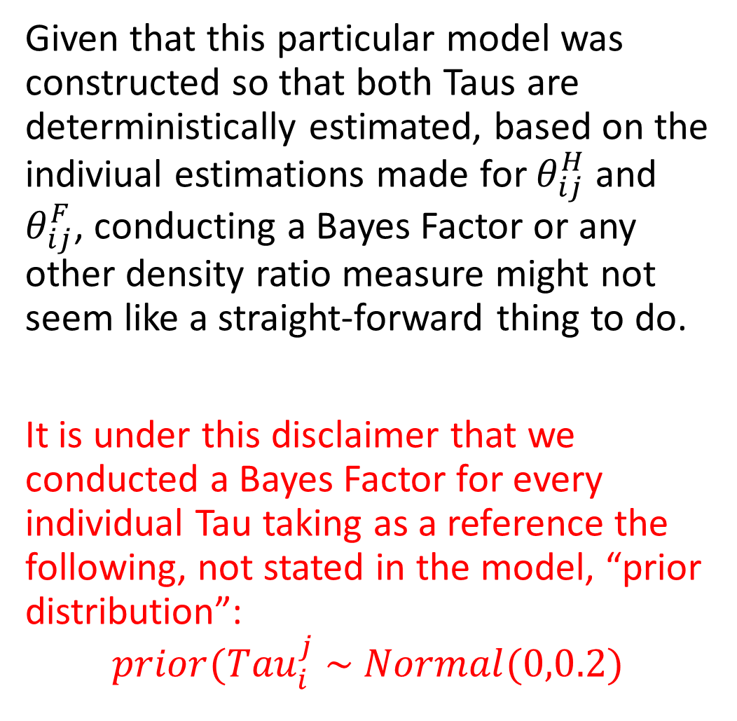
Given that this particular model was constructed so that both Taus are deterministically estimated, based on the indiviual estimations made for $θ_{ij}^{H}$ and $θ_{ij}^{F}$, conducting a Bayes Factor or any other density ratio measure might not seem like a straight-forward thing to do.
It is under this disclaimer that we conducted a Bayes Factor for every individual Tau taking as a reference the following, not stated in the model, “prior distribution”:
$$prior({Tau}_{i}^{j} \sim Normal(0,0.2)$$

Slide 60
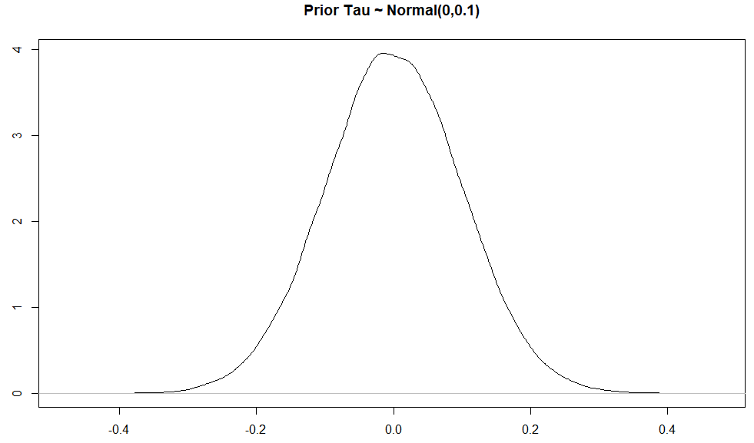
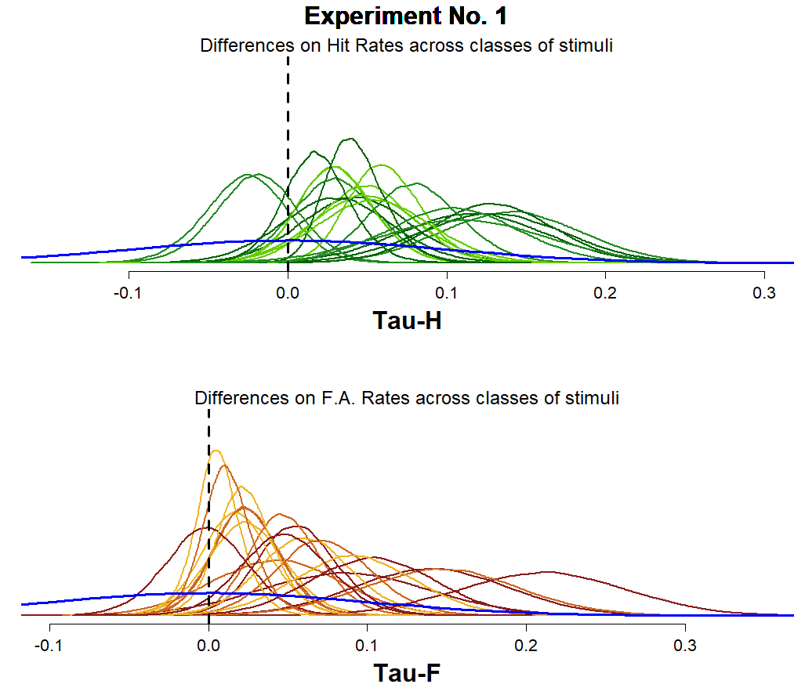

Given that this particular model was constructed so that both Taus are deterministically estimated, based on the indiviual estimations made for $θ_{ij}^{H}$ and $θ_{ij}^{F}$, conducting a Bayes Factor or any other density ratio measure might not seem like a straight-forward thing to do.
It is under this disclaimer that we conducted a Bayes Factor for every individual Tau taking as a reference the following, not stated in the model, “prior distribution”:
$$prior({Tau}_{i}^{j} \sim Normal(0,0.1)$$

Slide 61
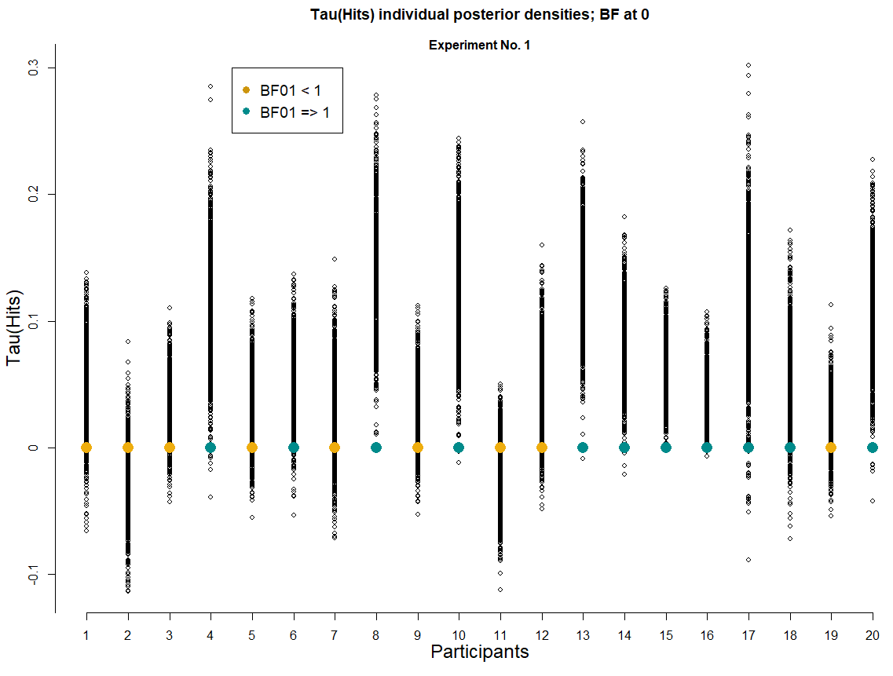
Plot 1
We can see that for Experiment No. 1, there are 9 participants (Golden color) who show a greater posterior desity at the 0 difference point between the Hit rates for each class of stimuli, compared to the artificial prior distribution proposed for reference.

Slide 62
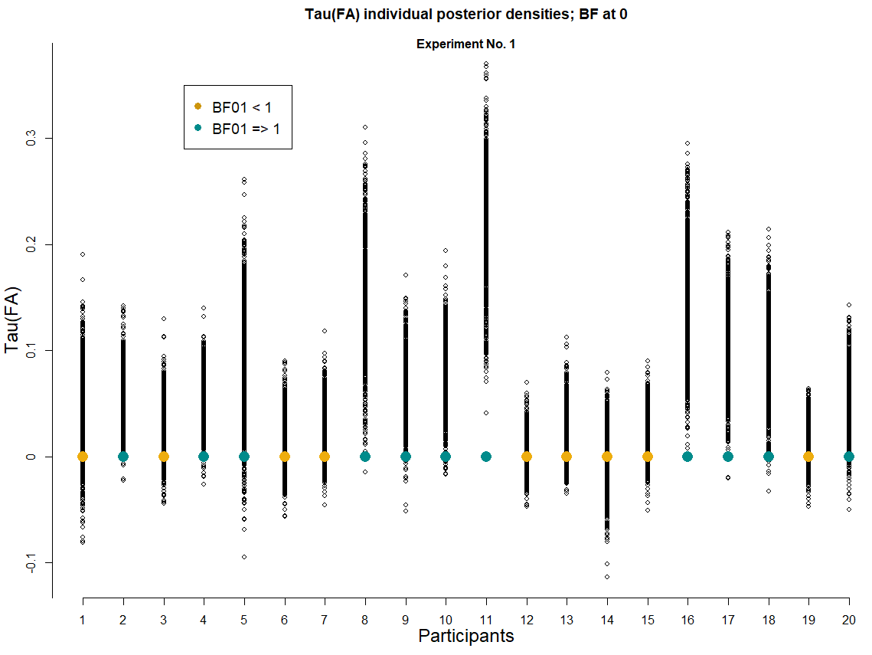
Plot 1
We can see that for Experiment No. 1, there are 9 participants (Golden color) who show a greater posterior desity at the 0 difference point between the False Alarms rates for each class of stimuli, compared to the artificial prior distribution proposed for reference.

Slide 63
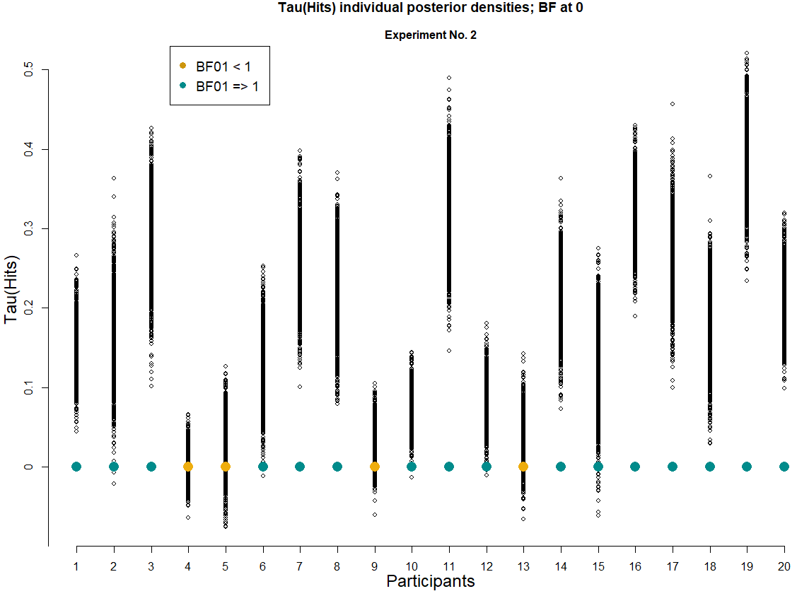
Plot 1
We can see that for Experiment No. 2, there are 4 participants who show a greater posterior density at the point of “0 differences” between the Hit rates of each class of stimuli, compared to the artificial prior.

Slide 64
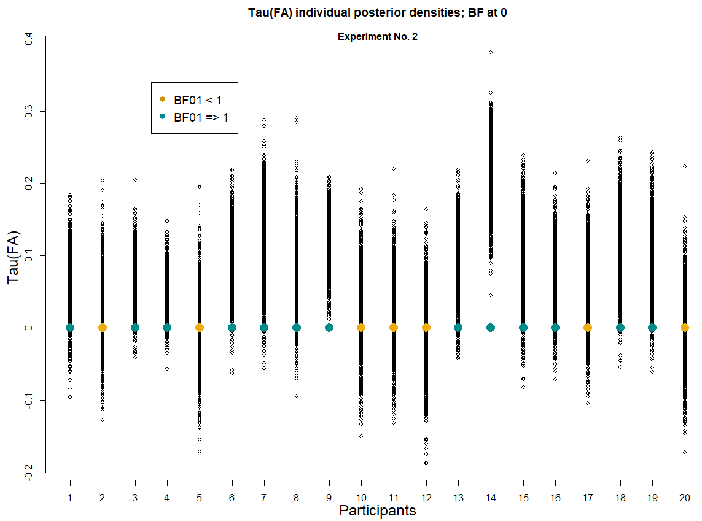
Plot 1
We can see that for Experiment No. 2, there are 7 participants who show a greater posterior density at the point of “0 differences” between the False Alarms rates of each class of stimuli, compared to the artificial prior.

Slide 65
Replication of the reported analyses
1.- Make sure that:
d’(A) > d’(B)
2.- Comparing the Hit and F.A. rates to test the M.E. pattern of response
3.- Comparing the Mean confidence ratings assigned to each class of stimuli.

Slide 66


Slide 67



Slide 68


Slide 69

Plot 1
It is interesting to note that for Experiment No. 1, yes, some differences are found in terms of the mean d’ estimations for each class of stimuli, but this doesn’t happen for C, which according to the proposed hierarchical model could be described by the same mean value for both classes of stimuli.

Slide 70

Plot 1
Even more interesting should be the fact that this doesn’t hold up for Experiment No. 2, where differences between classes of stimuli are observed both for d’ and C.

Slide 71
Discussion & Conclusions

Slide 72
.
Our task didn’t have anything like the study phase included in recognition memory studies.

Slide 73
.
Our task didn’t have anything like the study phase included in recognition memory studies.
Is the Mirror Effect an artefact of using SDT to interpret the observed rates of response?

Slide 74
.
Our task didn’t have anything like the study phase included in recognition memory studies.
Is the Mirror Effect an artefact of using SDT to interpret the observed rates of response?
About the application of Bayesian methods to the analysis of the pattern responses being found?

Slide 75
Thank you very much!
Adriana F. Chávez De la Peña
adrifelcha@gmail.com
This project was made thanks to PAPIIT IN307214 y PAPIME IE310016 (and Dr. Bouzas of course ☺ )

Slide 76
Extra material
por Adriana Felisa Chávez De la Peña

Slide 77


Slide 79


Teoría de Atención Verosimilitud
N rasgos
p(new) marcados
n(i) elementos muestreados
alpha(i) tasa de muestreo
Tasa de marcaje:
El número de items marcados es el resultado de un proceso binomial donde

Slide 80


Slide 81

¿Los círculos centrales son del mismo tamaño?
No
Sí

