Slide 1



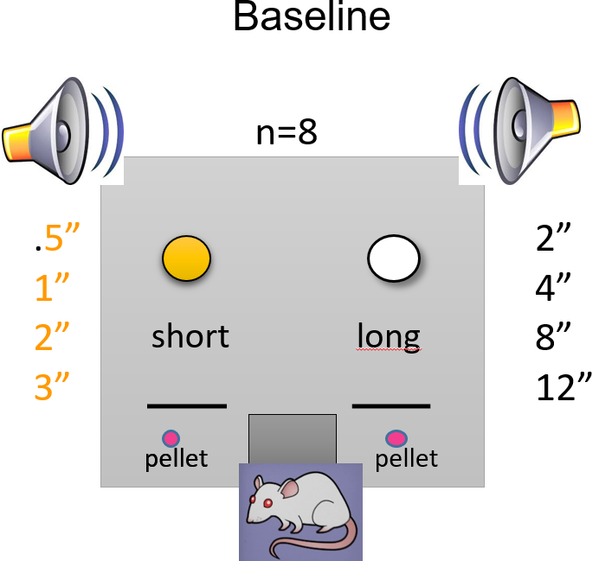
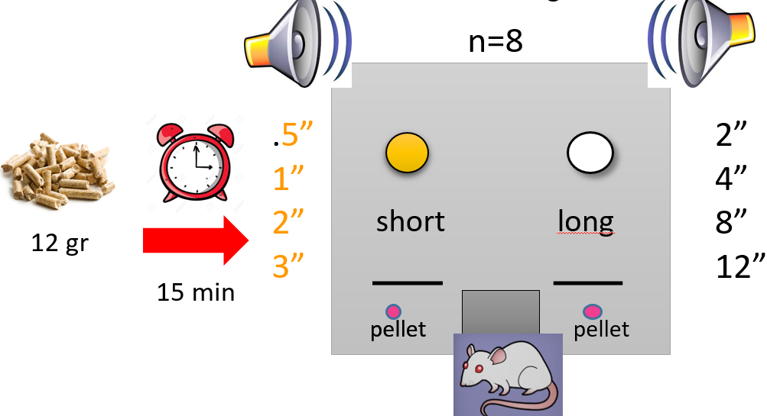
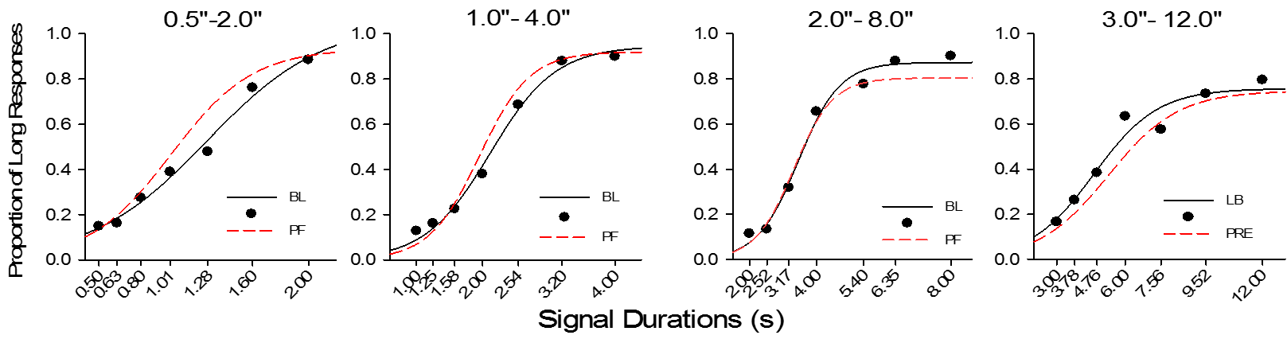
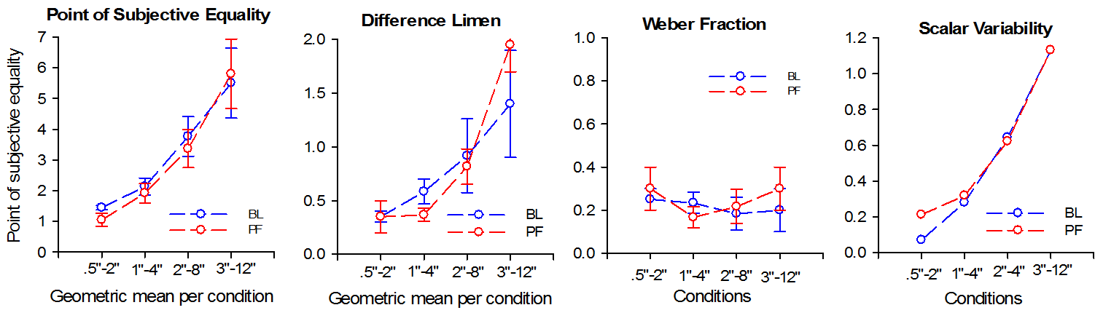


Effects of reward magnitude and prefeeding
on a temporal bisection task
Oscar Zamora Arévalo, Pérez Calzada Mario & Mayra Patricia Cruz
Universidad Nacional Autónoma de México, Facultad de Psicología
INTRODUCTION
Motivational variables alter intervalar timing performance (Akdoğan & Balcı, 2016; Galtress & Kirkpatrick, 2010; Ludvig, Conover & Shizgal, 2007; Roberts, 1981; Ward & Odum, 2006).
REWARD MAGNITUDE
PREFEEDING
METHOD
METHOD
Baseline (10 sessions)
0.5”
1.0”
2.0”
3.0”
n=4
2.0”
4.0”
8.0”
12.0”
0.5”
1.0”
2.0”
3.0”
n=4
2.0”
4.0”
8.0”
12.0”
Short
Long
Short
Long
Pellet
Pellet
Pellet
Pellet
Reward magnitude manipulation (10 sessions)
Pre Feeding
0.5”
1.0”
2.0”
3.0”
2.0”
4.0”
8.0”
12.0”
0.5”
1.0”
2.0”
3.0”
2.0”
4.0”
8.0”
12.0”
Short
Long
Short
Long
Pellet
Pellets
Pellets
Pellet
RESULTS
RESULTS
Proportion of Long Responses
DISCUSSION
REFERENCES
ACKNOLEDGMENTS

