Slide 1
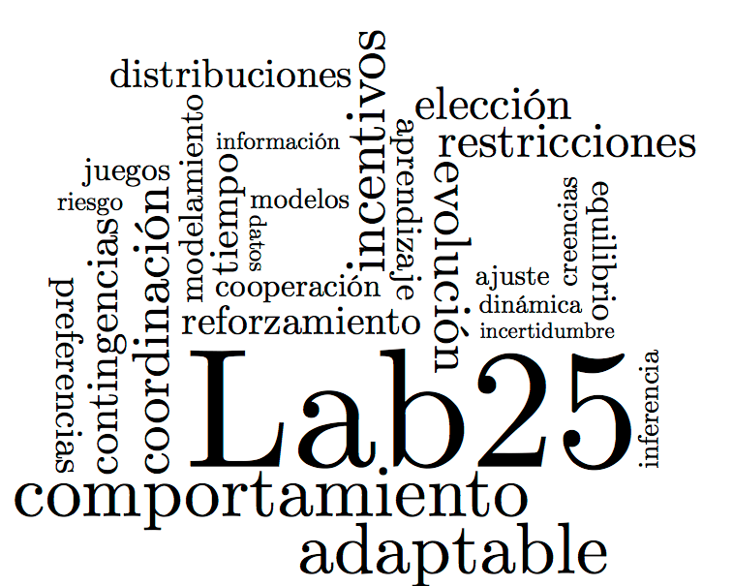

Bayesian cognitive and statistical modeling applied to Signal Detection Theory and the Mirror Effect in a perceptual task
Adriana F. Chávez De la Peña.
Michael Lee Arturo Bouzas Riaño

Slide 2

Introduction

Slide 3
Cognitive & Statistical Models within Psychology

Slide 4
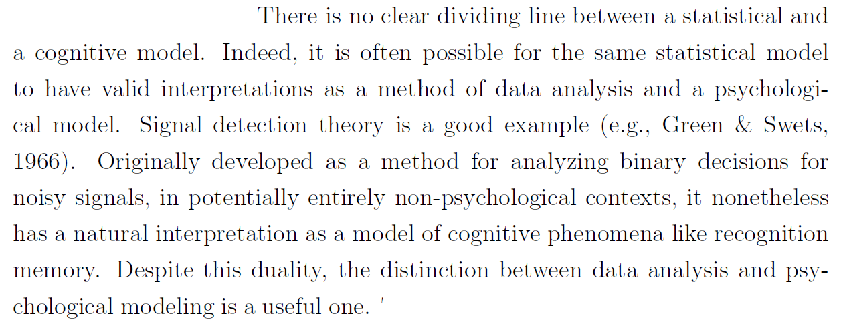
Lee, M. D. (2018). Bayesian methods in cognitive modeling. Stevens' Handbook of Experimental Psychology and Cognitive Neuroscience, 5, 1-48.

Slide 5
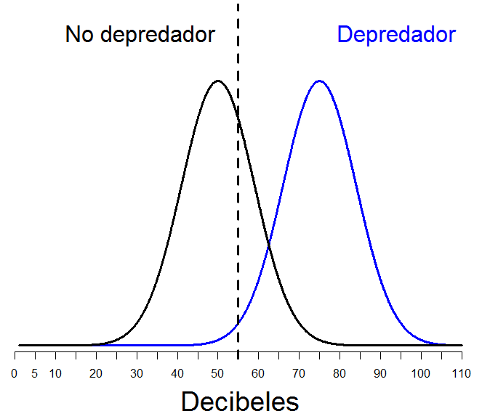
Signal Detection Theory
Noise
Signal
Decision axis

Slide 6
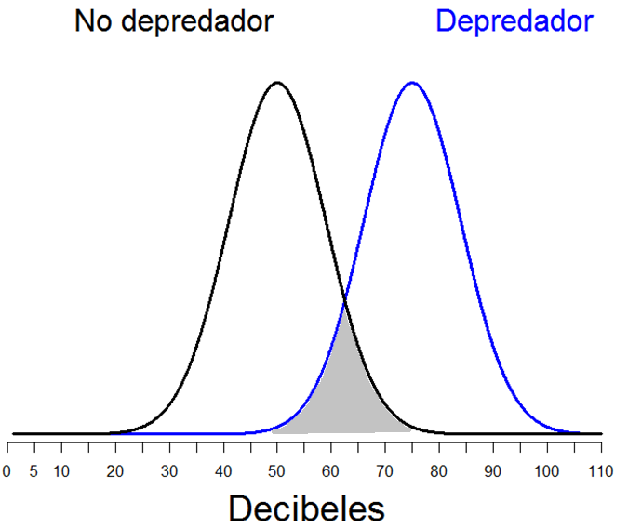
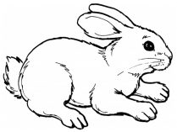
The world is full of noise and uncertainty….
Noise
Signal
Decision axis

Slide 7

The world is full of noise and uncertainty….
Noise
Signal
Other animal
Decision axis

Slide 8
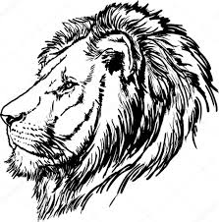
The world is full of noise and uncertainty….
Noise
Predator
Other animal
Decision axis

Slide 9
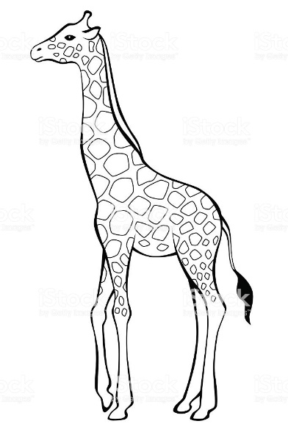
The world is full of noise and uncertainty….
Another animal
Predator
Other animal
Decision axis

Slide 10
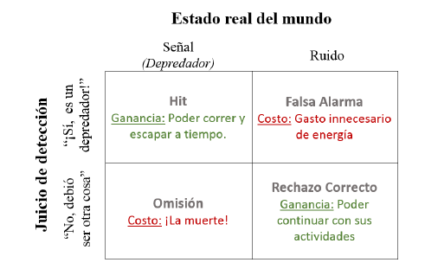


Getting it right, pays; getting it wrong, costs; and both things happen on their own magnitude
Actual situation
Hit
False Alarm
Judgement
Miss
Correct Rejection

Slide 11
Getting it right, pays; getting it wrong, costs; and both things happen on their own magnitude
Actual situation
Hit
False Alarm
Judgement
Miss
Correct Rejection

Slide 12

Getting it right, pays; getting it wrong, costs; and both things happen on their own magnitude
Actual situation
Hit
False Alarm
Judgement
Miss
Correct Rejection

Slide 13
Lee, M. D. (2018). Bayesian methods in cognitive modeling. Stevens' Handbook of Experimental Psychology and Cognitive Neuroscience, 5, 1-48.

Slide 14
The Mirror Effect
It is a well-established pattern of responses reported in Recognition Memory studies where signal detection theory has been applied to analyse data coming from subjects’ performance.

Slide 15
Mirror Effect
“If there are two classes of stimuli, and one is more accurately recogized than the other, then the superior class is both more accurately recognized as old when old and also more accurately recognized as new when new (…) means that the greater efficiency in recognizing is always twofold”
(Glanzer, Adams, 1990)

Slide 16
Mirror Effect
STUDY phase
A class
<<Low Frequency words>>
B class
<<High Frequency words>>

Slide 17
Mirror Effect
STUDY phase
Recognition task
Is this a known stimulus?
A class
<<Low Frequency words>>
A Class
A Class
B class
<<High Frequency words>>
B Class
B Class

Slide 18
Mirror Effect
“If there are two classes of stimuli, and one is more accurately recogized than the other, then the superior class is both more accurately recognized as old when old and also more accurately recognized as new when new (…) means that the greater efficiency in recognizing is always twofold”
(Glanzer, Adams, 1990)

Slide 19
Binary Tasks (Yes/No)
Task:
Has this stimulus been shown to you before?
Yes / No

Slide 20
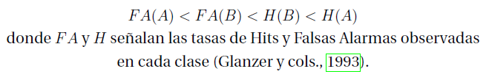
Binary Tasks (Yes/No)
Task:
Has this stimulus been shown to you before?
Yes / No

Slide 21
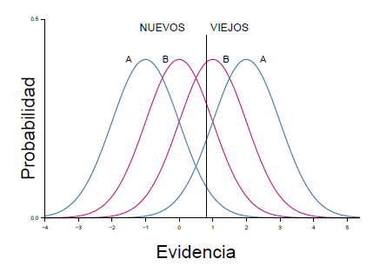
Binary Tasks (Yes/No)
Task:
Has this stimulus been shown to you before?
Yes / No

Slide 22
Binary Tasks (Yes/No)
Task:
Has this stimulus been shown to you before?
Yes / No

Slide 23
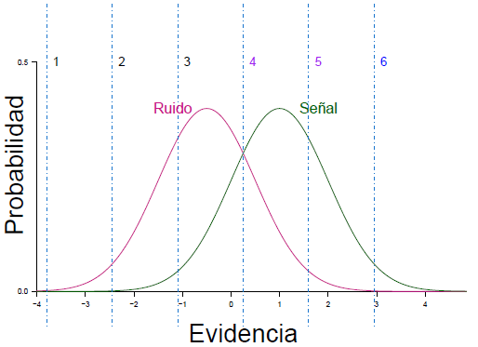
Confidence Scale task
1 | 2 | 3 | 4 | 5 | 6

Slide 24
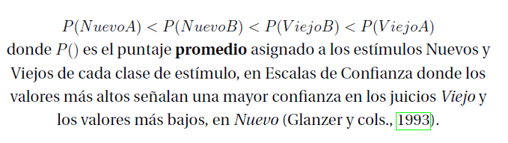
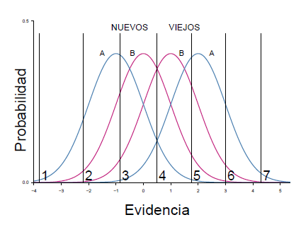
Confidence Scale task

Slide 25

Why is it important?

Slide 26
Why is it important?

Slide 27
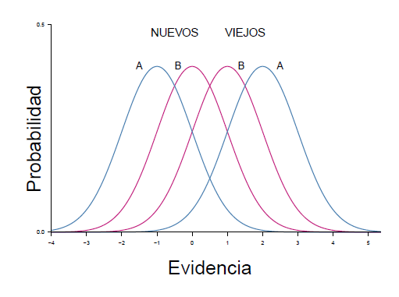
Why is it important?

Slide 28
Method

Slide 29

OBJETIVE: To test the generalizability of the Mirror Effect to other domains (a.k.a. a perceptual task).

Slide 30
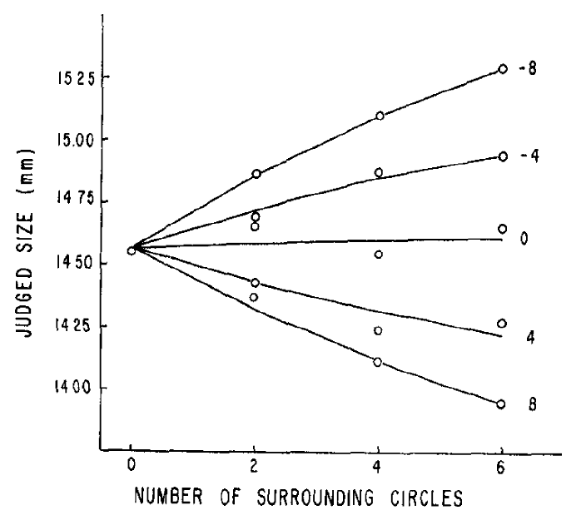
Experimental design
A and B clases of stimuli were created based on what’s known about optical illusions (Massaro & Anderson, 1971)

Slide 31
Experimental design
A Class: “Fewer” external circles
B Class: “More” external circles

Slide 32
Our Task
Are the two central circles on the screen of the same size?
Yes (signal) No (noise)
Experiment 1
Experiment 2
Ebbinghaus
Aisle Circle
Ebbinghaus
Ebbinghaus

Slide 33
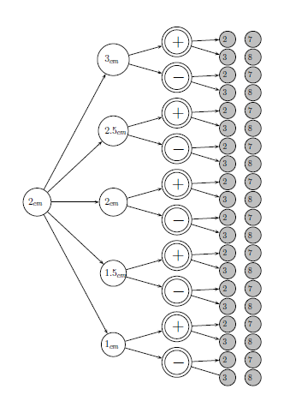
Stimuli design for Experiment 1
Factorial design 5x2x2
16 Noise stimuli
(160 en total)
4 Signal stimuli
(160 en total)
320 stimuli per class A and B
640 stimuli in total

Slide 34
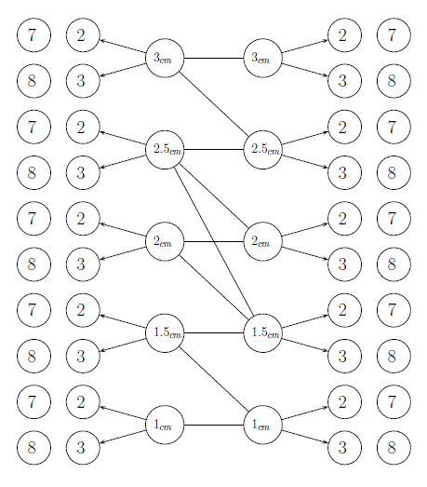
Diseño de Estímulos en el Experimento 2
10 pairs of external circles
5 signal pairs
5 noise pairs
4 posible combinations given by the number of external circles
Both Over and Under estimation effects are included
320 stimuli per class of stimuli
640 stimuli total

Slide 35
Participants
41 participants
20 on Experiment 1
21 on Experiment 2

Slide 36
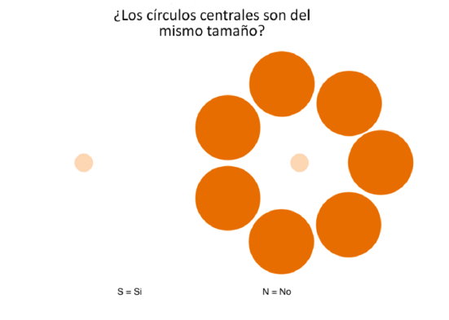
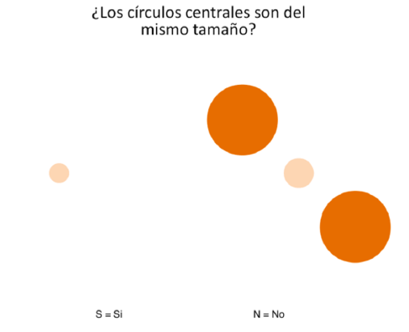
Procedure

Slide 37
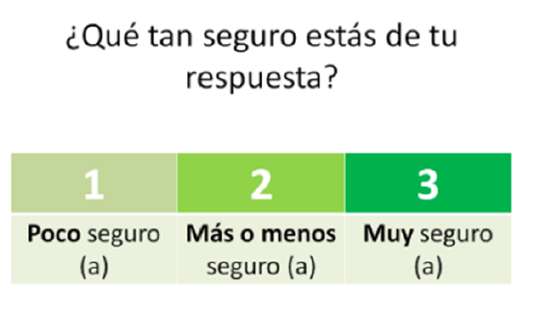

Slide 38
Results

Slide 39
Data!

Slide 40
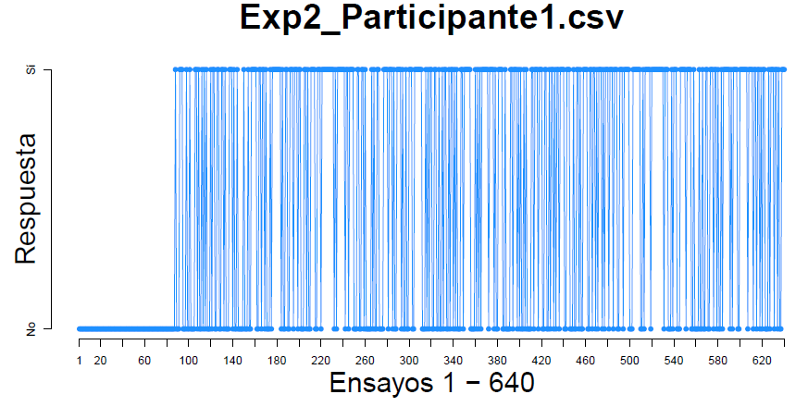
Data!

Slide 41
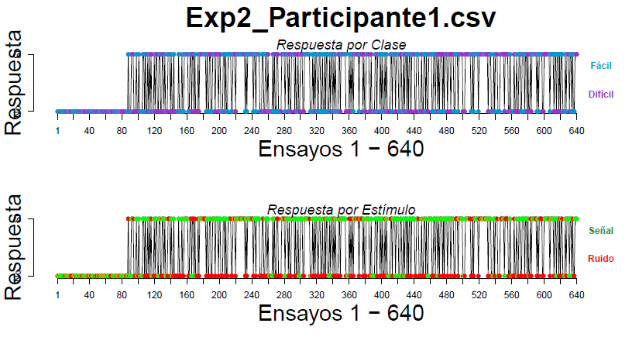
Data!

Slide 42
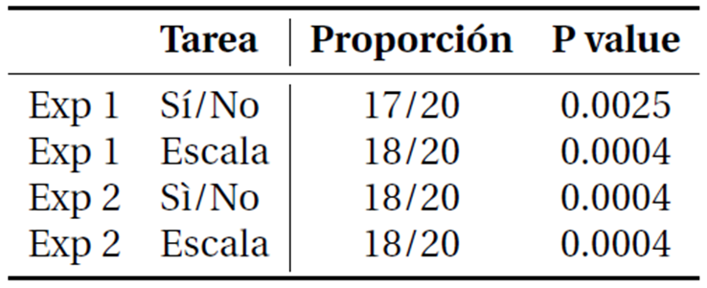
Proportion of cases of the M.E. found…
Proportion
Yes/No task
Scale
Yes/No task
Scale

Slide 43
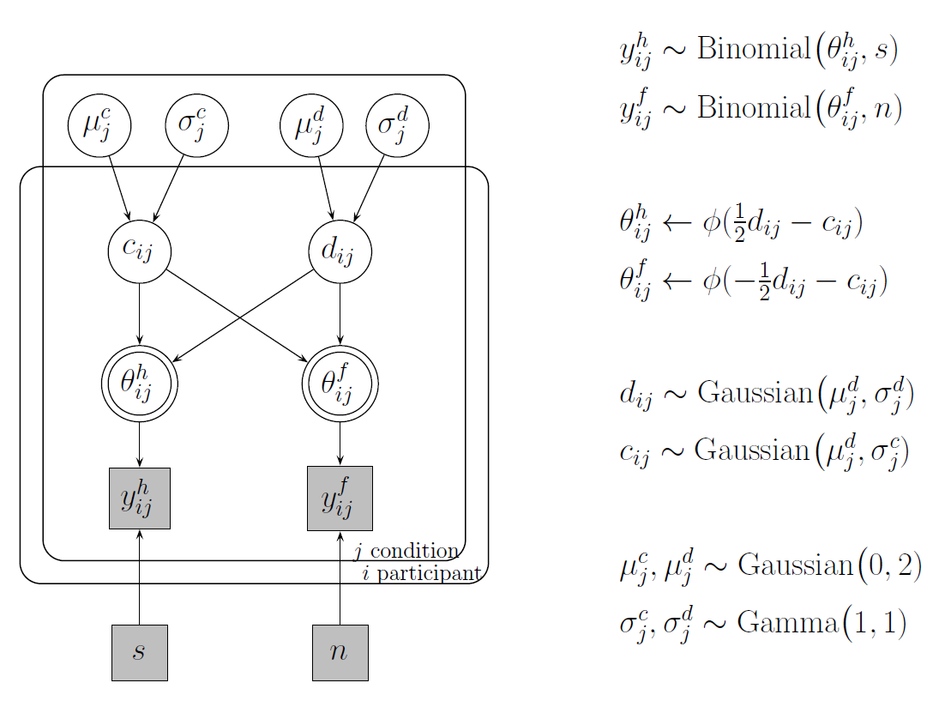

Slide 44
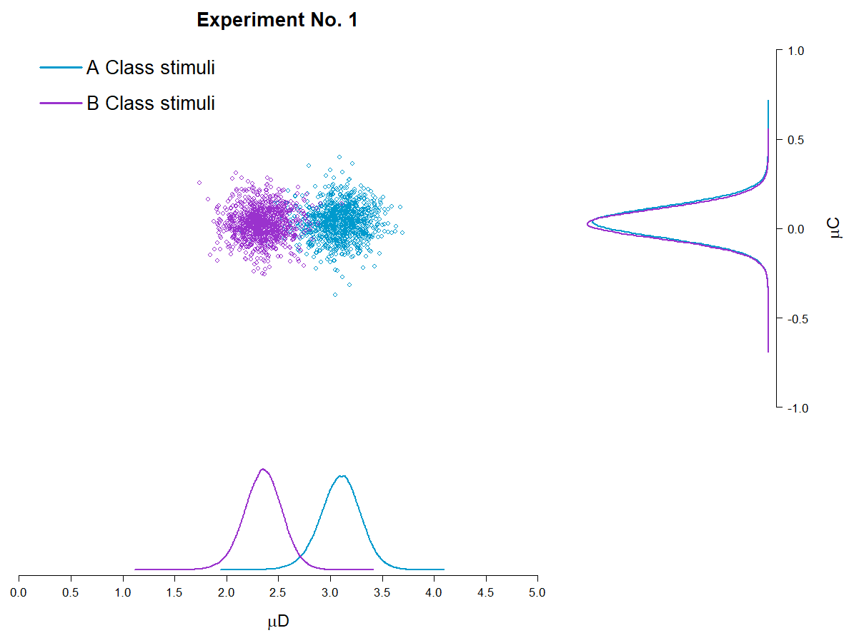

Slide 45
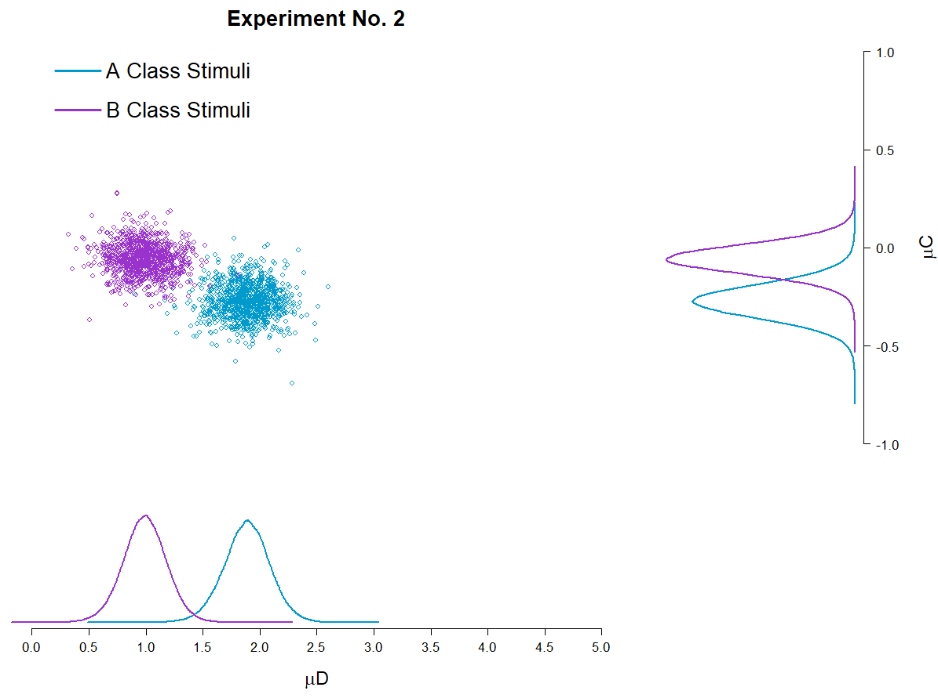

Slide 46

Replication of the reported analyses
1.- Make sure that:
d’(A) > d’(B)
2.- Comparing the Hit and F.A. rates to test the M.E. pattern of response
3.- Comparing the Mean confidence ratings assigned to each class of stimuli.

Slide 47
Replication of the reported analyses
1.- Make sure that:
d’(A) > d’(B)
2.- Comparing the Hit and F.A. rates to test the M.E. pattern of response
3.- Comparing the Mean confidence ratings assigned to each class of stimuli.

Slide 48
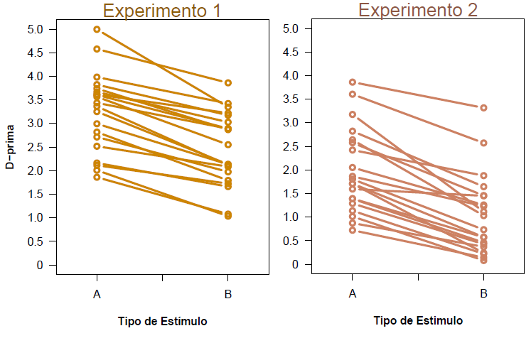
.

Slide 49
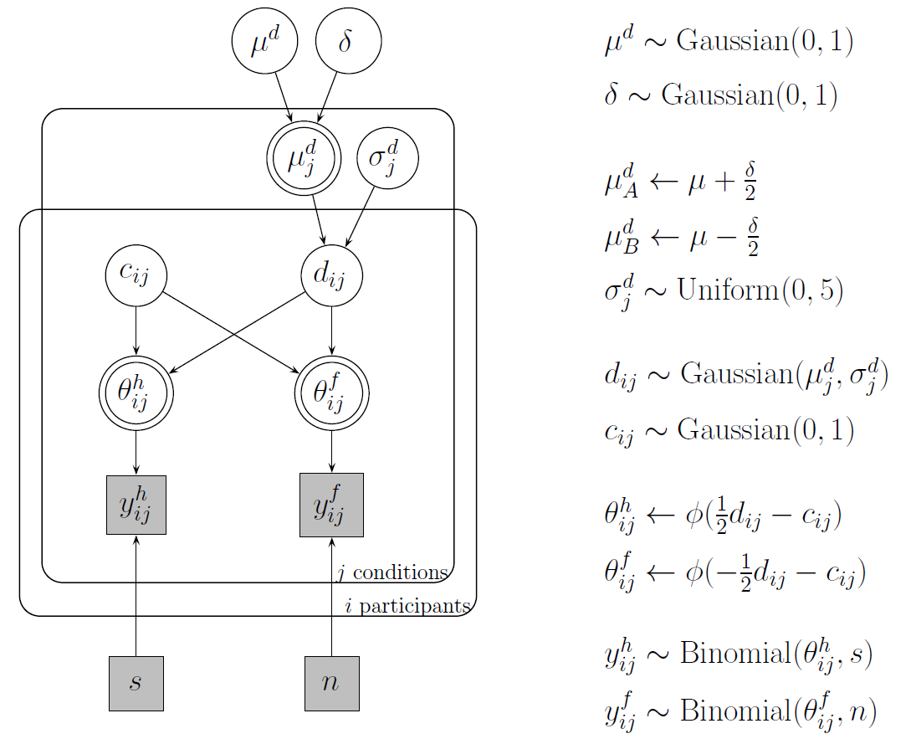

Slide 50
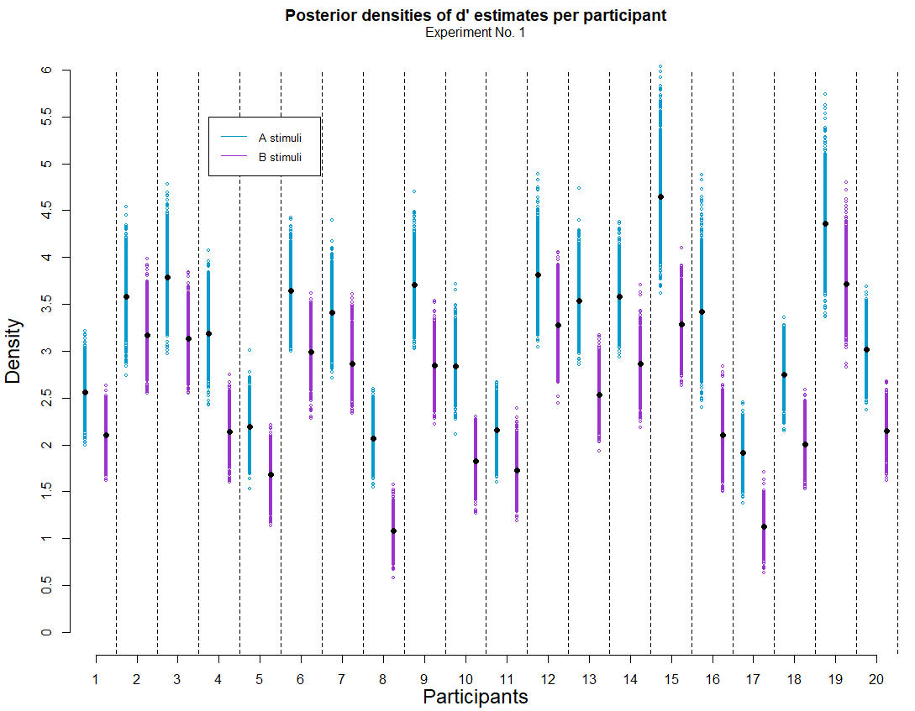
Plot 1
What’s important about this plot?
For all participants, d’ estimates are greater for A class stimuli than for B class.
Notes:
PS: Alex suggested me to use this kind of plot and I really liked it.

Slide 51
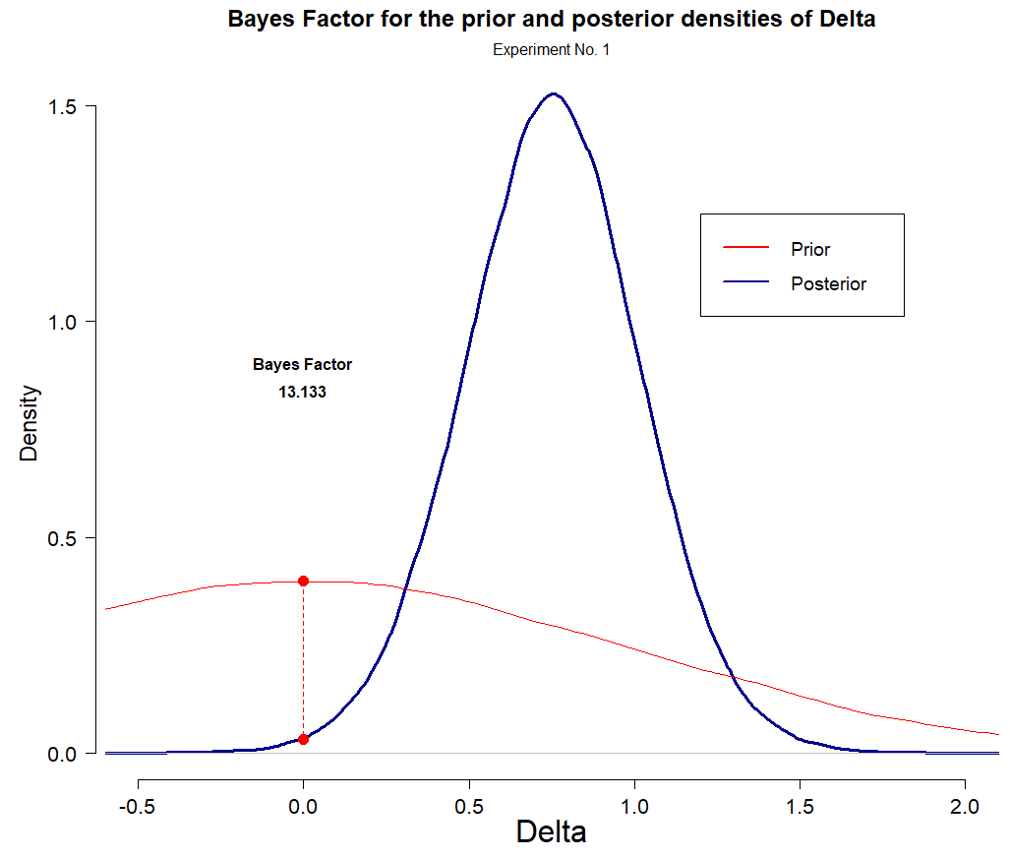
Plot 2
What’s important about this plot?
According to the Bayes Factor, the posterior estimates suggest that it’s 13 times lees likely that the difference between d’ across each class of stimuli is 0, than/from what had been stated on the prior.
Notes:
PS: Alex suggested me to use this kind of plot and I really liked it.

Slide 52
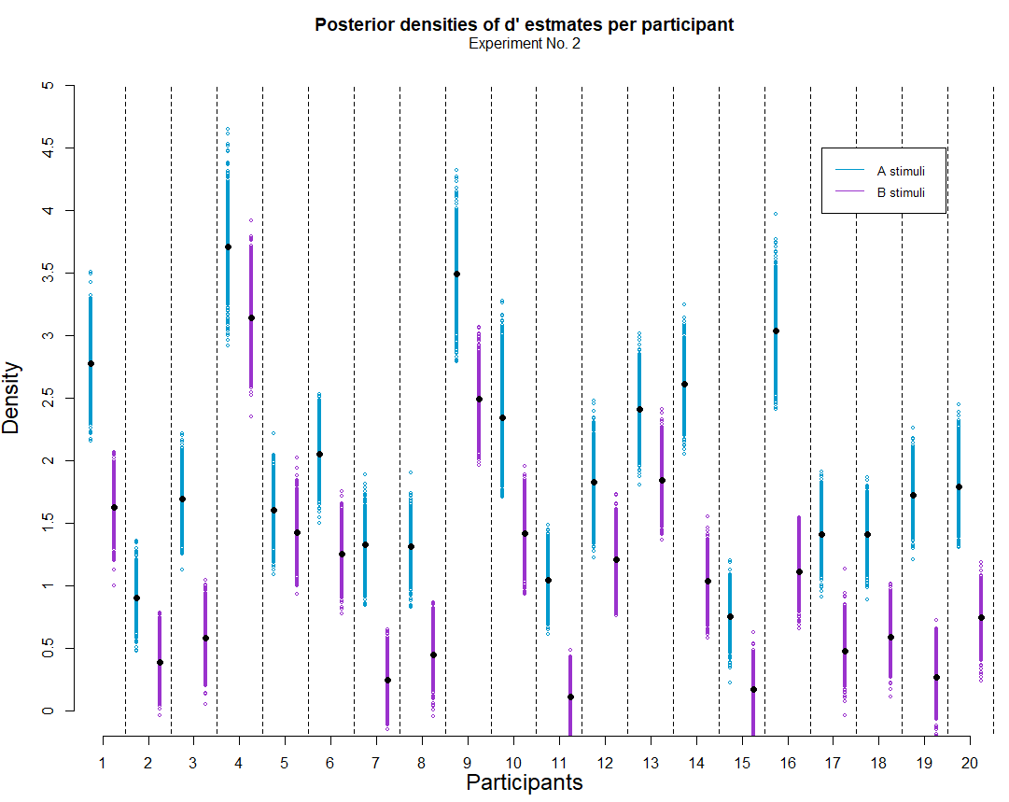
Plot 1
Same things happen in Experiment 2
For all participants, d’ estimates are greater for A class stimuli than for B class.
Notes:
PS: Alex suggested me to use this kind of plot and I really liked it.

Slide 53
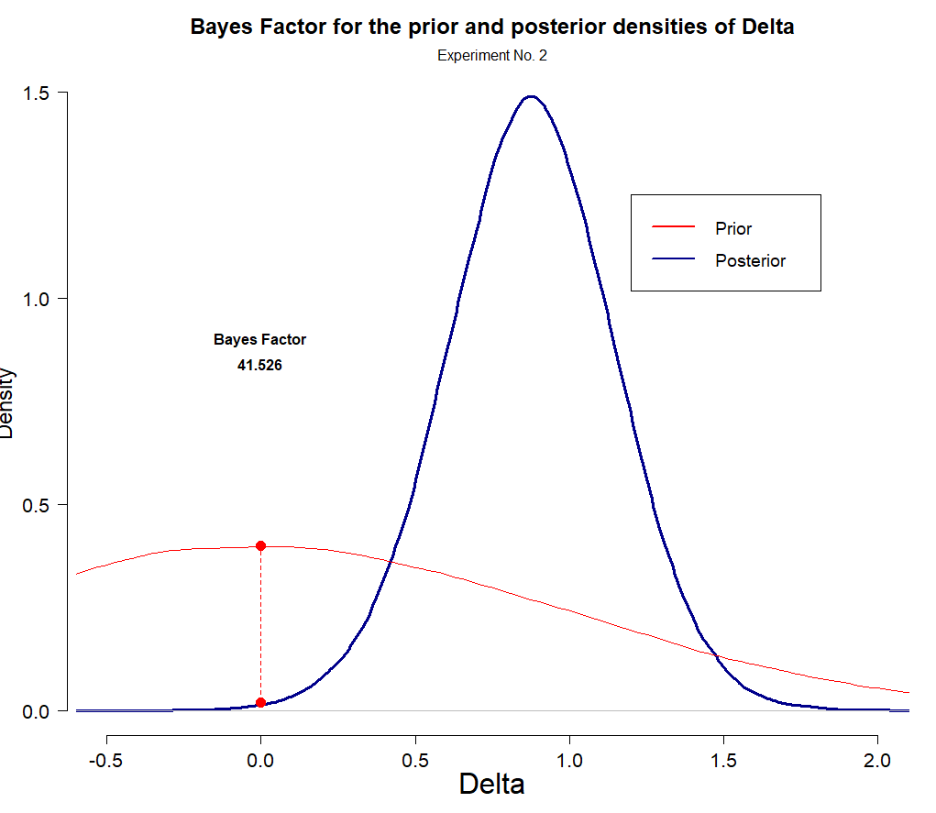
Plot 2
According to the Bayes Factor, the posterior estimates suggest that it’s 41.5 times lees likely that the difference between d’ across each class of stimuli is 0, than/from what had been stated on the prior.

Slide 54
Replication of the reported analyses
1.- Make sure that:
d’(A) > d’(B)
2.- Comparing the Hit and F.A. rates to test the M.E. pattern of response
3.- Comparing the Mean confidence ratings assigned to each class of stimuli.

Slide 55
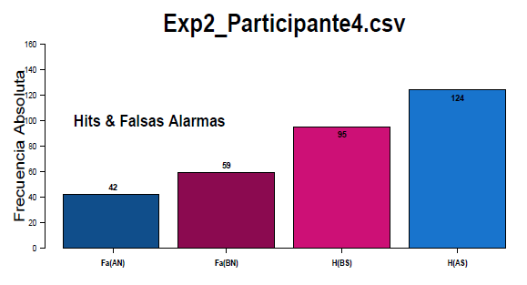
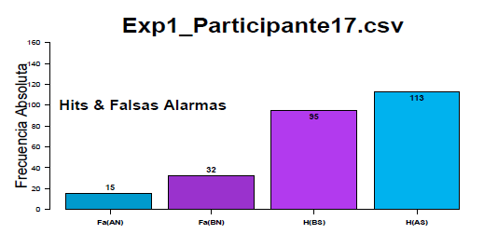
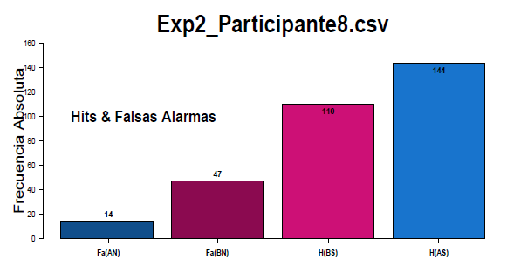
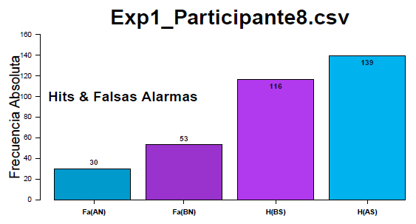

Slide 56
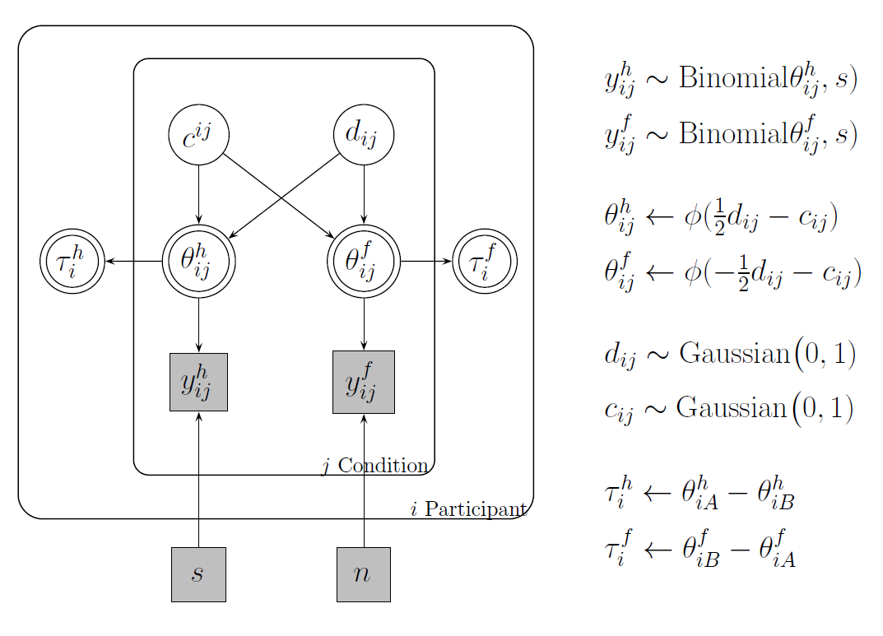

Slide 57
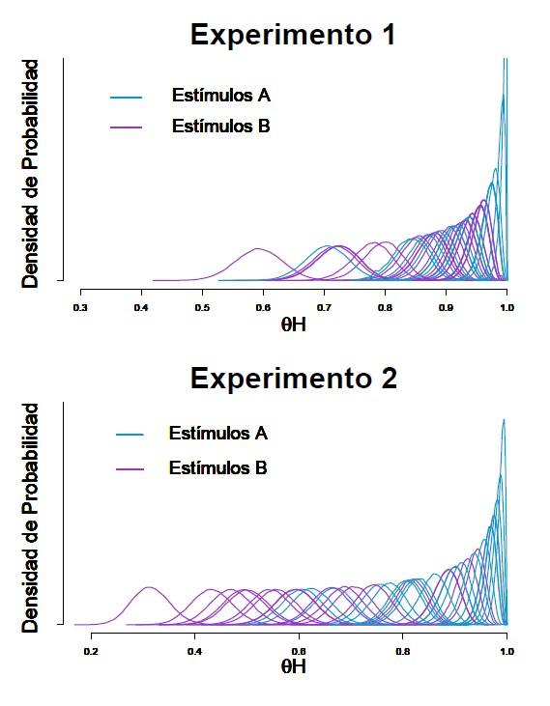
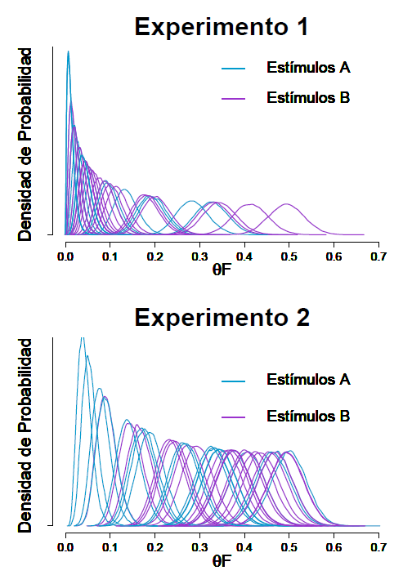

Slide 58
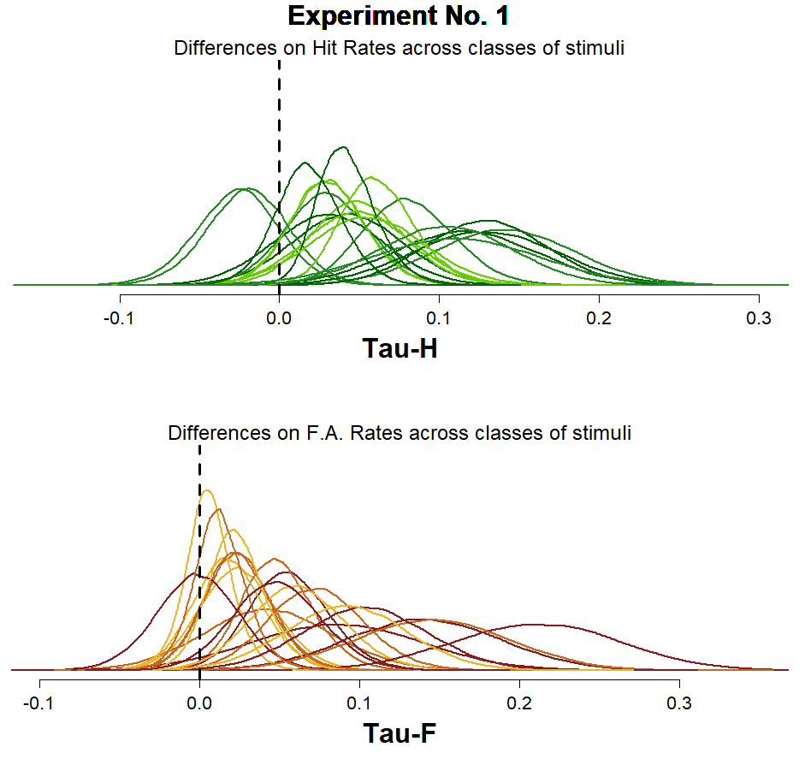
Plot 1
Based on the individual Tau-H and Tau-F posterior distributions being shown, it’s clear that there’s a lot of variability (even if “at first glance” one might be tempted to say that the majority of the posterior density lies to the right side of the “0 differences between classes” point).

Slide 59
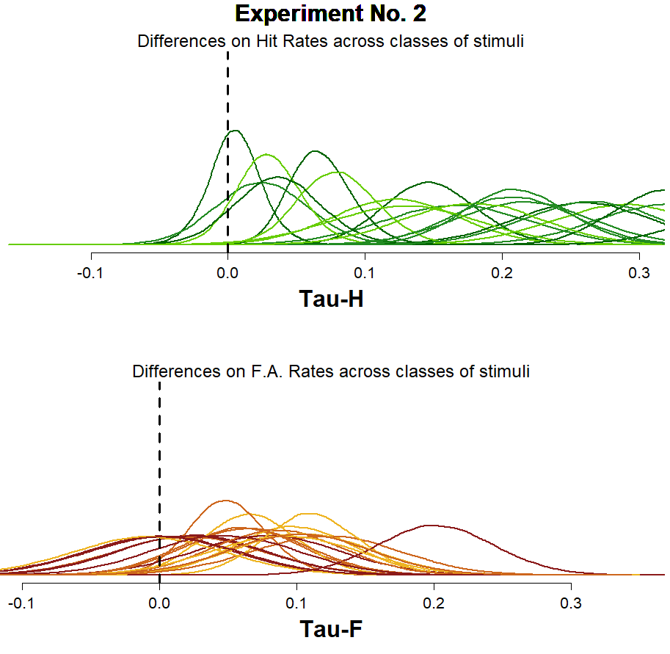
Plot 1
For Experiment 2, you can see that the estimates for the differences between the Hit Rates has clearly increased, at the same time that the estimates made for the differences between the FA rates seem to be a Little bit more clustered around 0.

Slide 60
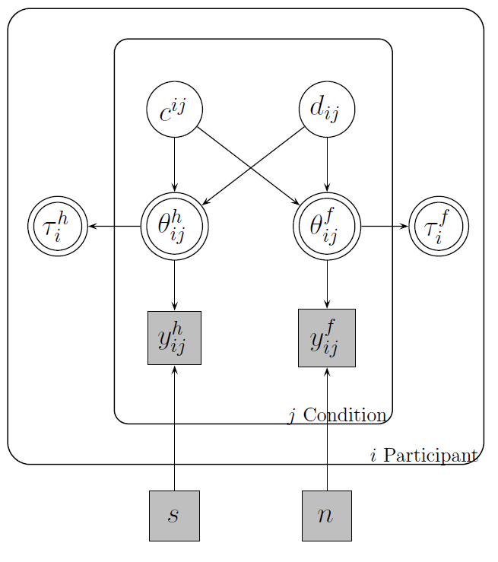

Given that this particular model was constructed so that both Taus are deterministically estimated, based on the indiviual estimations made for $θ_{ij}^{H}$ and $θ_{ij}^{F}$, conducting a Bayes Factor or any other density ratio measure might not seem like a straight-forward thing to do.

Slide 61
Replication of the reported analyses
1.- Make sure that:
d’(A) > d’(B)
2.- Comparing the Hit and F.A. rates to test the M.E. pattern of response
3.- Comparing the Mean confidence ratings assigned to each class of stimuli.

Slide 62
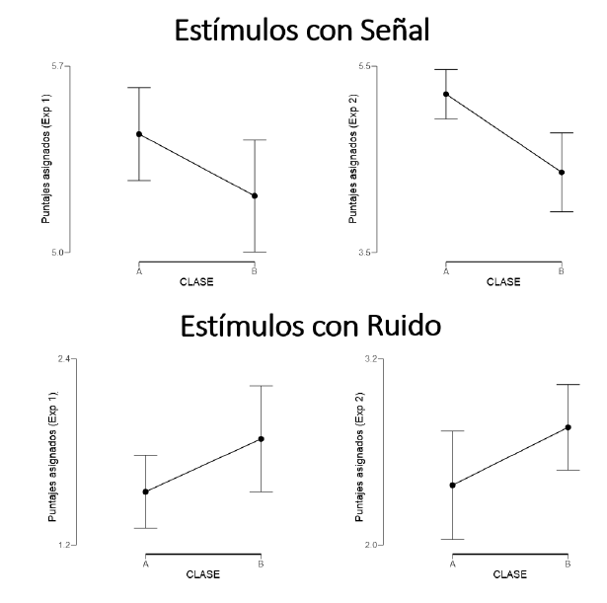

Slide 63
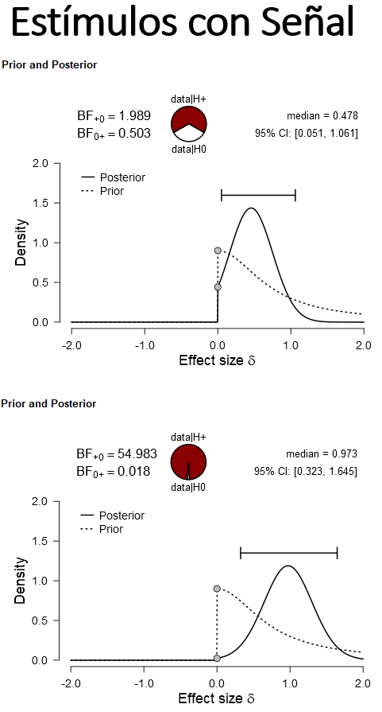
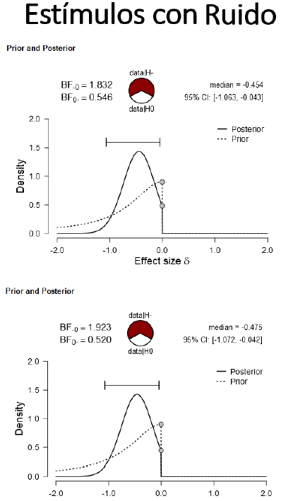

Slide 64
Discussion & Conclusions

Slide 65
.
Our task didn’t have anything like the study phase included in recognition memory studies.

Slide 66
.
Our task didn’t have anything like the study phase included in recognition memory studies.
Is the Mirror Effect an artefact of using SDT to interpret the observed rates of response?

Slide 67
.
Our task didn’t have anything like the study phase included in recognition memory studies.
Is the Mirror Effect an artefact of using SDT to interpret the observed rates of response?
About the application of Bayesian methods to the analysis of the pattern responses being found?

Slide 68
Thank you very much!
Adriana F. Chávez De la Peña
adrifelcha@gmail.com
This project was made thanks to PAPIIT IN307214 y PAPIME IE310016 (and Dr. Bouzas of course ☺ )

Slide 69
Extra material
por Adriana Felisa Chávez De la Peña

Slide 70
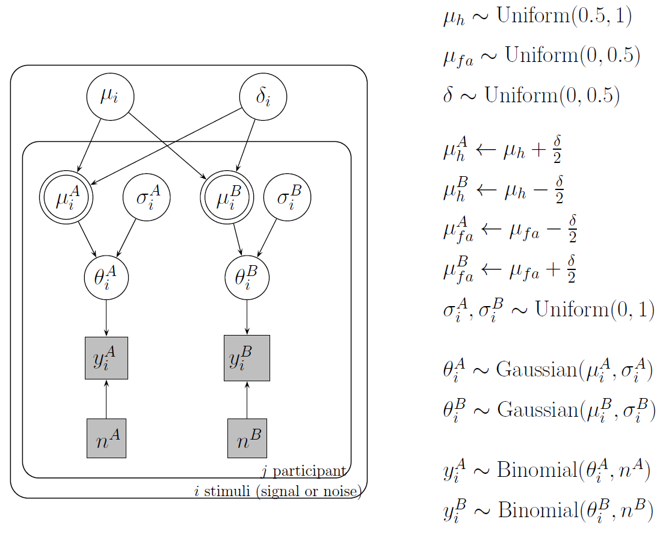

Slide 71
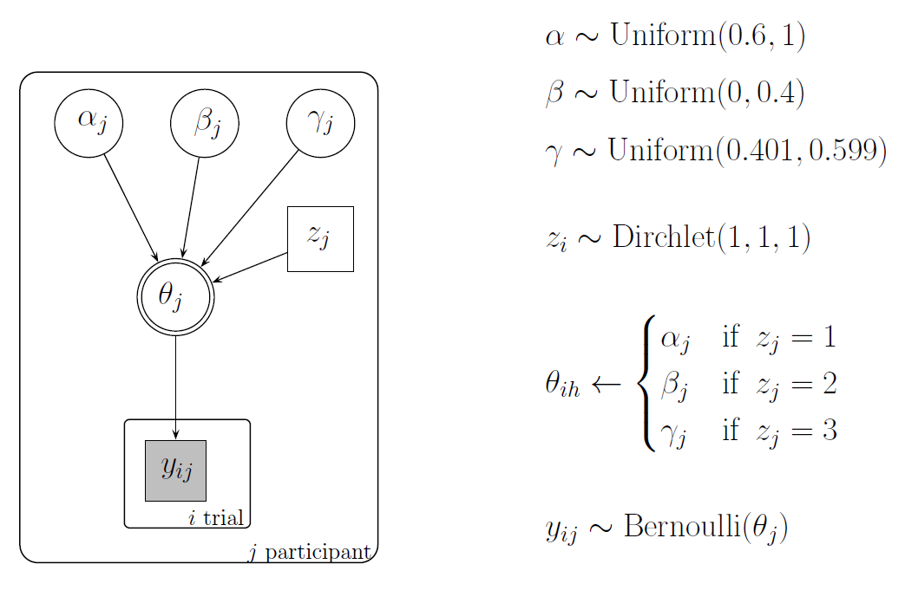

Slide 72
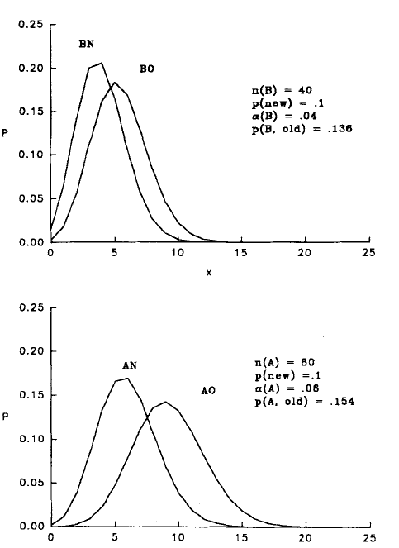

Teoría de Atención Verosimilitud
N rasgos
p(new) marcados
n(i) elementos muestreados
alpha(i) tasa de muestreo
Tasa de marcaje:
El número de items marcados es el resultado de un proceso binomial donde

Slide 73
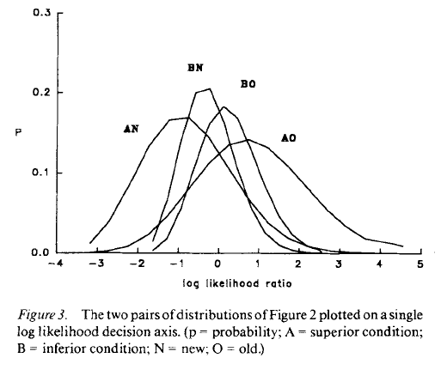

Slide 74

¿Los círculos centrales son del mismo tamaño?
No
Sí

