Slide 1
A Latent Class Regression Model for Risky Choice Behaviour

Slide 2
A little Background story
Back in 2014...
1284 participants (High school students) responded to a battery with 9 scales:
Trait scales
Temporal discount scale (1)
Cognitive reflection (2)
Impulsivity Scale (5)
Grit Scale (9)
Maximization (6)
Risky choice behaviour
Aggressive behaviour (4)
Alcohol consumption (7)
Tobacco consumption (3)
Unprotected sex (8)

Slide 3
Objective:
To measure a wide variety of variables / behaviours related to Risky choice decission making.

Slide 4
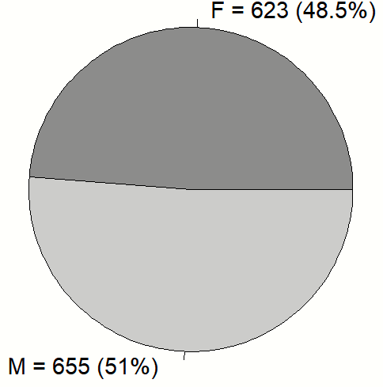
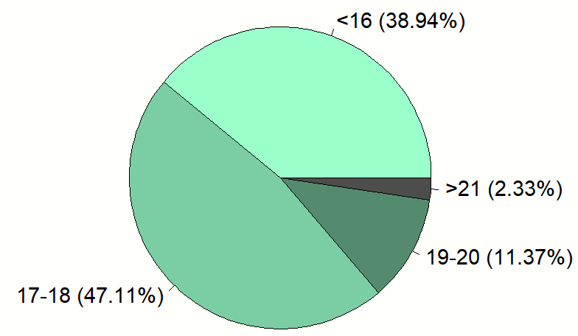
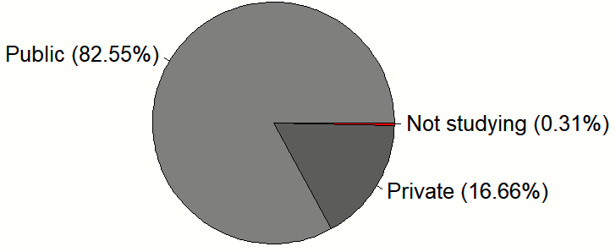
About Demographics
Sex
Age
Life style
Type of School
Previous G.A
Current G.A
Working status
Religious or not

Slide 5
Latent ‘trait’ scales

Slide 6
Temporal discount scale
27 items where participants had to choose between LL and SS
Would you rather receive
$34 now b) $50 in 30 days

Slide 7
Impulsivity Scale
20 items:
Eating dessert
Frequency subescale
“How often do you…?”
Never - - Frequently
Damage subescale
How hazardous is to…?
Nothing - - Very
Temptation subescale
How tempted do you feel about…?
Nothing - - Very

Slide 8
Grit Scale
8 items assessing grit
“I’ve been obssessed with an idea for a short period of time, but then I lost interest”
Strongly dissagree - - Strongly agree

Slide 9
Cognitive Reflection
3 items which require the inhibition of an initial, tempting, wrong answer:
A ball and a bat cost $110 total. The bat costs $100 more than the ball, how much is the ball?
If you need 5 machines to fabricate 5 products in 5 minutes, how much time would 100 machines need to fabricate 100 products?
There’s a path next to a lake which doubles its length each day. If the path needs 48 days to cover the entire length of the lake, how much would it take for it to cover half of the length of the lake?

Slide 10
Maximization scale
15 items
How well do the following sentences describe you?
“Before making a decision, I try to gather as much information as possible”
Totally . . Nothing

Slide 11
Risky choice behaviour assessment
Aggressive behaviour (60 items)
Tobacco (61 items)
Alcohol (77 items)
Unprotected sex (79 items)

Slide 12
Our goal…
759 participants (High school students) who responded to a battery of 9 scales:
Temporal discount scale (1)
Cognitive reflection (2)
Impulsivity Scale (5)
Grit Scale (9)
Maximization (6)
Aggressive behaviour (4)
Alcohol consumption (7)
Tobacco consumption (3)
Unprotected sex (8)

Slide 13
Linear Class Regression Models
Describe the relationship between a dependent variable and a set of explanatory variables, being the case that observations may arise from a number of (unknown) heterogeneous groups.
Formally, latent classes are represented by K distinct categories of a nominal latent variable X.

Slide 14
Linear Class Regression Models
Two approaches:
Once latent classes are defined, the probability of latent class membership is predicted by one or more covariates.
Dependent variable is partitioned into latent classes as part of estimating the regression model, (simultaneously fit more than one regression to the data when the latent data partition is unknown)

Slide 15

Previous work on this matter

Slide 16
Previous work on this matter
Linear regression models for continuous indicators.
IRT applications

Slide 17
Current work
poLCA, fpc and flexmix packages in R

Slide 18
The real goal:
To go full bayesian!

Slide 19
Why, tho?
Mixed class latent model to explore the number of latent classes involved
Mixed class latent model to explore the distribution that describe our data better.

